Slide 1
Introduction to Focus Group on Disaster Relief Systems, Network Resilience and Recovery-
Background, Demand & Activities
WTSA 2012, Dubai
Dr. Leo Lehmann
Vice chairman FG-DR&NRR
Notes:
1

Slide 2
Outline
Background
Definitions
Effects of damages/ power outages
Network resilience and recovery
2. About FG-DR&NRR
3. Conclusion

Slide 3
Background
The great East Japan earthquake and tsunami devastated a large part of the east coast of Japan on 11 March 2011. At the subsequent annual CTO meeting held on October 2011, Japanese companies including NTT stressed the importance of standardization studies in relation to safety confirmation systems, emergency communication, and ICT systems to be utilized during a disaster.
  Mr. Malcolm Johnson, ITU-T TSB Director, indicated to consider the establishment of a New Focus Group.
At the TSAG meeting on January 2012, the Japanese government led the discussion on establishing an FG on a disaster relief system as requested by ITU-T director.
  It was agreed to establish a new FG on disaster response in the TSAG.
Focus Group on Disaster Relief Systems, Network Resilience and Recovery （FG-DR&NRR)

Slide 4
Definitions (UN Terminology)
Disaster: A serious disruption of the functioning of a community
or a society involving widespread human, material, economic or
environmental losses and impacts, which exceeds the ability of the
affected community or society to cope using its own resources.
Resilience: The ability of a system, community or society exposed
to hazards to resist, absorb, accommodate to and recover from the
effects of a hazard in a timely and efficient manner, including through
the preservation and restoration of its essential basic structures
and functions
Recovery: The restoration, and improvement where appropriate,
of facilities, livelihoods and living conditions of disaster-affected
communities, including efforts to reduce disaster risk factors
Note: current focus on natural hazards e.g. (earthquakes, tsunamis
flooding, avalanches) which may destroy telecommunication infra
structure

Slide 5

Effects on components (damage)
depends on position in the network hierarchy
Backup generators ran out of fuel because of long power outages
Base stations collapsed or backup batteries ran out
Backup generators ran out of fuel because of long power outages
Source: MIC
Transmission line relay station
Communication cable
RNC
Core
Network
Cables cut or duct destroyed
Base
station
local/regional (depending from # affected components)
total outage

Slide 6
Power Outage
■ CH: theoretically 50’000 backup power generators to cover a total blackout.
■ Japan: Over 80% of communications breakdown of both fixed and mobile was caused by widespread and prolonged power outages in March 2011.
■ Dependability of infrastructures.
Fixed telephone
Mobile telephone
Source: MIC
Battery buffer:
mobile network basestations: ~20 minutes – 2 hours
central offices (x-change): ~8 hours
Longer operation times for backup
power generators and storage batteries?

Slide 7

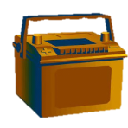
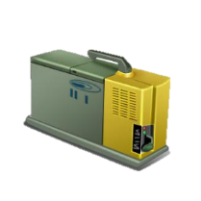












Network Resilience & Recovery
Source: MIC
I. Power outage
① Longer operating times for backup power generators and storage batteries
Augmented with wide-zone base stations
II. Damage to trunk transmission lines
② Reports and updates on efforts to restore power
⑥ Reports and updates on repairs to trunk transmission lines
Central disaster response facility
Central disaster response facility
Spare line
(micro-entrance link)
V. Other
24-hour operation of backup power generators and storage batteries
Mobile power generator trucks
⑬ Improve PHS resilience to power outages
⑤ Additional base station capacity at central disaster response facility
Mobile base station trucks
⑫ Designate organizations with priority access to telephone network in an emergency
④ Improve loop structure network reliability
③ Provide multiple transmission routes between all exchange facilities
Authentication system
Authentication system
⑦ Geographical dispersion of key telecommunications facilities
⑩ Analyze network usage during restricted periods
⑨ Reports and updates on design capacity
⑧ Response based on hazard maps
IV. Network congestion and priority communication services
⑪ Updates on network congestion
III. Tsunami/flooding

Slide 8
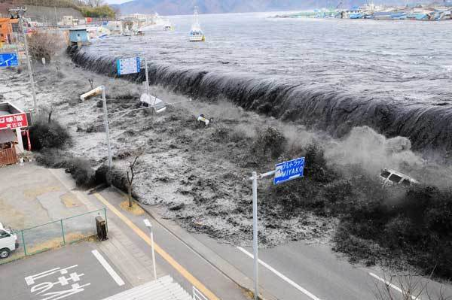
Emergency Recovery considerations
Aim to recover basic operation of mobile networks within a small period of intensive restoration (several days)
Temporary replacement of destroyed antennas by mobile base stations (with power generators). Note: mobile base stations usually cannot compensate the complete supply of whole agglomeration area
Compensation of lost connections between infrastructure by alternative links (e.g. satellite, temp. microwave)
Interoperability between networks: reconstruction of network-infrastructures immediately and automatically between different networks, when network-infrastructures are broken by the disaster
Transfer of whole processing functions
Being prepared by building collaborative frameworks among Telecommunications operators to secure communications in the event of a disaster (e.g.. Swiss Crisis Reaction Team Telecom (CRTT)).

Slide 9
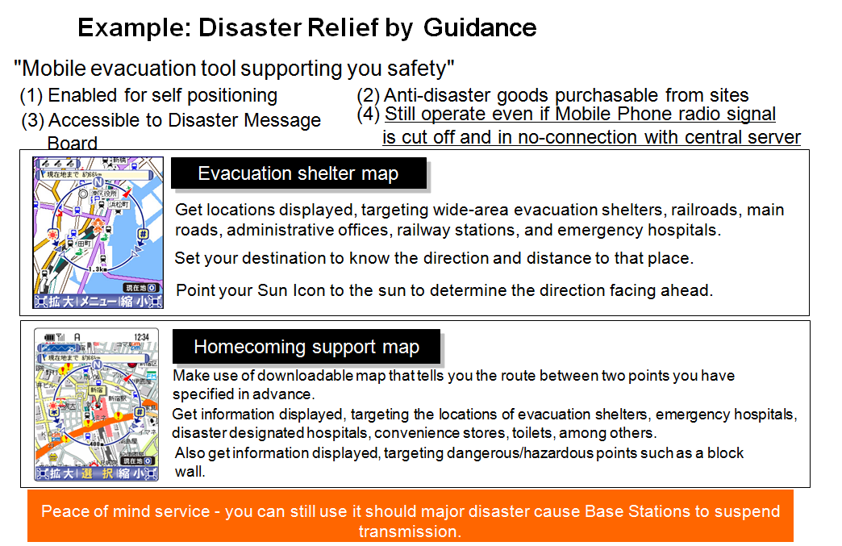
Source: KDDI

Slide 10
Recommendations in ITU-T
Recommendations related to emergency numbers: ITU-T E- series
Recommendations related to ETS and EPS: ITU-T E-series, Q-series
Recommendations related to signaling for IEPS support: Q-series
Recommendations related to ETS in H.323 systems: H-series
Recommendations related to ETS in IPCablecom: J-series
Recommendations related to ETS in NGN: Y-series, Q-series
Supplement 47 to ITU-T Q-Series “Emergency services for IMT-2000 networks – Requirements for harmonization and convergence”
Recommendations related to common alerting protocol/ alerting object identifier: X- series
Further recommendations under preparation:
E-series: E.ABC “Requirements for land mobile alerting broadcast capabilities for civic purposes”; E.TDR “Framework for the implementation of Telecommunications for Disaster Relief (TDR)”
Draft H.323 Annex M5 for the transport of ITU-T X.1303 common alerting protocol (CAP 1.1) messages
Currently no recommendations on network/
infrastructure resilience and recovery

Slide 11
Recommendations in ITU-R
Radiocommunication services are important for disaster prediction,
detection, alerting and relief. In certain cases, when the "wired“
telecommunication infrastructure is significantly or completely destroyed by a disaster, only radiocommunication services can be employed for disaster relief operation.
ITU-R Recommendations:
BO/BT.1774, F.1105, M.632/633, M.690/693, M.1024, M.1637, M.1826, M.1854, M.2009, M.2015, RS.1859, S.1001, SA.1863

Slide 12
Recommendations in ITU-D
Guidelines on the use of the Common Alerting Protocol (Report of 2006 – 2010 study period Q.22/2 - Utilization of ICT for disaster management, resources, and active and passive space-based sensing systems as they apply to disaster and emergency relief situations)
New Draft ITU Handbook “Telecommunication outside plants in areas frequently exposed to natural disasters”
http://www.itu.int/ITU-D/emergencytelecoms/index.html

Slide 13
ToR of FG-DR&NRR
Scope
Identifying requirements for disaster relief and network resilience
Identifying existing standards and existing work that are related to the requirements mentioned above
Identifying any additional standards that may need to be developed and identifying future work items for specific ITU-T Study groups and related actions
Encouraging collaboration among ITU-T Study Groups, in particular SG2, SG5, SG11, SG13, SG15, SG16 and SG17, ITU-R, ITU-D and relevant organizations and communities, including the PCP-TDR;
Objective: to make following documents,
Disaster relief systems and/or applications from a telecommunication/ICT perspective, and
Improved network resilience and recovery capability which could better cope with a disaster.

Slide 14
Structure of FG-DR&NRR
WG1: Use cases and disaster classification
    To liaise with other groups, in particular ITU-T study groups, to identify what is being done, and potential gaps or areas where additional work might be required.
    - Identify different types of disasters and develop use cases of services and reference models for telecommunication/ICT, considering both technical solutions and best management practices.
WG2: Requirements for network resilience and recovery
    To consider specific topics such as: systems and/or applications for (1) power supply in disaster situations (e.g., for mobile base station or other network equipment) and (2) design of physical network infrastructures.
WG3: Disaster relief systems
    To consider specific topics such as: systems and/or applications for (1) disaster relief for individuals (to notify the damage situation from victims to their relatives, friends, and employers), (2) disaster relief guidance (to show victims the routes to evacuation shelters, home, etc.), (3) disaster notification, (4) special treatment for emergency communication (5) public protection and disaster relief (PPDR) and public safety mobile networks, and (6) aspects for persons with disabilities (accessibility) and older persons (human factors).

Slide 15
Draft overview of study area of FG-DR&NRR
Health Care for Victims
Emergency Alert
Disaster Relief
Systems
Disaster Detection
Evacuation Assistance
Safety Confirmation
Emergency telecommunication
Network
Resiliency and
Recovery
Telecommunication in disaster area
Restoring damaged base station
Highly reliable telecommunication network
Temporary telephone services
High-reliable power supply
Electric Power
Supply
Emergency generator and battery
Ensuring electric power supply
including refueling method
Preparedness
Response
and relief
Recovery
Reconstruction

Slide 16
Deliverables of FG-DR&NRR
Deliverables of FG-DR&NRR
(1) Overviews
(2) Definitions, terminology and classification
(3) Use case
(4) Gap analysis
(5) Requirements documents for disaster relief (incl. accessibility) and network resilience and recovery
Expected output
Develop and maintain a living list of standards bodies, forums, and consortia dealing with telecommunication/ICT aspects
Gather relevant new ideas and identify potential study areas
Develop use cases of services and reference models for telecommunication/ICT
Develop and maintain terminology and taxonomy
Carry out an analysis of communications networking requirement functions and capabilities (including QoS/QoE, security, reliability and accessibility)
Perform a gap analysis of standards for communications networking
Develop a roadmap to guide further developments of relevant ITU-T Recommendations

Slide 17
Output Documents from 2nd meeting 09/12
Draft document “Overview deliverables”
Draft document “Definitions, terminology and classification“
Template for usage assessment of telecommunication services in disasters
Draft document “Requirement documents for disaster relief systems“
Output Documents expected for the 3rd meeting
special focus on:
Considerations on accessibility
Detailed requirements concerning network
recovery and power supply

Slide 18
Relationships
ITU-D (SG2)
ITU-R (WP 4B, WP 4C, WP 5A, SG4)
ITU-T (SG’s, JCA-SG&HN, JCA-AHF,
JCA-ICT & CC )
UNISDR
UNDP
IARU
W3C
DAISY consortium

Slide 19
Schedule of FG meeting
1st meeting: 25-27 June 2012, Geneva Switzerland
2nd meeting: 24-26 September 2012, Geneva Switzerland
3rd meeting: 11-13 December 2012, Istanbul Technical University (ITU), Istanbul Turkey
4th meeting: 6-8 February 2013, Keio Plaza Hotel, Tokyo Japan
5th meeting: targeted April - May 2013, Host country TBC (Target location: Thailand, tentative)
Note: Host countries are expected to have experienced serious disaster, such as flood, hurricane, earthquake and tsunami.
At every meeting, FG will have workshop/special session
to listen to the voice of local experts on disasters.

Slide 20
Conclusion
ITU-T established a new FG on disaster response, FG-DR&NRR)
2nd meeting was held in Geneva Switzerland, 24-26 September 2012.
Support from groups and organizations outside ITU
First draft output documents from 2nd meeting
FG-DR&NRR meetings outside Geneva enables participation of local experts from countries that have experienced serious disaster, such as flood, hurricane, earthquake and tsunami, to learn and collect their experiences all over the world.
The FG-DR&NRR would not only study the standardization concerning the disaster, but also take the role of distributing effective ways of proceeding during a disaster anywhere in the world based on the experiences of several countries with a view to contributing to society.
URL FG DR&NRR: http://www.itu.int/en/ITU-T/focusgroups/drnrr/Pages/default.aspx

