Slide 1
Ushering in a New Era of Global Connectivity

Slide 2
agenda
Outcome and some Observations
Key Achievements and Highlights
Analysis of some Key Provisions
Article 10, Accession
The Road Ahead

Slide 3
Outcome and some observations
OUTCOME OF THE CONFERENCE
1,275 proposals from Member States considered by 151 Member States attending
Adopted on 13 December 2012 and signed by 89 governments out of 144 present and accredited to sign
Compares with 1988 when 112 countries signed ITRs on the last day of the Melbourne conference
Remainder of Member States acceded later bringing the current total of 190 Member States party to the ITRs.

Slide 4
WHAT IS IN THE 2012 ITRs (1/2)
Outcome and some observations
Preamble (human rights, right to access)
Article 1: Purpose and scope (not content-related, AOA)
Article 2: Definitions
Article 3: Right to communicate at good technical quality; countries to coordinate their infrastructure (misuse, CLI, traffic exchange points)
Article 4: International telecom services to be made available to the public (roaming transparency, quality and competition)
Article 5: Priority to be given to emergency communications (emergency number notification)
Article 5A: Network security
Article 5B: Combating spam
Items in red are new Articles compared to the 1988 version.
The above numbering scheme was used in the Final Acts and is subject to change in the final edition of the Treaty text.

Slide 5
WHAT IS IN THE 2012 ITRs(2/2)
Outcome and some observations
Article 6: Charging and accounting (commercial agreements, encourage investments, competitive wholesale pricing)
Article 7: Suspension of services
Article 8: Dissemination of information (Member States to communicate information to ITU)
Article 8A: Energy efficiency, E-waste
Article 8B: Accessibility
Article 9: Special arrangements
Article 10: Entry into force; reservations
Appendix 1: Accounting rate system
Appendix 2: Maritime telecommunications
Some provisions of the old Appendix 3 on service telecommunications were moved to Article 6
Items in red are new Articles compared to the 1988 version.
The above numbering scheme was used in the Final Acts and is subject to change in the final edition of the Treaty text.

Slide 6
Outcome and some observations
OPEN, TRANSPARENT AND INCLUSIVE
Key facts and figures
The 1,581 delegates represented 151 Member States and 37 observer organizations
Significant increased participation from the developing world compared with 1988
Many Member State delegations included private sector and civil society
Plenary meetings webcast to public in 6 UN languages, and captioning archived
Social media and interactive briefings

Slide 7
Outcome and some observations
Some Observations…
WCIT brought unprecedented public attention to the different and important perspectives that govern global communications
Showed that there is not one single world view but several, and these views need to be accommodated and converged

Slide 8
agenda
Outcome and some Observations
Key Achievements and Highlights
Analysis of some Key Provisions
Article 10, Accession
The Road Ahead

Slide 9
Key achievements and highlights
SOME KEY ACHIEVEMENTS (1/2)
This treaty contains a number of important revised and new provisions that represent a major improvement over the 1988 text.
Affirmation of Member States commitment to implement the treaty in a manner that respects and upholds their human rights obligations.
Right of access of Member States to the international telecommunication services
Improving transparency and accuracy in mobile roaming charges as well as promoting competition in the provision of mobile roaming services
Improving energy efficiency and cutting e-waste
Bringing the benefit of ICTs to the 650 million people living with some kind of disability

Slide 10
Key achievements and highlights
SOME KEY ACHIEVEMENTS (2/2)
Bringing greater security by promoting international cooperation to ensure the security and robustness of international telecommunication networks
Combatting unsolicited bulk electronic communications
Preventing misuse of international telecommunication numbering resources
Encouraging implementation of Calling Line Identification information
Encouraging investment in international telecommunication networks and promoting competitive wholesale pricing for traffic carried
Promoting the implementation of regional telecommunication traffic exchange points
Improving access to emergency services

Slide 11
Key achievements and highlights
Highlights: Mobile Roaming (under Articles 4, 5)
The new provisions on International Mobile Roaming could help provide :
  transparency of end-user prices for international mobile services
  satisfactory quality
  greater cooperation and competition to avoid “bill shock”
  avoid and mitigate inadvertent roaming charges in border zones.
  free and quick access for international roaming users to the local number(s) for emergency services

Slide 12
Key achievements and highlights
Highlights:
Security and Robustness of Networks (new Article 5a)
This Article recognizes that the threats to security are international in scope, and therefore safeguarding international telecommunication networks requires not only national initiatives but also international cooperation.
The new Article 5a stipulates that Member States shall individually and collectively endeavour to ensure the security and robustness of international telecommunication networks […]
  Could prompt Member States to implement the provisions of this article through appropriate national instruments related to network security.
  provides a broad framework for cooperation among Member States on the various facets of network security.

Slide 13
Key achievements and highlights
Highlights: Economic Issues
(Articles 6, 9 and Appendix 1)
Assists in the application of the basic pricing principles for international services relations:
  Transparency: the open availability of information used in the cost derivation process in order to allow comprehension of the final rate/tariffs.
  Practicability: the ability to implement a costing methodology with reasonable demands being placed on data availability and data processing.
  Causality: the demonstration of a clear cause-and-effect relationship between service delivery and the network elements and other resources used to provide it.
Provides a framework for commercial agreements for international telecommunication services arrangements (subject to applicable national law).

Slide 14
Key achievements and highlights
Highlights: Economic Issues
(Articles 6, 9 and Appendix 1)
Assists in dispute resolution through the provision of guidelines and the possibility to agree commercial special mutual arrangements.
Encourages investment in international telecommunication networks.
Promotes competitive wholesale pricing for traffic carried, this will benefit end-users.
Contributes to avoid double taxation for international services.

Slide 15
Key achievements and highlights
Highlights: Energy Efficiency
(new article 8a)
The new Article 8A recognizes, in treaty-text, the importance of sustainability in the ICT sector through the promotion of:
  energy efficiency best practices;
  E-waste best practices.
The inclusion of this article in the ITRs reflects the increased awareness on these issues since 1988.
With the new article, Member States will have an additional incentive to take action at the national level and implement the provisions of this article through appropriate national instruments.

Slide 16
Key achievements and highlights
Highlights : Accessibility
(new article 8b)
The new Article 8b recognizes in a treaty-level text the importance of accessibility in ICTs in order to bring the benefit of ICTs to the 650 million people living with some kind of disability.
There is a good overlap between the countries that signed the ITRs and those that either signed or ratified the United Nations Convention on the Rights of Persons with Disabilities (UNCRDP) (status at February 2013: Signed: 154; ratified: 127).
Member States will have an additional incentive to take action at the national level through implementation of Article 8b through appropriate national instruments.

Slide 17
Key achievements and highlights
WCIT-12 Resolutions
5 new Resolutions:
  Special measures for landlocked developing countries and small island developing states for access to international optical fibre networks
  Use of one of the globally harmonized national numbers for access to emergency services (911 or 112)
  Foster an enabling environment for the greater growth of the Internet
  Periodic review of the International Telecommunication Regulations
  International telecommunication service traffic termination and exchange
NOTE: Resolutions are not part of the ITRs. They do not require any ratification, acceptance or approval process, and they are not inherently binding for the Member States.

Slide 18
agenda
Outcome and some Observations
Key Achievements and Highlights
Analysis of some Key Provisions
Article 10, Accession
The Road Ahead

Slide 19
Analysis of some key provisions
Preamble
(provision on right of access of Member States to international telecommunication services) (1/2)
These Regulations recognize the right of access of Member States to international telecommunication services.
This clause is in the Preamble of the treaty. It should be noted that the preambular text in international treaties does not have the same legal status as the text found in the subsequent articles.
It follows that preambular text does not usually give rise to legal rights or obligations for subjects of international law

Slide 20
Analysis of some key provisions
Preamble
(provision on right of access of Member States to international telecommunication services) (2/2)
Articles 35 of the Constitution permits Member States to suspend the international telecommunication service, either generally or only for certain relations and/or for certain kinds of correspondence, outgoing, incoming or in transit, with other countries provided that it immediately notifies such action to each of the other Member States through the Secretary-General.
NOTE: In accordance with Article 4 of ITU Constitution the CS/CV prevails over the ITRs.

Slide 21
Analysis of some key provisions
The scope of the ITRs
Article 6 (No.38) of the ITU Constitution (modified in 1998) states that the Administrative Regulations [i.e. the ITRs and the Radio Regulations] shall apply to the operating agencies authorized by them [i.e. the Member States] to establish and operate telecommunications and which engage in international services […]
Since the CS/CV prevails over the ITRs, the WCIT-12 was obliged to aligned the text in the ITRs (regarding the scope and its relation to operating agencies) with Article 6
The scope of application of the 2012 ITRs therefore covers, besides the Member States which are parties to the treaty, the so-called “authorized operating agencies”, i.e. those operating agencies, authorized or recognized by a Member State, to establish, operate and engage in international telecommunications services to the public (Article 1.1b)

Slide 22
Analysis of some key provisions
Unsolicited bulk electronic communications
Article 5b
Article 1.1.a states that: These Regulations do not address the content-related aspects of telecommunications
Therefore the technical measures to counter unsolicited bulk electronic communications in accordance with Article 5b cannot include measures based on content filtering but rather the many other technical measures which do not use content filtering:
  E.g. ITU-T X.1230/X.1240 series of Recommendations, and corresponding informative Supplements in the X-series of ITU-T Recommendations.

Slide 23
Analysis of some key provisions
WCIT Resolution 3: To foster an enabling environment for the greater growth of the Internet
WCIT Resolutions are not part of the ITRs.
Resolutions do not require any ratification, acceptance or approval process, and they are not inherently binding for the Member States, but have immediate effect
The only operative part of Resolution 3 calls for ITU to play an active and constructive role in the development of broadband and the multistakeholder model of the Internet
The subject matter is not new for ITU (e.g. PP-10 Res. 101, 102, 133, 180 address the Internet)

Slide 24
agenda
Outcome and some Observations
Key Achievements and Highlights
Analysis of some Key Provisions
Article 10, Accession
The Road Ahead

Slide 25
Article 10 – Final Provisions
Article 10, Accession
Entry into force:
  1st January 2015, for Members States which, prior to that date, have notified the ITU Secretary-General of their consent to be bound.
  Provisional application
    1st January 2015, for Member States which have signed the 2012 ITRs, and which did not oppose such provisional application at the time of signature
  If a Member State which has signed the 2012 ITRs fails to notify the ITU Secretary-General of its decision concerning its consent to be bound prior to 31 December 2017, that Member State shall be deemed to have consented to be bound by the new treaty, unless the Member State has made a corresponding reservation at the time of signature of the 2012 ITRs.

Slide 26
Relationship between the 2012 ITRs AND 1988 ITRs
Article 10, Accession
The 2012 ITRs replace the 1988 ITRs for the relationships between Member States which are parties to the 2012 ITRs
The 1988 ITRs remain in effect for the relationships between Member States which have not signed the 2012 ITRs and will not become parties to it
The 1988 ITRs also regulate the relationships between a party to the 2012 ITRs and a non-party to the 2012 ITRs

Slide 27
Article 10, Accession
Accession to the ITRs
Considering that the ITRs is an open treaty, any Member State which has not signed the treaty can still accede to it in the future, by way of a unilateral act of the Member State.
More specifically, according to Article 54 para. 3bis (no. 217A) of the ITU Constitution, “A Member State shall notify its consent to be bound by a partial or complete revision of the Administrative Regulations by depositing with the Secretary-General
an instrument of ratification, acceptance or approval of that revision, or
of accession thereto, or
by notifying the Secretary-General of its consent to be bound by that revision”.

Slide 28
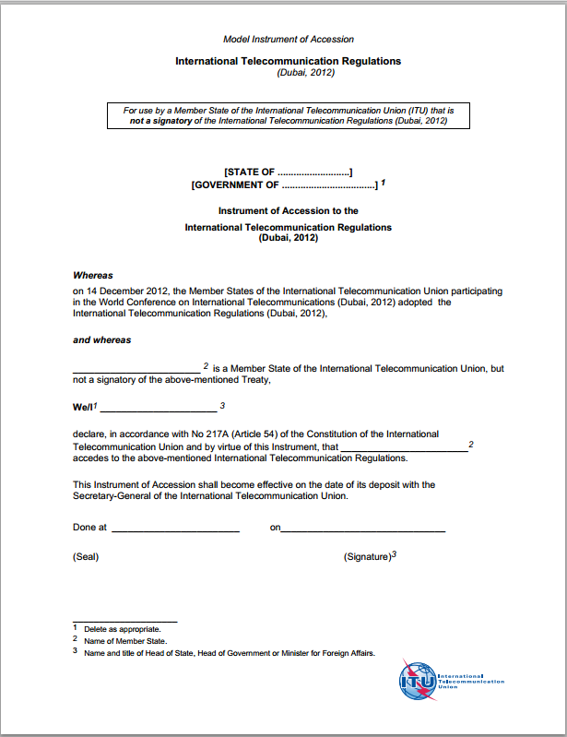
Article 10, Accession
The treaty is open for accession.
Details available at www.itu.int/wcit.

Slide 29
agenda
Outcome and some Observations
Key Achievements and Highlights
Analysis of some Key Provisions
Article 10, Accession
The Road Ahead

Slide 30
The road ahead
THE ROAD AHEAD
The treaty provides a framework for the accelerated growth of ICTs at the national and international level, in particular:
  To bring Internet access to the two-thirds of the world’s population which is still offline.
  To drive investment in broadband roll out and to ensure the continuing promotion of digital inclusion for all.

Slide 31
Ushering in a New Era of Global Connectivity

