Slide 1
Overview of
ITU-T Study Group 20 “IoT and its applications including smart cities and communities (SC&C)”
Cristina Bueti, Advisor, ITU

Slide 2
ITU
ITU-T Study Group 20
Related group
Joint Coordination Activity on Internet of Things and Smart Cities & Communities (JCA-IoT&SCC)
Work with us

Slide 3
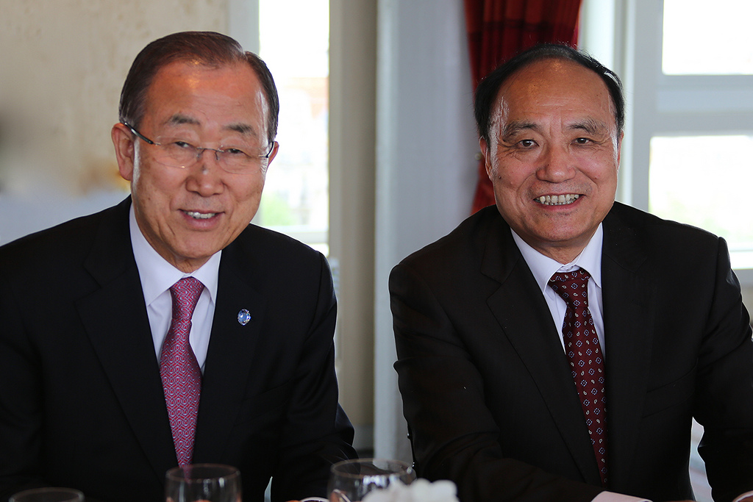
ITU
UN specialized agency for ICTs
standards developing organization
unique public/private partnership
Members:
193 Member States (Governments and regulatory bodies)
Over 700 Private Sector (Sector Members and Associates)
Over 90 Academia

Slide 4
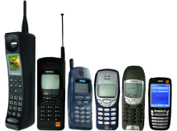
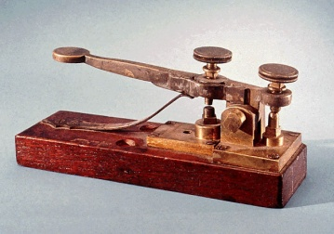
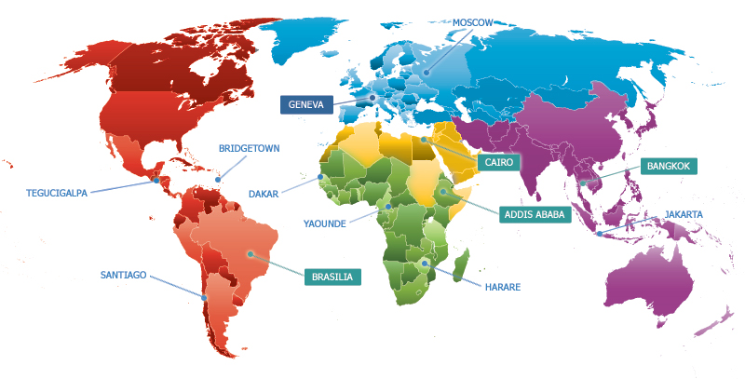
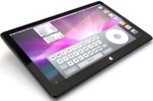
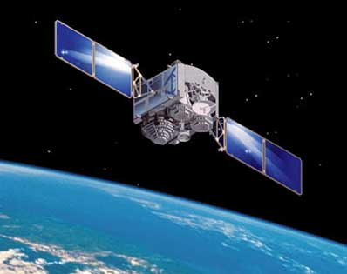
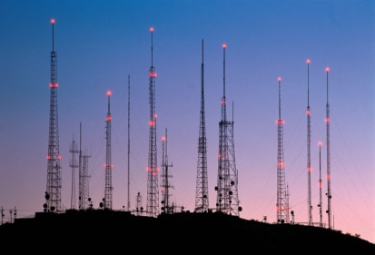
ITU’s structure
Standardization (ITU-T) produces interoperable technical ICT standards
Radiocommunication (ITU-R) coordinates global wireless communication
General Secretariat provides coordination
for the whole organization
Development (ITU-D) provides assistance to the un-connected

Slide 5
ITU-T Study Group 20 (SG20)
ITU-T SG20 is responsible for international standards to enable the coordinated development of IoT technologies, including machine-to-machine communications and ubiquitous sensor networks.
Established by the Telecommunication Standardization Advisory Group (TSAG) in June 2015.
First meeting: 19-23 October 2015, Geneva, Switzerland

Slide 6
SG20 management team
SG20 Chairman
Nasser Saleh AL MARZOUQI (United Arab Emirates)
SG20 Vice Chairmen
Fabio BIGI (Italy)
Silvia GUZMÁN ARAÑA (Spain)
Takafumi HASHITANI (Japan)
Hyoung Jun KIM (Republic of Korea)
Abdulrahman M. AL HASSAN (Saudi Arabia)
Ziqin SANG (China)
Sergio TRABUCHI (Argentina)
Sergey ZHDANOV (Russian Federation)

Slide 7
SG20 areas of work
SG20 will develop standards and guidelines that leverage IoT technologies to address urban-development challenges.
Key work will include, inter alia:
The standardization of end-to-end architectures for IoT and mechanisms for the interoperability of IoT applications and datasets employed by various vertically oriented industry sectors.
Photo credit: custominfographics.org

Slide 8
Tasks and objectives
Develop framework and roadmaps for the harmonized and coordinated development of IoT, including M2M communications, ubiquitous sensor networks and smart cities and communities;
Assess how the use of IoT has an impact on the smartness of cities;
Study requirements and capabilities of IoT and its applications including SC&C;
Develop standards, guidelines, methodologies and best practices to help cities (including rural areas and villages) deliver services using the IoT, with an initial view to address city challenges;
Cooperate with other regional and international standards-development organizations (SDO) and industry forums.

Slide 9
SG20 Structure
 | Title
PLEN
Question 1/20 | Research and emerging technologies including terminology and definitions
Working Party 1 | Internet of Things (IoT)
Question 2/20 | Requirements and use cases for IoT
Question 3/20 | IoT functional architecture including signalling requirements and protocols
Question 4/20 | IoT applications and services including end user networks and interworking
Working Party 2 | Smart cities and Communities (SC&C)
Question 5/20 | SC&C requirements, applications and services
Question 6/20 | SC&C infrastructure and framework
See: http://www.itu.int/en/ITU-T/studygroups/2013-2016/20/Pages/structure.aspx
List of Questions: http://www.itu.int/en/ITU-T/studygroups/2013-2016/20/Pages/questions.aspx

Slide 10
Related group
Activities open to all
United in diversity to shape a better future through global ICT standards

Slide 11
Joint Coordination Activity on Internet of Things and Smart Cities & Communities
To co-ordinate the activity on IoT & SCC across ITU-T Study Groups and to coordinate with ITU-R and ITU-D.
To provide a visible contact point IoT and SC&C activities in ITU-T, to seek co-operation from external bodies working in the field of IoT & SCC and enable effective two-way communication with these bodies.
Maintenance of a list of cross-SDO IoT & SCC standardization items and associated roadmap.
http://itu.int/en/ITU-T/jca/iot/Pages/default.aspx

Slide 12
Global standards are key
W
O
R
K
W
I
T
H
U
S
Drive competitiveness, for individual businesses and world economy;
Lower prices;
Reduce technical barriers;
Foster interoperability;
Manufacturers, network operators and consumers;
Reduce negative impacts on the environment.

Slide 13
THANK YOU
ITU-T SG20 “IoT and its applications including smart cities and communities (SC&C)” itu.int/go/tsg20
Contact: tsbsg20@itu.int

