Slide 1
A global Service layer platform for M2M communications
ITU Workshop on the “Internet of Things -
Trend and Challenges in Standardization”
(Geneva, Switzerland, 18 February 2014)
Dr. Friedbert Berens
FBConsulting Sarl, Luxembourg
friedbert.berens@me.com

Slide 2
Mission
oneM2M is working to unify the Global M2M Community, by enabling the federation and interoperability of M2M systems, across multiple networks and topologies.

Slide 3
Global Partners

Slide 4
Scope & Objectives
To develop: Global M2M end-to-end specifications - using common use cases and architecture principles across multiple M2M applications to connect M2M devices with application servers worldwide with an access independent view of end-to-end services
To define: Service Layer platform with high level / detailed service architecture including: - Protocols/APIs/standard objects (open interfaces & protocols) - Interoperability, test and conformance specifications - Common use cases, terminal/module aspects - Service Layer interfaces/APIs between:
Application and Service Layers
Service Layer and communication functions
Security and privacy aspects
authentication, encryption, integrity verification

Slide 5
M2M Service Layer
Middleware - supporting secure end-to-end data/control exchange between M2M devices and customer applications by providing functions for remote provisioning & activation, authentication, encryption, connectivity setup, buffering, synchronization, aggregation and device management
- software layer
- sits between M2M applications and communication elements that provides data transport
- normally rides on top of IP
- provides commonly needed functions for M2M applications across different industry segments

Slide 6
Vision:
Interconnecting the Internet of Things; Connecting the Un-connected
oneM2M native App
Hybrid protocol App
Other M2M protocol
App
oneM2M
IoT Device
Underlying protocol
Other M2M protocol
oneM2M protocol
Underlying protocol
IoT Device
Underlying protocols

Slide 7
Horizontal Platform Vision
Pipe (vertical):
1 Application, 1 NW, 1 (or few) type of Device
Horizontal (based on common Layer)
Applications share common infrastructure, environments and network elements
Business Application
Business Application #1
Business Application #2
Business Application #n
Common Application Infrastructure/Service layer
Communication Network (mobile, fixed, Powerline ..)
Communication Network 1
Communication Network 2
Gateway
IP
Local NW
Gateway
Local NW
Device
Device
Device
Device
Device

Slide 8
oneM2M simplified Architecture
M2M Applications
AE
AE
AE
Mca
Mca
Mca
CSE
Mcc
CSE
Mcc
CSE
M2M Service layer
Mcn
Mcn
Mcn
Mcn
Network Service Entity
NSE
NSE
Underlying Transport

Slide 9
oneM2M Common Service Functions
Ref: oneM2M TS: Functional Architecture

Slide 10
OneM2M architecture entities
AE: Application Entity, containing the application logic of the M2M solution like home management functions, fleet management, blood sugar monitoring
CSE: Common Service Entity containing a set of common service functions (CFE) that are common to a broad range of M2M environment (verticals). This is the main part of the oneM2M specification
CSF: Common Service Functions included in a CSE, CSFs can be mandatory or optional, CSF can contain sub-functions (mandatory or optional)
NSE: Network Service Entity, provides network services to the CSE, like device triggering, device management support, location services. These services are related to the underlying network capabilities

Slide 11
OneM2M architecture Reference points
Mca- Reference Points: the interface point between the AE and the CSE, the Mca point provides the M2M applications access to the common services included in the CSE. The AE and CSE my be co-located in the same physical entity or not
Mcc- Reference Points: This is the reference point between two CSEs. The Mcc reference point shall allow a CSE to use the services of another CSE in order to fulfil needed functionality. Accordingly, the Mcc reference point between two CSEs shall be supported over different M2M physical entities. The services offered via the Mcc reference point are dependent on the functionality supported by the CSEs
Mcn- Reference Points: This is the reference point between a CSE and the Underlying Network Services Entity. The Mcn reference point shall allow a CSE to use the services (other than transport and connectivity services) provided by the Underlying Network Services Entity in order to fulfil the needed functionality.
Mcc‘- Reference Point: interface between two M2M service providers, As similar as possible to the Mcc reference point. But due to the nature of inter-M2M Service Provider communications, some differences are anticipated.

Slide 12
oneM2M Organization
Legal
Steering Committee (Partners)
Finance
Methods & Processes
MARCOM
Technical Plenary (Members / Partners)
Method of Work
Work Programme
Requirements WG1
Management, Abstraction, Semantics WG5
Architecture WG2
Protocols WG3
Security WG4

Slide 13
Work Areas
WG1 - Requirements
Input accepted on more than 100 service requirements
WG2 - Architecture
Distilling service-layer architectural options
WG3 - Protocols
Assessing protocols for service layer, and interoperability
WG4 - Security
Ensuring Security and Privacy aspects are considered
WG5 - Management & Semantics
Providing device management; Working on semantic library

Slide 14
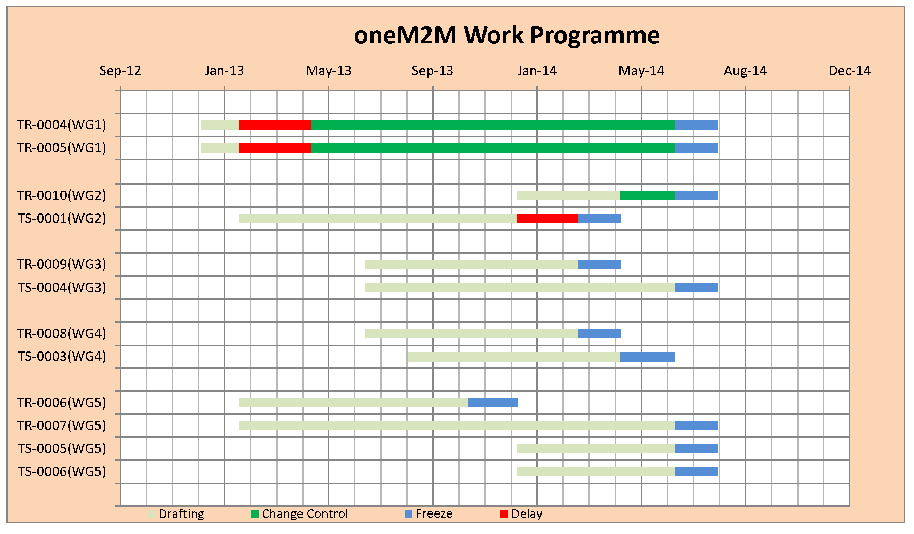
Schedule towards Release 1
Requirements
Architecture
Protocols
Security
Management, Abstraction, Semantics
Target Date: Release 1

Slide 15
Participation
Levels of participation:
Partner Type 1
Member companies participate directly
Partner Type 2
Contributes on behalf of Member companies
Associate Member
Join: http://www.onem2m.org/join.cfm
Docs: http://www.onem2m.org/library/index.cfm
News: http://www.onem2m.org/subscribe.cfm

Slide 16
www.oneM2M.org

