Slide 1
Standardization and Innovations from Emerging Markets The Road Ahead
ITU Workshop on
“Bridging the Gap: From Innovations to Standardization”
(New Delhi, India, 14 March 2013)
Dr. Vikram Srinivasan
Director Network Algorithms and Systems,
Alcatel-Lucent Bell Labs, India
*Disclaimer: The views presented are that of the speaker and not Alcatel-Lucent

Slide 2
Assumption – goal of workshop is to emerge consensus on how emerging economies can shape standards and innovations in the telecom space.

Slide 3
Innovation in Standards
Decrease the spend on patent fees
Unique characteristics –
Radio propagation due to terrain, different mobility patterns

Slide 4
The Ecosystem
Chipset Vendors
Network Equipment Vendors
Regulatory body
Operators

Slide 5
Operators Influence The Vendors Towards New Innovations
Radio
Radio
Fiber 20Km
Baseband SoC
Baseband SoC
Virtualized Radio Processing
Data center on GPP/SoC
Cloud-RAN:
China Mobile led industry wide initiative
Co-creation agreements with Vendors with
Appropriate IP arrangements
Paying customers!

Slide 6
Indigenous Vendor Ecosystem
30% preference for local vendors
India’s Huawei/ZTE/Samsung?
Macro RAN market not growing.
No space for a new entrant

Slide 7
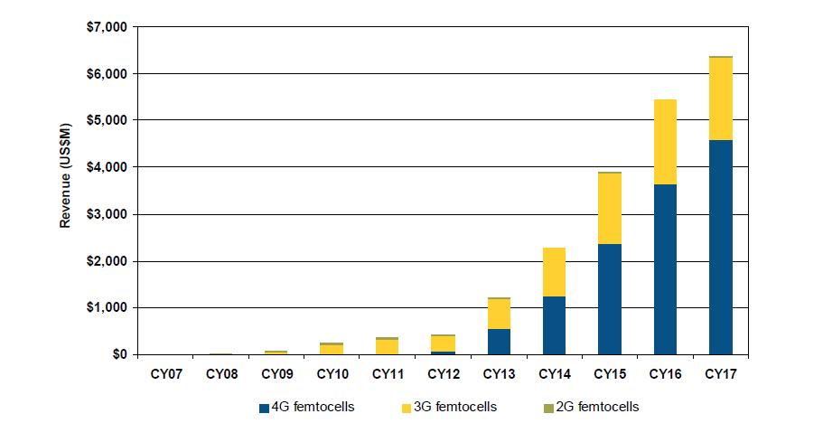
The Future: Small Cells and HetNets Significant Standardization Ongoing
Plenty of opportunities for new entrants

Slide 8
Policy – Change the Incentives/Rules
Economics of running networks for operators are dismal, especially true in India
Encourage active RAN sharing rules
Separate service provider from infrastructure provider
Emerging model in small cells (small cell as a service)
Leap forward in spectrum rules
E.g., 3.65GHz for DSA spectrum sharing

Slide 9
Conclusion
Innovations from emerging markets implies
Operator vendor co-creation agreements
Policy makers changing the dynamics of the market so innovation is possible here.

