Slide 1







Data, a critical resource
for Smarter cities
Javier Gil Arenales

Slide 2
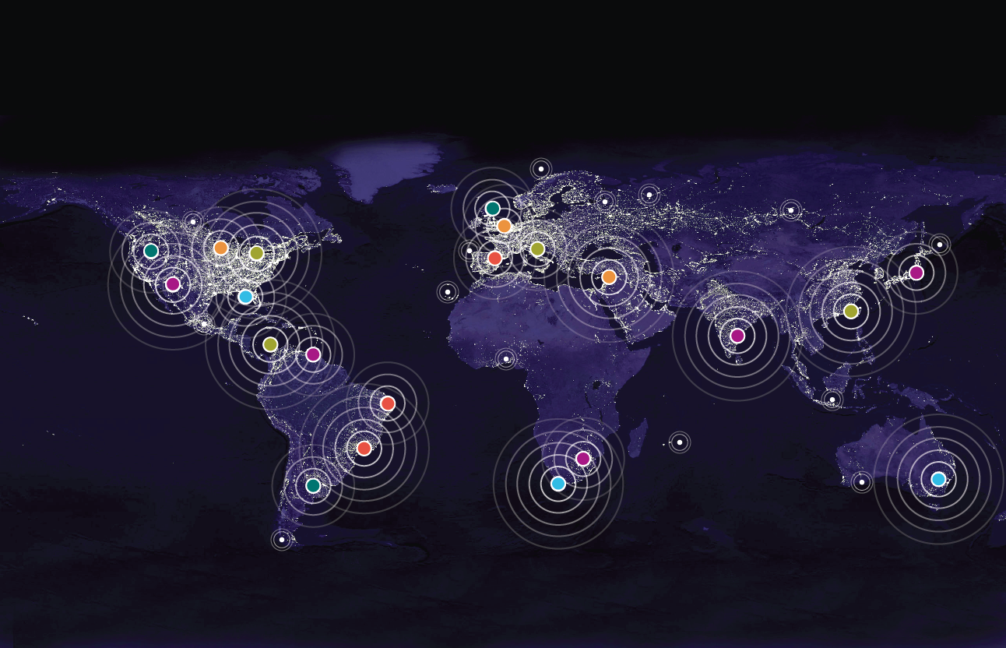

Slide 3

Keep doing the same is not sustainable
Cities need innovative solutions

Slide 4


Smarter Planet a path for an Smarter City
INSTRUMENTED
INTERCONECTED
INTELIGENT

Slide 5
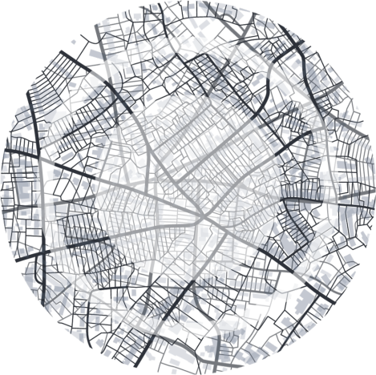










What citizens and city leaders want to became “smarter” ?
Anticipating problems to resolve them proactively
Leveraging information
to make better decisions
Planning and Management
Human
Infrastructure
Enables leaders to better serve citizens and businesses in a rapidly changing world
Coordinating resources
and processes to operate effectively

Slide 6
How can Technology help them?
Analyzing Data thru Analytics technology
Watson
Risk Analysis
BIG DATA
Analytics
Leveraging predictive algorithms to resolve issues proactively
Leveraging
Multiple Data Sources
Planning and Management
Human
Infrastructure
Enables leaders to better serve citizens and businesses in a rapidly changing world
Social Netwoks
Leveraging Citizens & Businesses fostering collaboration

Slide 7



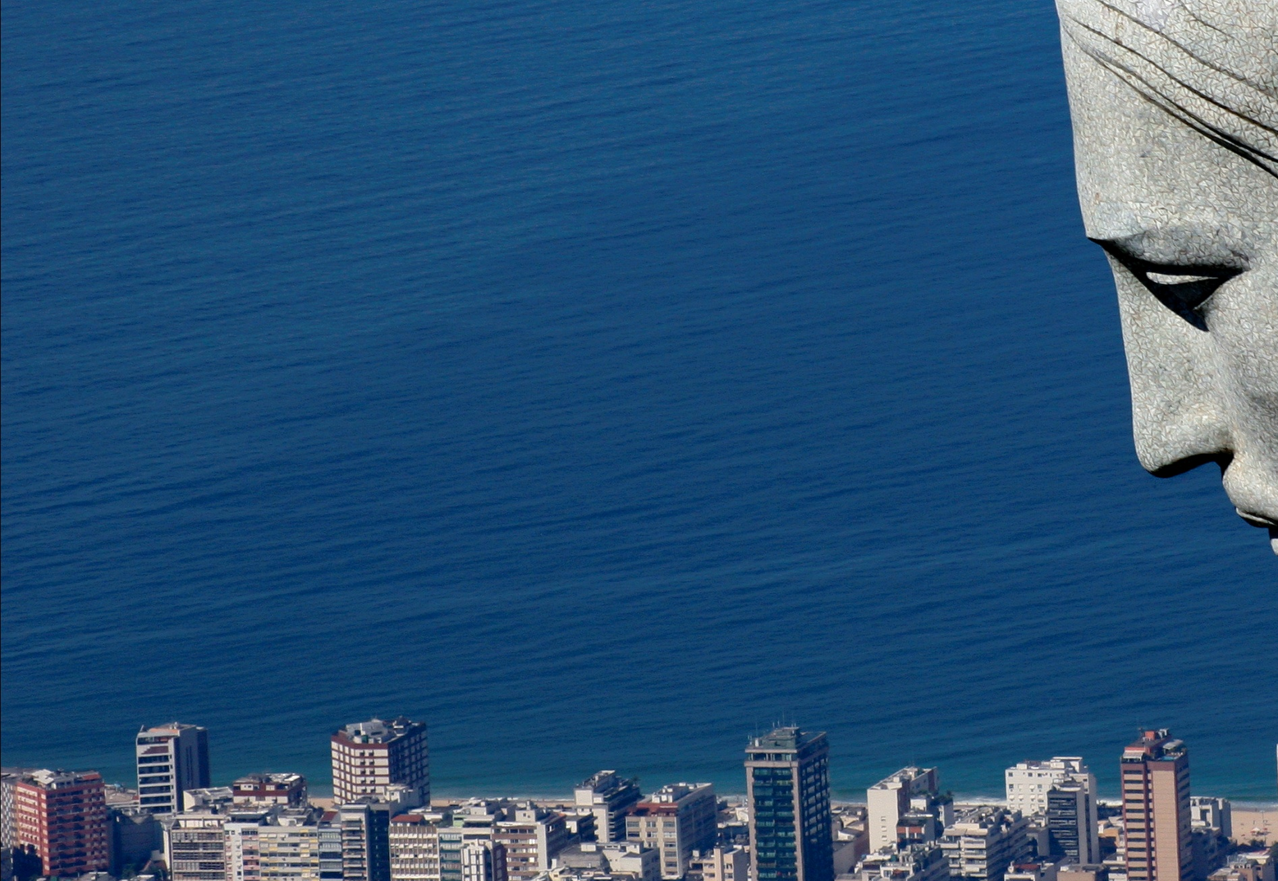
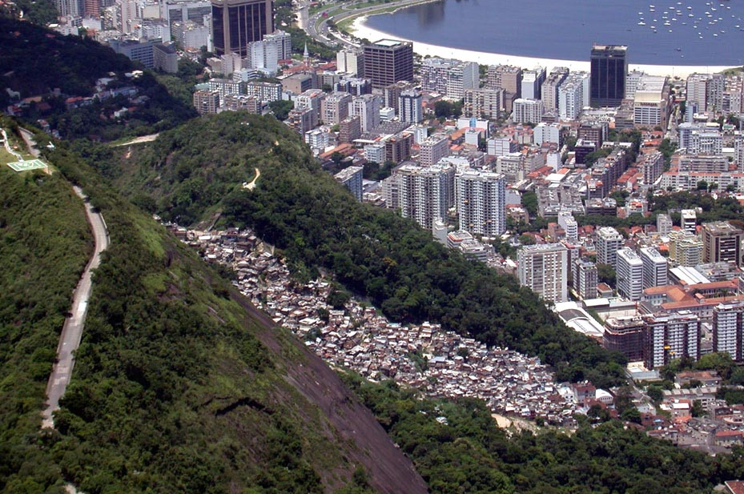
Ready for the future
Rio de Janeiro
Create an Integrated operating center to manage the city operations with an initial focus on emergency response due to floods. The operations center integrates information from 40 different agencies to analyze, predict and perform a rapid response to any emergency.
Project is currently evolving to traffic management and safety and security
7
7
Notes:
7
Thème de l’ENERGIE: EAU et ELECTRICITE
Page 29: les 2 références seront MALTE et EDELIA en Bretagne
En moyenne 20 % de l eau consommée dans les villes est perdue – Moyenne mondiale et francaise confirmée par nos partenaires sur Malte et Monaco ( Suez Environment) .
Cette perte de 20% se repartit en part egale entre les fuites non detectées et non detectables car trop faible et les pertes dues a des debits reels mais que l’on ne sait pas facturer .
Le réseau d’ electricite subit aussi des pertes NON facturées, qui sont le résultat de fraude ( branchement non autorisés ) ou de dysfonctionement des compteurs, problèmes qui ne peuvent se detecter que si on instrumente le reseau tres finement .
2 exemples : celui de MALTE ou IBM construit l infrastructure informatique d un reseau intelligent permettant de distribuer eau et electricite sur 250000 foyers avec notre partenaire LYONNAISE DES EAUX .
Et celui de l experimentation conduite avec EDELIA , filiale d EDF en Bretagne cet hiver , qui a permit de maitriser les pics de productions , donc d eviter de demarrer des centrales thermiques et de securiser la bonne tenue du reseau breton .

Slide 8
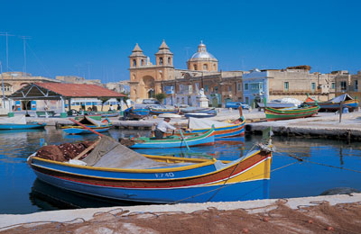
Water and energy together
Malta
Build an integrated distribution network for water and electricity, based on 250,000 interactive meters that can monitor electricity usage close to real time, identify water leaks and electricity losses, set variable rates, and reward customers who consume less power
8
8
Notes:
8
Thème de l’ENERGIE: EAU et ELECTRICITE
Page 29: les 2 références seront MALTE et EDELIA en Bretagne
En moyenne 20 % de l eau consommée dans les villes est perdue – Moyenne mondiale et francaise confirmée par nos partenaires sur Malte et Monaco ( Suez Environment) .
Cette perte de 20% se repartit en part egale entre les fuites non detectées et non detectables car trop faible et les pertes dues a des debits reels mais que l’on ne sait pas facturer .
Le réseau d’ electricite subit aussi des pertes NON facturées, qui sont le résultat de fraude ( branchement non autorisés ) ou de dysfonctionement des compteurs, problèmes qui ne peuvent se detecter que si on instrumente le reseau tres finement .
2 exemples : celui de MALTE ou IBM construit l infrastructure informatique d un reseau intelligent permettant de distribuer eau et electricite sur 250000 foyers avec notre partenaire LYONNAISE DES EAUX .
Et celui de l experimentation conduite avec EDELIA , filiale d EDF en Bretagne cet hiver , qui a permit de maitriser les pics de productions , donc d eviter de demarrer des centrales thermiques et de securiser la bonne tenue du reseau breton .

Slide 9
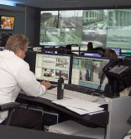
Better response in critical situations
City of Chicago
Include large-scale video surveillance and incorporates license plate recognition, advanced search and trending capabilities to provide several benefits to both city officials and citizens including: real-time video surveillance intelligence for proactive homeland security monitoring; faster response time to emergencies; more effective deployment of emergency responders; and increased travel efficiency through traffic congestion tracking.
9
Notes:
9
a real-time Crime Information Warehouse that makes NYPD more proactive and effective in fighting crime
Memphis Police Dept
Use predictive analytics to reduce crime without a proportional increase in staff – while expanding
coverage area.
Memphis Police Dept reduces crime 19% over 4 years

Slide 10
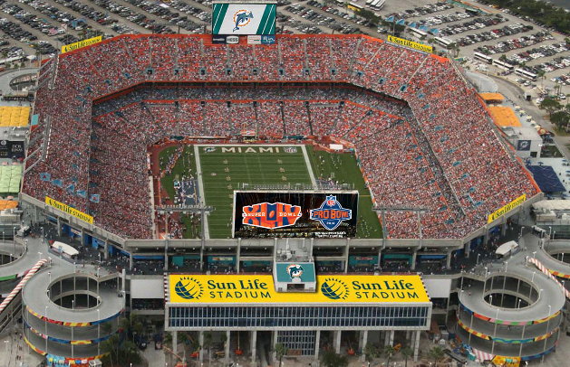
Smarter Infrastructures better service and less cost
Stadium : Sun Life stadium
Use Intelligent Operations Center for Smarter Cities to address the logistical and management challenges facing its staff while offering visitors a unique fan experience. IBM's IOC provides a complete interconnected view of stadium activity, from weather alerts, to real-time security, to traffic flow into the stadium creating a seamless flow of visitors attending a game, to insights into whether visitors prefer a full dining experience or buy food at concession stands prior to a big game
Notes:
10
All around the world, businesses, governments and institutions are investing to reduce costs, drive innovation and transform their infrastructure. The economic downturn has intensified this trend, as leaders seek not simply to repair what is broken, but to prepare for a 21st Century economy.
Many of their key priorities are in areas where IBM has leading solutions—such as smarter utility grids, traffic, healthcare, financial systems, telecommunications and cities. We are aggressively pursuing this transformational, global opportunity.
Smarter Food
In a world where 820 million people are undernourished, it is a tragedy that grocers and consumers throw away $48 billion worth of food each year in the U.S. alone. Inefficiencies and quality issues plague the global food supply chain. But with new technologies to trace food from the farm to the market shelf, and more intelligent solutions to track supply and demand, a healthier future is in store.

Slide 11


Thank you

