Slide 1






Smart Cities & Communities
Mercè Griera i Fisa
Smart Cities & Sustainability
DG CONNECT – European Commission

Slide 2
Outline
  European Activities on Smart Cities
  The Green Digital Charter
European Innovation Partnership on Smart Cities and Communities
H2020
Notes:
2

Slide 3
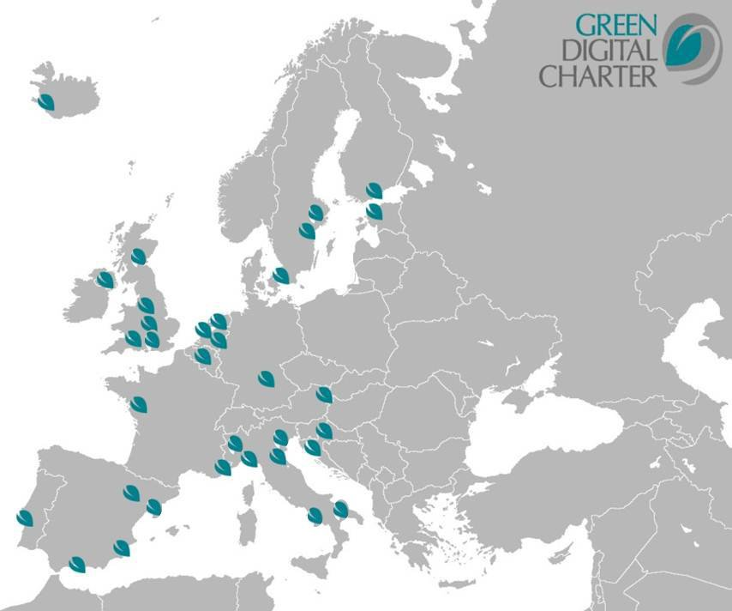
The Green Digital Charter
Charter
Connecting and enabling European cities:
The Green Digital Charter means political commitment and specific actions towards ICT-enabled sustainability targets and greening ICT itself.
Overall Objectives
Since November 2009, to encourage cities to:
reduce the carbon footprint of their ICT and
roll-out ICT solutions leading to more energy and resource efficiency, carbon neutrality and further public policy goals
Signatory Mayors’ Commitments
Closely cooperate on ICT deployment towards public policy goals
Deploy 5 large scale ICT projects within 5 years
Decrease ICT’s direct carbon footprint by 30% within 10 years
Notes:
3
This initiative set up by Eurocities and the city of Manchester has put the EU’s energy and climate targets at the centre of its activities.
It is hooked into the bigger and broader Covenant of Mayors Initiative, but:
- It focuses specifically on the use of ICT to help achieve these targets (will say some more about this later when we come to address energy efficiency. ).
- It also focuses on reducing the footprint of ICT in cities (through consolidation of large data-centres for example).

Slide 4

The Green Digital
Charter
The Green Digital Charter
Charter
Connecting and enabling European cities:
‘NiCE – Networking intelligent Cities for Energy Efficiency’ is the EC’s support action to promote and advance the Green Digital Charter.
Key Objectives
Objectives: establishing an ICT footprint Reporting Tool drawing on existing international standards to measure, compare and report ICT’s direct carbon footprint at city level
Supporting the Green Digital Charter in moving from political commitment to action:
Define a set of monitoring and reporting tools
Deliver practical support to the signatory cities
Knowledge exchange
beyond GDC
    Cooperation
    with China
Notes:
4
As part of the Green Digital Charter, cities have made ambitious commitments.
Nice should help stimulate action and make progress visible. It should enable cities to interact and share ideas, approaches,…
.

Slide 5

EIP on Smart
Cities
EIP on Smart Cities
Charter
European Innovation Partnership on Smart Cities and Communities - Moving beyond the silo:
The European Commission will focus its efforts on smart cities across portfolios to optimise outputs and ensure public policy coherence.
EU Smart Cities and Communities Initiative
Mobility and Transport
ICT
Energy
5
Notes:
5

Slide 6
EIP on Smart
Cities
EIP on Smart Cities
Charter
Implementation
  Supply side:
  Large-scale demo projects
  ('lighthouse projects')
  Demand side:
  Business models
  Public procurement
  Horizontal actions (e.g. regulatory measures, standards, common measurement frameworks)

Slide 7
H2020
H2020
Charter
Horizon 2020
A European Research & Innovation funding programme (2014-20) with a considerable size (77 billion Euro)
Part of proposals for next EU budget, complementing Structural Funds, education, etc.
A core part of Europe 2020, Innovation Union & European Research Area.
Funds will be used to support a set of the Smart Cities and Communities SIP.

Slide 8

H2020
Charter
Europe 2020 priorities
International cooperation
European Research Area
Shared objectives and principles
Tackling Societal Challenges
  Health, demographic change and wellbeing
  Food security, sustainable agriculture and
  the bio-based economy
  Secure, clean and efficient energy
  Smart, green and integrated transport
  Climate action, resource efficiency and raw
  materials
  Inclusive, innovative and reflective societies
  Secure Societies
Creating Industrial Leadership and Competitive Frameworks
Leadership in enabling and industrial technologies
  ICT
  Nanotech., Materials, Manuf. and Processing
  Biotechnology
  Space
Access to risk finance
Innovation in SMEs
ICT
ICT
ICT
ICT
ICT
ICT
ICT
EIT
JRC
Excellence in the Science Base
Frontier research (ERC)
Future and Emerging Technologies (FET)
Skills and career development (Marie Curie)
Research infrastructures
ICT
ICT
Simplified access
Common rules, toolkit of funding schemes
Dissemination & knowledge tranfer

Slide 9
H2020
H2020
Charter
September-October: Consultations with national experts
October-November: Finalisations of WP2014-15
November 6-8: ICT 2013 in Vilnius
December 10: WP adoption
December 11: Publication of first calls
Spring 2014: closing of first call

Slide 10

Thank you

