Slide 1
Shaping smarter and more sustainable cities: striving for sustainable development goals
Rome (IT) 18-19 May 2016
With the support from the European Union Programme “EaSi 2014-2020”

Slide 2
MANAGING THE GEOGRAPHICAL LABOUR MOBILITY AS A STRATEGIC TOOL TO MAKE COMMUNITIES MORE COMPETITIVE
WHAT I WILL SPEAK ABOUT
There’s “labour mobility” in the AGENDA 2030?
How does labour mobility fit with SSC?
Best practises in labour mobility
Notes:
Summary of the presentation

Slide 3
1) There’s labour mobility in the Agenda 2030?
Notes:
Are labour policies in the 2030 Agenda?
Goal 8: Promote inclusive and sustainable economic growth, employment and decent work for all
Goal 10: Reduce inequality within and among countries
Goal 10 Target: Facilitate orderly, safe, regular and responsible migration and mobility of people, including through the implementation of planned and well-managed migration policies
Goal 17: Revitalize the global partnership for sustainable development
Goal 17 Target: Enhance the global partnership for sustainable development, complemented by multi-stakeholder partnerships that mobilize and share knowledge, expertise, technology and financial resources, to support the achievement of the sustainable development goals in all countries, in particular developing countries
Encourage and promote effective public, public-private and civil society partnerships, building on the experience and resourcing strategies of partnerships
Goal 4: Ensure inclusive and quality education for all and promote lifelong learning
TARGET: By 2030, ensure that all learners acquire the knowledge and skills needed to promote sustainable development, including, among others, through education for sustainable development and sustainable lifestyles, human rights, gender equality, promotion of a culture of peace and non-violence, global citizenship and appreciation of cultural diversity and of culture’s contribution to sustainable development
Goal 9: Build resilient infrastructure, promote sustainable industrialization and foster innovation
TARGET: Develop quality, reliable, sustainable and resilient infrastructure, including regional and transborder infrastructure, to support economic development and human well-being, with a focus on affordable and equitable access for all

Slide 4
2) How does labour mobility fit with SSC?
A Smart Sustainable City: “starts a community on the path to become competitive for talent, investment and jobs” (Aoun-Schneider Electric - 2014).
Geographical labour mobility can be a strategic tool in addressing new economic and social challenges and a potential trigger of economic growth, making communities more competitive and efficient for talent, investment and jobs
Notes:
Why geographical labour mobility drives to a Smart Sustainable Cities? A lot of different definitions of Smart Sustainable Cities

Slide 5
2) How does labour mobility fit with SSC?
A lack of skilled labour will be one of the main obstacles to economic growth in the coming years:
skills mismatches (imbalances between what employers need and what job seekers offer) related to geography, sector and mobility;
skill shortages and skill gaps (too few people with the required skills);
structural unemployment (too many people without the required skills).

Slide 6
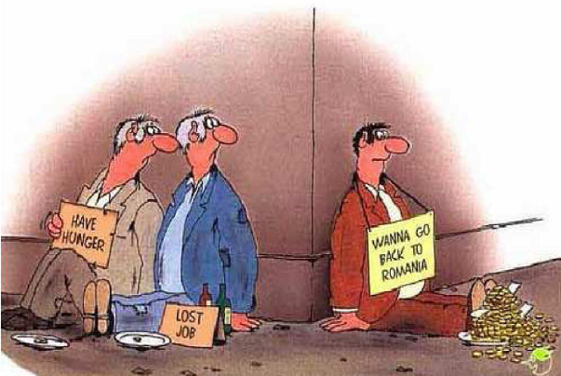
2) How does labour mobility fit with SSC?
Which Labour Mobility?
ECONOMICAL MIGRATION
Threats:
1) Brain Drain
2) Brain Waste
3) Lack of integration
Notes:
Firstly, labour mobility contributes to improving the allocation of resources and serves as an adjustment mechanism for unbalanced labour markets whilst enabling economies to cope better with sudden shocks. Nevertheless, if we confine the potential of labour mobility only on this factor, we could foster brain-drains, making poorest the countries with an high unemployment rates and rising the economic imbalance among states.

Slide 7
2) How does labour mobility fit with SSC?
Which Labour Mobility?
BRAIN CIRCULATION
Opportunities:
1) knowledge transfer
2) innovation
3) human capital development
Notes:
The main objective of labour mobility must not definitely be to encourage brain-drains or limit the number of vacancies for national jobless people, but rather to acquire diversified knowledge and skills: labour mobility can promote knowledge transfer, innovation and human capital development, which is essential in a context of quick technological change and global competition.
A foreign workforce can make governments and businesses more innovative and competitive and help them to take more advantage of opportunities on the international marketplace.
It creates interaction between citizens, and it can improve mutual understanding, contribute to making societies more tolerant and inclusive and strengthen the worldwide citizenship values.

Slide 8
2) How does labour mobility fit with SSC?
Labour Mobility Demand
71%
of millennial want to work outside their home country during their career
20%
the number of female assignee abroad has doubled in the last 10 years from 10% to 20%

Slide 9
2) How does labour mobility fit with SSC?
Labour Mobility Supply
75%
of companies expect to increase their population of mobile employees in the next three to five years, but …
… just 2%
of companies currently consider their mobility function world class.

Slide 10
3) Best practises on labour mobility
Key factors to foster the “good” labour-mobility
a supranational governance (EU);
a public-private cooperation (new EURES Regulation);
an ICT platform featuring a set of tools regarding job postings, job tracking, searches, alerts, matching and data management (YfEj);
…
Notes:
Key factors to foster this favourable labour-mobility are a supranational governance, a public-private cooperation, ICT platform featuring a set of tools regarding job postings, job tracking, searches, alerts, matching and data management

Slide 11
3) Best practises on labour mobility
Labour mobility is a cornerstone in the EU integration
EU promotes labour mobility and assists the member states on the removal of existing obstacles:
Directive on Free Movement of EU Citizens
EURES network
Mobility programmes for civil servants, students (Erasmus+), for entrepreneurs (Erasmus for entrepreneurs) for young and for over 35 jobseekers (YfEj - REACTIVATE)
Notes:
Several EU legal and operational initiatives focus on supporting free movement of EU citizens, not only as an individual right of each citizen, but also in the collective interest as Europeans that people are mobile and ready to cross borders.

Slide 12
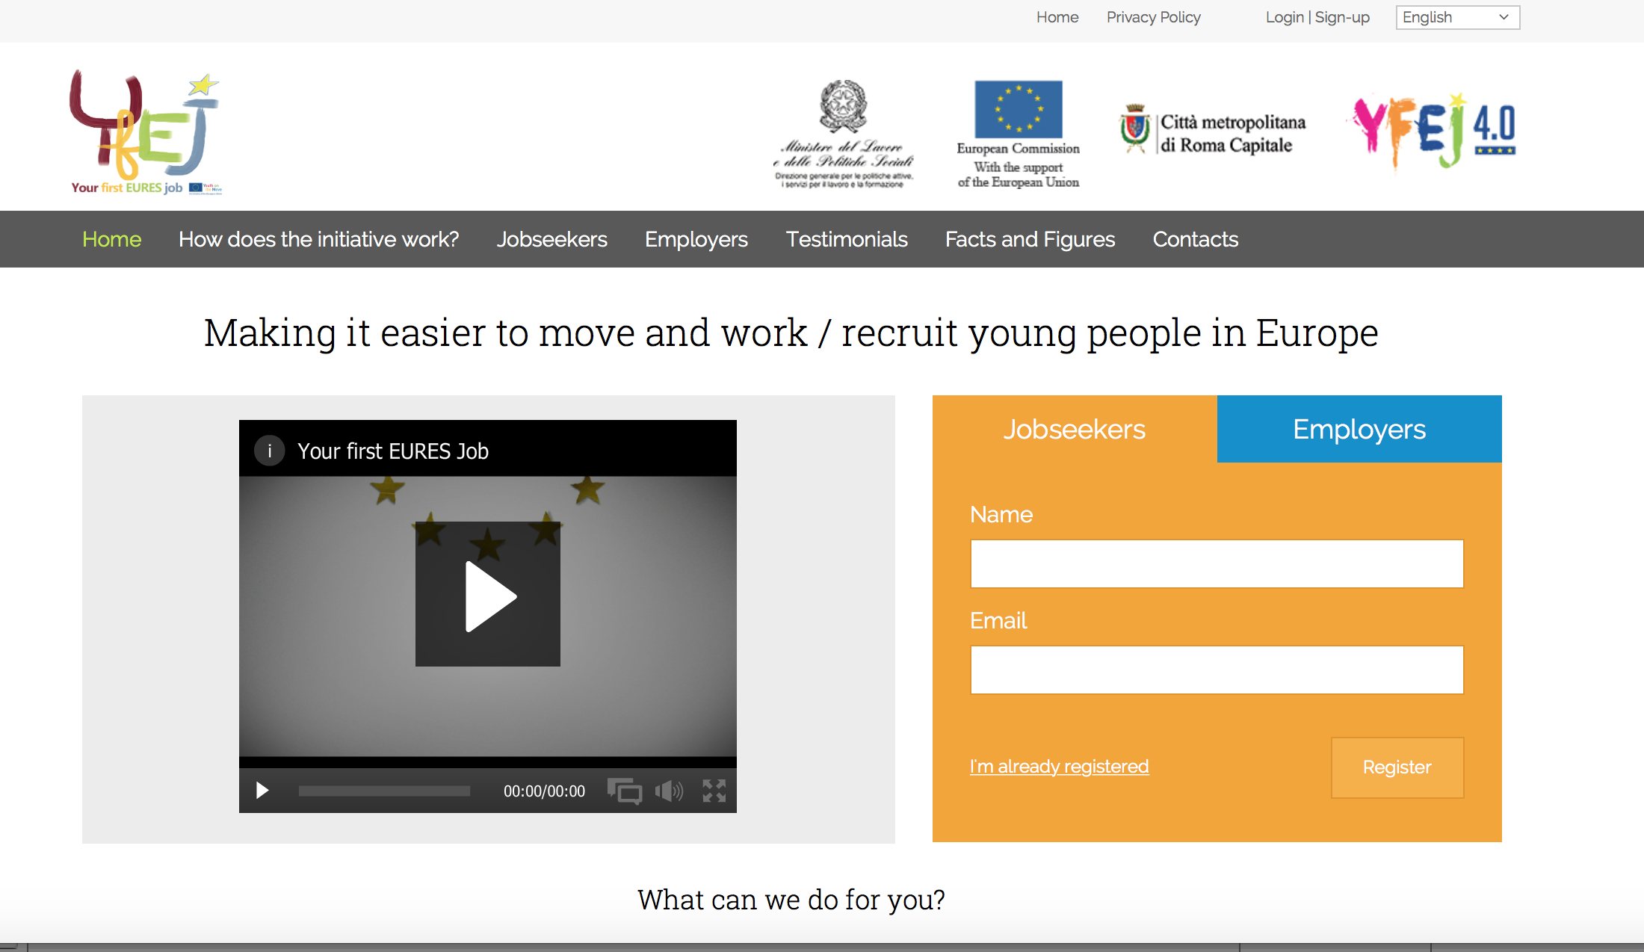
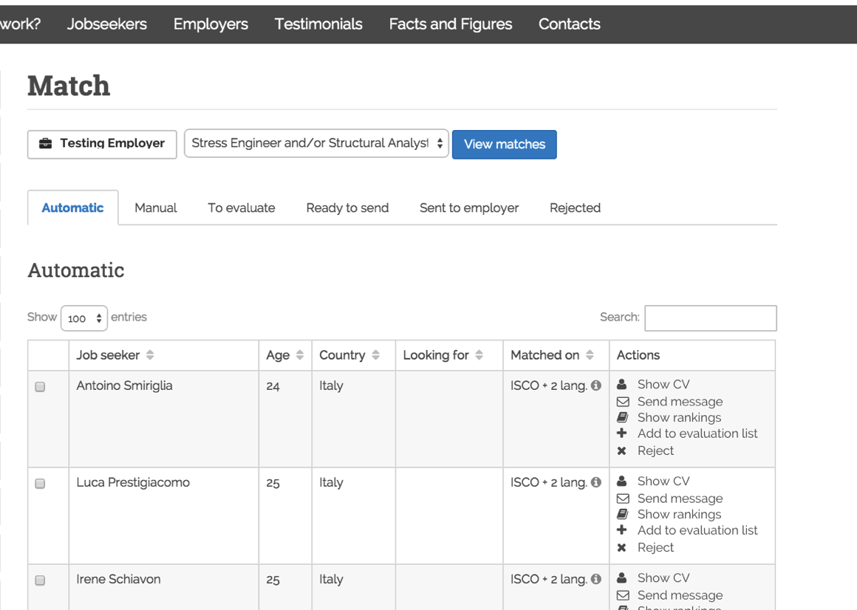
3) Best practises on labour mobility
PORTA FUTURO
@ Metropolitan City of Rome
EU-wide services for youth and employers
European HUB for youth mobility
Notes:
Mainly, it will be presented a model created to manage intra-EU labour mobility, in the framework of the new EURES 2016 Regulation: the EU initiative “Your first EURES job”, managed by the Metropolitan City of Rome with the Italian Ministry of Labour Policies, and the technical assistance of Capitale Lavoro S.p.A, the “in house providing Company” of the Metropolitan City of Rome (ex art. 12 - Directive 2014/24/EU on Public Procurement).

Slide 13
Dario Manna (Capitale Lavoro S.p.A.)
Chief Operating Officer – Porta Futuro Città Metropolitana di Roma
www.capitalelavoro.it www.portafuturo.it
www.yourfirsteuresjob.eu
(+39) 3284911572
d.manna@portafuturo.it

