Slide 1


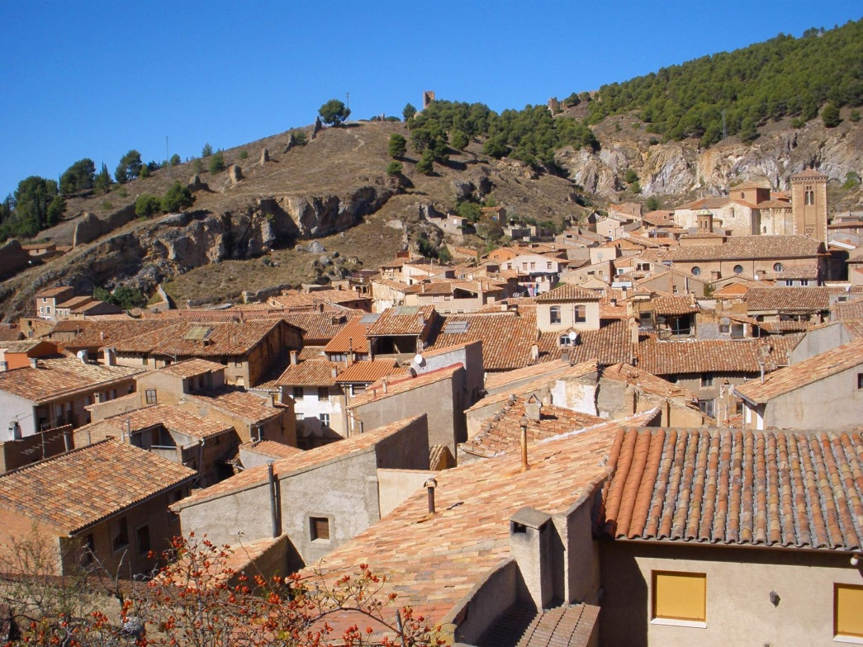
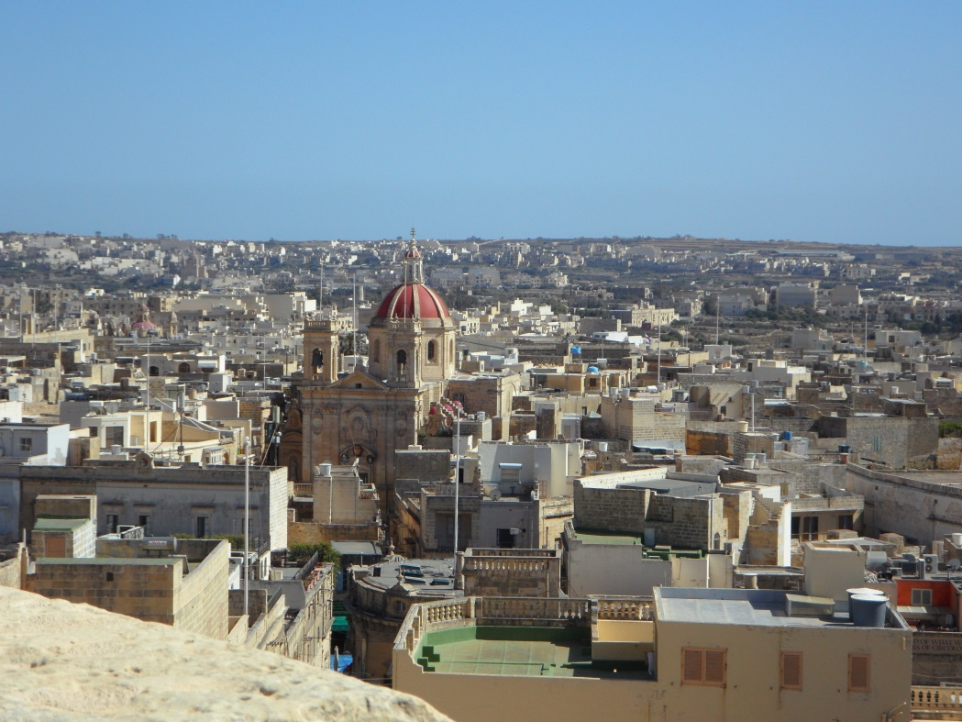
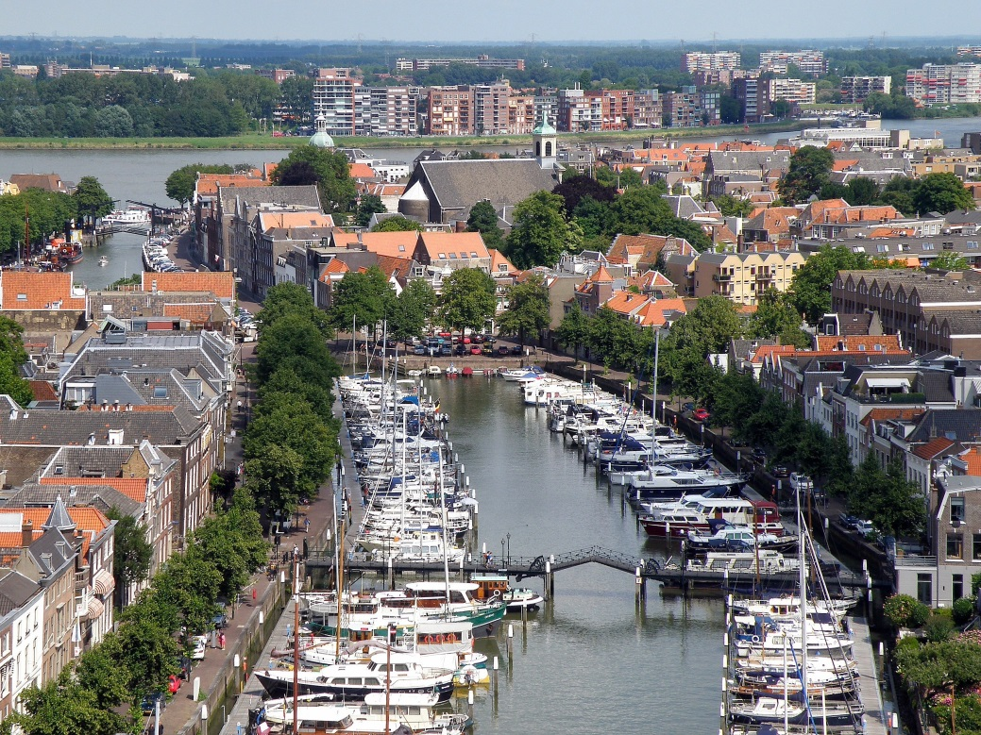
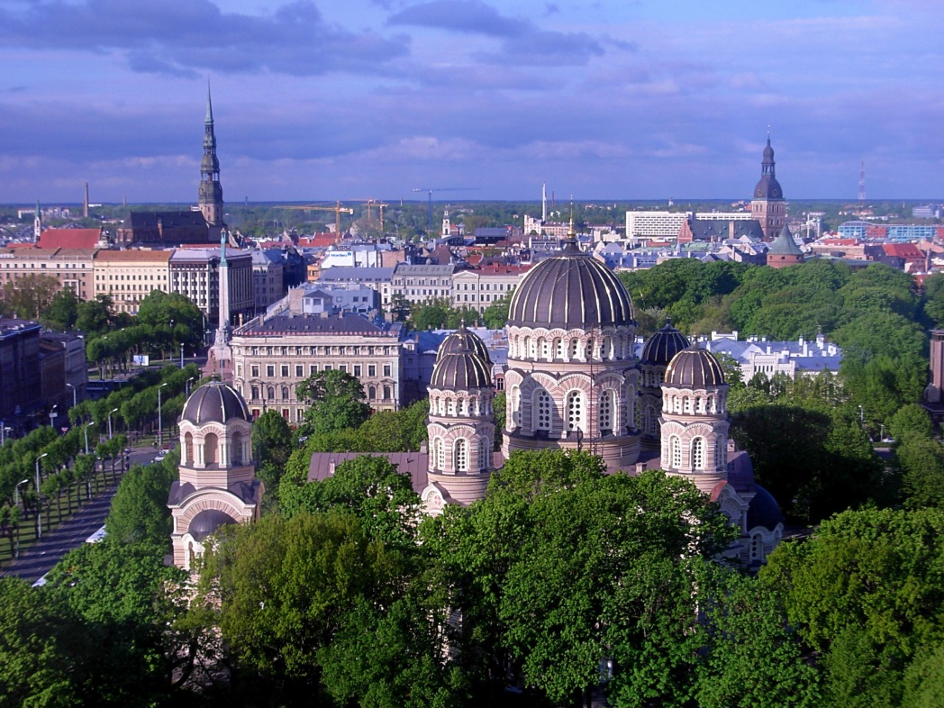
Key Performance Indicators for smart sustainable cities
all-free-download.com
Draft Recommendations:
all-free-download.com
Gundula Prokop – Environment Agency Austria
all-free-download.com
all-free-download.com

Slide 2

Why recommendations and indicators?
Global Target (SDG)
Key Performance Indicators for Smart Sustainable Cities help cities achieve Sustainable Development Goals.
long term: promote solutions for sustainable development and climate change adaption (& mitigation) in cities of the world
strengthen capacity building in urban administrations towards sustainable urban development
improve knowledge transfer among cities
→ exchange best practices among cities

Slide 3

Background
SMART CITY PROFILES
Environment Agency Austria develops Smart City Indicators (PROFILES) for Austrian Cities
2011
OiER, UNECE, EAA form alliance
→ to involve industry partners
→ design indicators that address global urban issues
→ formation of multi-stakeholder network
2013
2015
Test implementation in Armenia
ICU-T joins process
→ redesign of indicators with stronger focus on ICT
Key Performance Indicators

Slide 4
KPI Structure
Areas
Economy
Environment
Society & Culture
ICT
Innovation
Employment
Trade
Productivity
Phys. Infrastructure
Public Sector
Air quality
Water & sanitation
Noise
Environ. quality
Biodiversity
Energy
Education
Health
Safety
Housing
Culture
Social Inclusion
Topics
Indicators
13 core
20 additional
19 core
9 additional
18 core
10 additional
Information & Communication Technologies

Slide 5

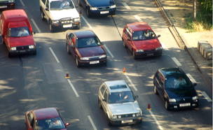

Economy
Internet access in households [%]
Household with a computer [%]
R&D expenditures [%]
Patents [per 100,000 cap]
Employment rate [%]
Labour productivity [U$ / h]
Availability of smart water meters [%]
Availability of smart electricity meters [%]
Electricity system outage frequency [no./yr.]
Electricity system outrage time [min.]
Public transport network [km / 100,000 cap]
Road traffic efficiency [ratio]
Real-time public transport information [%]
© xinxinxing – fotolia.com

Slide 6
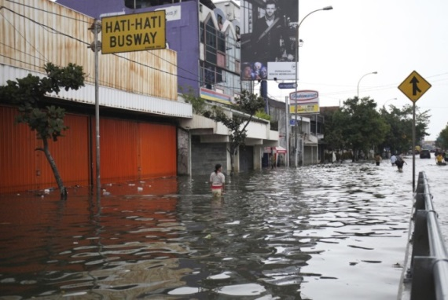
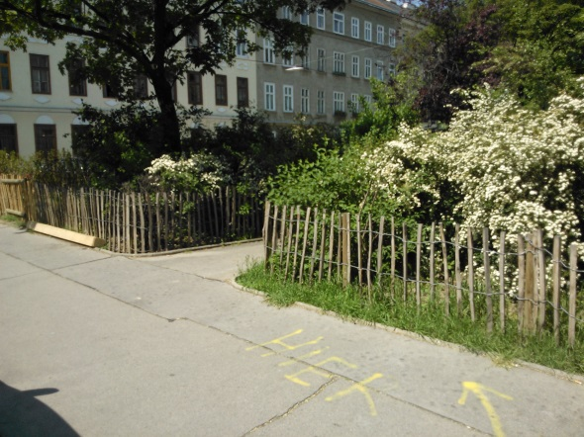
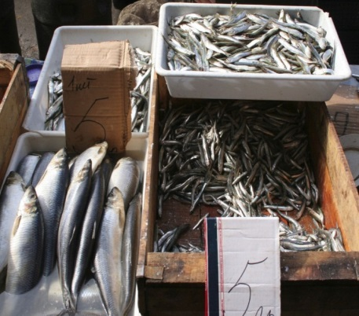
Environment
Air pollution [no.]
GHG emissions per capita [t eCO2/cap]
Quality of water resource [%]
Access to improved water source [%]
Water consumption [L day cap]
Waste water treated [%]
Wastewater collection [%]
Houshold sanitation [%]
Exposure to noise [%]
Compliance with WHO exposure guidelines to electromagnetic fields [Y/N]
© iStochphoto.com/herianus
G. Prokop
© iStochphoto.com/lukova

Slide 7
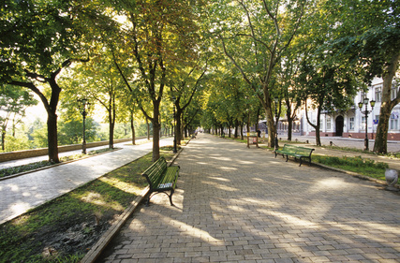
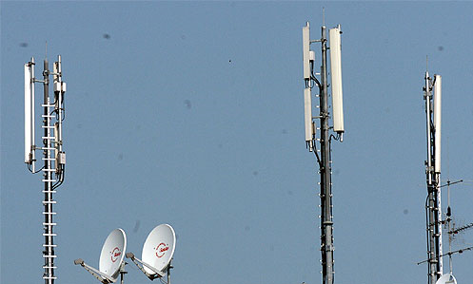
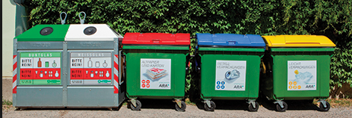
Environment
Adoption of a consistent planning approval process with respect to EMF [Y/N]
Availability of EMF information [Y/N]
Solid waste collection [%]
Solid waste treatment [%]
Green & public areas [m²/ 100,000 cap]
Native species monitoring [no.]
Renewable energy consumption [%]
Electricity consumption per capita [kWh/day*cap]
© fotolia

Slide 8

Society
Students ICT access [%]
Adult literacy [%]
School enrollment [%]
Higher education ration [%]
Electronic health records [%]
Sharing of medical resources [%]
Life expectancy [yrs]
Maternal mortality [per 100,000 births]
Doctors [per 100,000 cap]
Resilience plans [checklist]
Emergency response [min]
Information security and privacy protectionn [checklist]
© iStockphoto.com/kudryashka
Housing expenditure [%]
Informal settlements [%]
Connected libraries [per 100,000 cap]
Cultural infrastructure [per 100,000 cap]
Cultural resources online [per 100,000 cap]
Public participation [checklist]
Gender income equity [ratio]
Opportunities for people with special needs [checklist]

Slide 9
Example

Slide 10
Benchmarking
How can you judge indicator results?
Does the result meet the relevant Sustainable development Goal?
Compare with regional best practice

Slide 11
Indicator development
Indicator
calculation
The following sources were assessed:
More than 25 worldwide urban indicator initiatives
Available statistical data (Europe and globally) checked;
i.e. EUROSTAT, Urban Audit, World-Bank, WHO, FAO etc.
Thematic maps (Europe and globally) on i.e. likelihood of drought, earthquakes, flooding, precipitation
Other methods to assess the quality of urban features, such as perception surveys, check lists, expert judgement etc.
Local data
Satellite data, maps
Surveys
Expert opinions
Check lists

Slide 12
Contact & Information
Gundula Prokop
Soil & land use management
gundula.prokop@umweltbundesamt.at
Umweltbundesamt GmbH
Spittelauer Lände 5
1090 Vienna/Austria
www.umweltbundesamt.at

