Slide 1
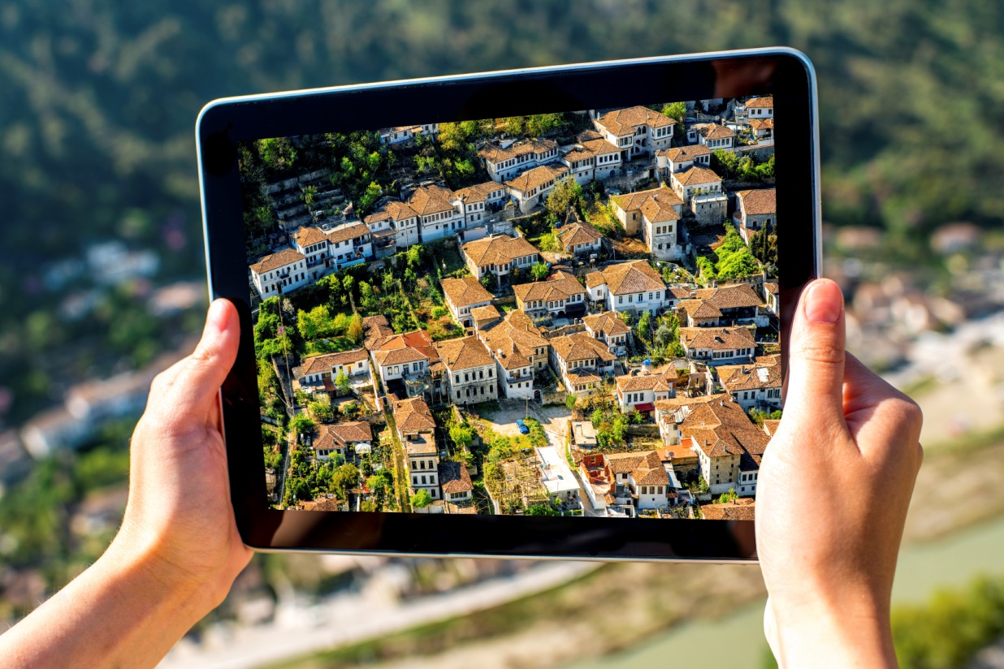
Forum
“Shaping smarter and more sustainable cities: striving for sustainable development goals”
18-19 May 2016, Rome
United 4 Smart Sustainable Cities:
shaping the cities of today and tomorrow
Domenica Carriero
Housing and Land Management Unit
Forests, Land and Housing Division, UNECE

Slide 2
IDENTITY CARD
What: global initiative
When: launch 18 May 2016
Why: facilitate the transition into smart sustainable cities
Where: www.itu.int/en/ITU-T/ssc/united/Pages/default.aspx

Slide 3
Smart city: definition
Many existing definitions
UNECE/ITU definition combines the «smartness» and the sustainability of a city
Framed in the SDG 11
“A smart sustainable city is an innovative city that uses information and communication technologies (ICTs) and other means to improve quality of life, efficiency of urban operation and services, and competitiveness, while ensuring that it meets the needs of present and future generations with respect to economic, social and environmental aspects as well as cultural.” [UNECE/ITU]

Slide 4
Objectives
Support to create a regulatory and institutional framework for sustainable urban development
Encourage cooperation among stakeholders
Provide practical guidance to cities seeking to become smart sustainable cities
Provide a platform to connect people and cities
Harmonize methodologies and approaches to assess cities performances
Help in achieving and monitoring the SDGs
Capacity building

Slide 5
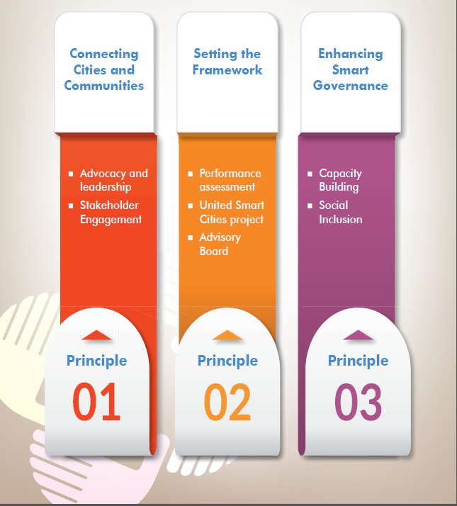
Pillars of the initiative
Pillars
Activities
Pillar
Pillar
Pillar

Slide 6
U4SSC Action plan - actions
Smart Education
Discussing ways of integrating IoT and other ICTs into Smart Sustainable Cities;
Identifying SSCs goals and challenges in relation to the implementation of key targets
Panel discussions and events
participation/organization of expert events
capacity building
partners and stakeholders consultations
Knowledge sharing & research
Collecting relevant case studies on SSC worldwide, or specific related topics (resilience to disasters, compact planning, urban noise, urban safety, etc.)
Researching and examining the potential role of various technological innovations in urban ICT infrastructures for Smart
Standards implementation
use of international standards & KPIs
establishing guidelines for the transition to SSC
test and pilot standards

Slide 7
Pillar 2 - activities
Pillar
United Smart Cities
Performance assessment
City profiles
City action plan
KPIs development and testing
Advosory Board
Technical Board
Selection of cities

Slide 8
United Smart Cities
Activity 1
Methodology
Pilot cities
Standards
Activity 2
Smart sustainable city profile
Performance assessment
Activity 3
Implementation of reccommendations
City action plan

Slide 9
Advisory and Technical Board: Partnering UN organizations

Slide 10
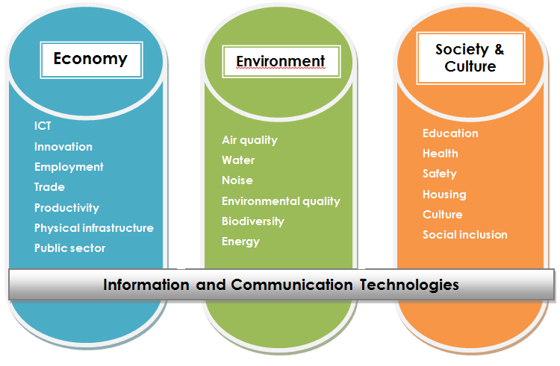
KPIs for smart sustainable cities to assess the achievement of SDGs (TD 1465 Rev.2)
Developed by a consortium of organizations – framework: ITU-T SG5
Basis: the UNECE/ITU Smart Sustainable Cities Indicators endorsed by the Committee on Housing and Land Management on 15 December 2015 (ECE/HBP/2015/4)
Approach
3 main areas
19 topics
91 indicators (core & additional)

Slide 11
KPIs for smart sustainable cities to assess the achievement of SDGs: Milestones
2013: 74th session of the Committee on Housing and Land Management (CHLM) - smart cities as one of the main priorities for member States
2013: Creation of the ITU Focus Group on Smart Sustainable Cities
2014: Analysis of the sources and development of the draft list of indicators
2014: 75th session of the CHLM - the Committee approves the project “United Smart Cities” and indicators become a priority
2015: Draft indicators tested in the pilot city of Goris, Armenia for feasibility
2015, 11 May : Expert Consultation, Geneva, Switzerland – indicators discussed among experts
2015, 4 and 5 June: Workshop and Committee Bureau meeting, Rakvere, Estonia – starting point of the inter-governmental dialog
2015, 30 June: Cities workshop, Vienna, Austria – input from cities
2015, June: negotiations with ITU to merge ITU and UNECE indicators
2015, July: draft sent to the member States for comments
2015, 14-15 December: 76th session of the CHLM – indicators endorsed
2016, March: proposal to the ITU-T SG5 for a draft Recommendation (standard)
2016, 20-27 April: ITU-SG5 meeting, Kuala Lumpur, Malaysia – discussion of KPIs and approval with revisions
2016, 18-19 May, Rome: Launch of the Advisory Board for the KPIs
2016, 22 July, Geneva: first meeting of the Advisory Board
2016, October, Geneva: KPIs will be called for consent at ITU-T ST20
2017, Geneva: 78th session of the CHLM – Committee will be invited to endorse the KPIs
Long process – dialogue and negotiations (experts, countries, cities, organizations, etc.)
One-UN approach

Slide 12
Thank you for your attention!
Domenica Carriero
Housing and Land Management Unit, UNECE
Email: domenica.carriero@unece.org
Tel.: +41 (0) 22 917 16 72
Website: www.unece.org/housing
Follow us:
@UNECE Housing and Land Management

