Slide 1
Striving to achieve through international standards
Paolo Gemma ITU
19 May 2016, Rome

Slide 2
Importance of global standards
Drive competitiveness, for individual businesses and world economy;
Lower prices;
Reduce technical barriers;
Foster interoperability;
Manufacturers, network operators and consumers;
Reduce negative impacts on the environment.
Work with us!
Notes:
As part of its mandate, ITU-T develops international “green” standards to promote innovative solutions to tackle e-waste, combat climate change and promote environmental sustainability using ICTs.
ITU-T Recommendations are beneficial to:
Drive competitiveness, for individual businesses and world economy
Lower prices
Reduce technical barriers
Foster interoperability
Manufacturers, network operators and consumers
Reduce negative impacts on the environment (including e-waste)
Through its Recommendations, ITU-T facilitate the development, transfer and diffusion of clean and green technologies, including access to modern energy, energy efficiency and ideas for renewable sources.

Slide 4
Smart Water Management in Cities
Requirements for water sensing and early warning systems
700 million people in 43 countries are suffering from water stress and scarcity
1 billion people without access to clean water
ITU-T L Suppl.16 to ITU-T L.1500
ITU-T L Suppl.15 to ITU-T L.1500
Notes:
Management challenges to the water sector. Approximately 700 million people in 43 countries are currently suffering from wáter stress and scarcity, with over 1 billion people without Access to clean water, and over 2.6 million lacking adequate sanitation facilities.

Slide 5
Green Data Centers
ICT Equipment and Energy Efficiency
For example, applying best practices to cooling could reduce the energy consumption of a typical data centre by more than 50%.
ITU-T L.1310
ITU-T L.1320 ITU-T L.1321
ITU-T L.1330
ITU-T L.1340
ITU-T L.1300
ITU-T L.1301 ITU-T L.1302
Notes:
L.1300 describes best practices aimed at reducing the negative impact of data centers on the climate.
L1301 established minimum data set and communication interface requirements for data center management in a responsible manner.
L.1302 contains the assessment methodology of energy efficiency on infrastructure in data centre and telecom centre
L.1320 contains the general definition of energy efficiency metrics and measurement for power and cooling equipment for telecommunications and data centres

Slide 6
KPIs for SSC
International Definition
By 2050, 70% of the worlds population is expected to live in urban environments
Cities produce up to 70% of global greenhouse gas emissions
ITU-T L Suppl.17 to ITU-T L.1600
ITU-T L Suppl.18 to ITU-T L.1600
ITU-T L.1603 (Draft)
Notes:
ITU-T L.1603 Draft New Recommendation: Key performance indicators for smart sustainable cities to assess the achievement of sustainable development goals “A smart sustainable city is an innovative city that uses information and communication technologies (ICTs) and other means to improve quality of life, efficiency of urban operation and services, and competitiveness, while ensuring that it meets the needs of present and future generations with respect to economic, social, environmental as well as cultural aspects”

Slide 7
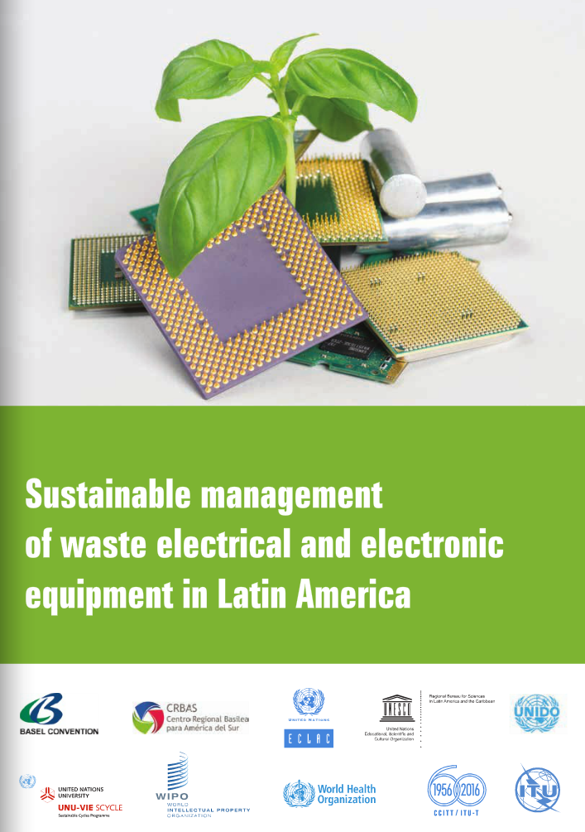
Recycling of rare metals in ICT products
Power supply series
Circular economy
ITU-T L.1000
ITU-T L.1001 ITU-T L.1002 (draft)
ITU-T L.1005
ITU-T L.1100
ITU-T L.1101
Notes:
Recommendation ITU-T L.1000: Universal power adapter and charger solution for mobile terminals and other hand-held ICT devices:
Saves 82,000 tons of e-waste per year
Saves at least 13.6 million tonnes of CO2 emissions annually
Recommendation ITU-T L.1001: External universal power adapter solutions for stationary information and communication technology devices:
Saves 300,000 tons of e-waste per year
Reduces the energy consumption and greenhouse gas (GHG) emissions of external power supplies by between 25% and 50%

Slide 8
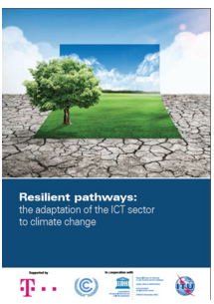
Adapting information and communication technology infrastructure to the effects of climate change
Methodologies to assess the environmental impact of ICT
195 countries
Keep warming “well below 2°C”.
ITU-T L.1400
ITU-T L.1410
ITU-T L.1420
ITU-T L.1430
ITU-T L.1440
ITU-T L.1500
ITU-T L.1501 ITU-T L.1502
Notes:
Adapting information and communication technology infrastructure to the effects of climate change

Slide 9
Thank you

