Slide 1



Innovative ICT
Building a Better Smart City
Notes:
Introduction of myself.

Slide 2
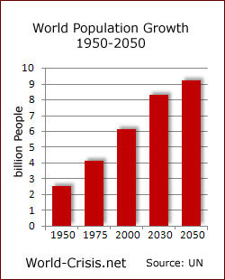
Why are countries focused on “Smart City”?
Increase in Population
2014 7B 2050 >9B
Increasing Urbanisation
Half the world’s population lives in a city – an increase from 30% 50 years ago
57% by 2025 (Frost & Sullivan)
Cities significantly contribute
to GDP
70% of global GDP is generated by cities
37 of the World’s largest economies are cities
Increase in Urbanization
Source: United Nations
Source: McKinsey
Notes:
World is changing. Technology is change. Have you changed.
Demography of our population has changed. (Point to the chart)
We also face with issues like public safety, food safety, pollutions, traffic jams, Energy shortage …etc

Slide 3
What is a “Smart City”?
Very Wide Concept:
Scope
Content
Global Trends
  City Admin (Smart Transportation, Grid, Healthcare, Public Safety, Education, etc.)
  Financing Models (Public-Private, Crowd, Green Bonds, Tax-Increment, “Pay-per-Use)
  Govern’ment Incentives
  Technology
In essence: Very extended concept which requires long-term evolutionary process where nobody can do or make all alone
Notes:
many countries have started their initiative about build a smart city.
Any smart city can not be accomplished without connections, Intelligence applications, and many sensors.
Therefore the core infrastructure surrounding smart cities is (Point to the right hand chart)

Slide 4
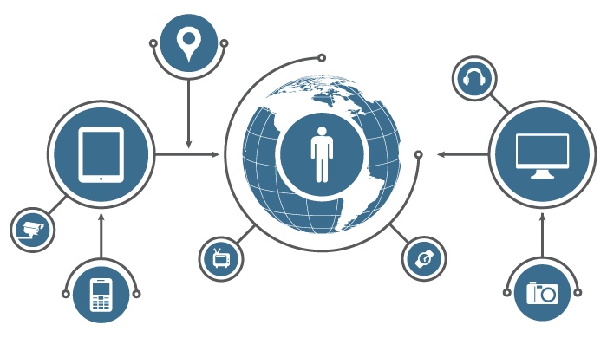
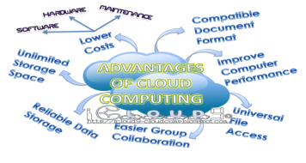

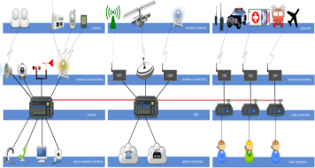
What is a “Smart City”?
Urban Development, Security & Sustainability
Smart Utilities
(Grid, Water, Gas)
Safe City
(Emergency, Disaster, Security, Environment)
Smart Buildings
(Commercial Environment Mgmt)
Internet Of Things
Smart Traffic &
Transportation
(Bus, Train,
Traffic Flow)
Information Flows
Connected City
(Wireless, Fixed)
Smart City Intelligence
Sensor City
(M2M / IoT)
ICT Infrastructure
Intelligent Operations Center
Applications Store
Contact Center
Intelligent Computing
Smart Homes
(Security, Environmental, Convenience)
Smart
Healthcare
(Remote, Hospital)
Smart
Education
(Remote, School)
MICE, Hospitality & Entertainment
(Stadiums, Tourism, Conventions)
Collaborative Response
Social Development Communities, Villages, Citizens
Notes:
many countries have started their initiative about build a smart city.
Any smart city can not be accomplished without connections, Intelligence applications, and many sensors.
Therefore the core infrastructure surrounding smart cities is (Point to the right hand chart)

Slide 5
Business-Driven ICT Infrastructure （BDII）
Customer Value
Applications
ICT Infrastructure
ICT Convergence
Capabilities
Product Innovations
Drive
Drive
Network
Cloud OS
Business Requirements
Industrial Applications
(e.g. Telemedicine, Distance Education )
Open API
(eSDK)
Cloud
Big Data
Drive
Storage
Big Data
Enable
Enable
Enable
Server
Security
Social
IoT
Enterprise Wireless
UC
Mobility
CPS
Vertical Industries
App Developers
Huawei

Slide 6
Which is the value of a global ICT vendor?
Big investments in research and innovation (5G, IoT, Cloud, Big Data, UBB)
    170 Countries
    14% of Global Revenue invested in R&D
    80,000 R&D Engineers Worldwide
    31 Joint Innovation Centers globally
    3,400 International Patents in 2014
Commitment to build a “Better Connected World” by supporting Countries’ & Cities’ Digital Agenda
    Success=Healthy ICT Ecosystem
    Healthy ICT Ecosystem=Open, Collaborative, Inclusive Approach
    → Speed-up Digital Transformation
Notes:
many countries have started their initiative about build a smart city.
Any smart city can not be accomplished without connections, Intelligence applications, and many sensors.
Therefore the core infrastructure surrounding smart cities is (Point to the right hand chart)

Slide 7
What are the Key Steps to create a Sustainable Smart City Project?
Standardization and Open Standard
Private-Public Collaboration
Dynamic and “Inclusive” Ecosystem (ESDC Munich, over 200 Solution Partners)
Real Improvement of the Customer/Citizen Experience
Public Funds to support the efforts
Clear Priorities and Guidelines
Notes:
many countries have started their initiative about build a smart city.
Any smart city can not be accomplished without connections, Intelligence applications, and many sensors.
Therefore the core infrastructure surrounding smart cities is (Point to the right hand chart)

Slide 8














































Ecosystem towards a Smart City
Energy
Education
Healthcare
Government
Finance
Transport
Media

Slide 9










Huawei’s Footprints in More Than 30+ Countries
Dunhuang, Tian shui and Jinchang, Gansu Province
Smart City, Yanbian, Jilin Province
Smart Transportation, Xian
Smart Liaoyuan
Smart City Management , Cangzhou
Smart Country, Nigeria
Smart Country, Cuba
Smart City Management , Shihezi
Safe City, Kalamay
Smart City, Hefei
Smart Dali
Tajikistan
Pakistan
Oman
Yemen
Mexico
Venezuela
Brazil
Chile
Guyana
Smart Shenzhen
Smart City, Pakistan
Smart Langfang
Smart Transportation, Maldives
Smart Healthcare, Angola
Smart Emergency Command, Lao
Smart City, Cambodian
Huawei takes part in 100+ Smart City plan and construction
Notes:
Play a video

Slide 10


Building a Better Connected World
THANK YOU
www.huawei.com
Copyright©2014 Huawei Technologies Co., Ltd. All Rights Reserved.
The information in this document may contain predictive statements including, without limitation, statements regarding the future financial and operating results, future product portfolio, new technology, etc. There are a number of factors that could cause actual results and developments to differ materially from those expressed or implied in the predictive statements. Therefore, such information is provided for reference purpose only and constitutes neither an offer nor an acceptance. Huawei may change the information at any time without notice.
Notes:
We all know that Bosch neither produces cars nor manufacturer for engines, but its fuel injection system and other core engine components are assembled in almost all high-end cars, such as Mercedes-Benz, BMW, and Volkswagen. Huawei wants to be the "Bosch" in the ICT industry, and sticks to "Huawei Inside". And we want our partners to be the Car Maker for our solution.

