Slide 1
Sardinia: from smart cities to a smarter island
Luigi Filippini, President CRS4
CRS4 - Loc. Piscina Manna, Edificio 1, 09010 Pula (CA), Italy - www.crs4.it

Slide 2
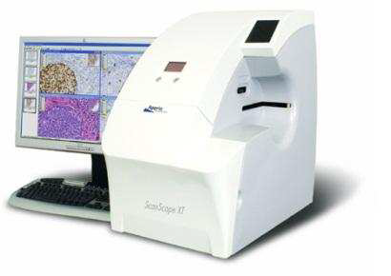
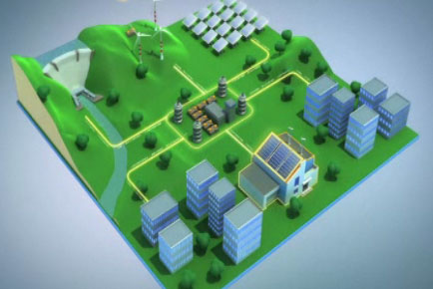
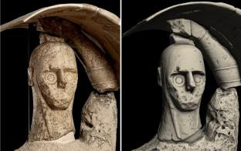
About CRS4
CRS4, Center for Advanced Studies, Research and Development in Sardinia, is an interdisciplinary research center that promotes the study, development and application of innovative solutions to issues in natural, industrial and social environments.
These developments and solutions are based on Computational Science, Information Technology and High-Performance Computing.
The main goal is innovation through e-science

Slide 3
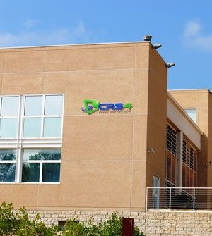
About CRS4
CRS4 was founded by the Sardinia Autonomous Region in 1990, initially headed by the Nobel Prize in physics Carlo Rubbia currently has a staff of about 150-200 researchers.
The aim of the Centre is to study, develop and apply innovative solutions using highly specialized skills and knowledge. On this basis, the CRS4 cooperates with academic, scientific and industrial entities, participating in relevant national and international projects.
CRS4 is located at the Science and Technology Park of Sardinia in Pula, in the province of Cagliari, Italy.
The Park is a network of advanced infrastructures and services for innovation and the development and industrialization of research. It is located in an area of 160 hectares, immersed in a natural park, at the foot of the mountain massif of the Sulcis.

Slide 4
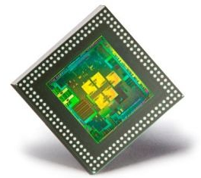
CRS4 at a glance
The activity of the Centre is based on 3 main areas that combine high technology and international vision with support and technology transfer to the local environment:
Research and development
ICT and computational sciences
Enabling technologies
Infrastructure
HPCN: a top level computer centre with important features (hybrid systems, visualization, etc.) and broadband network connectivity
NextGen Sequencing: major Italian centre, among the first in Europe
Support to the local environment
Cooperation and integration (universities, municipalities, National Research Council, INAF, SRT, DASS, etc.)
Higher education, technological transfer to local companies

Slide 5
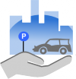
Recent R&D activity related to smart cities
NETFFICIENT
Smart grids, energy storage, smart communities, meteo
PATH (Pathology in Automated Traceable Healthcare)
Smart health, personal medicine, med workflow
Cagliari2020
Infomobility, urban information grid
CagliariPort2020
Smart nodes (city, port, airport), logistic tracking
Handy Parking
Video surveillance, infomobility

Slide 6
From smart cities to a smarter island
Regional control room for innovation initiatives
Energy, transportation, ICT, aerospace, tourism, etc.
Very good network infrastructure (soon becoming exceptionally good)
Large regional fiber optic networks and MANs
By 2020 everyone with >30mbps and 85% >100mbps
High skilled people
Two universities, many research institutions, ICT eco-system
Sardinia population is not very dense
Area of 24000 km², population of 1.6 mln, 377 cities
Population density of 69/km² (London >5000, Rome >2000)
Sardinia is becoming a test field
for smart city initiatives and solutions deployment.
Many hi-tech companies are localizing R&D in Sardinia

