Slide 1

“Homologation Procedures & Type Approval
Testing for Mobile Terminals for ARB Region”
Tunisia, 20-24 April 2015
Presented by: Mr Zied SALHI

Slide 2
Plan
Objective
Introduction
Procedure
Approval Methodology
Different types of devices
Standards
Tests and measurements
Measuring devices
Recommendations
Conclusion
Presented by: Mr Zied SALHI

Slide 3
Objective
Detail procedures, administrative and technical mechanisms related to the activity of Type Approval of telecommunications terminals
Presented by: Mr Zied SALHI

Slide 4
Introduction
Every modern country organizes the local telecommunications sector via organizations and definite regulations.
Telecommunications Standards and procedures for local country must be consistent and aligned with the organizations and international standards of regulation in the sector.
Presented by: Mr Zied SALHI

Slide 5
Introduction
Each country including telecommunications networks with all their components, and having defined a national frequency plan must have, obviously, a telecommunications terminal approval body .
The approval process ensures conformity of telecommunications terminals connecting to the Access Network with the requirements of the country's network, national and international standards and to national frequency plan
Presented by: Mr Zied SALHI

Slide 6
Procedure
Approval definition
The approval is the set of control operations and necessary tests, by which CERT ascertains and certifies that a representative sample of telecommunications terminal equipment or radio equipment complies with regulations, standards and technical specifications.
Presented by: Mr Zied SALHI

Slide 7
Procedure
Type Approval definition
Are subject to approval any terminal equipment or radio installation to be connected to a public network.
Terminal equipment : Any device, any system or group of system, designed to be connected to an endpoint of a network and transmits, receives or processes telecommunications signals.
Radio Equipment : Any telecommunications system that uses radio frequencies for wave propagation in free space
Presented by: Mr Zied SALHI

Slide 8
Procedure
Definition of compliance
All operations that focus on the verification of the compatibility of the technical characteristics of the equipment with the technical requirements of interworking with public telecommunications networks and rules for use and operating frequency, it is intended for individual people (Equipment imported for public use).
Presented by: Mr Zied SALHI

Slide 9
Procedure
Definition of Technical Control
Approval is always followed by a process of technical control during importation (border), on the basis of a certificate of approval, which ensures the compliance of imported products with the samples approved.
Presented by: Mr Zied SALHI

Slide 10
Procedure
Objective
Approval aims to :
Verify compliance of terminal equipment or radio equipment with needed requirements
User safety
Security of staff operating in public telecommunications networks
Presented by: Mr Zied SALHI

Slide 11
Procedure
Objective
Protection of networks and information exchanged
Optimum use of the radio spectrum.
interoperability of the terminal equipment with the network and with other terminals accessing same service.
Presented by: Mr Zied SALHI

Slide 12
Approval Methodology
The customer presents the product to be approved to the One Stop Shop (OSS)
The OSS examines the administrative request of the customer, then it transmits it to Type Approval Lab (CERTLABS)
Presented by: Mr Zied SALHI

Slide 13
Approval Methodology
A second preliminary engineering study is made by CERTLabs experts that includes:
Verification of technical specifications of the equipment presented
Verification of certificates of compliance and report tests of the manufacturer
Verification of the smooth functioning of the equipment presented
The definition of the tests to be performed
Presented by: Mr Zied SALHI

Slide 14
Approval Methodology
Tests and measurements
Generation of Approval report
Elaboration of the approval certificate (fail or pass) based on the recommendations in the written approval report
Closing process
Presented by: Mr Zied SALHI

Slide 15
Documents supplied by lab
Test report
Technical Request
Presented by: Mr Zied SALHI

Slide 16
Problems encountered during test
The equipment is defective
Missing of accessories (power, driver, cables ... etc)
The equipment interfaces are inaccessible
Equipment require an internal configuration (eg: access points or Smartphones)
Presented by: Mr Zied SALHI

Slide 17
Technical Request
The objective of sending a technical request to the customer is to invite him to solve the problems encountered during testing.
It sent by lab to the OSS and thereafter OSS sends to the customer
The customer can intervene in the lab to unlock situations (hardware configuration, inaccessibility ..) or to retrieve his equipment and intervene in its locale.
The Approval request closes with a negative decision after sending 6 TR
Presented by: Mr Zied SALHI

Slide 18
Technical Request
The Technical request contain:
Reference OSS
Reference lab
The brand, model and product name
The customer name
Tests made
The problems encountered
The recommendations of the lab
Date
The names of the engineers and their signatures
Presented by: Mr Zied SALHI

Slide 19
Test Report
It contains:
Reference OSS
Reference lab
The brand, model and product name
The customer name
Standards and references of studies
Application fields
Identification and description of the equipment and customer
Product specifications
Presented by: Mr Zied SALHI

Slide 20
Test Report
Tests and measurements made and results
The final recommendations of the lab (successful or unsuccessful)
Measurement reports and tests and picture of equipment
Date
The names of the engineers and their signatures
Note: The test report is sent to OSS, and based on the recommendation of the lab, the OSS issues a certificate of positive or negative approval signed by the General Manager of CERT.
Presented by: Mr Zied SALHI

Slide 21
Different types of devices
Each telecommunication network contains components of different types that include several types of equipment:
Radio Components
Transmission components
Switching components
Computer components
Presented by: Mr Zied SALHI

Slide 22
Different types of devices
Each telecommunication network also contains different types of connections:
The wired links
Radio links
Optical links
A telecommunication terminal may interface with the telecommunications network via one or more connections types
Presented by: Mr Zied SALHI

Slide 23
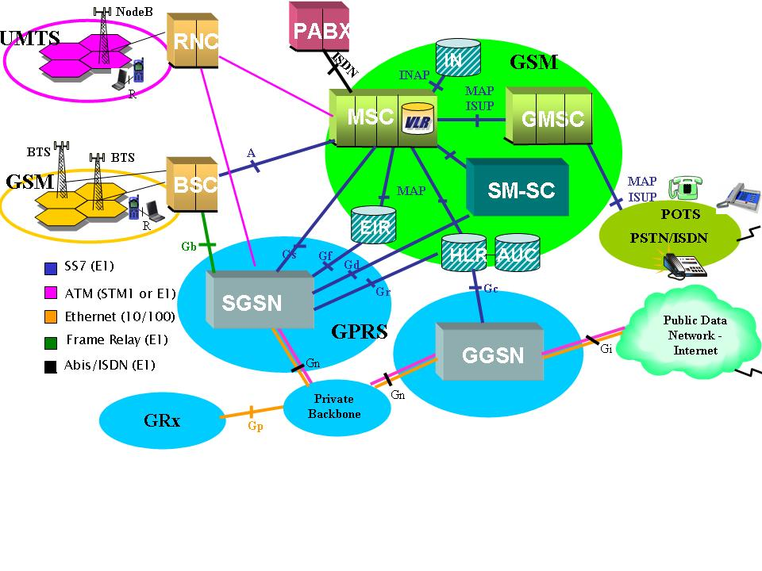
Different types of devices
Presented by: Mr Zied SALHI

Slide 24
Different types of devices
Fixed terminals:
Fixed terminals of a telecommunication network are wired terminals, IP terminals, ADSL terminals ... (The telephones, routers, modems ....)
Presented by: Mr Zied SALHI

Slide 25
Different types of devices
Mobile teminals:
Mobile telecommunications terminals occupy a very wide and extensive range
These terminals can be transmitters / receivers, Bluetooth, WIFI, GSM, HSDPA, UMTS, GPS, geo-location equipment, the signal converter equipment .......
Presented by: Mr Zied SALHI

Slide 26
Standards
Define:
Frequency bands allocated to radio equipment
The maximum power and fields allowed
The occupancy rate of the spectral band
Ensuring coexistence between different users of radio waves
Presented by: Mr Zied SALHI

Slide 27
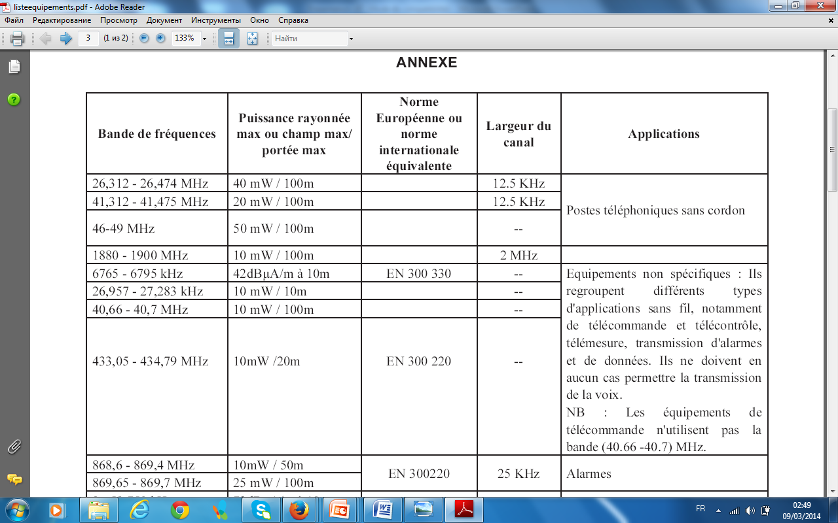
Standards
Presented by: Mr Zied SALHI

Slide 28
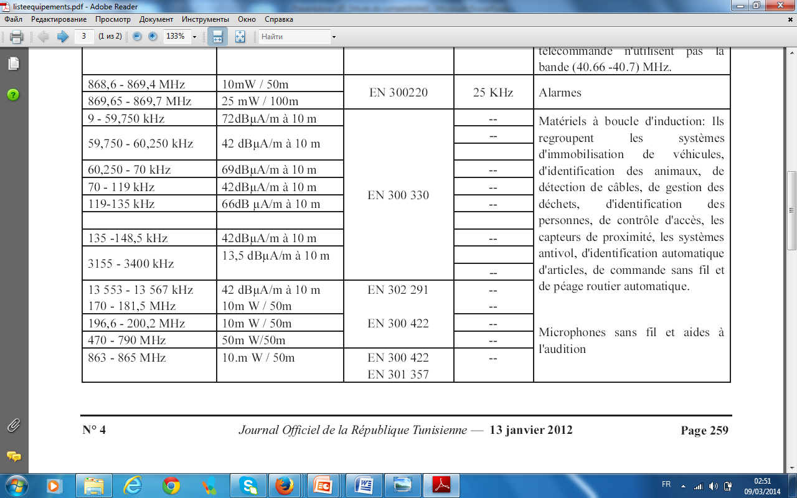
Standards
Presented by: Mr Zied SALHI

Slide 29
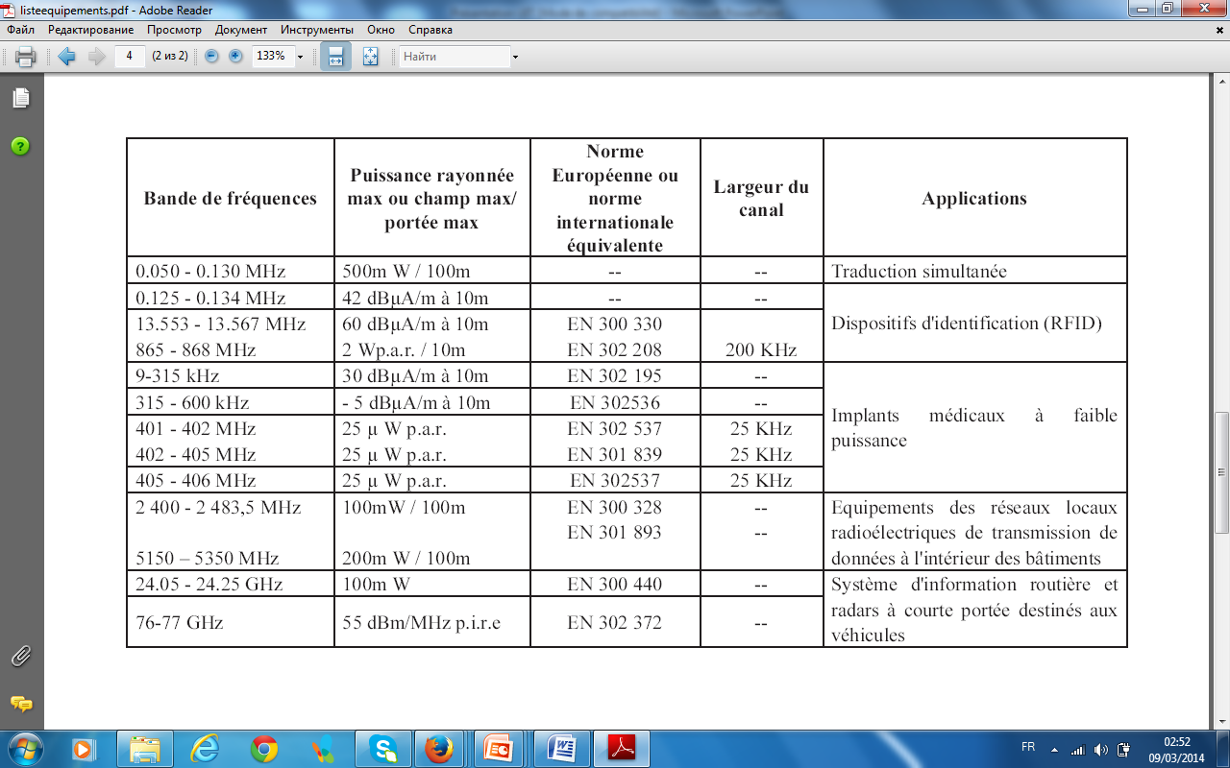
Standards
Presented by: Mr Zied SALHI

Slide 30
Tests and Measurements
Definition
By applying the appropriate standard and with a set of measuring instruments and test benches, we ensure the conformity of the equipment under test, submitted for approval, compared to standard that supports them
Presented by: Mr Zied SALHI

Slide 31
Tests and Measurements
Measurements
Among the tests and measurements performed during the approval of a telecommunication terminal :
Verification of the frequency band
Measuring the frequency error
Measurement of the emitted power
Measurement of reception levels
Measurement of BER (bit error rate)
Measurement of internal impedance
Presented by: Mr Zied SALHI

Slide 32
Tests and Measurements
Functional test
During the approval, all telecommunication terminals are subject to functional tests in terms of commissioning and testing of the product and its smooth functioning
Presented by: Mr Zied SALHI

Slide 33
Measuring devices
Agilent Technologies 8960 Series 10
The test bench of a GSM terminal consists of three essential components:
Simulator test radio (eg Agilent 8960)
computer
A test application installed on the computer (eg WTM)
A link between these components is necessary USB / GPIB
Presented by: Mr Zied SALHI

Slide 34
Measuring devices
Agilent Technologies 8960 Series 10
A detailed test report is delivered by this instrument and it contains:
Date / time
Name of operator
The reference measuring device
IMEI of the EUT
IMSI of the SIM card test
All parameters tested with the measured values ​​and test results (pass or failed)
Presented by: Mr Zied SALHI

Slide 35
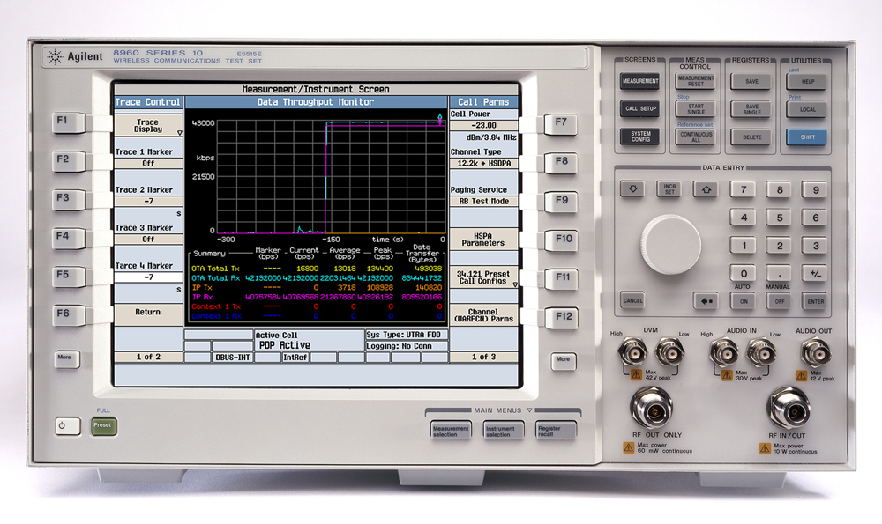
Measuring devices
Agilent Technologies 8960 Series 10
Presented by: Mr Zied SALHI

Slide 36
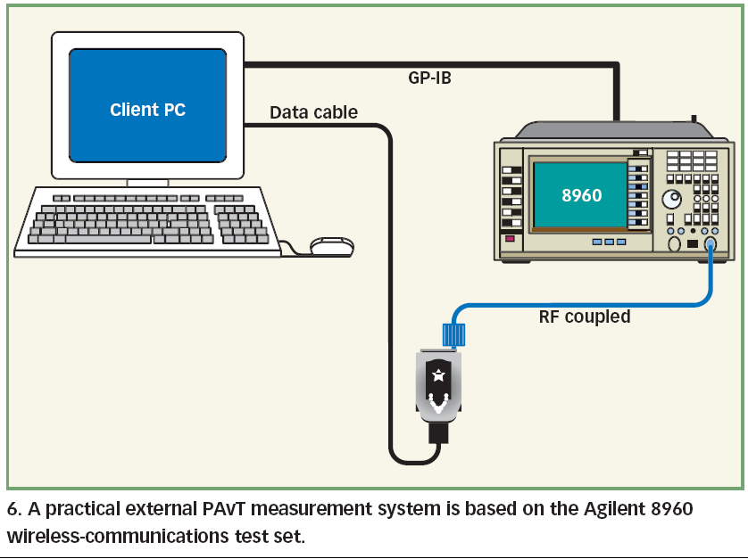
Measuring devices
Agilent Technologies 8960 Series 10
Presented by: Mr Zied SALHI

Slide 37
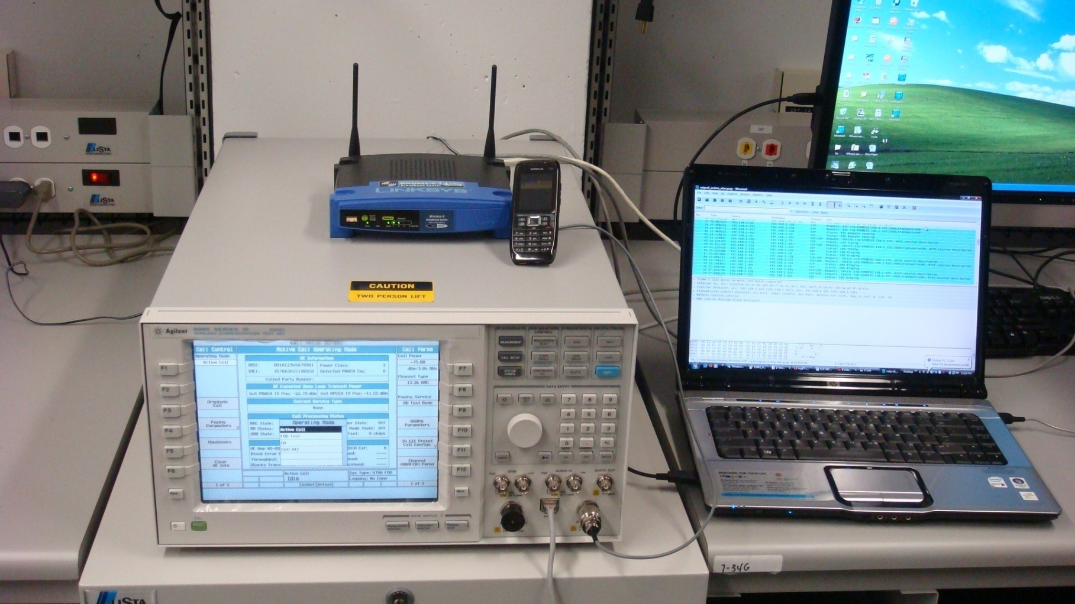
Measuring devices
Agilent Technologies 8960 Series 10
Presented by: Mr Zied SALHI

Slide 38
Measuring devices
Wavetek 4107
As for the approval of a GSM terminal, technical control testing requires a radiated radio simulator mode, it’is not conducted mode and we take a minimum number of tests (Wavetek 4107)
Presented by: Mr Zied SALHI

Slide 39
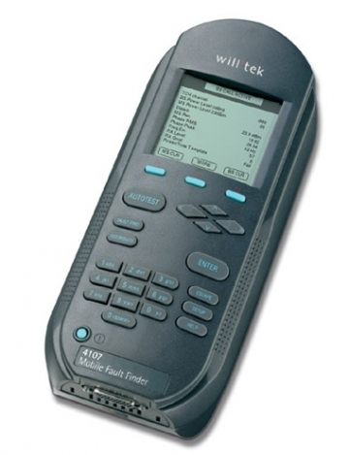
Measuring devices
Wavetek 4107
Presented by: Mr Zied SALHI

Slide 40
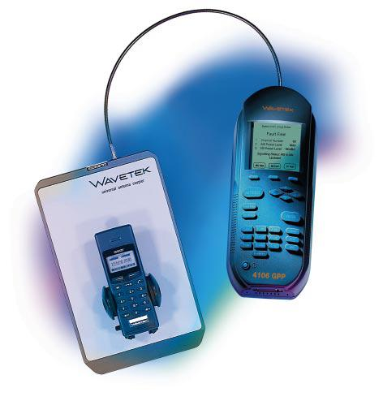
Measuring devices
Wavetek 4107
Presented by: Mr Zied SALHI

Slide 41
Measuring devices
Spectrum Analyzer
A spectrum analyzer is a measuring instrument for displaying the different frequencies contained in a signal and their respective amplitudes. The signals can be of various types: electrical, optical, acoustic, radio
Presented by: Mr Zied SALHI

Slide 42
Measuring devices
Spectrum Analyzer
A digital spectrum analyzer used to measure the voltage of electric signals in the frequency domain. The measurements can range from a few tenths of Hz to several tens of GHz.
For the approval of telecommunications terminal a spectrum analyzer (0-60GHz) can support all types of products to be approved
Presented by: Mr Zied SALHI

Slide 43
Measuring devices
Spectrum Analyzer
Among the things to check :
The frequency band
The transmission power
Channel spacing
The number of channels
Presented by: Mr Zied SALHI

Slide 44
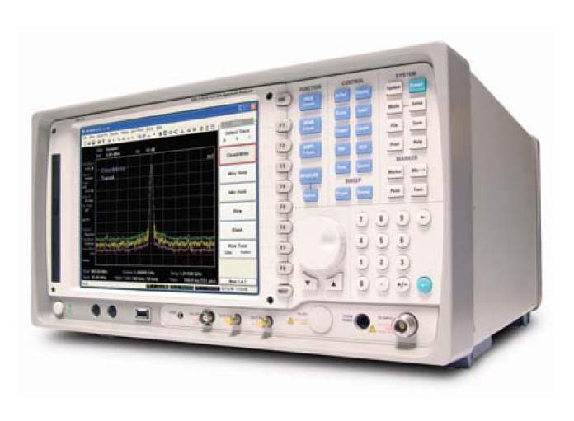
Measuring devices
Spectrum Analyzer
Presented by: Mr Zied SALHI

Slide 45
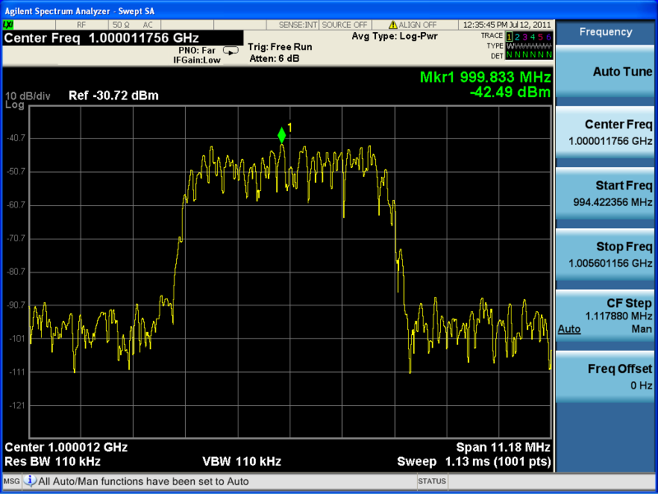
Measuring devices
Spectrum Analyzer
Presented by: Mr Zied SALHI

Slide 46
Measuring devices
An check of the parameters of the analyzer is made before each measurement:
The frequency band (frequency of start and end)
Spam
The amplitude of signal
We must choose the values ​​of these parameters for good and reliable results
Presented by: Mr Zied SALHI

Slide 47
Measuring devices
Power meter
The power meter is a device that measures the electrical power consumed by a receiver or supplied by an electric generator.
The power meter is used in Approval activities to measure the minimum and maximum output power for Radio equipment
Presented by: Mr Zied SALHI

Slide 48
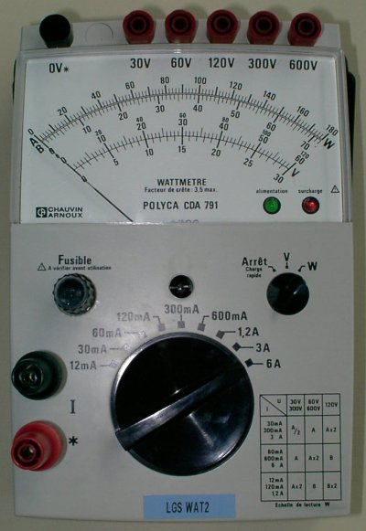
Measuring devices
Power meter
Presented by: Mr Zied SALHI

Slide 49
Practices
3 practices are programmed in the LABCERT on Radio test benches:
Wavetek 4107:
Make the measurement of a GSM terminal
Knowing the parameters to be tested and the required limits
Diagnose the test report issued by the measuring device

Slide 50
Practices
Agilent 8960
Make the measurement of a GSM terminal
Knowing the parameters to be tested and the required limits
Diagnose the test report issued by the measuring device
Knowing the different test plans required
Knowing the difference between the tests in radiated and conducted mode

Slide 51
Practices
Spectrum Analyzer
Make practical on this unit for measuring a wireless terminal
Have an idea on radio measurement teschniques
Knowing the setup of parameters of the measuring device
diagnose the test report issued by the measuring device
Knowing the difference between the tests in radiated and conducted mode

Slide 52
Recommendations
The foundation of a certification service must be overwhelming followed by three other services: standardization, technology monitoring and training, quality
Service standards: it ensures the development and monitoring of standards and national and international requirements. It develops very specific reports to be followed by laboratory technicians
Presented by: Mr Zied SALHI

Slide 53
Recommendations
The technology monitoring and training service which provides:
1- Monitoring of all new technologies
2- The annual training plan development for laboratory technicians
Quality Service : it ensures the implementation and updating of approval procedures and preparation of means of accreditation and ISO.
Presented by: Mr Zied SALHI

Slide 54
Conclusion
The approval process in a country is a very necessary step for the safety of the state, final consumers and the proper functioning of its telecommunication network.
But it must not be an economic and regulatory obstacles for investors and traders.
So we must put this project in place with flexible and reliable procedures.
Presented by: Mr Zied SALHI

Slide 55
THANKS
Presented by: Mr Zied SALHI

