Slide 1

IMT evolution: Toward 5G Systems
Joaquin RESTREPO
Head OPS Division
Radiocommunication Bureau
ITU – PITA Pacific Radio Communication Workshop 2019 (PRW-19)
Coral Coast, Fiji, 11 – 12 April 2019

Slide 2
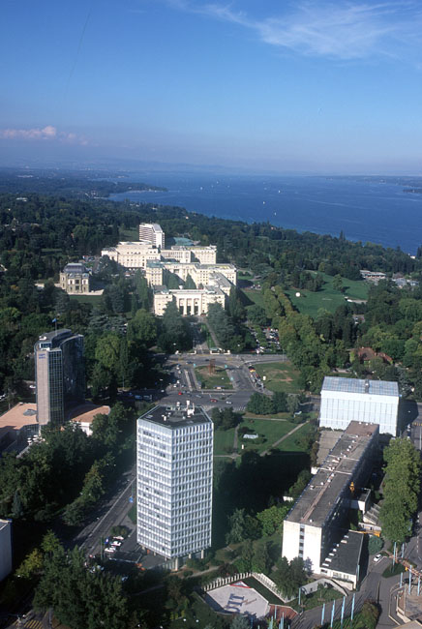

International Telecommunication Union Website: www.itu.int
193 Member States
155 Academia Members
700 staff / 70 nationalities
536 Sector Members
and 191 Associates
United Nations specialized agency for information and communication technologies – ICTs:
allocate global radio spectrum and satellite orbits,
develop the technical standards that ensure networks/technologies interconnect,
strive to improve access to ICTs to underserved communities worldwide.

Slide 3
Broadband Access: Fixed vs. Mobile
0%
Broadband Networks
100%
Fixed
Mobile
Satellite
Broadband services require an infrastructure of networks. 3 types of final access (last km, last mile):
Fixed: copper, coaxial, fiber
Wireless (Terrestrial): cellular, Wi-Fi?
Satellite
Broadband penetration is topped by the penetration of these networks

Slide 4
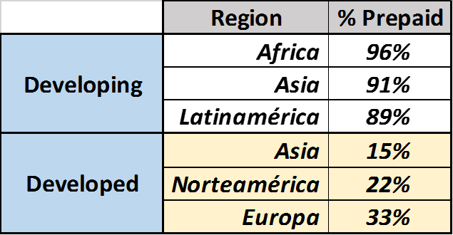
Broadband Access: Fixed vs. Mobile
Fixed Networks in slight decline
Mobile Networks in high growth, near saturation
increasing Gap between developed and developing world.
Broadband Universal Service in developing world: Mobile & Prepaid

Slide 5
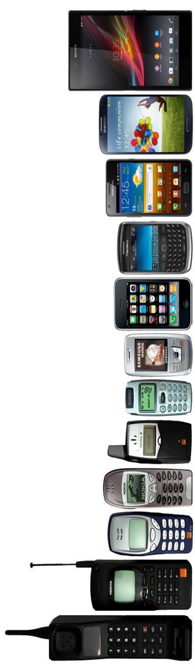
Mobile Networks Evolution
5G (IMT2020)
.
.
4 Years
.
.
2016
2012
.
.
5 Years
.
.
For over 30 years, ITU has been developing the standards and spectrum arrangements to support International Mobile Telecommunications (IMT)
2007
.
.
.
7 Years
.
.
.
2000
.
.
.
.
10 Years
.
.
.
.
1990

Slide 6
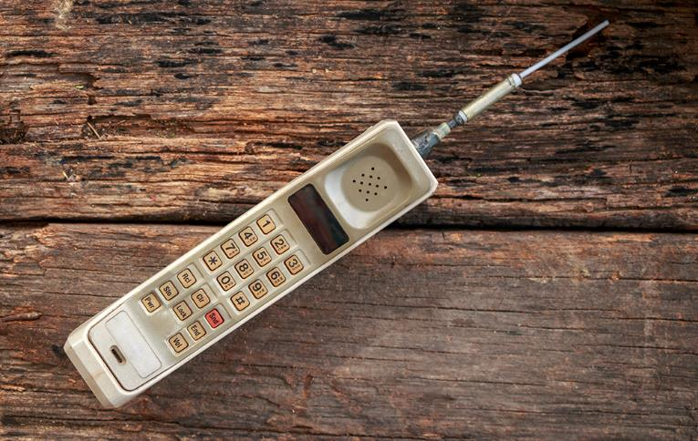
First Generation (1G)
1G analogue systems provided two key improvements over the first radiotelephone services:
the invention of the microprocessor; and
digitization of the control link between the mobile phone and the cell site.
1970s
Frequencies for mobile services allocated
in the Radio Regulations

Slide 7
Second Generation (2G)
2G systems digitized not only the control link
but also the voice signal - better quality and
higher capacity at lower cost.
Regional/global operation was hampered by:
- multiple incompatible standards;
- different frequency bands and channels
in different parts of the world.
1980s-1990s
ITU-R develops the international mobile telecommunication system (IMT) to address these issues – first global IMT frequencies identified at WRC-92

Slide 8
IMT-2000 – Third Generation (3G)
ITU’s IMT-2000 global standard for 3G unanimously approved at the ITU Radiocommunication Assembly 2000 – digital voice and data.
Global standard and harmonized frequencies:
- global roaming;
- massive economies of scale;
- innovative applications and services.
2000s
WRC-2000 and WRC-07 identify additional frequency
bands for IMT in the Radio Regulations

Slide 9
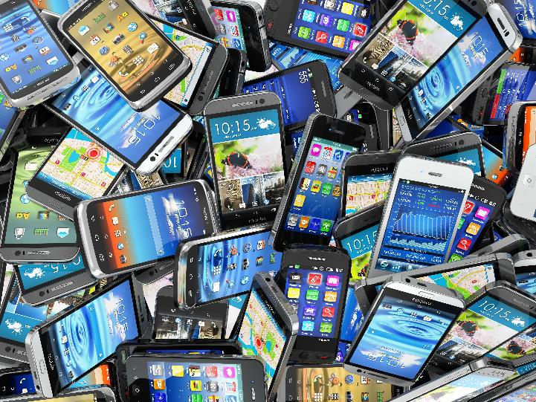
IMT-Advanced – Fourth Generation (4G)
IMT-Advanced specifications approved at the ITU Radiocommunication Assembly 2012 - packet-based, multi-media, high data rates.
Mobile broadband becomes the main method of accessing the Internet
2010s
WRC-15 harmonizes and identifies additional frequency
bands for IMT in the Radio Regulations

Slide 10
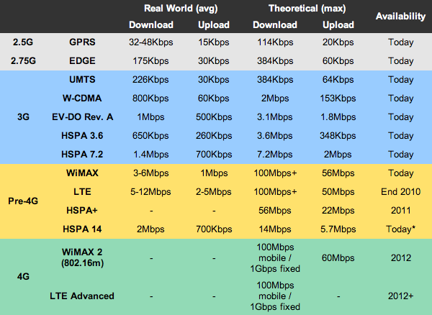
1G → 2G : Analog to Digital
2G → 3G : Narrowband to Broadband
3G → 4G : Broadband evolution (Multimedia)
4G → 5G : High Broadband to connect People and machines
2G→3G Transition
3G→4G Transition
4G→5G Revolution
Figure taken from: http://sudhakarreddymr.wordpress.com/2011/06/01/difference-between-1g-2g-2-5g-3g-pre-4g-and-4g/

Slide 11
IMT Definition
IMT Concept*
From: Recommendation ITU-R M.1224*
International Mobile Telecommunications (IMT) systems are mobile systems that provide access to a wide range of telecommunication services including advanced mobile services, supported by mobile and fixed networks, which are increasingly packet-based
IMT systems support low to high mobility applications and a wide range of data rates in accordance with user and service demands in multiple user environments. IMT also has capabilities for high quality multimedia applications within a wide range of services and platforms, providing a significant improvement in performance and quality of service.
*
,
IMT encompasses both IMT-2000 & IMT-Advanced, …and IMT-2020
* 1st release ITU-R M.1224-0 (02-97); current version ITU-R M.1224-1 (03-12)

Slide 12
IMT Key Features
From: Recommendation ITU-R M.1224
A high degree of commonality of functionality worldwide while retaining the flexibility to support a wide range of services and applications in a cost efficient manner;
Compatibility of services within IMT and with fixed networks;
Capability of interworking with other radio access systems;
High quality mobile services;
User equipment suitable for worldwide use;
User-friendly applications, services and equipment;
Worldwide roaming capability;
Enhanced peak data rates to support advanced services and applications.
These features enable IMT to address evolving user needs and the capabilities of IMT systems are being continuously enhanced in line with user trends and technology developments

Slide 13
IMT Requirements
From: Recommendation: ITU-R M.1822-0 (10/2007)
Seamless connectivity
Mobility management
Interoperability
Constant connection
Application scalability
Security
Prioritization
Location
Broadcast/multicast
Presence
Usability
Voice recognition
User-friendly human-to-machine interface
Support for a wide range of services

Slide 14
IMT and Mobile Labels
- IMT: Devised within ITU through the work of ITU Study Groups (worldwide participation, amongst all stakeholders: Regional Organizations, Regulators, operators, manufactures, universities and R&D Centers,, etc.)
Unique set of Definitions and Specifications (through ITU-R publications)
IMT encompasses all its versions: IMT2000, IMT-Advanced, IMT 2020
- xG: Devised by operators and mobile community.
There is no unique set of definitions and specifications.
________________________________________________
- IMT-2000 and 3G: there was consensus about matching both these concepts and associated specifications.
- IMT-Advanced and 4G: no consensus was reached:
Some Regulators demanded that a 4G brand must comply with
IMT-Advanced specifications.
Other Regulators recognized 4G as those technologies providing an enhanced performance in comparison to IMT-2000 Specifications.
___________________________________
IMT-2020 and 5G: consensus achieved

Slide 15
4G Roll-outs at the global level
Towards 5G: 4G Roll-outs at the Global level
 | Region | No countries | Total # Countries | % region | No. Net-works | %Total 4G NWs | Average No. networks/ country
1 | Africa | 27 | 52 | 52 | 68 | 9.8% | 2.5
2 | Americas | 25 | 37 | 67.6 | 129 | 18.6% | 5.2
3 | Asia | 39 | 45 | 79.6 | 188 | 27.1% | 4.8
4 | Europe | 43 | 49 | 95.6 | 276 | 39.8% | 6.4
5 | Oceania | 8 | 15 | 53.3 | 32 | 4.6% | 4.0
 | Total | 142 | 198 |  | 693
4G roll-outs by region (Source: ITU)
Source: ITU, GSMA.
Notes:
ITU estimates that, by the end of Q1 2016, 142 ITU Member States had deployed a total of 693 4G networks, with steady growth in 4G/LTE networks since 2011. In terms of networks, Europe accounts for nearly 40% of all 4G networks deployed, although roughly as many countries as Asia – but this percentage is falling all the time.
Some unusual/unexpected countries – Benin, Cote d’Ivoire and Guinea-Bissau have deployed 4G. For example, Gabon Telecom has extended 3G and 4G coverage of its networks to 21 major towns in all nine provinces.
Equally, there are some countries missing – Egypt, Viet Nam.
In China, China Mobile was planning a city-by-city roll-out of VoLTE services in 145 cities by end 2015 – intending to go very fast.
But…. mainly in urban centres with pre-existing 3G services.
At the global level, operators are tending to layer in additional connectivity where it exists already, rather than provide new connections

Slide 16
5G Usage scenarios
Notes:
Three main usage scenarios for IMT-2020 have been identified in Recommendation ITU-R M.2083, “IMT Vision – Framework and overall objectives of the future development of IMT for 2020 and beyond,” which are enhanced mobile broadband, ultra-reliable and low latency communications, and massive machine-type communications. Additional use cases are expected to emerge, which are currently not foreseen. For future IMT, flexibility will be necessary to adapt to new use cases that come with a widely varying range of requirements.
IMT-2020 will encompass a large number of different features. Depending on the circumstances and the different needs in different countries, future IMT systems should be designed in a highly modular manner so that not all features have to be implemented in all networks.
This figure illustrates some examples of envisioned usage scenarios for IMT-2020.

Slide 17
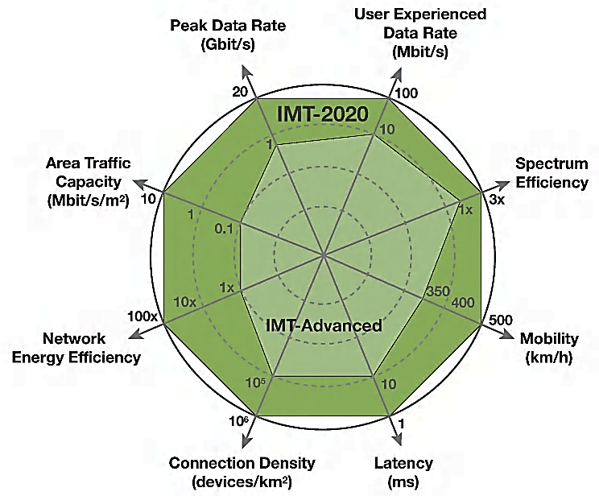
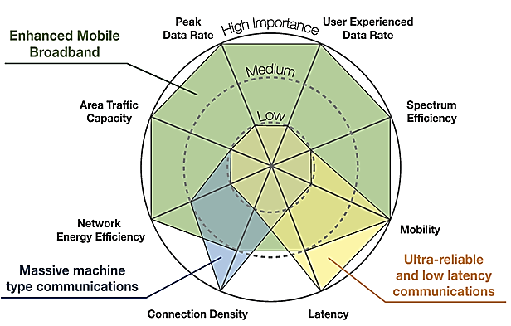
5G Capability Perspectives from the ITU-R IMT-2020 Vision Recommendation
Enhancement of key capabilities
from IMT-Advanced to IMT-2020
The importance of key capabilities in different usage scenarios
The values in the figures above are targets for research and investigation for IMT-2020 and may be revised in the light of future studies. Further information is available in the IMT-2020 Vision Recommendation (Recommendation ITU-R M.2083)
Notes:
IMT-2020 systems will need to support low to high mobility applications and a wide range of data rates in accordance with user and service demands in multiple usage scenarios. IMT-2020 also needs to have capabilities for high quality multimedia applications within a wide range of services and platforms, providing a significant improvement in performance and quality of service. The key design principles of capabilities of IMT-2020 are flexibility and diversity to serve many different use cases and scenarios.
IMT is the enabler of new trends in communication devices – from the connected car and intelligent transport systems to augmented reality, holography, and wearable devices, and a key enabler to meet social needs in the areas of mobile education, connected health and emergency telecommunications. E-applications are transforming the way we do business and govern our countries, and smart cities are pointing the way to cleaner, safer, more comfortable lives in our urban conglomerates.

Slide 18

IMT-2020
Standards
Spectrum
ITU-R Study Group 5 Process
IMT-2020 Vision, overall requirements, radio interface specifications
ITU membership, other standard making bodies
Industry driven
ITU WRC Process
Mobile spectrum allocations and IMT identifications
ITU membership, ITU-R Study Groups, Regional Groups, International organisations
Member States driven
FP 2020-2023 - January 2018
Notes:
Let me describe how the ITU is building consensus around the world to enable the development of radiocommunication services, including 5G.
To exist, 5G requires spectrum and standards. Both require global cooperation. Both need to be globally harmonised.

Slide 19
IMT-2020 Standardization Process –
Where we are and what is ahead
Development Plan
Market/Services View
Technology/
Research Kick Off
Vision & Framework
Name IMT-2020
< 6 GHz Spectrum View
> 6 GHz Technical View
Process Optimization
Spectrum/Band
Arrangements
(post WRC-15)
Technical
Performance
Requirements
Evaluation Criteria
Invitation for Proposals
Sharing Study Parameters (IMT- WRC-19)
Sharing Studies (WRC-19)
Proposals
Evaluation
Consensus
Building
CPM Report (IMT- WRC-19)
Sharing Study Reports (WRC-19)
Spectrum/Band
Arrangements (WRC-19 related)
Decision & Radio Framework
Detailed IMT-2020 Radio Interface Specifications
Future Enhancement/
Update Plan &
Process
2012-2015
2016-2017
2018-2019
2019-2020
Setting the stage for the future:
vision, spectrum, and
technology views
Defining the
technologies
Notes:
The process for developing the IMT-2020 radio interface specifications is shown in this figure and is similar to the process that was successfully applied in the development of the IMT-2000 and IMT-Advanced standards. It is important to stress that the development of the IMT standards is not carried out by ITU alone. It is a highly collaborative process with substantial input from and coordination with all involved national, regional and international standards development organizations and partnerships, as well as administrations, equipment manufacturers, network operators and academia.
In essence, the process consists of developing a forward-looking perspective (the “Vision” Recommendation), developing the technical requirements to meet the vision objectives, calling for submissions of proposals to meet those requirements, assessing the proposals against a set of evaluation criteria, and harmonizing the proposals to agree on a common set of specifications and spectrum for global implementation of the system.

Slide 20
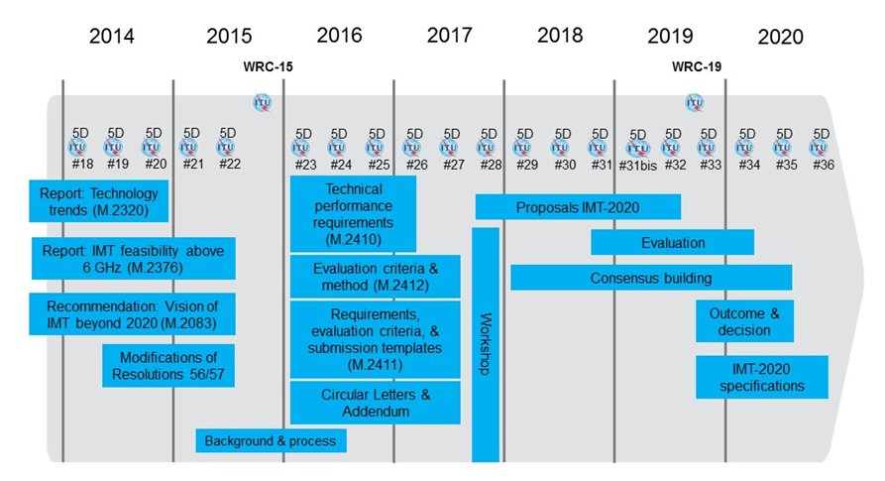
IMT-2020 standardization process
Standards
Notes:
Invitation to propose candidate radio interface technologies for IMT-2020 October 2017
Guidelines for both the procedure (methodology) and the criteria (technical, spectrum and service) to be used in the evaluation process November 2017
Submission of proposals for candidate radio interface technologies for the terrestrial components of the radio interface(s) for IMT-2020 November 2017
Independent evaluation groups started the assessment of the IMT-2020 radio interface technologies in October 2017, 11 groups active in February 2018
Deadline for submission of proposals : July 2018
Deadline for evaluation of proposals : December 2019
The timeline shown above is the timeline agreed in close collaboration with the industry as a whole as a challenging but realistic development plan.
It is closely coordinated with the development of technical specifications in external standards development organizations/partnerships.
We can anticipate that between now and 2020 when the final specifications are approved there will be many 5G technologies and elements of IMT-2020 being developed and trialed, but large-scale deployments of IMT-2020 are not expected to commence before year 2020.
The process for developing the IMT-2020 radio interface specifications is shown in this figure and is similar to the process that was successfully applied in the development of the IMT-2000 and IMT-Advanced standards. It is important to stress that the development of the IMT standards is not carried out by ITU alone. It is a highly collaborative process with substantial input from and coordination with all involved national, regional and international standards development organizations and partnerships, as well as administrations, equipment manufacturers, network operators and academia.
In essence, the process consists of developing a forward-looking perspective (the “Vision” Recommendation), developing the technical requirements to meet the vision objectives, calling for submissions of proposals to meet those requirements, assessing the proposals against a set of evaluation criteria, and harmonizing the proposals to agree on a common set of specifications and spectrum for global implementation of the system.

Slide 21
Technical performance for IMT-2020
Standards
Target values for user experienced data rate in the Dense Urban eMBB:
Minimum user plane latency:
Minimum connection density in mMTC usage scenario:
  Downlink user experienced data rate is 100 Mbit/s
  4 ms for eMBB
  1 ms for URLLC
  1 000 000 devices per km²
eMBB Enhanced mobile broadband
URLLC Ultra-reliable and low-latency communications
mMTC Massive machine type communications
Source: Draft Report ITU-R M.[IMT-2020.TECH PERF REQ] - Document 5/40 https://www.itu.int/md/R15-SG05-C-0040/en
Notes:
4.3 User experienced data rate
User experienced data rate is the 5% point of the cumulative distribution function (CDF) of the user throughput. User throughput (during active time) is defined as the number of correctly received bits, i.e. the number of bits contained in the service data units (SDUs) delivered to Layer 3, over a certain period of time.
In case of one frequency band and one layer of transmission reception points (TRxP), the user experienced data rate could be derived from the 5th percentile user spectral efficiency through equation (3). Let W denote the channel bandwidth and SE_{user} denote the 5th percentile user spectral efficiency. Then the user experienced data rate, R_{user} is given by:
R_{user} = W × SE_{user} (3)
In case bandwidth is aggregated across multiple bands (one or more TRxP layers), the user experienced data rate will be summed over the bands.
This requirement is defined for the purpose of evaluation in the related eMBB test environment.
The target values for the user experienced data rate are as follows in the Dense Urban – eMBB test environment:
– Downlink user experienced data rate is 100 Mbit/s.
– Uplink user experienced data rate is 50 Mbit/s.
These values are defined assuming supportable bandwidth as described in report ITU-R M.[IMT-2020.EVAL] for each test environment. However, the bandwidth assumption does not form part of the requirement. The conditions for evaluation are described in Report ITU-R M.[IMT-2020.EVAL].
4.7.1 User plane latency
User plane latency is the contribution of the radio network to the time from when the source sends a packet to when the destination receives it (in ms). It is defined as the one-way time it takes to successfully deliver an application layer packet/message from the radio protocol layer 2/3 SDU ingress point to the radio protocol layer 2/3 SDU egress point of the radio interface in either uplink or downlink in the network for a given service in unloaded conditions, assuming the mobile station is in the active state.
This requirement is defined for the purpose of evaluation in the eMBB and URLLC usage scenarios.
The minimum requirements for user plane latency are
– 4 ms for eMBB
– 1 ms for URLLC
assuming unloaded conditions (i.e., a single user) for small IP packets (e.g., 0 byte payload + IP header), for both downlink and uplink.
4.8 Connection density
Connection density is the total number of devices fulfilling a specific quality of service (QoS) per unit area (per km²).
Connection density should be achieved for a limited bandwidth and number of TRxPs. The target QoS is to support delivery of a message of a certain size within a certain time and with a certain success probability, as specified in Report ITU-R M.[IMT-2020.EVAL].
This requirement is defined for the purpose of evaluation in the mMTC usage scenario.
The minimum requirement for connection density is 1 000 000 devices per km².

Slide 22
IMT-2020 spectrum allocation process
WRC-19, AI 1.13: to consider identification of frequency bands for the future development of International Mobile Telecommunications (IMT), including possible additional allocations to the mobile service on a primary basis, in accordance with Resolution 238 (WRC‑15)
TG 5/1
Conduct sharing and compatibility studies in accordance with Res. 238 (WRC-15)
Develop draft CPM-text under WRC-19 AI 1.13
CPM 19-2
CPM 19-2: 18 – 28 February 2019
Switzerland, Geneva
WRC-19
WRC-19 28 October to 22 November 2019
Egypt, Sharm el-Sheikh
Spectrum allocation
WP 5D
Spectrum/band arrangements (post WRC-15)
Spectrum/band arrangements (WRC-19)
Notes:
ITU-R WP 5D is required to provide the relevant information for IMT to TG 5/1 and relevant ITU-R working parties in Study Groups 4, 5, 6 and 7 are to provide the information for the existing services, while the working parties of ITU-R Study Group 3 are to provide the radiowave propagation models.
TG 5/1 has already held one meeting on 23 – 24 May 2016 and plans to hold five more meetings during the course of 2017 and 2018 in order to complete its tasks in time for the CPM process.
While the sharing studies would indicate the possibilities for sharing between IMT applications and the existing services, and the conditions under which such sharing would be possible, the draft CPM text would provide the draft international radio regulatory solutions should an allocation to the mobile service be made and/or an identification for IMT in a particular frequency band.
Amongst other WRC-19 agenda items contained in Res. 809 (WRC-15), AI 1.13 (Res 238 (WRC-15)) is the agenda item under which additional spectrum for IMT should be identified. Under this agenda item the ITU should make provision for future spectrum requirements of IMT-2020 in the frequency range 24.25 – 86 GHz, taking into account:
– technical and operational characteristics of terrestrial IMT systems that would operate in this frequency range, including the evolution of IMT through advances in technology and spectrally efficient techniques;
– the deployment scenarios envisaged for IMT-2020 systems and the related requirements of high data traffic such as in dense urban areas and/or in peak times;
– the needs of developing countries;
– the time-frame in which spectrum would be needed;
And to conduct and complete in time for WRC 19 the appropriate sharing and compatibility studies, taking into account the protection of services to which the band is allocated on a primary basis, including primary services in adjacent band.
In Dec 2015 CPM19-1 decided that Task Group 5/1 should be established and tasked to perform the preparatory work on AI 1.13. It also defined terms of reference of the group and invited ITU-R SG 5 to establish this group as one of its sub-ordinate groups (CA/226).
At its meeting in May 2016, ITU-R SG 5 agreed to establish TG 5/1, approved the ToR and elected Ms Cindy Cook (Canada) as Chairman of the task group.

Slide 24
RADIO REGULATIONS: IMT Bands per Region

Slide 25
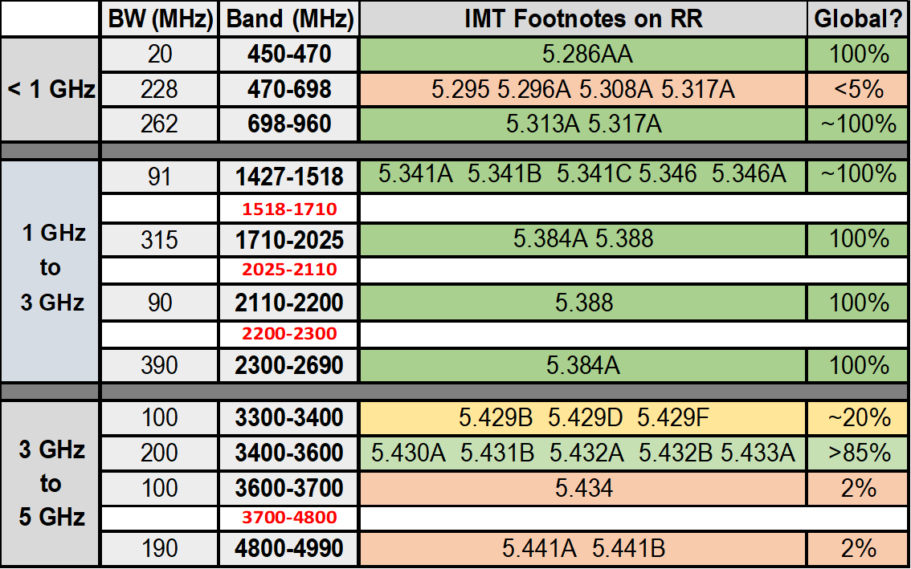
RADIO REGULATIONS: IMT Bands
All IMT footnotes indicate that: the band X MHz is identified for International Mobile Telecommunications (IMT). This identification does not preclude the use of this band by any application of the services to which it is allocated and does not establish priority in the Radio Regulations

Slide 27
IMT-2020 spectrum bands
Capacity
Extremely high data rates
Short range - Small cells
High bandwidth backhaul
Dense Urban areas
Infrastructure sharing
Coverage
Indoor coverage
Rural and Remote areas
Long range - Macro cells
Less infrastructure required
Capacity/Coverage
Bridging coverage/capacity
Urban and Suburban areas
Below 1GHz
E.g. 700 MHz
1GHz to 6GHz
E.g. 3.4 GHz
Above 24GHz
WRC-19

Slide 28
New spectrum: Bands under study for WRC-19
Notes:
WRC-15 harmonized existing and identified new frequency bands for IMT operation.
Studies are underway for WRC-19 to identify additional frequency bands for 5G IMT operation.
As can be seen, the different bands span from around 24 GHz up to 86 GHz. While some of those bands are already allocated for the operation of mobile services in the Radio Regulations, others would require a mobile service allocation in addition to an identification for operation of IMT systems.
The focus of the ITU-R studies should be to identify a limited subset of these bands that are recommended to be identified globally for use by IMT.

Slide 29
Overlapping frequency bands (GHz) between some WRC-19 agenda items
AI1.6 – NGSO FSS Res. 159 (WRC-15) | AI1.13 – IMT Res. 238 (WRC-15) | AI1.14 – HAPS Res. 160 (WRC-15) | AI9.1 (9.1.9) – FSS Res. 162 (WRC-15)
 | 24.25-27.5 | 24.25-27.5 (Reg. 2)
37.5-39.5 (S-E*) | 37-40.5 | 38‑39.5 (globally)
39.5-42.5 (S-E*) | 40.5-42.5
47.2-50.2 (E-S*) | 47.2-50.2
50.4-51.4 (E-S*) | 50.4-52.6 |  | 51.4-52.4 (E-S*)
* E-S: Earth-to-space; S-E: space-to-Earth.
Studies to address mutual compatibility & sharing feasibility among
the services/applications for which allocation/identification is envisaged
under the corresponding Res. relating to the AI in the overlapping bands

Slide 30
WRC-19 AI 1.13 sharing & compatibility studies
24.25 GHz
Incumbent services
Mobile-satellite Radionavigation-satellite service
Fixed-satellite Broadcasting-satellite
Radio astronomy
Space research Earth exploration-satellite
Inter-satellite
Earth exploration-satellite (passive) Space research (passive)
Fixed
Mobile – Multiple gigabit wireless systems
Aeronautical mobile Radiodetermination
Selected frequency bands
Mobile service
IMT-2020
86 GHz

Slide 31
Frequency bands under study for WRC-19
Spectrum
 | Frequency bands (GHz) mentioned in Resolution 238 (WRC-15) in which studies are focused/prioritized
 | 24.25-27.5 | 31.8-33.4 | 37-40.5 | 40.5-42.5 | 42.5-43.5 | 45.5-47 | 47-47.2 | 47.2-50.2 | 50.4-52.6 | 66-71 | 71-76 | 81-86
CEPT | X |  |  | X | X |  |  |  |  | X
ASMG | X | X |  | X | X
RCC | X | X |  | X |  |  |  |  |  | X
APT | X | X | X | X | X |  |  |  |  | X | X | X
ATU | X |  | X | X | X
CITEL
Reference docs:
https://www.itu.int/en/ITU-R/conferences/wrc/2019/Pages/reg-prep.aspx
APT: indication in grey reflects the views of some administrations with regards to studies /identification
ATU: frequency bands as priority candidates for IMT identification
Notes:
WRC-15 harmonized existing and identified new frequency bands for IMT operation.
Studies are underway for WRC-19 to identify additional frequency bands for 5G IMT operation.
As can be seen, the different bands span from around 24 GHz up to 86 GHz. While some of those bands are already allocated for the operation of mobile services in the Radio Regulations, others would require a mobile service allocation in addition to an identification for operation of IMT systems.
The focus of the ITU-R studies should be to identify a limited subset of these bands that are recommended to be identified globally for use by IMT.

Slide 32
5G in Developing Countries
5G in the developing world
It will undoubtedly happen, and quite rapidly once it starts.
5G issue part is of a much bigger issue – connecting the unconnected, and bridging the digital divide.
Coverage versus speed trade-off reflects a larger debate about social objectives versus ‘cherry-picking’ profitable areas.
Need a credible, viable commercial business case going forward for 5G deployments to happen in most optimal way.
Notes:
It will undoubtedly happen, and quite rapidly once it starts – still large uncertainties surrounding ‘which’ set of 5G technologies, in ‘which’ countries…

Slide 33
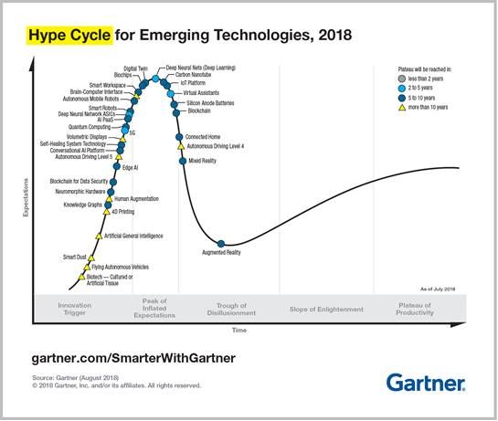
5G Cycle: down the hype to steady growth?

Slide 34

  Keep an eye in the future and another in the present
  thus
  develop 5G while prioritizing the reduction of the digital divide
  by
  fostering affordable and universal access to ICTs and telecommunication services

Slide 35

Thank you

