Slide 1
5G in Korea
ITU BDT TND
JONGHO KIM
2019. 4.12

Slide 2
CONTENTS
Relationship between the Fourth industrial Revolution and 5G
Status of 5G commercialization
Key Implementation tasks for 5G
Characteristic in 5G Services

Slide 3
Relationship between the Fourth industrial Revolution and 5G

Slide 9
Status of 5G commercialization

Slide 19
Key Implementation tasks for 5G

Slide 21
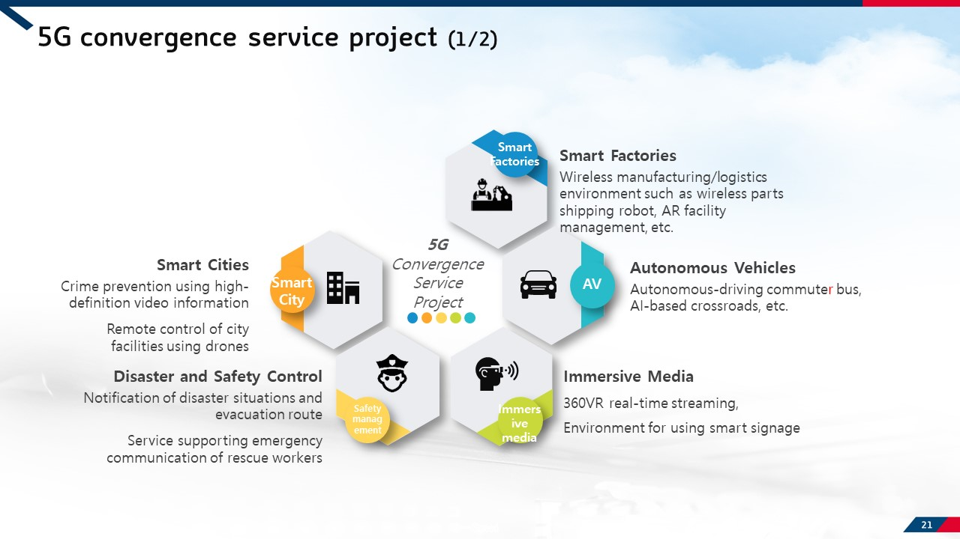

Slide 23
CHARACTERISTICS in 5G SERVICES
One Connectivity; Telco based services
B2B>B2C
CONTENTS and SERVICES; GAP BETWEEN TECHNOLOGIES AND CONTENTS
COLLABORATION with OTHER SECTORS’ INDUSTRIES
ODD and EVEN GENERATION OF MOBILE SERVICES; introducing destructive innovation and improving and spreading out innovation. 1G-mobile service, 3G-smart phone, 5G-IoT, AI

Slide 24
Thank you

