Slide 1
HIPSSA
Support for Harmonization of the ICT Policies
in Sub-Sahara Africa
28/29 August, 2013, Swaziland

Slide 2
Summary of the Content
What is Personal Information? How is it Processed?
What is Sensitive Information?
Who is a Data Subject?
Who is a Data Controller?
Who is a Data Processor?
What are the principles of data protection?
Governing Trans-border flow of personal information

Slide 3
Data Controller
“data controller” means a public or private body or any other person which or who, alone or together with others, determines the purpose of and means for processing personal information, regardless of whether or not such data is processed by that party or by a data processor on its behalf, where the purpose and means of processing are determined by or by virtue of an act, decree or ordinance, the controller is the natural person, legal person or public body has been designated as such by or by virtue of that act, decree or ordinance.

Slide 4
Data Controller – Ultimate Responsibility
“data processor” refers to a natural person, legal person, or public body which processes personal information for and on behalf of the controller and under the data controller’s instruction, except for the persons who, under the direct authority of the controller, are authorised to process the data;
“data protection officer” or “DPO” refers to any individual appointed by the data controller charged with ensuring, in an independent manner, compliance with the obligations provided for in this law;
“data controller's representative” or “controller's representative”: refers to any natural person, legal person or public body permanently established on the territory [of the concerned country], who takes the place of the data controller in the accomplishment of the obligations set forth in this law;

Slide 5
Data Controller Continued
Organisations that process personal data – data controller or data processor or representative.
Data controller – responsible for compliance including security breaches.
Contracts – statement that a supplier is acting as a data processor and confirm responsibility of data controller (customer)
Unclear
Lawyers, accountants and doctors are data controllers
Outsourced service providers are data processors.

Slide 6
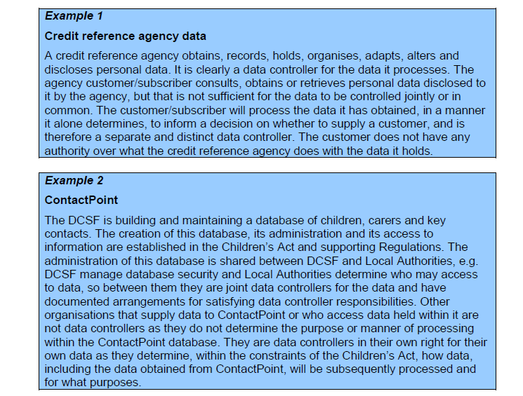

Slide 7
Defining Personal Information
information about an identifiable individual that is recorded in any form, including, without restricting the generality of the foregoing:-
information relating to the race, national or ethnic origin, religion, age or marital status of the individual;
information relating to the education or the medical, criminal or employment history of the individual or information relating to financial transactions in which the individual has been involved;
any identifying number, symbol or other particular assigned to the individual;
the address, fingerprints or blood type of the individual;
the name of the individual where it appears with other personal information relating to the individual or where the disclosure of the name itself would reveal information about the individual;
correspondence sent to a data controller by the individual that is explicitly or implicitly of a private or confidential nature, and replies to such correspondence that would reveal the contents of the original correspondence; and
the views or opinions of any other person about the individual.

Slide 8
Processing of Personal Information
processing: refers to any operation or set of operations which is performed upon personal information, whether or not by automated means, such as obtaining, recording or holding the data or carrying out any operation or set of operations on data, including –
(a) organization, adaptation or alteration of the data;
(b) retrieval, consultation or use of the data; or
(c) alignment, combination, blocking, erasure or destruction of the data
Limitations on Processing

Slide 9
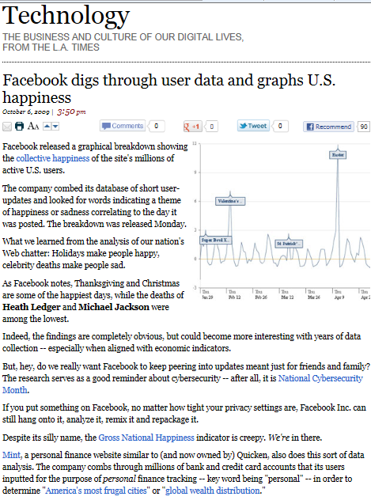

Slide 10
Sensitive Personal Information
“sensitive personal information” (a) refers to genetic data, data related to children, data related to offences, criminal sentences or security measure, biometric data as well as, if they are processed for what they reveal, personal information revealing racial or ethnic origin, political opinions, religious or philosophical beliefs, affiliation, trade-union membership, gender and personal information concerning the health or sex life of the individual (b) refers to any personal information otherwise considered by Swaziland law as presenting a major risk to the rights and interests of the data subject, in particular unlawful or arbitrary discrimination.

Slide 11
Case studies
Torbay Care Trust in Torquay was fined £175,000 after it published the sensitive details of over 1,000 employees on the Trust’s website. The data covered individuals’ names, Dates of birth, National Insurance numbers, Religion and Sexuality
We regularly speak with organizations across the health service to remind them of the need to look after people’s data. The fact that this breach was caused by Torbay Care Trust publishing sensitive information about their staff is extremely troubling and was entirely avoidable. Not only were they giving sensitive information out about their employees but they were also leaving them exposed to the threat of identity fraud.
Stephen Eckersley, Head of Enforcement

Slide 12
Case studies
Australian Privacy Commissioner case
Information was disclosed for a purpose other than the primary purpose for which it was collected, and the disclosure was not permitted by any of the exceptions
The Commissioner formed the view that the disclosure was an interference with the complainant's privacy
Conciliation and Settlement

Slide 13
What happened to the News of the World! (Case Study)
The closure of the News of the World, the best-read Sunday newspaper in the English language, is a stark illustration of the reputational and commercial damage that can result from privacy-intrusive practices carried out in the name of ‘investigative journalism’.
This case demonstrates that data protection applies even in relation to the publication of material in the media. However, in such cases, the issue to be considered in the first instance is whether a general public interest could be deemed to apply to the publication of the material. If it does then the general requirements of data protection are set aside. However, if no public interest could legitimately be claimed, then the media must have due regard to their data protection obligations

Slide 14
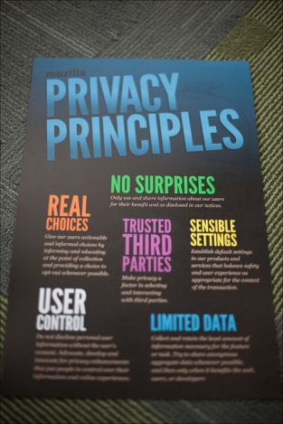
PROTECTION OF PERSONAL INFORMATION PRINCIPLES

Slide 15
Principles
A number of principles involved in data protection will be discussed and illustrated through case studies. Some cases will illustrate more than one principle:
Confidentiality:
Southampton Municipality and CCTV cameras case; The Southampton municipality had a policy that all taxis had to have CCTV cameras and audio recording. The Commissioner ruled that the processing was unlawful because it breached the confidentiality principle and that there had not been demonstrated that there was need.
Access:
Ashbury Taverns case: In this case, the Commissioner received complaint that an access request had been denied by a data processor. The Commissioner’s office issued an enforcement notice requiring Ashbury Tavern to comply with the access

Slide 16
Adequacy and legitimate purpose
Canadian Regulator v Canadian Insurance Adjusters:
Complaints were filed by consumers regarding overboard data collection approaches by Canadian insurance adjusters. The loss adjusters required claimants to sign consent forms which listed several categories of personal information which the adjusters wanted to be authorised to obtain from 3rd parties and also pass on or disclose to whomever. The Commissioner ruled that the complaint was legitimate and that an organisation was not as a condition of the supply of a service or a product, to require an individual to consent to the collection, use, disclosure of information beyond that required to fulfill the explicitly specified and legitimate purpose

Slide 17
Accountability &Security Safeguards Principle
Marks and Spenser, the safeguards case: An agent engaged by M&S lost a computer that contained valuable sensitive personal data. Commissioner ruled that M&S should have put in safeguards to protect the information

Slide 18
Fairness, lawfulness, accuracy & necessity
“Solicitors from Hell” case: Reinforces the link between lawful processing and human rights. The publisher said the EU convention on human rights gave freedom of expression and requested people to name and shame “their oppressor solicitors” and he added them to his list of “solicitors from hell” Information of a sensitive nature was contained in the publications. The law society sued the publisher. The court ruling in favour of the law society, held amongst others that the data had been processed in an unfair and unlawful manner, that it was not accurate, not necessary, etc

Slide 19
Limits of use and disclosure
Canadian Regulator v Canadian Insurance Adjusters; Complaints were filed by consumers regarding overboard data collection approaches by Canadian insurance adjusters. The loss adjusters required claimants to sign consent forms which listed several categories of personal information which the adjusters wanted to be authorised to obtain from 3rd parties and also pass on or disclose to whomever. The Commissioner ruled that the complaint was legitimate and that an organisation was not as a condition of the supply of a service or a product, to require an individual to consent to the collection, use, disclosure of information beyond that required to fulfill the explicitly specified and legitimate purpose

Slide 20
Implementation
Policy:
Privacy Policy (internal)
Privacy Policy (external)
Information Security Policy
Monitoring Policy
Records Management Policy.
Contracts:
Consent
Third Parties
Data Processors
Data Controller’s Representative
Employees/ Contractors
Assessments
Technical
Compliance Assessments

Slide 21
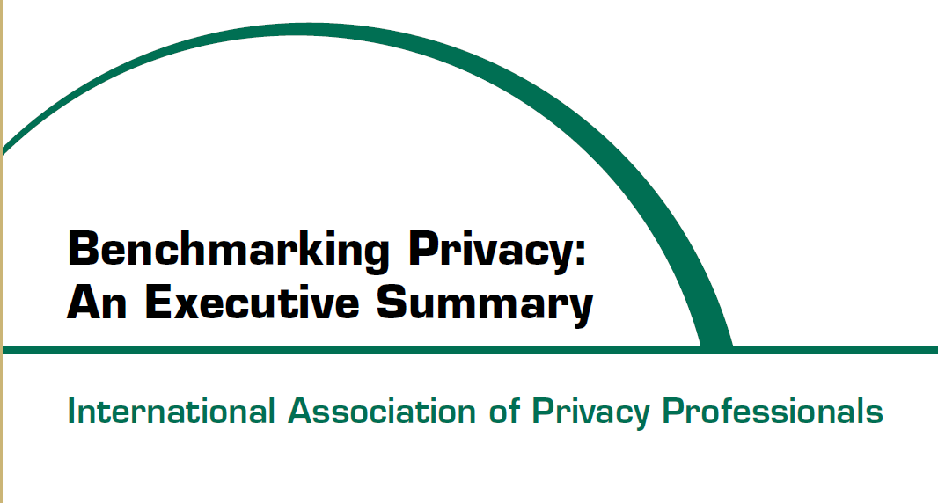

Slide 22
TRANS BORDER FLOW OF PERSONAL INFORMATION
Background to Transborder Flow
“Transborder data flow" term that arose in the 1980s following concerns in the EU regarding the value of information and the exchange of information across countries
between business units of one company, data processing services or purposes ancillary to the commercial engagement.
Includes transfer of human resources, financial records customer information: marketing and travel, and for public sector agencies (law enforcement, border controls and tax agencies).

Slide 23
Application
Adequate level of assurance
Countries - adequate level of protection – assessment
Derogation
  Data Subject Consent
  Transfer is necessary ….
  Authorisation
Criteria and Methodology for Assessments
Contracts
Three conditions in order to guarantee a minimum level of protection: the purpose limitation principle, restrictions on onward transfers and the data importers' undertaking of providing the data subjects with the rights of access, rectification, deletion and objection

Slide 24
Limitations on Trans border Flow
Member State with harmonised law:
recipient establishes that the data is necessary
for the performance of a task carried out in the public interest
pursuant to the lawful functions of a data controller
legitimate interests of the data subject not prejudiced
subject to conditions

Slide 25
Non member state with harmonised law/3rd party
adequate level of protection is ensured in the country of the recipient and the data is transferred solely to permit processing otherwise authorised to be undertaken by the controller
subject to due diligence assessment and further conditions

Slide 26
Assessment
assessed in the light of all the circumstances surrounding the relevant data transfer(s),
particular consideration to be given to the nature of the data, the purpose and duration of the proposed processing, the recipient’s country, the relevant laws in force in the third country and the professional rules and security measures which are complied with in that recipient’s country

Slide 27
Deeming by the Authority
categories of processing - transfer of personal data to countries outside (i) Swaziland (ii) SADC is not authorized
authorize a transfer or a set of transfers of personal information to a recipient country outside Swaziland or SADC which does not in its laws ensure an adequate level of protection - controller satisfies the Authority that it shall ensure adequate safeguards with respect to the protection of privacy and fundamental rights and freedoms of the data subjects concerned, and regarding the exercise of the data subject’s rights such safeguards can be appropriated through adequate legal and security measures and contractual clauses in particular

Slide 28
Thank you
Mrs. Kuena Mophethe
ITU International Expert: Data Protection Law
Kmophethe@gmail.com
Ms. Gcinaphi Mndzebele
ITU National Expert: Data Protection Law

