Slide 1

EXPERT LEVEL TRAINING ON
TELECOM NETWORK COST MODELLING
FOR THE HIPSSA REGIONS
Arusha
15-19 July, 2013
Christopher Kemei, ITU Expert

Slide 2
Sessions 15/16:
Country by country analysis in the Eastern & Southern Africa Sub-Region

Slide 3
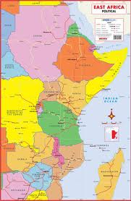
Review of cost-based regulation in …
Botswana
Djibouti
Eritrea
Ethiopia
Kenya
Lesotho
Malawi
Mauritius
Namibia
Rwanda
Seychelles
South Africa
Sudan
Swaziland
Tanzania
Uganda
Zambia
Zimbabwe

Slide 4
Analytical framework

Slide 5
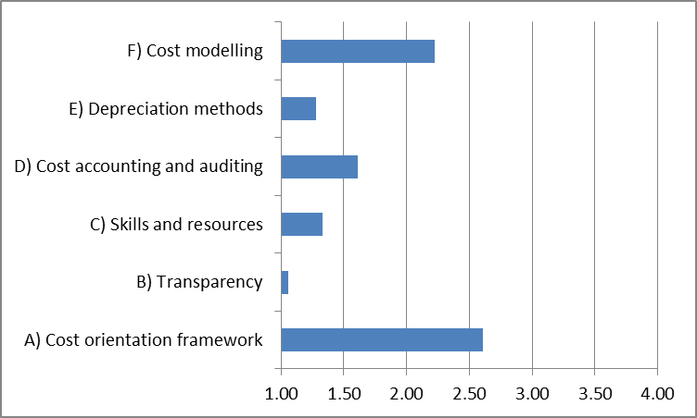
Regional overview
Scores can range from 1 to 4; higher scores represent more progress towards effective regulated cost-orientation

Slide 6
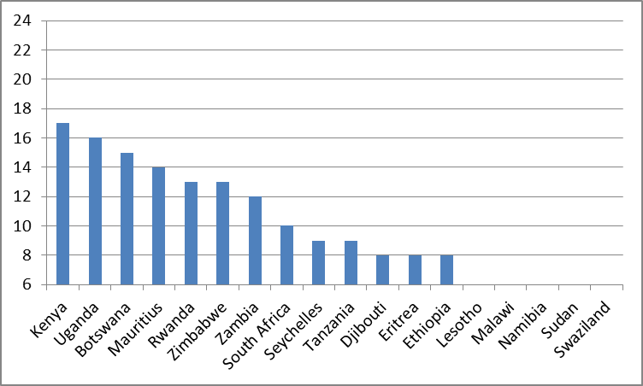
Cross-country comparison
Scores can range from 6 to 24; higher scores represent more progress towards effective regulated cost-orientation

Slide 7
Eastern & Southern Africa Sub-Region - Overall
In almost the entire sub-region the obtaining legislative framework broadly provides for cost oriented tariff regulatory framework.
However the instruments for the implementation of the broad legal framework need to be enhanced
There is also need for harmonization in view of the diverse nature of the frameworks
There is also the need for skill enhancement
There is also the need for the adoption modern costing methodologies and the adoption of modern tariff regulatory processes including transparency

Slide 8
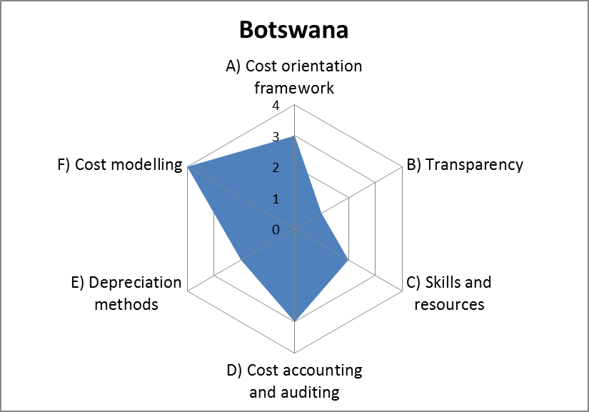
Botswana - summary

Slide 9
Botswana - comments
The Legal framework in Botswana provides for cost accounting based on forward looking incremental costs as the methodology for the determination of termination rates.
The LRIC cost model developed by consultants is used when a tariff review is due. The model is however not published.
Operators with SMP have both retail and wholesale prices subject to control
Would the representatives from Botswana like to add any comments of their own?

Slide 10
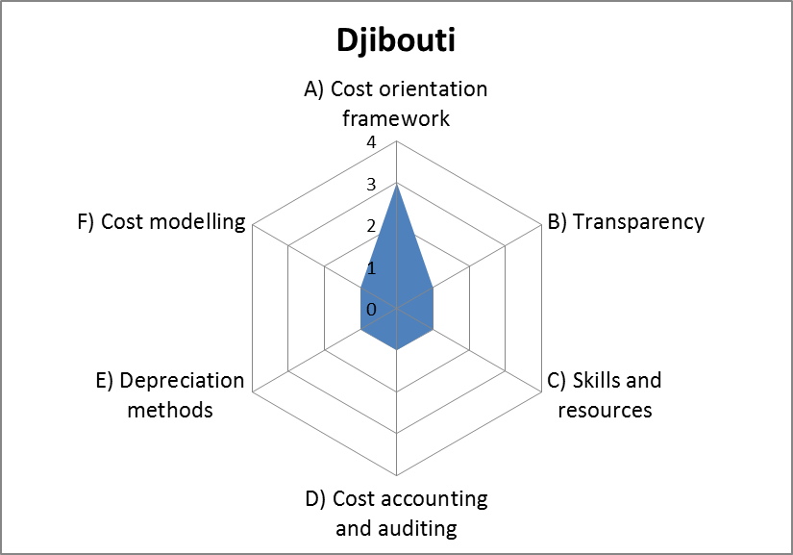
Djibouti - summary

Slide 11
Djibouti - comments
Djibouti did not participate in the HIPSSA data collection survey therefore there was insufficient data for the assessment.
However online research indicates as follows:
  That the law provides for an interconnection framework based on the principle of reasonable cost allocation.
  That there is only one operators providing both fixed and mobile services
  That tariff regulations forbids tariff that are below costs.
Would the representatives from Djibouti like to add any comments of their own?

Slide 12
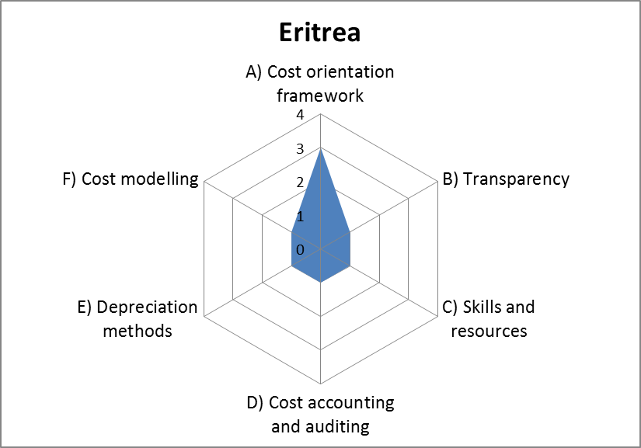
Eritrea - summary

Slide 13
Eritrea - comments
Eritrea did not participate in the HIPSSA data collection survey therefore there was insufficient data for the assessment.
However online research indicated as follows:
  The law provides for the establishment of a framework for tariff formulation (calculation).
  There is no NRA in place
  The Ministry of Transport and Communications is vested with the regulatory authority of the communications sector
Would the representatives from Eritrea like to add any comments of their own?

Slide 14

Ethiopia - summary

Slide 15
Ethiopia - comments
Council of Ministers Regulations No. 47/1999, provides for a framework for cost modelling.
  Aim to attract and sustain investment
  Prices theoretically to be based on efficient operator incremental cost
Work on cost modelling was to be started in 2012
Single incumbent operator (fixed and mobile) so arguably cost-based regulation is not relevant.
Cost accounting system is not fully implemented
Would the representatives from Ethiopia like to add any comments of their own?

Slide 16
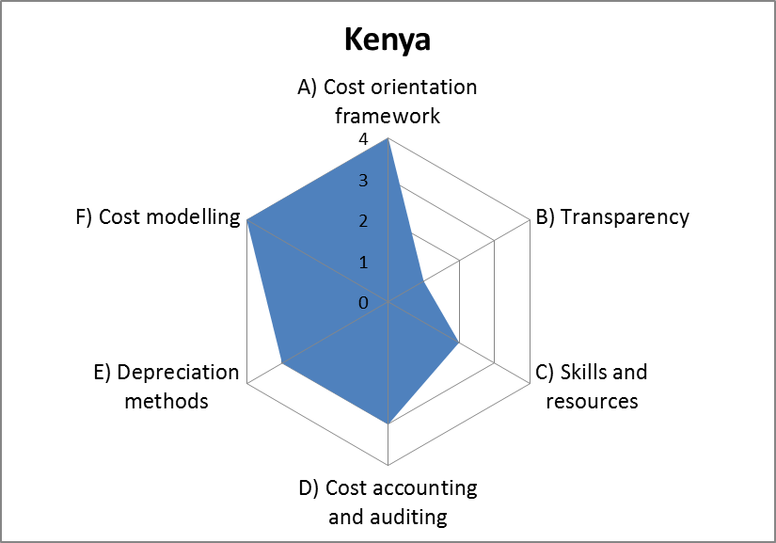
Kenya - summary

Slide 17
Kenya - comments
The sector legislation in Kenya provides for the Legal framework for regulating tariffs based on efficiency and economy
A cost model (pure LRIC) is in place but is not publicly available. Individual operators given their modules
The depreciation method used is Annuity
Would the representatives from Kenya like to add any comments of their own?

Slide 18
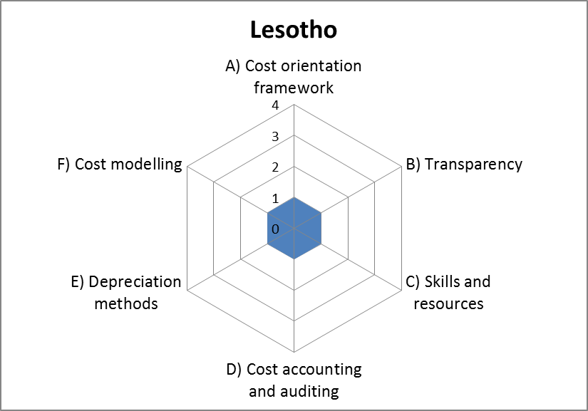
Lesotho - summary

Slide 19
Lesotho - comments
Insufficient data provided through the HIPSSA questionnaire
Cost accounting not mandated due to lack of appropriate legal framework.
There is a planned review of the law
No cost model in place.
Would the representatives from Lesotho like to add any comments of their own?

Slide 20
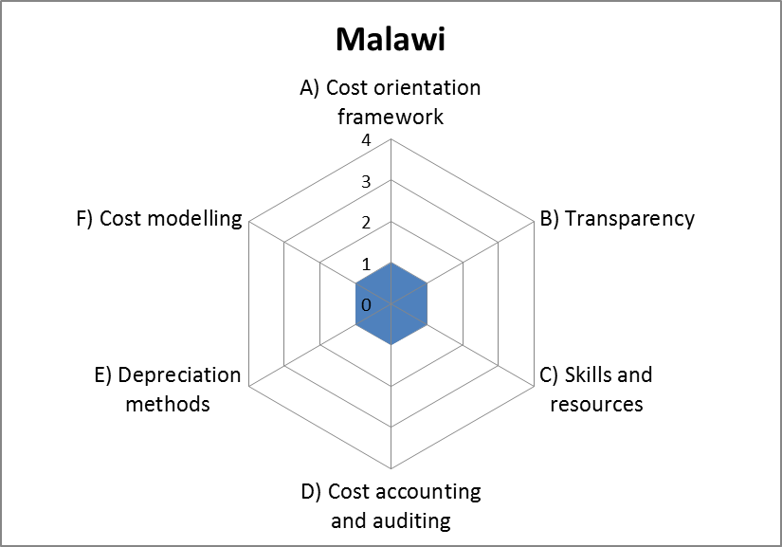
Malawi - summary

Slide 21
Malawi - comments
Cost accounting not imposed in Malawi due to lack of legal framework and skills
There is a planned review of the Law
Malawi operates a Sender Keeps All
Cost model does not exist
Challenges in data collection
Would the representatives from Malawi like to add any comments of their own?

Slide 22
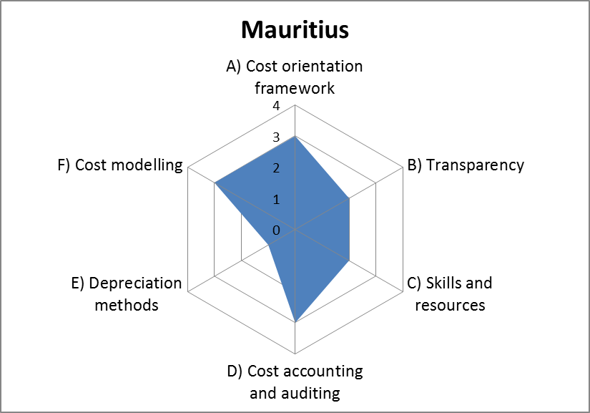
Mauritius - summary

Slide 23
Mauritius - comments
The Information and Communication Technologies Act 2001, Act 44/2001 provides for a framework for regulating tariffs based on.
Interconnection rates are computed based on historical costs using the FDC methodology
The regulator (ICTA) issues regular directives on interconnection rates referred to as the Interconnection Usage Charges (IUC).
Migration to a LRIC model is under consideration
Would the representatives from Mauritius like to add any comments of their own?

Slide 24

Namibia - summary

Slide 25
Namibia - comments
Cost accounting in Namibia is not implemented as the cost accounting regulations provided for in the Act are yet to be developed.
There is no cost model in place.
There is also insufficient skills
Plans are underway to have a consultant assist in the development of a cost model.
Would the representatives from Namibia like to add any comments of their own?

Slide 26
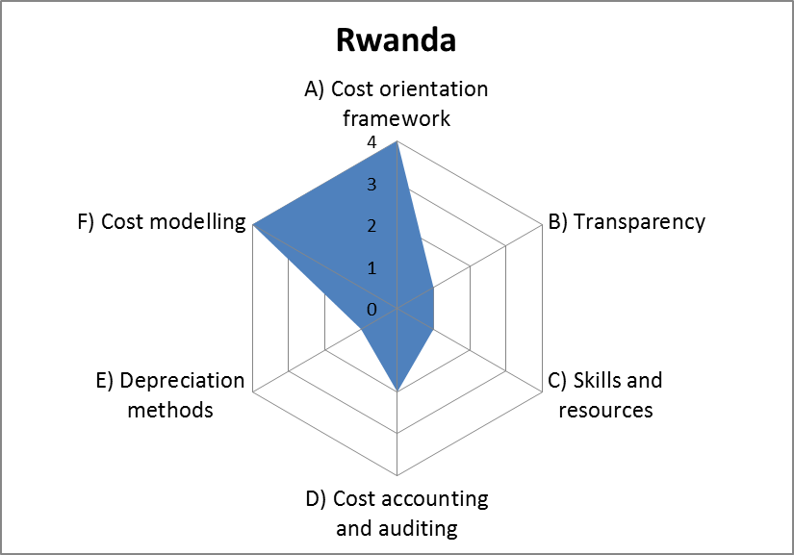
Rwanda - summary

Slide 27
Rwanda - comments
The sector legislation, Law No. 44/2001 of 30/11/2001, provides for a framework for derivation of tariffs.
The regulator (RURA) is mandated to regulate tariffs, for dominant operators (with SMP), based on objective and cost based criteria.
However no cost accounting is imposed as the dominant player is yet to be determined
Would the representatives from Rwanda like to add any comments of their own?

Slide 28
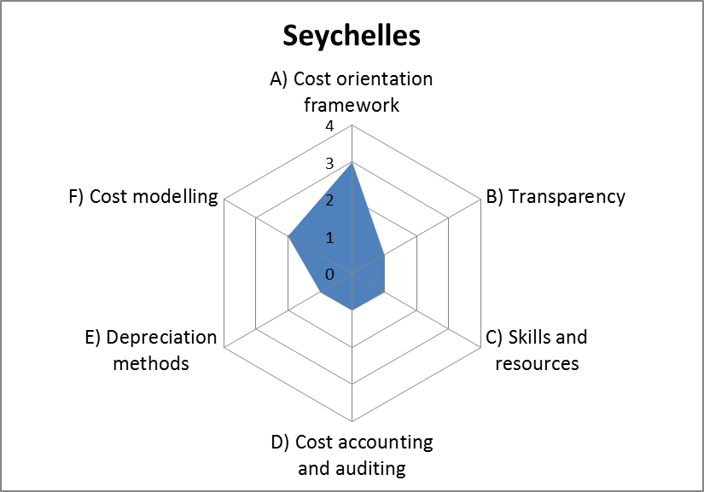
Seychelles - summary

Slide 29
Seychelles - comments
The sector legislation, the Broadcasting and Telecommunication Act, 2000 mandates the Minister in charge of ICT to regulate tariffs.
Interconnection rates are required to be based on incremental costs (additional cost accruing).
The Department of Information Communications Technology in the Office of the Vice President is mandated to among others regulate tariffs based on incremental cost accounting principles.
Would the representatives from Seychelles like to add any comments of their own?

Slide 30
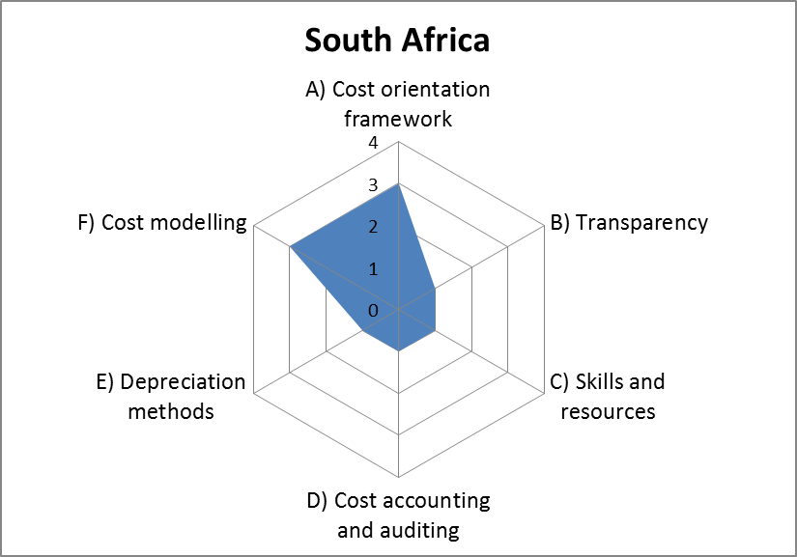
South Africa - summary

Slide 31
South Africa - comments
The Legal framework in South Africa provides for cost accounting obligations to operators with SMPs.
Cost accounting separation guidelines are under development
A Top down costing approaches based on fully distributed costing is used. In this approach data extracted from accounting separation reports and traffic figures submitted by SMP operators are to be used. There is no specific cost model in use.
Would the representatives from South Africa like to add any comments of their own?

Slide 32
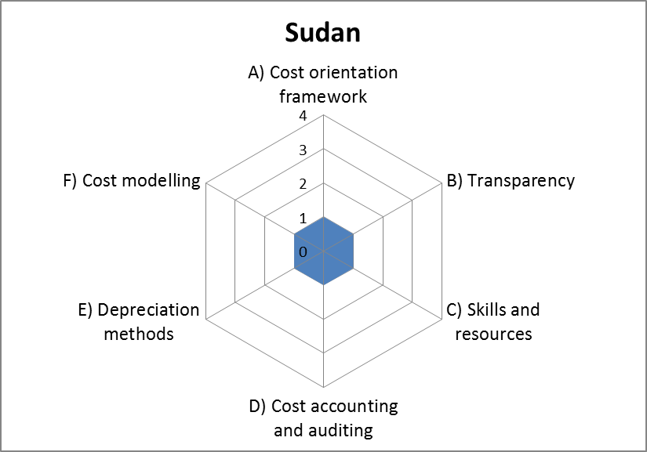
Sudan - summary

Slide 33
Sudan - comments
Sudan did not participate in the HIPSSA data collection survey.
However online research indicates as follows:
  That the Telecommunication Act 2001 mandates the regulator to approve the methods and costing of telecommunication services.
  The National Telecom Corporation (NTC) as the regulator is therefore mandated to regulate tariffs including the methodology of costing of services
Would the representatives from Sudan like to add any comments of their own?

Slide 34

Swaziland - summary

Slide 35
Swaziland - comments
Cost accounting not mandated due to lack of appropriate legal framework.
No cost model in place
There is no independent regulatory body as the incumbent operator also performs regulatory functions.
Would the representatives from Swaziland like to add any comments of their own?

Slide 36
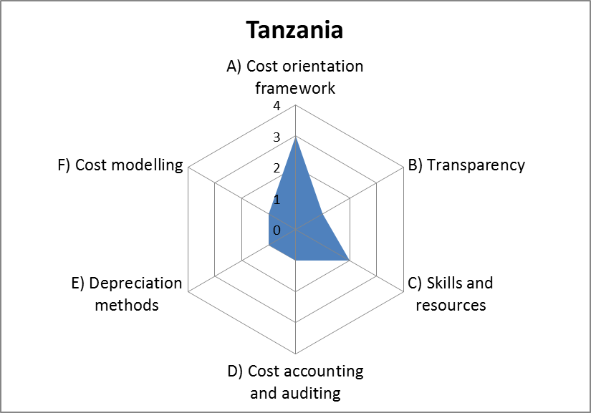
Tanzania - summary

Slide 37
Tanzania - comments
The ICT sector legislation in Tanzania, the Electronic and Postal Communications Act, 2010, gives broad principles that guide operators in setting tariffs
The Tariff Regulations, 2005, provide for cost oriented tariffs.
The regulator, Tanzania Communications Regulatory Authority (TCRA) is mandated to ensure the application of cost oriented tariffs
No cost model is in use presently (although LRIC models were previously developed)
Would the representatives from Tanzania like to add any comments of their own?

Slide 38
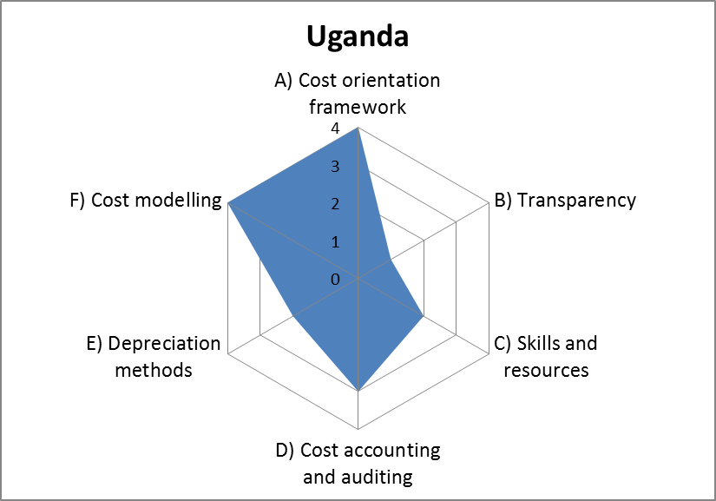
Uganda - summary

Slide 39
Uganda - comments
The sector legislation, Uganda Communications Act Chapter 106, provides for a framework for tariffs setting principles which include cost orientation and causality.
A cost model based on LRIC was under development
The model is not publicly available
The depreciation method applied is the Straight-line
Would the representatives from Uganda like to add any comments of their own?

Slide 40
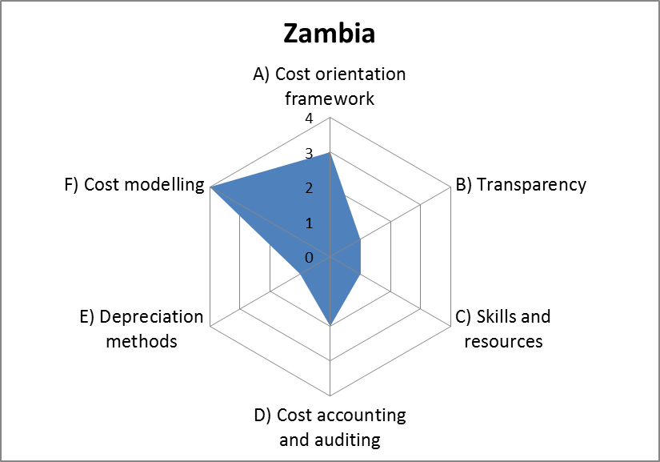
Zambia - summary

Slide 41
Zambia - comments
The Legal framework provides for cost accounting obligations to operators with SMPs
Bespoke Hybrid cost model developed by consultant is used when tariffs are reviewed
Data gathered in specific request. There is resistance by operators to give data.
Cost model not published for confidential reasons
Would the representatives from Zambia like to add any comments of their own?

Slide 42
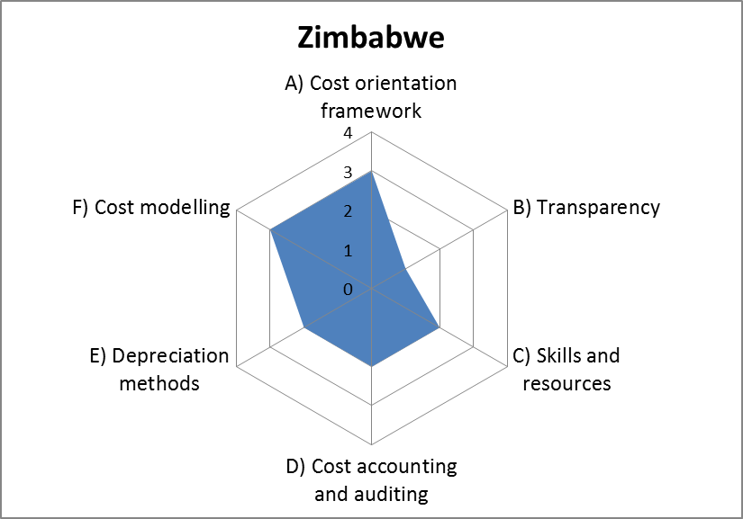
Zimbabwe - summary

Slide 43
Zimbabwe - comments
The Legal framework provides for cost accounting obligations to operators.
Cost accounting is implemented using tariff proposal guidelines.
Presently uses COSITU Model
In the process of developing a new system based on forward looking costing methodologies for wholesale and retail services.
Would the representatives from Zimbabwe like to add any comments of their own?

Slide 44
Conclusions
Good progress in establishing the legal basis for cost-orientation
Cost modelling work at least started in most countries
Too much reliance on accounting approaches (historic costs; straight line depreciation)
Distinct lack of transparency in both methodology used and resulting models.
Lack of skills and resources a widespread issue

