Slide 1
HIPSSA Project
Support for Harmonization of the ICT Policies
in Sub-Sahara Africa
Training on select aspects of electronic trasactions and on-line consumer protection
Presentation FOUR: 6th of March 2013
Notes:
Bonjour à tous,
Je suis tres heureux d‘être parmi vous aujourd‘hui.
Je voudrais remercier Mr. Kamdem pour son invitation a l‘atelier.
Permettez-moi de me presenter.
Je viens de rejoindre le bureau de regional de l‘UIT pour l‘Afrique d‘Addis Abeba pour coordonner le projet d‘harmonisation reglementaire de l‘UIT et de la CE en Afrique sub-saharienne
Je travaillais precedemment chez le regulateur français l‘ARCEP au service economique.
Je m‘occupais de travaux de modelisation technico-economique et j‘etais plus particulièrement en charge de l‘évaluation du cout du service universel et de la terminaison d‘appel mobile dans les departements français d‘outremer.

Slide 2
Overview
Time and place of contract formation
Obligation of offering goods & services on-line / Consumer Protection
Case law

Slide 3
Contract formation
Legal recognition of electronic transactions formed through e-communications
Questions:
  Time of sending and receipt becomes effective
  Determine time contract formation takes place

Slide 4
Practical example
Sisi accessed http://www.julia.co.tz completes online order form. It is automatically accepted.
Where and when is the contract formed?
  Sisi lives in Paris Julia lives in Dar
  The web site is hosted by “Happy Geeks” of Zambia
  The pots are shipped from Botswana
  ?????????????????????????????????

Slide 5

Bull terrier puppies
Fred, in Dar Es Salaam sells puppies on www.fredbullterries.co.tz. Sue, of Nairobi, completes an on-line order form on Friday. She receives an e-mail from Fred informing her that she can become the owner of a puppy when he receives proof of payment. She pays and send proof of payment. Dar Es Salaam is hit by a power failure and Fred cannot switch on his computer. On Sunday he sells all five puppies to his neighbour. Does Sue have an action for breach of contract?

Slide 6
Theories
Theories:
  Information theory
  Mailbox/ Postal theory

Slide 7
Place of Contracting
Locus contractus - place of last step for completion of contract
Place posted; Location of mailbox;
inter partes place where you were where meeting of minds
If you know when, you know where!

Slide 8
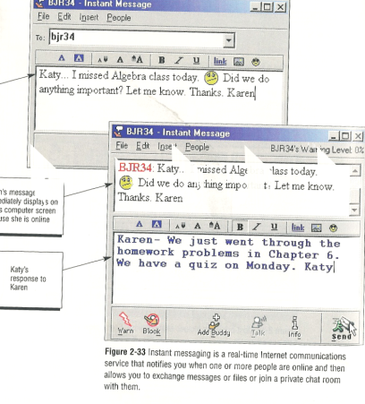
Difficulty in applying paper-based rules
Time – E-communications “instantaneous”?
Mobile devices - place where last step taken….anywhere

Slide 9
E-mail not instantaneous
Prof Chandler: 11 seconds
  Received: from mail1.unisa.ac.za (mail.unisa.ac.za [163.200.216.139]) by alpha.unisa.ac.za; Tue, 21 Sep 2004 17:16:42 +0200
  Message-ID: <415045C6.3C77480E@uottawa.ca> Date: Tue, 21 Sep 2004 11:16:23 -0400

Slide 10
Sometime it takes longer…
Unisa student: 2 hours 3 seconds
  Received: from mail1.unisa.ac.za (mail.unisa.ac.za [163.200.216.139]) by alpha.unisa.ac.za; Thu, 23 Sep 2004 20:46:44
  Received: from mail.telkomsa.net (nobelium.telkomsa.net [196.25.69.102]) by mail1.unisa.ac.za (Postfix) with ESMTP id 39640340F9 for ; Thu, 23 Sep 2004 20:46:42 +0200 (SAST) Received: (qmail 20465 invoked by uid 104); 23 Sep 2004 18:46:40

Slide 11
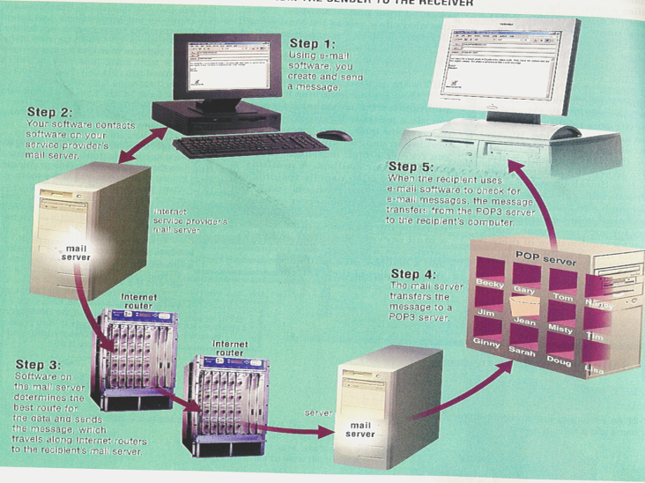
Illustration

Slide 12
Comparison of rules on time of electronic contract formation
Canada: Communicated - when? Sent? Received? Steps 2-5
Germany – reaches host computer of addressee Step 4
Norway: Comes to the knowledge of addressee – accessed & opened e-mail step 5

Slide 13
Tanzanian Bill: Reception theory
Sec 30(2): Time of contract formation
Time when acceptance of offer is received by offeror

Slide 14
Time of sending
Sec 33(1) Sent:
  data message enters info system out of control of originator/
  Same info system: capable of being retrieved

Slide 15
Time of receipt
Sec 33(2) Received when the elctronic communication enters information system
  designated or used for purpose of receiving communications of that type
  other system becomes aware
capable of being retrieved and processed

Slide 16
S36 Place of receipt
Dispatched place where originator has place of business
  Foreign; remote; irrespective device.
More than one place of business: closest relationship or principle place of business
No place of business:
  habitual residence
  Place where body corporate incorporated

Slide 17

Illustration: Time of contracting

Slide 18
Obligations of on-line traders
Offering goods & services by way of electronic transaction

Slide 19
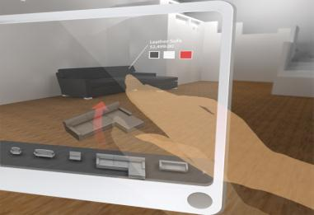
Consumer = any person who uses information system services to purchase or offer to purchase goods otherwise than for the purpose of resale

Slide 20
Information made available
11 pieces of info, e.g
  Full contact details place of the business; e-mail address and telefax number;
  Full information re goods or services, quality and characteristics – informed decision;
  The full price, additional costs such as transport and taxes;
  Payment systems;
  Terms of agreement & manner access & full record
Us | Contact Us | Price List | Terms and conditions

Slide 21
Links to terms & conditions: Incorporation by reference
Section 11 Information incorporated into an agreement is regarded as having been incorporated into an electronic communication.
Best practices for incorporation: Ticket cases

Slide 22


Ticket cases:
  Was notice of kind expected
  Binding if clear, even if not read
  T&C on tickets binding agreement

Slide 23
Were terms expected?
Yes
No
Would reasonable person have
noted the incorporation?
Not bound
Yes
No
Bound whether terms
were read or not.

Slide 24
  Best practices links:
  Referred to in a way in which a reasonable person would have noticed the reference thereto and incorporation thereof
  Font size / colour
  Place on web page

Slide 25
Example
New Tariffs New Telkom tariffs w.e.f. 1 August 2007... more>>Buy a PC from Telkom! Buy a PC on your Telkom account for as little as R219.37 per month... more>>Telkom PrepaidFone Waya-Waya Stay connected all year for R120 and ringa waya-waya more>>Moving home? Now Telkom SmartMoves has an easy to use service to inform your friends and family your new contact details in one go!....... more>>Let your opinion be heard... Have your say and earn exciting rewards... more>> Home |PAIA |Terms & Conditions |Proudly South African © Telkom SA Limited. 2007. All Rights Reserved

Slide 26
© IN TERMS OF SECTION 11 OF THE ELECTRONIC COMMUNICATIONS AND TRANSACTIONS (ECT) ACT 25 OF 2002 AND THE COMMON LAW OF CONTRACT, THESE TERMS AND CONDITIONS ARE VALID, BINDING AND ENFORCEABLE AGAINST ALL PERSONS THAT ACCESS THE TELKOM WEBSITE, WEB PAGES OR ANY PART THEREOF.
IF YOU DO NOT AGREE TO BE BOUND BY THESE TERMS AND CONDITIONS YOU MAY NOT USE THE TELKOM WEBSITE. REASONABLE USE OF THE TELKOM WEBSITE SHALL AUTOMATICALLY BIND THE USER TO THIS AGREEMENT.
DEFINITIONS AND INTERPRETATION
Hyperlinks herein to legal documents should be deemed part of these terms and conditions in terms of section 11(3) of the ECT Act. The fact that some or all of the hyperlinks may, from time to time, be non-operational, shall not affect the validity and interpretation of these terms and conditions.
f) Telkom's Standard Terms and Conditions for the provision of Public Switched Telecommunication Services (also referred to as the "Abridged Conditions of Contract")". Please click here to access the Abridged version
as well as the complete set of Terms and Conditions.
Online Bill Terms and Conditions
Ease-e-Bill Terms and Conditions

Slide 27
Validity?
Hyperlinks herein to legal documents should be deemed part of these terms and conditions in terms of section 11(3) of the ECT Act. The fact that some or all of the hyperlinks may, from time to time, be non-operational, shall not affect the validity and interpretation of these terms and conditions.

Slide 28
  Best practices links:
  Referred to in a way in which a reasonable person would have noticed the reference thereto and incorporation thereof
  Font size / colour
  Place on web page
  Links MUST work

Slide 29

Typo Errors
Sec 37(2) consumer opportunity –
  review entire transaction;
  correct mistakes &
  withdraw
  before finally ordering

Slide 30


Transacting with electronic agents

Slide 31
Automated transaction
Sec 29 "automated transaction" VALID means an electronic transaction conducted by electronic agents
Website transaction
  Data messages
  Not reviewed

Slide 32
E-shopper keystroke error
Sec 31 no legal effect where a natural person interacts directly with the automated message system and has made a material error during the creation of a data message and­—
  (i) the electronic agent did not provide that person with an opportunity to prevent or correct the error;
Return or destroy the consideration in accordance with instructions – benefit materially

Slide 33
Consumer Remedies
Sec 37(3):
If supplier fails to provide (1) all the information or (2) the opportunity to review and correct:
  Purchaser may cancel within 14 days after receipt of goods or services
S 37(4): If cancelled consumer must return performance/cease using service
Supplier: refund minus direct costs of returning goods

Slide 34
Cooling-off period Section 38
Cancel without reason, and without penalty any transaction and related credit agreement:
  Goods: within 7 days of receipt
  Services: 7 days after conclusion of agreement
Where payment has already been made prior to cancellation, Consumer is only liable for the cost of returning the goods
The consumer is entitled to a full refund – must be made within 30 days from date of cancellation
Must inform consumer

Slide 35
Excluded from cooling off: s 38(5)
Financial Services, investment services and banking, insurance and re-insurance; securities
Auctions
Supply of foodstuff, beverages
Personalized goods or deteriorate or expire
Unsealed audio or video recordings or computer software.
Sale of newspapers, periodicals, magazines or books.
For provision of gaming and lottery services.
Provision of accommodation, Transport; Catering or leisure services – dates;
Minister - regulations

Slide 36
Exclusion of rights
Apply to all Tanzanian traders – place of business; incorporated;
S 40: Protections are applicable to all consumer transactions despite the applicable legal system.
  Public policy

Slide 37
Website compliance
Interface design: information given
Links must be “up”
Opportunity to prevent & correct errors
Secure payment mechanism – update regularly
Cooling off
May not exclude consumer rights

Slide 38
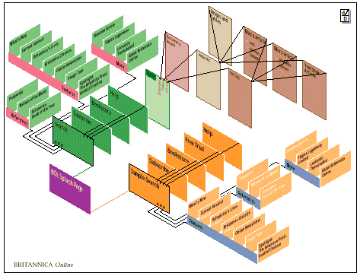
Website design
Information
Links
Security
Errors:
  review & confirmation of correctness
Transactional interface
  T&C Content; Manner of display; copy T&C - audit & time lag

Slide 39
CASE LAW

Slide 40

Jafta v Ezemvelo KZN Wildlife [2008] 10 BLLR 954 (LC)

Slide 41
Lost in cyberspace
Jafta v Ezemvelo KZN Wildlife [2008] 10 BLLR 954 (LC)
Jafta offer of employment condition: must accept by 24h00 31 December 2007
E-mail failure
Internet café sends again
  Requests telephonic confirmation –
e-Mail failure
SMS notification – responds to SMS and SMS received in time

Slide 42
Lost in cyberspace (2)
Court:
  Legal recognition of electronic communications
  Media neutrality
  Acceptance confirmed
No explanation of e-mail mishap

Slide 43
Jafta
Court criticised ECT Act –
  no provision for risk allocation if data messages lost in cyberspace
  Risk allocation advanced electronic signature
ECT Act clear – sent not received - Contract not formed
  Lost in cyberspace...

Slide 44
SMS sent in Haste
  SIHLALI, MAFIKA v SABC CASE NO: J 700/08
Contact of employment & policy
Suspension
SMS message to Chairperson of Board resigning
Resignation accepted via e-mail message and letter
Retraction – not proper resignation
  Not able to retract after resignation was accepted

Slide 45
SPCA v E-mailed Wills
Van der Merwe v Master of the High Court & another (605/09) [2010] ZASCA 99 (6 September 2010)
Two frinds e-mailed wills to each other - Unsigned
Acceptance of document as will in terms of s 2(3) of the Wills Act 7 of 1953
  absence of signature not an absolute bar = document
  authentic and intended to be deceased’s will.

Slide 46
Aura of Authenticity
I return to consider the document in question against the jurisdictional requirements of s 2(3) of the Act.
  The appellant provided proof that the document had been sent to him by the deceased via e-mail, lending the document an aura of authenticity.
  It is uncontested that the document still exists on the deceased’s computer. Thus it is clear that the document was drafted by the deceased and that it had not been amended or deleted.

Slide 47
Lessons:
  Burden of use of technology has shifted
    Postal – offerree risk
    E-communications addressee carries risk

Slide 48
SMS sent in Haste (2)
Lessons
  Bill will apply to common law & statutes
  Legal recognition of SMS as writing – sever consequences
  Message content & medium acceptable as written resignation
Importance: recognition that the Bill will have great consequence applies retroactively also as far as contracts are concerned

Slide 49
Lessons cont.
Even though a will are exluded a court may uphold an electronic will – depends on circumstances
Not all exclusions are absolute

Slide 50
Practical example
Sisi accessed http://www.julia.co.tz completes online order form. It is automatically accepted.
Where and when is the contract formed?
  Sisi lives in Paris, Julai in Dar
  The web site is hosted by “Happy Geeks of Zambia
  The pots are shipped from Botswana
  ?????????????????????????????????

Slide 51
Bull terrier puppies
Fred, in Dar Es Salaam sells puppies on www.fredbullterries.co.tz. Sue, of Nairobi, completes an on-line order form on Friday. She receives an e-mail from Fred informing her that she can become the owner of a puppy when he receives proof of payment. She pays and send proof of payment. Dar Es Salaam is hit by a power failure the weekend and Fred cannot switch on his computer. On Sunday he sells all five puppies to his neighbour. Does Sue have an action for breach of contract?

Slide 52
THANK YOU…
Tana Pistorius
ITU INTERNATIONAL EXPERT
pistot@unisa.ac.za
Research Professor: UNISA
Union Internationale des Télécommunications International Telecommunication Union
Notes:
Merci de votre attention.
Je me tiens a votre disposition pour repondre a vos questions.
Je peux vous faire parvenir par email une version electronique de ce support de presentation.
Sachant que nous abordons tout juste le lancement de ce projet, les informations contenues dans cette presentation sont susceptibles a certaines evolutions.

