Slide 1
HIPSSA Project
MINISTRY OF INFORMATION AND COMMUNICATIONS TECHNOLOGY (MICT)
TRANSPOSITION OF SADC CYBERSECURITY MODEL LAWS INTO NATIONAL LAWS FOR NAMIBIA, 2013
An Assessment of developments in Namibia towards enactment of an electronic transactions/communications/commerce law
(The Use of Electronic Transactions & Communications Bill).
Support for Harmonization of the ICT Policies in Sub-Sahara Africa
Notes:
1
Bonjour à tous,
Je suis tres heureux d‘être parmi vous aujourd‘hui.
Je voudrais remercier Mr. Kamdem pour son invitation a l‘atelier.
Permettez-moi de me presenter.
Je viens de rejoindre le bureau de regional de l‘UIT pour l‘Afrique d‘Addis Abeba pour coordonner le projet d‘harmonisation reglementaire de l‘UIT et de la CE en Afrique sub-saharienne
Je travaillais precedemment chez le regulateur français l‘ARCEP au service economique.
Je m‘occupais de travaux de modelisation technico-economique et j‘etais plus particulièrement en charge de l‘évaluation du cout du service universel et de la terminaison d‘appel mobile dans les departements français d‘outremer.

Slide 2
An overview of Namibia Policy directives /developments (I)
1. First overall ICT policy directives prepared by a team of private and public sector experts in 2001/02 – recommendations on direction for Namibia ICT endorsed MIB to Cabinet to National Assembly.
2. Incorporates recommendation for law on e-transactions & promotion of e-commerce
Notes:
2

Slide 3
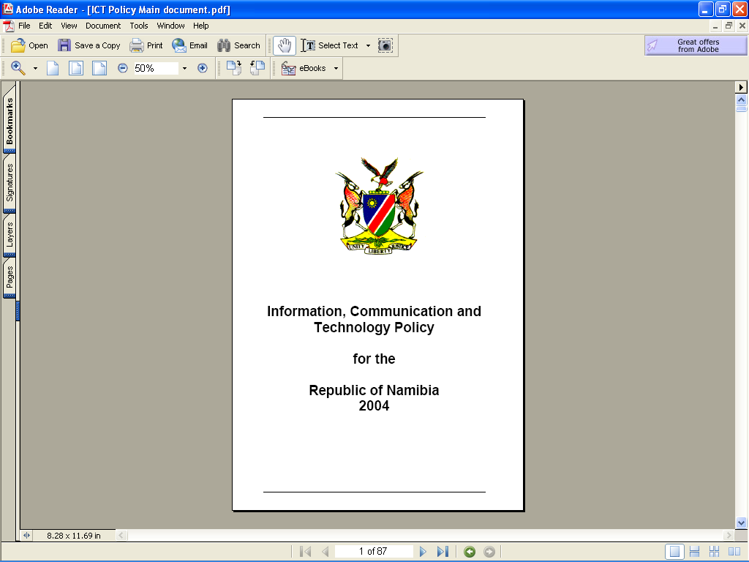
An overview of Namibia Policy directives /developments (I)
1st Cabinet decision in 2002:
Notes:
3

Slide 4
Namibia Policy directives /developments II
Notes:
The GRN has adopted a quite far-reaching e-gov policy.
This policy is quite clear – cut in its requirements with respect to records management requirements….

Slide 5
Namibia Policy directives /developments (III)
Both initiatives resulted in resolutions by Cabinet by 2002 that e-commerce and transactions law should be enacted for Namibia.
Also coincided with SADC Heads of State summit protocol on the advancement of e-commerce for the region (start of SADC Model law process)

Slide 6
Approaches to drafting of the e-transactions : structure(I)
6
Permanent Secretary group
E-government Coordinating Committee
E-Laws Technical Working Group
Ongoing /current
Appointment of Consultant/ Budgeting / Stakeholder consultations 2006 - 2010
Notes:
6

Slide 7
Namibia Policy directives /developments (IV)
7
Establishment of the MICT in 2008 also led to a (revised) policy statement : it will ensure that Namibia will have in place a e-transactions law that will “establish trust and confidence in secure electronic transaction by the public...”
Notes:
7

Slide 8
Namibia Policy directives /developments (IV)
NDP III – to promote Namibia as a information / knowledge-based society: also, there must be laws on e-transactions.
Draft Bill reviewed by Cabinet Comm on Legislation (twice – 2006 / 2011).
OMAs proceed with IT projects & OPM leads with e-Govt : estimated more than N$120 mill in 2008/11 in budgets
Cabinet 2010: proceed to enactment stage

Slide 9
Approaches to Drafting of the Law (I)
Functional equivalence Technology Neutral International Best Practice (UNCITRAL ; Model laws) Others : avoid over-legislation (approach will be incremental); use regulations ; limit additional institutional expansion Cabinet decision: adopt the 2010 version in principle.
9
Notes:
9

Slide 10
2010 Layman’s Legal draft of Bill (II)
Regulatory approach- not to burden legislature with technical matters (??)
ADMINSTRATION OF BILL – An Advisory Council (in the CRAN) to (eg.,)
On recognition of secure e-signatures;
Advise the Minister on adoption of regulations for...the security of data systems, the protection of privacy of personal data, and on the rights of persons and parties to access to information held in data formats;
10
Notes:
10

Slide 11
Layman’s Legal drafting of Bill (II)
Recommend the appointment of inspectors (ie., NAMPOL) to monitor and inspect data..in the public domain;
On regulations to curtail the harmful practices and illegal content on the internet....
On issuing of directives for compliance on complaints from consumers, clients and persons or parties in relation to e-transactions (mediation, conciliation & arbitration);
On issue of regulations in relation to: use in government, business & other sectors; and on stability, protection & security of NAM data systems

Slide 12
Areas covered by draft U/ETC Bill (I)
Chap1 : Definitions & Interpretation (sections 1-3
Chapter 2: Electronic Information Systems Management Council (sections 4 - 16)
Chapter 3: Legal Recognition of Data Messages & Contract Formation (sections 17-33)
Chapter 4: Electronic Commerce (sections 34 - 35)
Chapter 5: Limitation of Liability of Information System Service Providers (sections 36 -42)
Chapter 6: Cyber crimes (sections 43-50)
Chapter 7: General Provisions (sections 51 - 56)

Slide 13
Areas covered by draft U/ETC Bill (II)
Chapter 3:
Legal recognition of data messages
Incorporation by reference
e-Writing
E-Signature
Secure e-signature
Presumption & attribution of secure e-signatures
Original information
Admissibility & evidential weight of data messages

Slide 14
Areas covered by draft U/ETC Bill (III)
Retention of records
Production of documents or information
Formation & validity of e-contracts
Time & place and dispatch and receipt of data messages
Time of contract formation
Attribution of data messages
Automated message systems
Definitions in respect of above in line with international best practice

Slide 15
Other Areas of draft U/ETC Bill (IV)
Unsolicited communications (SPAM) (with opt-in requirement)
Limitation of Liability of Information System Service Providers (mere conduit, caching, hosting, information, location, take-down notification, no obligation to monitor)
Cyber crimes (offences in terms of the Bill)
Jurisdiction of courts, limitation of liability.

Slide 16
MICT Review of Bill 2012 (I)
Tender called for consultancy to review the Bill with a view to CCL and legal drafting scrutiny & confirmation for Legislature.
Review concluded that Bill be changed as follows:

Slide 17
MICT Review of Bill 2012 (I)
Redress certain aspects of the Bill i.r.o
Governance requirements (to comply with CCL recommendation – not be a committee of CRAN)
The exceptions list / schedule (part MoF requirement)
Re-designation of chapters (gaps identified)
Incorporation of new sections / provisions (part MoF requirement, such as e-Government)
A new offence to ensure child online protection
Recognition that data protection (privacy) provisions on e-transactions (online consumer) are required & the recognition of the “data controller” ;
That the IT profession be recognised as a statutory profession requiring & it be peer managed.

Slide 18
MICT Review of Bill 2012 (II)
Revised draft as follows:
Chapter 1 – Definitions & interpretation
Chapter 2 – EISMAC (options : MICT or CRAN)
Chapter 3 – Transmission of E-Communications
Chapter 4 – E-Transactions : part I – E-Gov
part II – E-commerce
(Cooling-off period ; Online Consumer Affairs Comm)
Chapter 5 – Cryptography & Accreditation
Chapter 6 – ISPs
Chapter 7 – Protection of Secure Databases
Chapter8– Cyber crimes
Chapter 9 – IT Professions’ Association
Chapter 10 – General Provisions (repeals)

Slide 19
U/ETC Bill to assist interpretation (I)
Regulations of the FIA CHAPTER 3: - Reg 22:
Electronic form of documents, records and reports.
Any documents, records, and reports, as well as copies thereof, required under these regulations may be in electronic form, unless otherwise prescribed….:
Provisions in Draft Bill relevant: e-writing, production of document or information
Anti – Corruption Act of 2003 (sec 27(2) …to disclose data stored in electronic form”;
THUS, TO BE SEEN AS OMNIBUS LEGISLATION

Slide 20
U/ETC Bill to assist interpretation (II)
Labour Act of 2007 (sec 133) “ In any legal proceedings a statement or entry …by the use of a computer…is admissable in evidence..”
- Provision in Draft Bill assist: “admissibility & evidential weight of data message
Anti – Corruption Act of 2003 (sec 27(2) …to disclose data stored in electronic form”
- Legal recognition, retention
THUS, TO BE SEEN AS OMNIBUS LEGISLATION

Slide 21
Next stage
HIPSSA process – transposition the revised Bill to SADC Model Law (esp in relation to chapter 3)
Further Stakeholder consultations
(in-country on governance, E-gov, exceptions, professions recognition, and repeals/amend other laws;
CCL & Legal drafting ; and
Parliement

Slide 22
THANK YOU…
22
Gordon Elliott
ITU national EXPERT
g.elliott@gdeconsult.com
Union Internationale des Télécommunications International Telecommunication Union
Notes:
22
Merci de votre attention.
Je me tiens a votre disposition pour repondre a vos questions.
Je peux vous faire parvenir par email une version electronique de ce support de presentation.
Sachant que nous abordons tout juste le lancement de ce projet, les informations contenues dans cette presentation sont susceptibles a certaines evolutions.

