Slide 1
VCEG-CB07 (v1)
Status Update on T.261
and coordination for ISO/IEC 23003-8, -9, -10
(formerly. H.BWC aka. BGWC)
for Joint WG6 & VCEG (Q6/21) meeting session — October 2026, Hangzhou
Notes:
[Sources]
VCEG-CB001-v1.

Slide 2
Status Update on ITU-T T.261 — Key Points
T.261 was consented by ITU-T SG 21 on 17 July 2026.
After post-meeting editing, which included removing a constraint determined to be counter to design intent (and had not been tested in software), Last Call ran from 1 September through 28 September.
Last Call comments: LC C 01 and LC C 02 from Fraunhofer HHI & IIS; LC C 03 from Dolby Laboratories: Basically editorial cleanup
Refined text was provided on 8 October.
A three-week AAP Additional Review step was advised.
ISO/IEC 23003-8 FDIS text delivery was delayed.
We suggest no project limit-date extension is needed (per new Directives).
DICOM WG 32 expressed interest in clinical evaluation and targets the T.261 transfer syntax for Q1 next year.
A preliminary lower-complexity encoding configuration was evaluated against the audio anchors.
Text and plans proposed for Conformance and Reference software specs
Notes:
[Sources]
VCEG-CB001-v1; FDIS and limit-date discussion point supplied by the user.

Slide 3
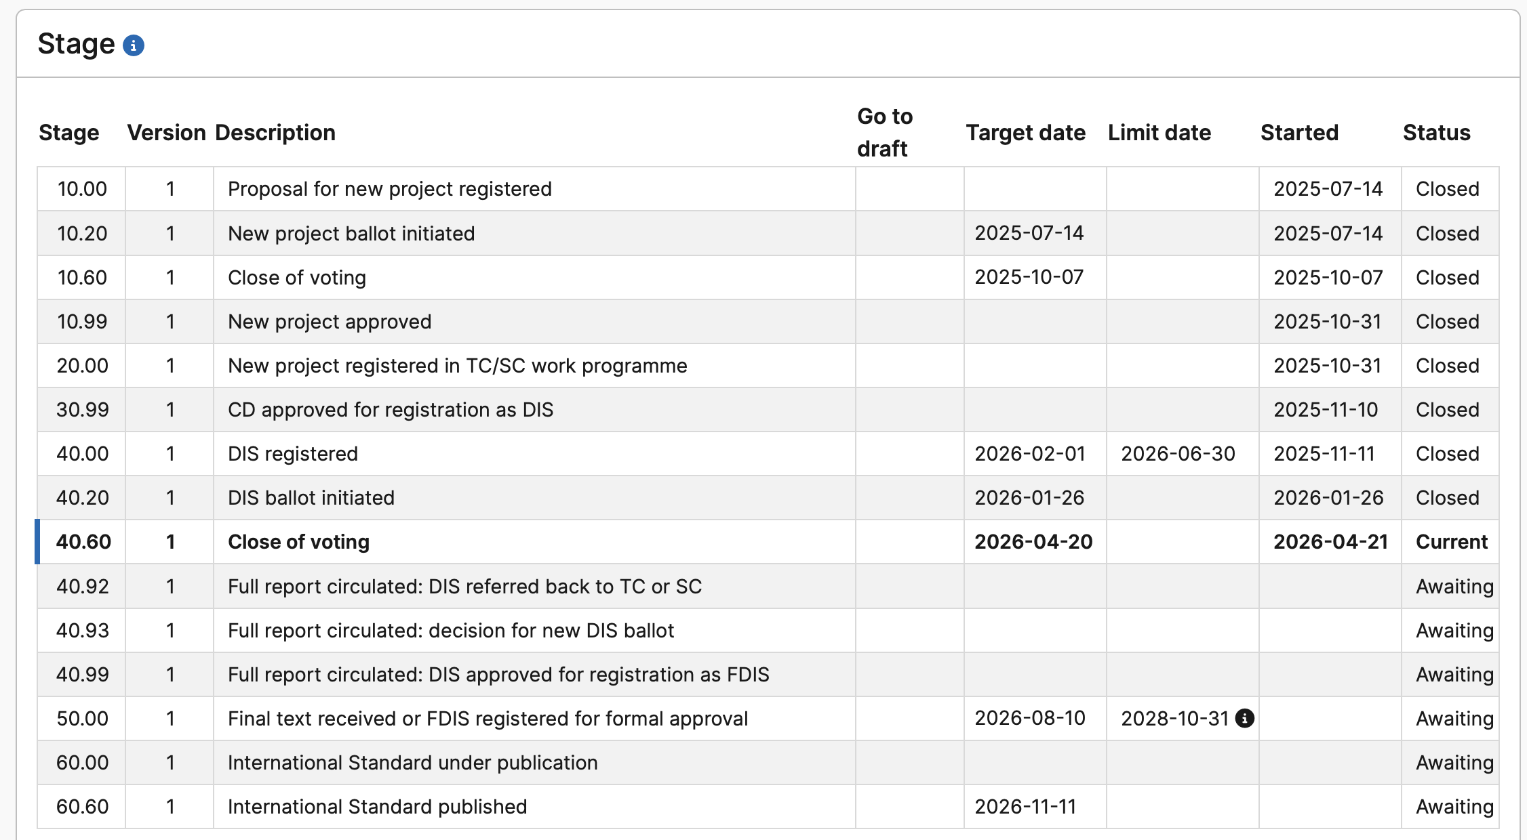
ISO/IEC 23003-8 Project Stage — Discussion
Discussion: Status of FDIS text and limit-date is required.
Notes:
[Sources]
Project-stage table transcribed from the image supplied by the user.

Slide 4
Communication with DICOM WG 32
Outgoing liaison from the July 2026 SG 21 meeting reported Consent of T.261 and related status.
Q6/21 experts participated in DICOM WG 32 meetings and reported on H.BWC/T.261.
DICOM WG 32 expressed interest in studying suitability for clinical applications.
DICOM WG 32 expressed interest in assessing near-lossless compression for clinically significant artefacts.
DICOM WG 32 stated that the T.261 transfer syntax should be finalized in Q1 next year.
Notes:
[Sources]
VCEG-CB001-v1, Communication with DICOM.

Slide 5
Preliminary Gain–Complexity Study
Preliminary study of low-complexity encoding reported (VCEG-CB01)
Objective: Create a BGWC software encoder operating point with encoder runtime approximately on par with the audio anchors, using configuration changes only.
Lossy audio anchor: Extended HE-AAC using the Exhale encoder with non-audio MSE-optimized quantization.
Lossless audio anchor: MPEG-4 SLS encoder and decoder executables provided in m73909, compiled from the SLS reference software.
Version 7 software was tested under the CTC with selected coding tools disabled and RDOQ enabled.
No reliable lossy decoder runtime was available for the xHE-AAC anchor.
Notes:
[Sources]
Email Re: Update on T.261 performance, 15 October 2026; VCEG-CB001-v1.

Slide 6
Lossy Compression — BGWC over Extended HE-AAC / Exhale Anchor
Dataset | BD-PSNR1 | BD-PSNR2 | EncT | DecT
MIT (ECG) | -27.30% | -26.92% | 73% | N/A
INCART (ECG) | -58.78% | -57.85% | 142% | N/A
CHBMIT (EEG) | -28.80% | -28.26% | 83% | N/A
NMR55 (EEG) | -46.57% | -49.41% | 68% | N/A
NMR57 (EEG) | -56.84% | -48.97% | 94% | N/A
Ozdemir (EMG) | -49.51% | -49.41% | 60% | N/A
PTT (PPG) | -29.92% | -31.33% | 147% | N/A
WristPPG (PPG) | -35.16% | -34.63% | 107% | N/A
Overall | -41.61% | -40.85% | 97% | N/A
Notes:
[Sources]
VCEG-CB001-v1; Email Re: Update on T.261 performance.

Slide 7
Lossless Compression — BWC over MPEG-4 SLS Anchor
Dataset | BR-R | EncT | DecT
MIT (ECG) | -9.01% | 97% | 28%
INCART (ECG) | -27.40% | 100% | 30%
CHBMIT (EEG) | -11.78% | 64% | 41%
NMR55 (EEG) | -7.49% | 60% | 37%
NMR57 (EEG) | -27.30% | 69% | 48%
TILT ILLUSION (EEG) | -8.68% | 79% | 60%
Ozdemir (EMG) | -1.91% | 115% | 36%
PTT (PPG) | -8.52% | 106% | 30%
WristPPG (PPG) | -3.16% | 109% | 39%
Average | -11.69% | 89% | 39%
Notes:
[Sources]
VCEG-CB001-v1; Email Re: Update on T.261 performance.

Slide 8
Lossy Compression — Lower-Complexity Configuration over BWC 7.0
Dataset | BD-PSNR1 | BD-PSNR2 | EncT | DecT
MIT (ECG) | 37.89% | 37.86% | 13% | 112%
INCART (ECG) | 69.56% | 69.70% | 10% | 120%
CHBMIT (EEG) | 12.94% | 12.89% | 8% | 107%
NMR55 (EEG) | 7.17% | 7.19% | 10% | 101%
NMR57 (EEG) | 12.75% | 12.69% | 5% | 99%
TILT ILLUSION (EEG) | 12.08% | 11.25% | 7% | 98%
Ozdemir (EMG) | 4.38% | 4.36% | 10% | 104%
PTT (PPG) | 11.98% | 11.49% | 8% | 98%
WristPPG (PPG) | 5.21% | 5.56% | 10% | 99%
Overall | 19.33% | 19.22% | 9% | 104%
Notes:
[Sources]
VCEG-CB001-v1.

Slide 9
Lossless Compression — Lower-Complexity Configuration over BWC 7.0
Dataset | BR-R | EncT | DecT
MIT (ECG) | 14.62% | 17% | 168%
INCART (ECG) | 40.80% | 15% | 193%
CHBMIT (EEG) | 7.12% | 13% | 200%
NMR55 (EEG) | 36.24% | 17% | 229%
NMR57 (EEG) | 2.38% | 7% | 188%
TILT ILLUSION (EEG) | 3.09% | 10% | 257%
Ozdemir (EMG) | 4.89% | 10% | 176%
PTT (PPG) | 38.04% | 13% | 196%
WristPPG (PPG) | 13.45% | 15% | 182%
Average | 17.85% | 13% | 199%
Notes:
[Sources]
VCEG-CB001-v1.

Slide 10
Study on ISO 60601 conformance
Testing was carried out against relevant parts of the ISO 60601 and ISO 80601 families of standards.
These are tests of features important for diagnostic accuracy, e.g. frequency response, triangular pulse tests.
All tests can be passed at near lossless, some tests fail in the lossy case, depending on signal gain and compression ratio.
Likely that all tests can be passed at meaningful operating points with different encoder settings, only tested with default values.
Available as document CB05.
Notes:
[Sources]
VCEG-CB001-v1; FDIS and limit-date discussion points supplied by the user.

Slide 11
Suggested Joint WG6 / VCEG Topics
T.261 AAP status and the advised Additional Review step.
Check in on FDIS preparation and DoCR
Continued aligned work on reference software and conformance specifications.
Notes:
[Sources]
VCEG-CB001-v1; FDIS and limit-date discussion points supplied by the user.

Slide 12
Thank you!

