Slide 1
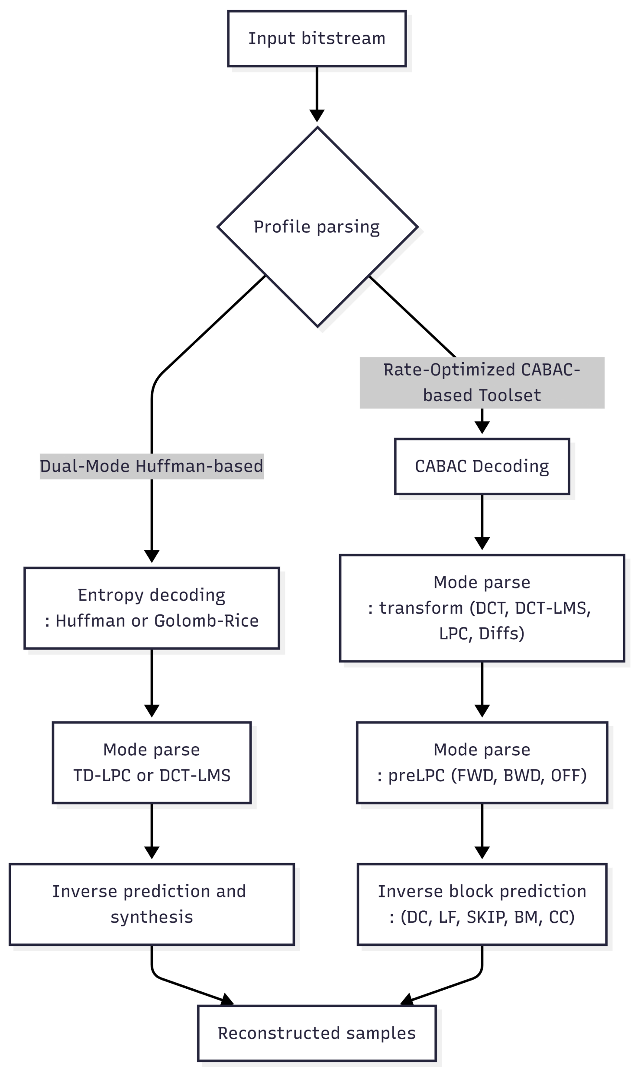
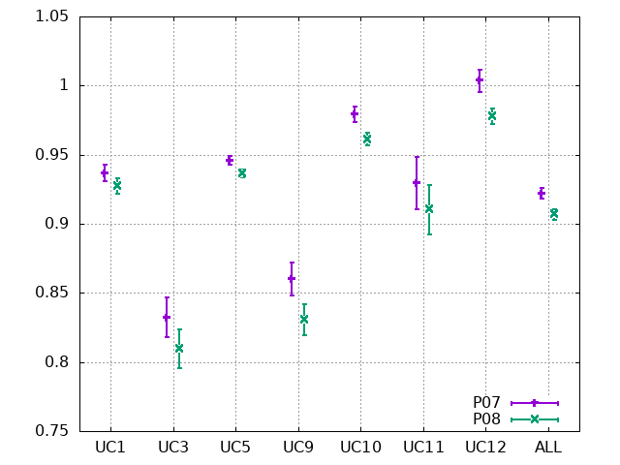
Introduction for VCEG experts
Lossless audio coding related requirements on ACoM CfP evaluation
Bit-exact reconstruction
Better compression ratio than the anchor system
Runtime is non-normative (informative)
ETRI’s proposal
Implementation based on H.BWC TM3.0
Additional functionalities in TM4.0
Minor changes on configuration
Original tool named preLPC of which performance gain was shown
Discussion history within this MPEG meeting
ETRI’s proposal satisfies the ACoM CfP requirements.
WG6 experts said that
Leverage prior standardization experience (H.BWC and MPEG-D part-8) to avoid redundant development and maintain alignment across related texts.
ETRI lossless decoder
ACoM CfP evaluation results
lossless audio compression performance

Slide 2
Proposed CTC for ACoM
Reference system
H.BWC TM4.0 + cherry pick “Bugfix: Wav header correction” commit
for dealing with 24 bit wav file perfect reconstruction
https://vcgit.hhi.fraunhofer.de/vceg-sw/bwc
Datasets
Use cases defined in MPEG ACoM updated CfP response
ISO/IEC JTC 1/SC 29/WG 6, N364, “Updated call for proposals on audio coding for machines”
Specifically, UC1, UC3, UC5, UC9, UC10, UC11, UC12
Encoding Configuration
combinedPresetACoM_lossless.cfg
Error measures
Check MSE = 0
BR-R: Bit rate Ratio = (anchor-target)/anchor * 100 (%)
Evaluation
BR-R (%)
For each test sequence, the percentage changes of the geometric means of the runtimes relative to the anchor

Slide 3
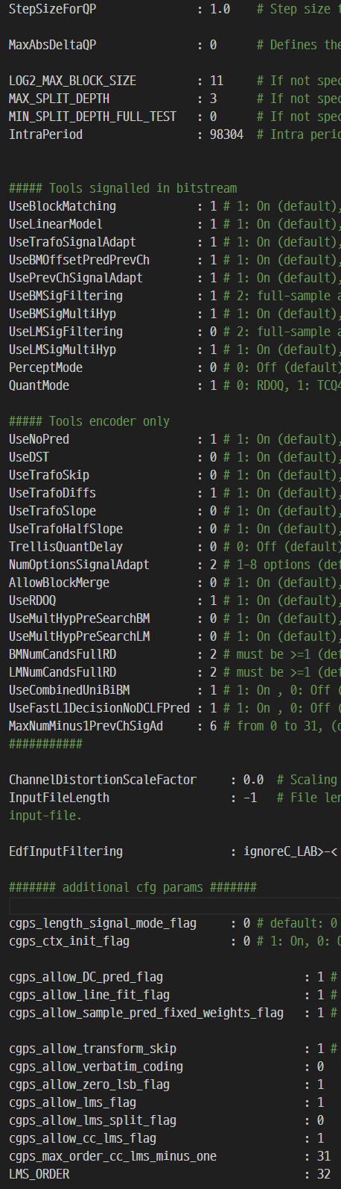
combinedPresetACoM_lossless.cfg
Based on combinedPresetEMG_lossless.cfg in TM4.0
Changes
LOG2_MAX_BLOCK_SIZE: 9→11
MAX_SPLIT_DEPTH: 1→3
UseLMSigFiltering: 1→0

Slide 4
Evaluation results under ACoM CTC
[Note] ETRI’s CfP proposal has been developed under ACoM CfP requirements not H.BWC requirements
Specifically, the main FoM (Figure of Merit) is set to compression ratio, and the encoder and decoder runtime are not part of FOM in ACoM CfP evaluation.
In ACoM FoM CR is evaluated relative to anchor
In ACoM CfP ETRI’s proposal based on TM 3.0 with some optimization outperformed Dolby’s proposal based on TM4.0 (with corrections)
New Evaluation Results
The performance of TM4.0 under ACoM_lossless.cfg is better than the previously shown TM 4.0 results due to the change of configuration.
For UC1,3,5,9-Circor, CR differences are positive but the overall CR difference is negative, which implies that the preLPC in “proposed without dual” still mainly contributes to the CR gain.
Similarly, BR-R has the same tendency, and the overall BR-R is -1.223 %.
deltas vs. H.BWC TM3.0/4.0
*CR: Compression Ratio = bitstream size / original size *100 (%)
*BR-R: Bit rate Ratio = (anchor-target)/anchor * 100 (%)
*Enc Time = the percentage changes of the geometric means of the runtimes relative to the anchor.

Slide 5
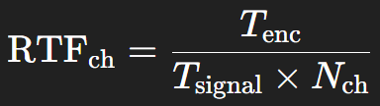
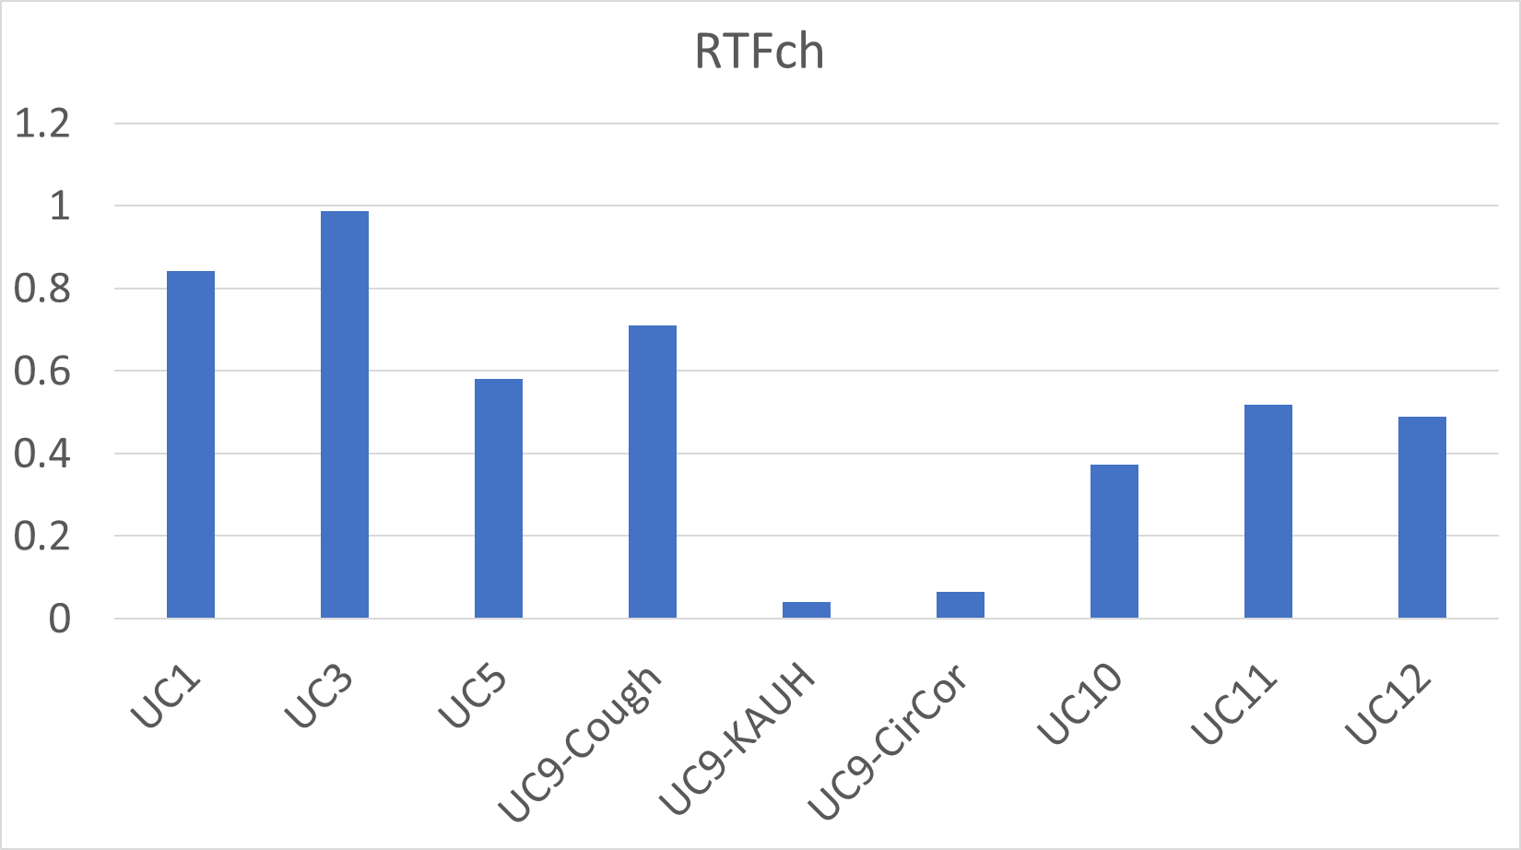
Channel RTF as a Practical Encoder Complexity Guideline (ACoM)
Motivation
The evaluation of encoder and decoder run-time in H.BWC is based on H.BWC-specific requirements and constraints.
These criteria are not directly aligned with the characteristics and complexity considerations of ACoM, indicating the need for a dedicated complexity study for ACoM.
As a preliminary step toward such a study, the channel real-time factor (RTFch) was evaluated as a computational complexity metric.
Definition
Channel RTF = encoding elapsed time / (input signal duration × number of channels)
Channel RTF < 1 indicates real-time encoding capability per channel
Evidence
The proposed ACoM lossless encoder achieves per-channel RTFch < 1 across all evaluated use cases, even with preLPC.
Takeaway
When considering expected improvements in future device performance, the proposed technology has sufficient potential.
Further complexity reduction should be studied through the ACoM CE process.
encoder time
wav recording time
number of channels
CPU: Intel® Core™ i9-14900KS 3.2GHz *Single file for single core in each UC was evaluated.

Slide 6
Proposed roadmap and discussion
Target
Codec from twin text of ITU-T H.BWC and MPEG-D part-8 be used audio core for ACoM
What needs to be done
Add preLPC block to H.BWC TM 5.0 if this improves compression for ACoM data sets
Check that the proposed addition does not increase complexity under the BWC CTC, while any increase in computational complexity is only observed under the ACoM CTC
→ Core experiment need to be finalized in April
Discussion agenda
Possibilities on the distinctive CE proposal for ACoM in next VCEG or MPEG WG6 meetings under proposed CTC for ACoM.

