Slide 1
ITU – Telecommunications Standardization Sector STUDY GROUP 21 Question 6 Video Coding Experts Group (VCEG) 76th Meeting: 27 March – 4 April 2025, by teleconference | Document VCEG-BX06-v1
Question: 6/21 (VCEG)
Source: Ray Krasinski E-mail: Raymond.Krasinski@philips.com
Title: ECG Use Cases
Purpose: Informational

Slide 2
ECG Use Cases
Ray Krasinski
Standardization, IP&S
2025-03-03

Slide 3
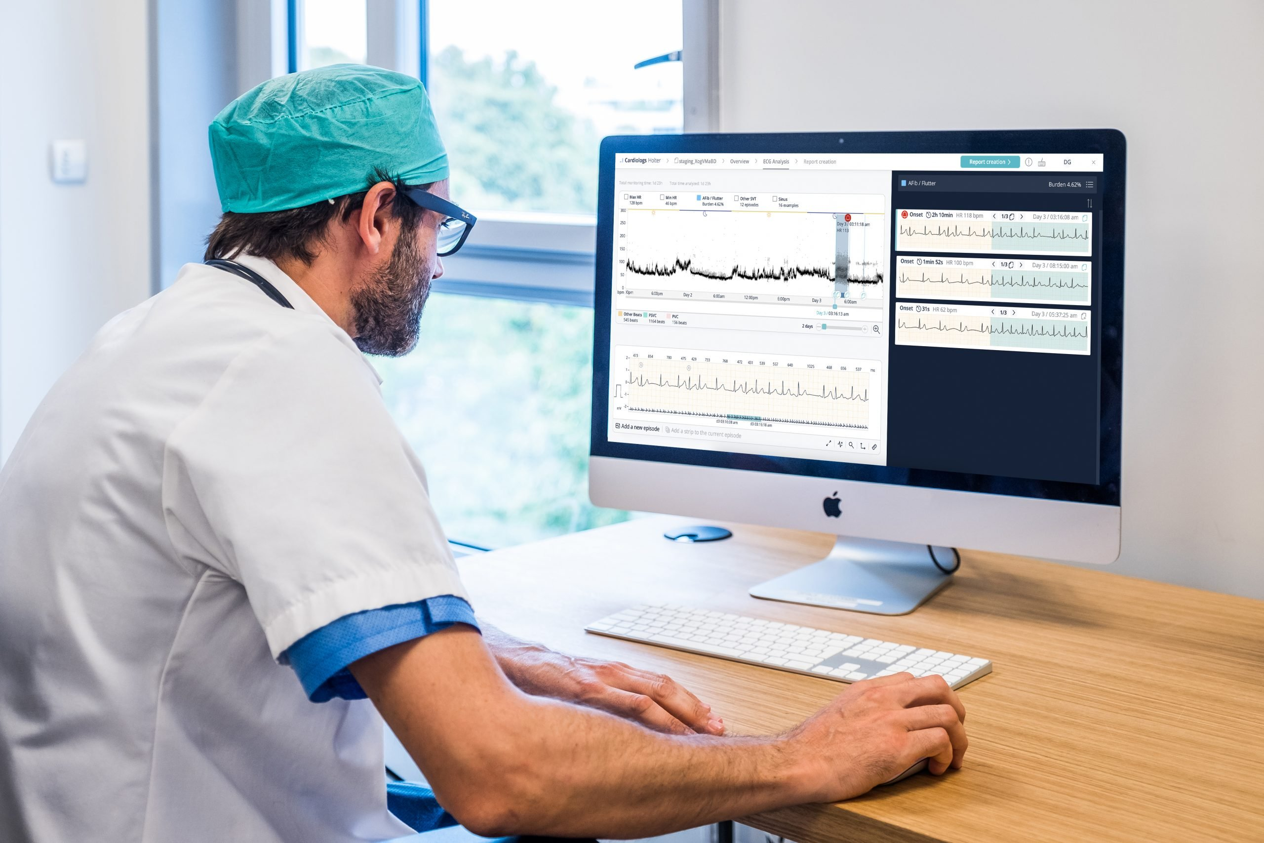
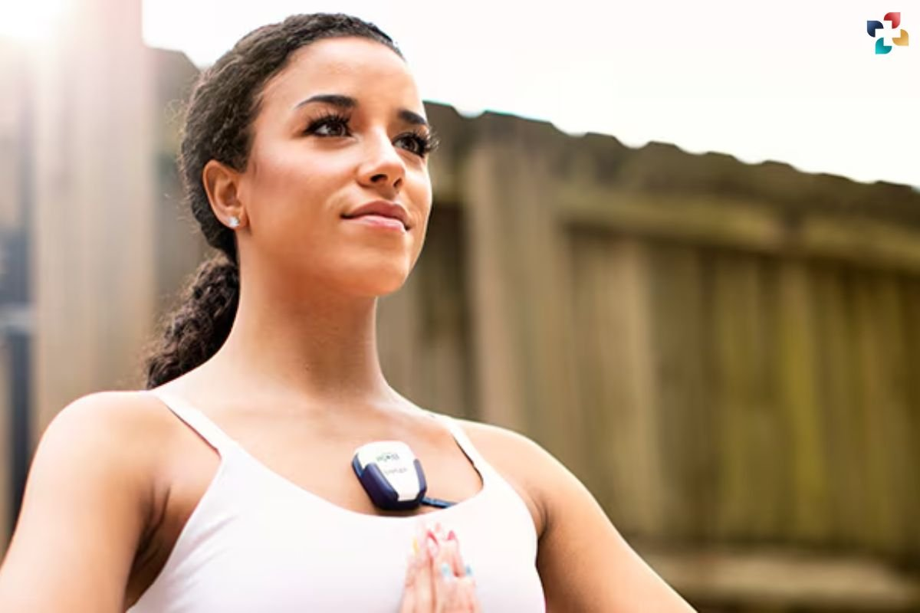
Considerations – Diagnostic Needs
Biomedical signals are subject to clinical evaluation
  Subjective and objective (e.g., AI algorithms) evaluation/ feature processing
    E.g., DC-Component to derive breathing rate from ECG
  Vital that clinical features remain intact
  The absence of a feature-extraction-resilient compression solution that encompasses multiple signal types is leading to solutions supporting only one signal type, which hinders cross-signal evaluation

Slide 4
Clinical Cardiology Landscape - 2025
Increasingly, monitoring and diagnosis of cardiology conditions is moving from the collection of short-duration heart telemetry performed in an exam-room to longer-duration heart telemetry studies performed ambulatory outside of a traditional exam-room setting
  Clinical-site-based collection of data is still an important use case, both for regular monitoring and for acute events
  The ability to collect data from a patient over multiple days increases the understanding of the patient’s specific situation and allows for a more precise diagnosis leading to improved treatment

Slide 5
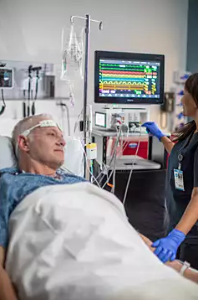
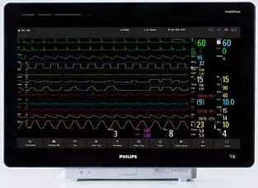
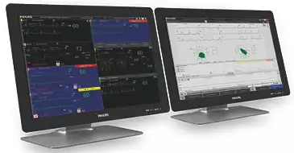
Bedside Patient Monitor - Hospital
Wired (multi-lead) bedside monitor collects real-time data continuously and displays on bedside monitor
Hospital staff may also monitor data from multiple patients via central monitoring system
Fully “wired” solution
Multi-lead real-time waveforms displayed bedside and on central monitoring system
Several “variants” for use “in the field” (Ambulance) applications

Slide 6
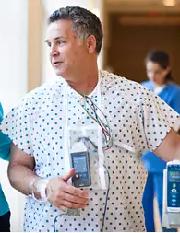
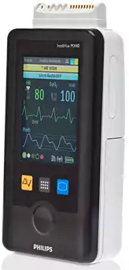


Philips Wearable Patient Monitor - Hospital
Clinician alerted when evaluation of anomalous results needed. Clinician may review patient data from central monitor
Wired (multi-lead) monitor collects real-time data continuously and transmits to in-hospital central monitoring system
Hospital staff continuously monitors data from multiple patients via central monitoring system
Clinician at central monitoring system receives alarms on clinical events
2 channels of real-time waveforms can be displayed directly on device and on central monitoring system
Wearable can work on rechargeable or disposable (AA) batteries
Allows for recovering patients to begin moving as part of recovery or to change locations within clinical site for treatment

Slide 7
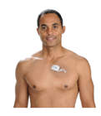
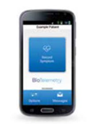

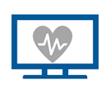
Philips Clinical Patch Workflow - Ambulatory
Place Order
Monitor continuously analyses patch data algorithmically
ECG Technicians review ECG transmissions (24/7) and alert clinician based on clinician’s notification protocol
Web portal reports for review to clinician and clinician provides intervention as needed
Patch collects real-time data continuously and transmits to monitor
Single-lead patch can be worn for 10-14 days before battery is exhausted
  12 bit, 2 channels, 50Hz
Three-lead version of patch can be worn for 3-5 days before battery is fully exhausted
The longer the patch can be continuously worn by the patient, the more accurate and complete the diagnosis

Slide 8
Non-clinical Heart Monitoring - 2025
As consumer wearable technology becomes the norm for consumers, it is now common for users of wearable technology to get continuous information on heart rate and other telemetry-like information
  These devices do not have the same quality and accuracy requirements as clinical devices. Data produced is of less-certain quality
There is a very large volume of data collected by consumer wearables and this data is finding its way into the clinical setting
Understanding the quality of this data, and its provenance, is necessary to properly situate this data in the health, wellness and fitness landscape

Slide 9
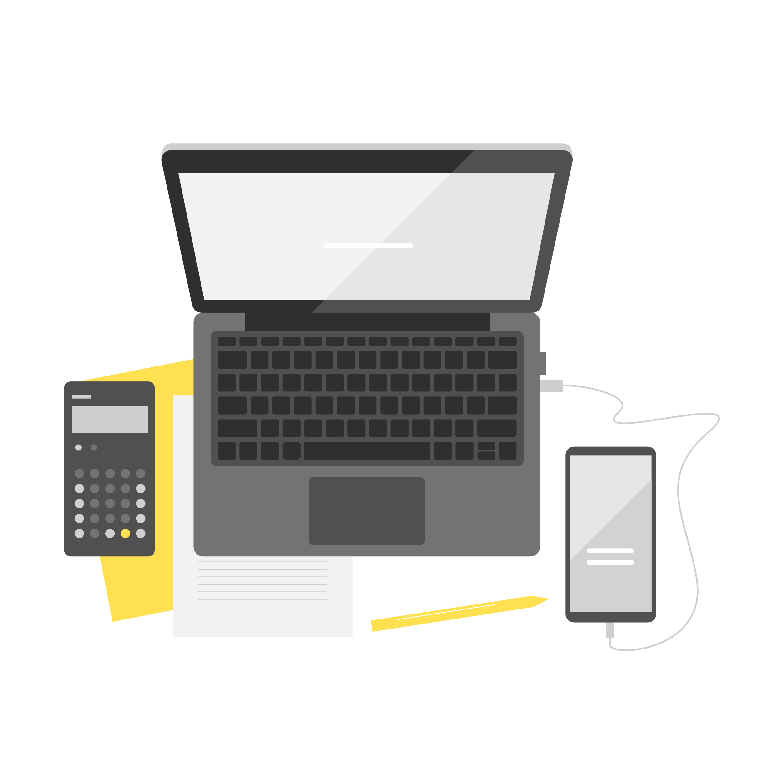

Consumer Wearable Use Case
Consumer Purchase
Watch collects data (continuously or at user request) and transmits to application, may be continuously or when requested
Mobile phone app displays near-real-time and retrospective data
Data may be uploaded to a device manufacturer web portal for further analysis and aggregation with other user’s data
(Mostly) single-sensor devices
Watches are worn intermittently (and unpredictably)
Watches are commonly worn too “loose” to produce high quality results

