Slide 1
Presentation cover slide example: Vertical white logo on blue background
Thoughts on datasets and computational load reduction.

Slide 2
High level summary
BX05 proposed:
  3 additional datasets for 24bit EEG dataset
  Reducing the number of files used per dataset to reduce the overall computational load.
A discussion between interested parties from Fraunhofer HHI, Dolby, ETRI and Philips resulted in:
  Suggestion to evaluate the three datasets further, and propose one for inclusion, consult with Dicom.
    Defer to next meeting
  Reduce the number of files used in the EEG datasets by 50%
  Reduce the number of operating points evaluated in the EEG datasets in the low BPS range.
  Include an additional ECG dataset including 12-lead data.

Slide 3
Potential Datasets.
3 datasets were suggested, that all contain EEG data in the BDF file format.
  Concerns were raised that while the data is contained in a 24-bit file format, it may not be using the 24-bit range.
  Agreed to further study the datasets to ensure that they are making sufficient use of the 24-bit data range.
  As the current encoder cannot load the BDF files, selection of the data can happen while the addition of file support is added to the encoder in parallel.

Slide 4
Data Reduction
ETRI provided an overview of their encoding times.
Broadly this is inline with the experience of others, though Fraunhofer HHI report significantly lower times for NMR55 (Still in the order of days)
Dataset Name | Category | No. of Files | Total Size | Processing Time @ 32 Cores
MIT | ECG | 48 | 768 MB | < 1 hour
CHBMIT | EEG | 137 | 7.3 GB | ~1.5 Days
NMR55 | EEG | 254 | 34 GB | ~6 days
NMR57 | EEG | 58 | 35 GB | ~6 days
Ozdemir | EMG | 39 | 284 MB | < 1 hour

Slide 5
Data Reduction
It was agreed to reduce the number of files used in the EEG datasets by half with the caveats:
  Maintain the balance of ‘headband’ and ‘psg’ recordings in the NMR55 dataset.
  Maintain the balance of ‘monopolar’ and ‘bipolar’ recordings in the NMR57 dataset.
  Ensure that the randomly selected files have a comparable performance w.r.t. the rate distortion curve as the full set (e.g. no significant BD change between the subset and full set)
  Maintain balance of clinically relevant features.
Additionally, reduce the number of operating points evaluated in the EEG datasets at the high compression ratios.
  At this point the difference in bitrate and error is small, and densely sampled.
  Currently (21 working points):
    QP_Step_Sizes =[1, 1.125, 1.5, 2, 3, 4, 5.5, 7, 9, 11, 13.5, 16, 22, 33, 44, 55, 66, 77, 88, 99, 110]
  Proposed (17 working points, reduction of ~20%):
    QP_Step_Sizes =[1, 1.125, 1.5, 2, 3, 4, 5.5, 7, 9, 11, 13.5, 16, 22, 44, 66, 88, 110]

Slide 6
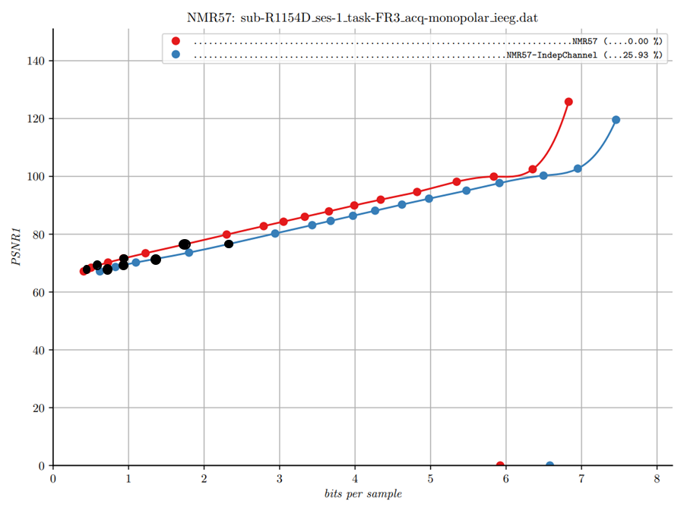
Data Reduction

Slide 7
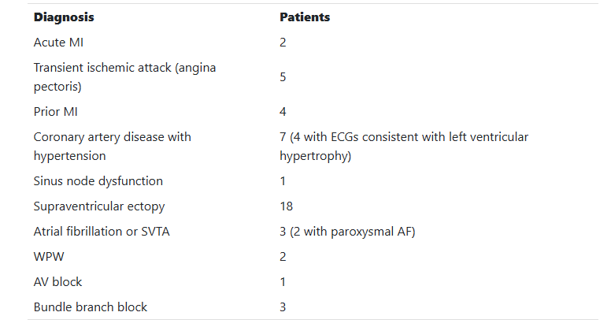
Additional ECG Data
It was noted in the discussion that adding an additional EEG dataset puts a heavy emphasis on EEG data.
ECG data is an important use-case so additional datasets would be beneficial.
One set that could be used is the St Petersburg INCART dataset:
  https://physionet.org/content/incartdb/1.0.0/
  12-lead compared to the current 2-lead data.
  75 recordings of 30 minutes each
  257Hz Sample rate.
  Variation in coronary artery diseases.
  Data is provided in WFDB format and needs conversion to EDF – one company should provide the converted data.

Slide 8
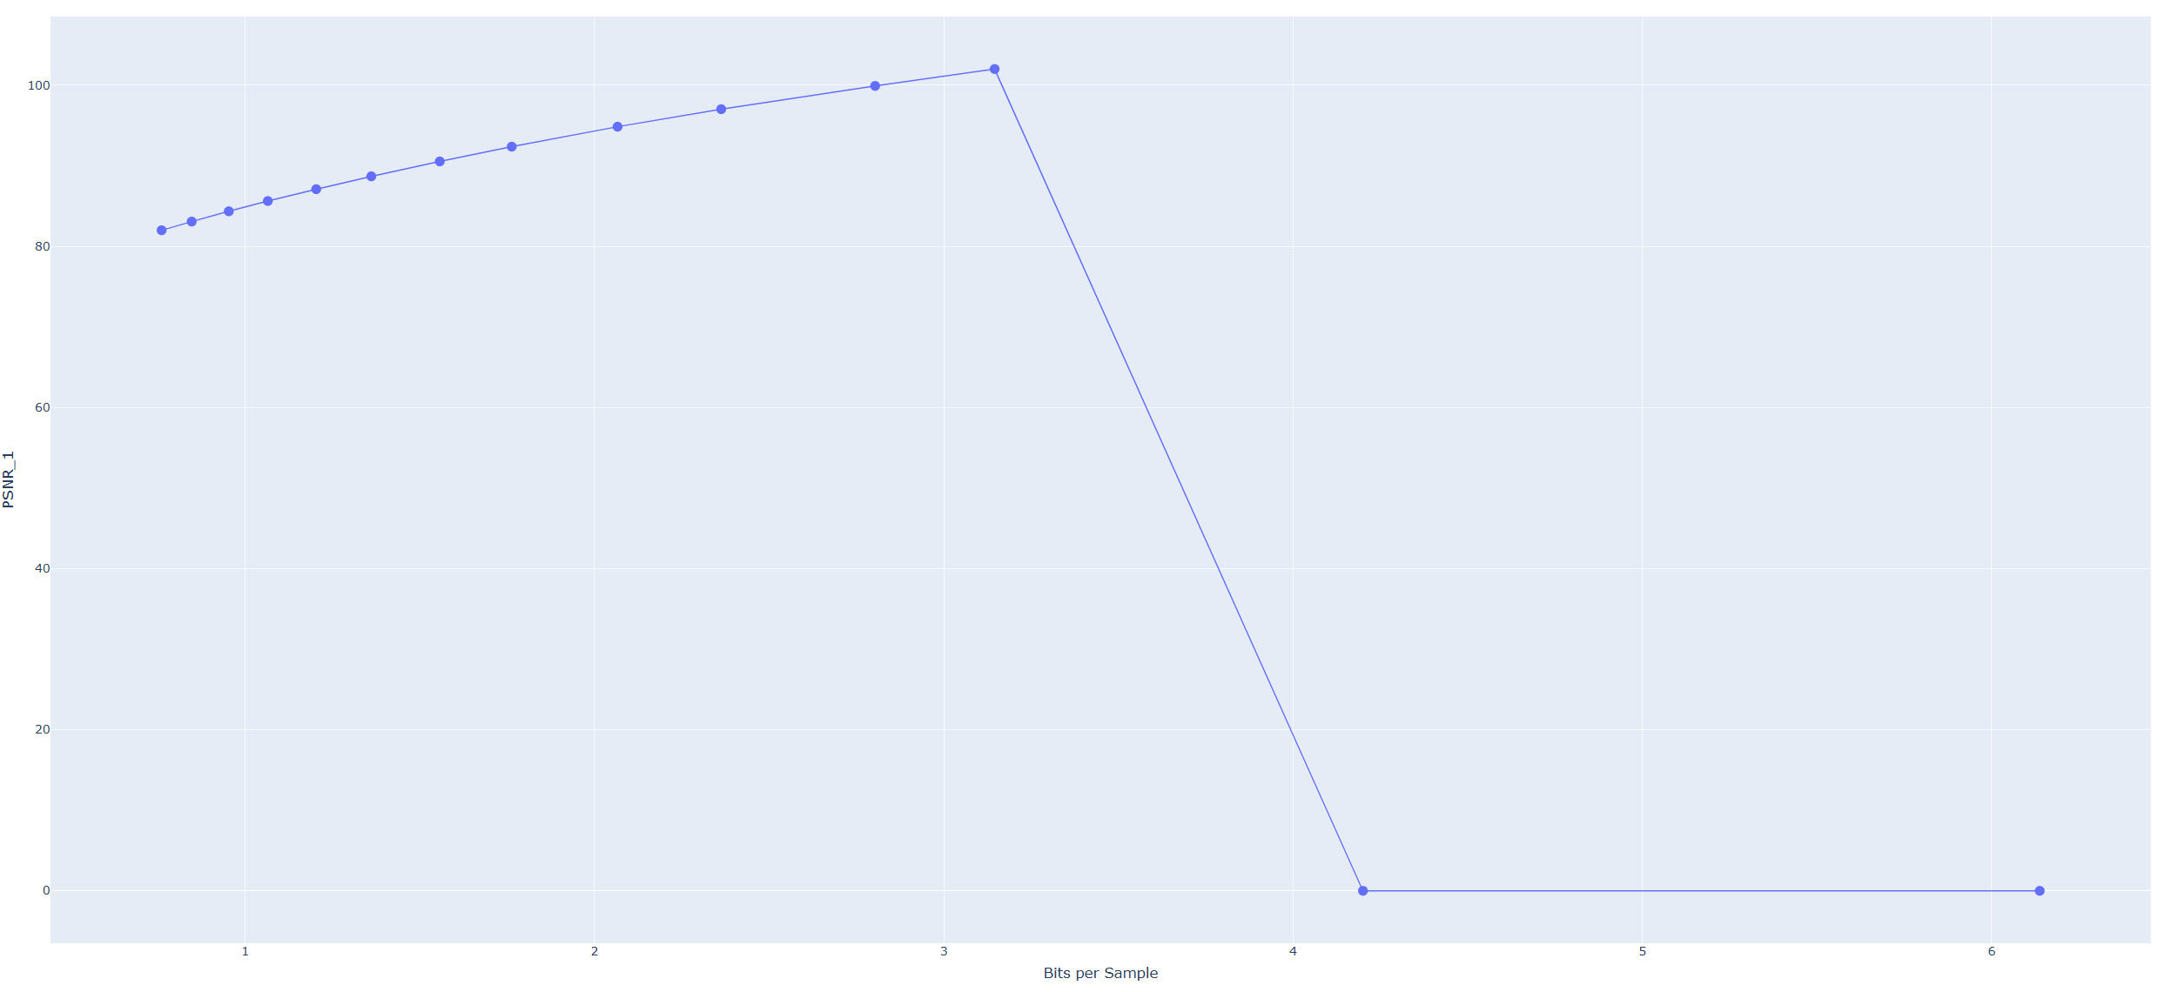
Additional ECG Data
INCARTDB – Default Encoder tuning. QP = 1 and 1.125 both return lossless performance.

