Slide 1
Presentation cover slide example: Vertical white logo on blue background
VCEG-BY14 – Inclusion of quality metrics

Slide 2
Motivation
For widespread adoption of the standard in the healthcare domain it is important that the clinicians have confidence in the output of any lossy compression
They can reliably detect what is a true signal artefact, an artefact introduced by poor signal capture, and an artefact introduced by the compression.
The current specification includes a distortion metric, but this is one value per interframe period (~9000 samples)
We see that this does not have sufficiently fine-grained resolution.

Slide 3
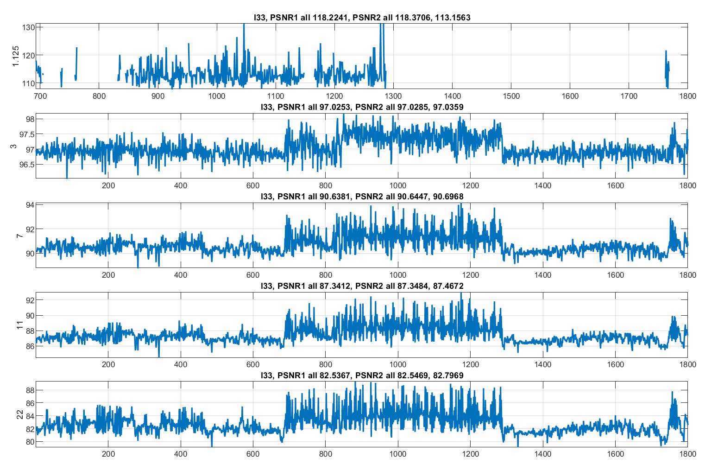
Recording I33 from incartdb dataset.
PSNR1, in 256 sample windows
At QP =22, whole file PSNR1 = 82.5 dB, but varies between ~80 and ~89 dB.

Slide 4
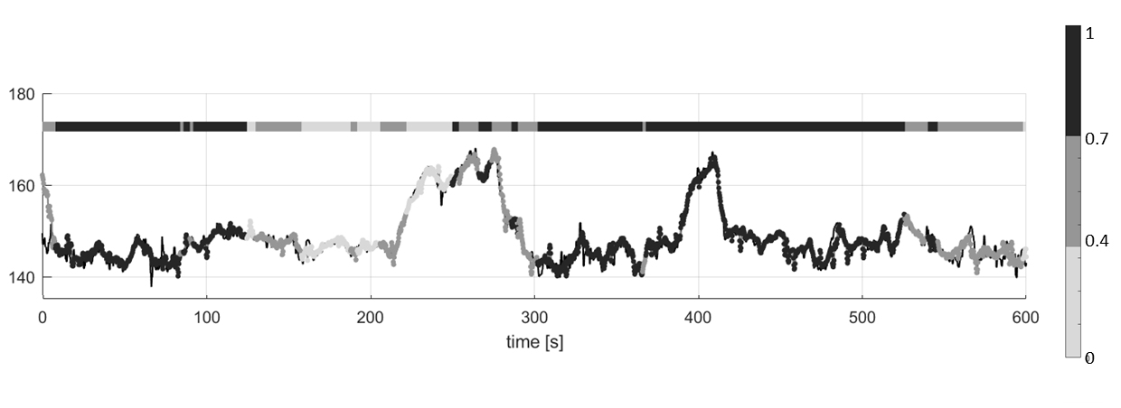

Slide 5
Proposed Solution
Extension of either the annotation channel syntax, or the feature set syntax, to optionally include fine-grained distortion metrics.
This can be either as raw distortion metrics, or quantized to ranges dependent on the signal modality and compression level.
Optionally, allow for the inclusion of signal quality metrics that can be generated by the recording device.
  Many devices measure parameters such as impedance between electrode pairs to automatically signal measurement issues, this is also an important metric to make available to clinicians.
As this does not touch the core codec, how to evaluate? We can bring complete implementation and syntax changes at the next meeting.

