Slide 1
Report on CE-4 and CE-5

Slide 2
Current H.BWC
LMS-branch:
  No block-based prediction
  LMS prediction for DCT-coefficients
  Huffman coding of DCT-coefficients
Block-based prediction branch:
  Block-based prediction (block-matching + cross-channel + DC prediction)
  DCT-transform coding of prediction residuals
  CABAC entropy coding of DCT-coefficients

Slide 3
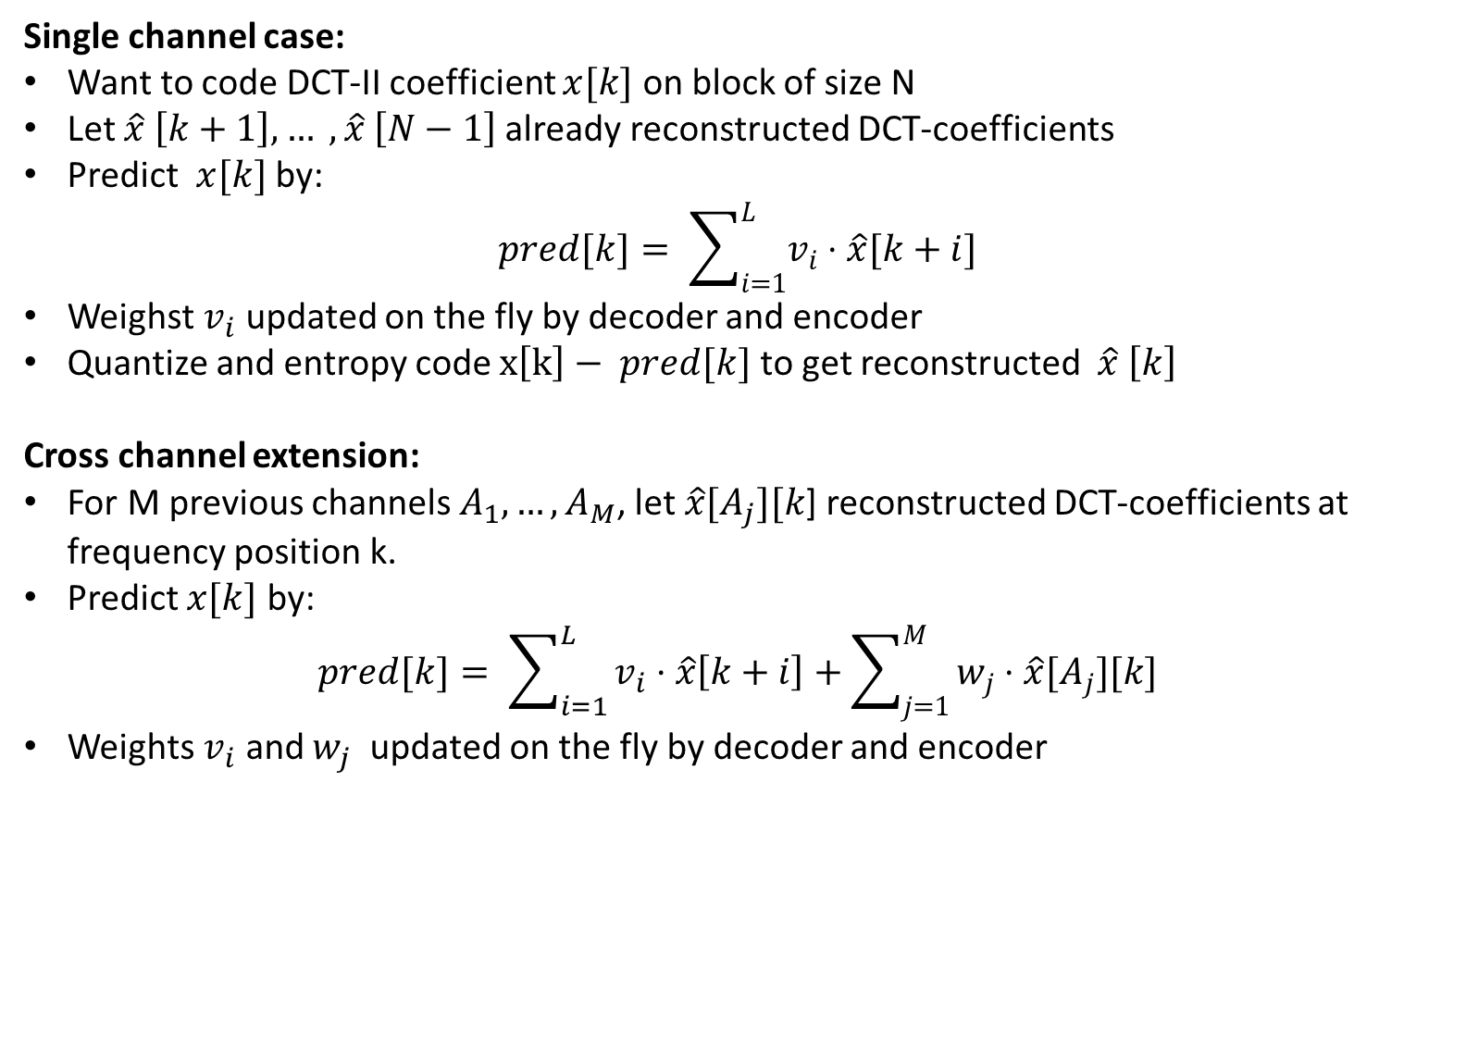
Review of LMS
Single channel case:
Want to code DCT-II coefficient $x[k]$ on block of size N
Let $\hat{x} \left[k+1\right], … , \hat{x} \left[N−1\right]$already reconstructed DCT-coefficients
Predict $x[k]$ by:
$pred[k]= \sum_{i=1}^{L}{v_{i}⋅\hat{x}[k+i]}$
Weighst $v_{i}$ updated on the fly by decoder and encoder
Quantize and entropy code $x\left[k\right]− pred[k]$ to get reconstructed $\hat{x} \left[k\right]$
Cross channel extension:
For M previous channels $A_{1},…,A_{M}$, let $\hat{x}[A_{j}][k$] reconstructed DCT-coefficients at frequency position k.
Predict $x[k]$ by:
$pred[k]= \sum_{i=1}^{L}{v_{i}⋅\hat{x}\left[k+i\right]+\sum_{j=1}^{M}{w_{j}⋅\hat{x}[A_{j}][k]}}$
Weights $v_{i}$ and $w_{j}$ updated on the fly by decoder and encoder

Slide 4
Goal of CE
Combination/unification of above two branches:
CABAC replacing Huffman in LMS branch
-> One entropy coding branch
Combine LMS and block-based prediction

Slide 5
Outline of CE-4
CE-4-LMS-Only Anchor: Use only LMS-branch
Fixed block size 2048
No block-based prediction
DCT-II transform
LMS prediction in DCT-II domain from current H.BWC
Huffman coding of DCT-II coefficients
CE-4 test: As CE-4-LMS-Only Anchor, but:
Replace Huffman by CABAC-entropy coding
CABAC either from current H.BWC or with modifications of CE 3
Thus: CE-4 studies individual impact of using CABAC for LMS

Slide 6
Outline of CE-5
Combine LMS and block-based prediction to a single branch:
Use LMS on residual of block-based prediction
On-off flag for LMS.
Inter-channel-LMS: Use DCT-coefficients only if same block-based prediction type used.
CABAC-entropy coding always used.
To not increase encoder-runtime: Restrict full-RD tests of block-based prediction compared to anchor

Slide 7
CE-4-x-1, CE-4-x-2, CE-5-x-1, CE-5-x-2
Three quantization methods as value for x:
  x=1: Scalar uniform reconstruction quantizer + simple quantization at encoder
  x=2: Scalar uniform reconstruction quantizer + RDOQ at encoder
  x=3: Trellis coded quantization with 4 states
Two CABAC versions:
  SW-v1: CABAC of current H.BWC
  Used for CE-4-x-1 and CE-5-x-1
  SW-v2: CABAC of current H.BWC + changes from CE-3.
  Used for CE-4-x-2 and CE-5-x-2

Slide 8
Results of CE-4 over LMS anchor, joint channel coding
 | MIT (ECG) | INCART (ECG) | CHBMIT (EEG) | NMR55 (EEG) | NMR57 (EEG) | Ozdemir (EMG) | Overall
 | BD-PSNR1 | BD-PSNR1 | BD-PSNR1 | BD-PSNR1 | BD-PSNR1 | BD-PSNR1 | BD-PSNR1 | BD-PSNR2 | EncT | DecT
CE 4-1-1 | 1,09% | -31,57% | -17,56% | -8,51% | -22,62% | -0,01% | -13,20% | -13,08% | 163% | 254%
CE 4-1-2 | -3,43% | -34,10% | -20,28% | -10,87% | -24,50% | -1,27% | -15,74% | -15,63% | 127% | 194%
CE 4-2-1 | 2,41% | -29,10% | -17,39% | -8,16% | -23,01% | 0,01% | -12,54% | -12,65% | 194% | 251%
CE 4-2-2 | -6,07% | -33,85% | -21,33% | -11,99% | -25,96% | -2,09% | -16,88% | -16,81% | 191% | 193%
CE 4-3-1 | 1,69% | -29,09% | -18,91% | -9,37% | -23,82% | -2,24% | -13,63% | -13,79% | 391% | 251%
CE 4-3-2 | -9,91% | -36,37% | -24,81% | -15,28% | -29,39% | -5,38% | -20,19% | -20,11% | 334% | 187%

Slide 9
Results of CE-4 over LMS anchor, independent channel coding
 | MIT (ECG) | INCART (ECG) | CHBMIT (EEG) | NMR55 (EEG) | NMR57 (EEG) | Ozdemir (EMG) | Overall
 | BD-PSNR1 | BD-PSNR1 | BD-PSNR1 | BD-PSNR1 | BD-PSNR1 | BD-PSNR1 | BD-PSNR1 | BD-PSNR2 | EncT | DecT
CE 4-1-1 | 1,09% | -31,57% | -17,56% | -8,51% | -22,62% | -0,01% | -13,20% | -13,08% | 163% | 254%
CE 4-1-2 | -3,43% | -34,10% | -20,28% | -10,87% | -24,50% | -1,27% | -15,74% | -15,63% | 127% | 194%
CE 4-2-1 | 2,41% | -29,10% | -17,39% | -8,16% | -23,01% | 0,01% | -12,54% | -12,65% | 194% | 251%
CE 4-2-2 | -6,07% | -33,85% | -21,33% | -11,99% | -25,96% | -2,09% | -16,88% | -16,81% | 191% | 193%
CE 4-3-1 | 1,69% | -29,09% | -18,91% | -9,37% | -23,82% | -2,24% | -13,63% | -13,79% | 391% | 251%
CE 4-3-2 | -9,91% | -36,37% | -24,81% | -15,28% | -29,39% | -5,38% | -20,19% | -20,11% | 334% | 187%

Slide 10
Results of CE-4 over CTC anchor, joint channel coding
 | MIT (ECG) | INCART (ECG) | CHBMIT (EEG) | NMR55 (EEG) | NMR57 (EEG) | Ozdemir (EMG) | Overall
 | BD-PSNR1 | BD-PSNR1 | BD-PSNR1 | BD-PSNR1 | BD-PSNR1 | BD-PSNR1 | BD-PSNR1 | BD-PSNR2 | EncT | DecT
CE 4-4-1 | 34,55% | 12,88% | 5,96% | 10,89% | 8,41% | 2,56% | 12,54% | 13,09% | 4% | 208%
CE 4-4-2 | 28,53% | 8,78% | 2,55% | 8,19% | 5,97% | 1,28% | 9,22% | 9,77% | 3% | 159%
CE 4-5-1 | 38,17% | 18,24% | 6,14% | 11,23% | 8,24% | 2,60% | 14,10% | 14,38% | 5% | 206%
CE 4-5-2 | 24,82% | 9,27% | 1,22% | 6,91% | 4,47% | 0,44% | 7,85% | 8,34% | 5% | 159%
CE 4-6-1 | 37,21% | 18,22% | 4,16% | 9,81% | 7,05% | 0,25% | 12,78% | 12,99% | 10% | 206%
CE 4-6-2 | 19,57% | 5,22% | -3,23% | 3,08% | -0,10% | -2,93% | 3,60% | 4,09% | 8% | 155%

Slide 11
Results of CE-4 over CTC anchor, independent channel coding
 | MIT (ECG) | INCART (ECG) | CHBMIT (EEG) | NMR55 (EEG) | NMR57 (EEG) | Ozdemir (EMG) | Overall
 | BD-PSNR1 | BD-PSNR1 | BD-PSNR1 | BD-PSNR1 | BD-PSNR1 | BD-PSNR1 | BD-PSNR1 | BD-PSNR2 | EncT | DecT
CE 4-4-1 | 39,35% | 42,59% | 5,74% | 10,47% | 8,25% | 2,80% | 18,20% | 18,85% | 4% | 151%
CE 4-4-2 | 33,01% | 38,04% | 2,60% | 7,90% | 6,27% | 1,53% | 14,89% | 15,54% | 4% | 132%
CE 4-5-1 | 43,38% | 47,84% | 5,73% | 10,74% | 8,14% | 2,87% | 19,78% | 20,18% | 5% | 146%
CE 4-5-2 | 29,06% | 36,43% | 1,35% | 6,90% | 5,07% | 0,71% | 13,25% | 13,89% | 6% | 131%
CE 4-6-1 | 42,39% | 48,27% | 4,13% | 9,11% | 6,53% | 0,49% | 18,49% | 18,77% | 9% | 147%
CE 4-6-2 | 23,69% | 31,74% | -2,62% | 3,03% | 1,09% | -2,70% | 9,04% | 9,65% | 9% | 130%

Slide 12
Results of CE-5, joint channel coding
 | MIT (ECG) | INCART (ECG) | CHBMIT (EEG) | NMR55 (EEG) | NMR57 (EEG) | Ozdemir (EMG) | Overall
 | BD-PSNR1 | BD-PSNR1 | BD-PSNR1 | BD-PSNR1 | BD-PSNR1 | BD-PSNR1 | BD-PSNR1 | BD-PSNR2 | EncT | DecT
CE 5-1-1 | 8,09% | -17,42% | 1,99% | 9,05% | 4,76% | 3,42% | 1,65% | 2,14% | 37% | 147%
CE 5-1-2 | 7,09% | -17,94% | -1,93% | 5,73% | 1,99% | 1,12% | -0,65% | -0,18% | 37% | 145%
CE 5-2-1 | 5,13% | -20,10% | 0,95% | 8,89% | 3,60% | 3,35% | 0,30% | 0,59% | 41% | 146%
CE 5-2-2 | 3,89% | -20,52% | -4,01% | 4,43% | -0,10% | 0,22% | -2,68% | -2,27% | 48% | 144%
CE 5-3-1 | 1,47% | -23,10% | -1,30% | 7,14% | 1,48% | 1,30% | -2,17% | -1,96% | 71% | 144%
CE 5-3-2 | -0,14% | -23,66% | -7,97% | 0,82% | -4,30% | -3,04% | -6,38% | -5,98% | 85% | 177%

Slide 13
Results of CE-5, independent channel coding
 | MIT (ECG) | INCART (ECG) | CHBMIT (EEG) | NMR55 (EEG) | NMR57 (EEG) | Ozdemir (EMG) | Overall
 | BD-PSNR1 | BD-PSNR1 | BD-PSNR1 | BD-PSNR1 | BD-PSNR1 | BD-PSNR1 | BD-PSNR1 | BD-PSNR2 | EncT | DecT
CE 5-1-1 | 10,41% | 6,82% | 6,25% | 10,19% | 7,02% | 3,91% | 7,43% | 8,03% | 29% | 131%
CE 5-1-2 | 9,22% | 5,96% | 2,41% | 6,85% | 4,87% | 1,61% | 5,15% | 5,73% | 29% | 128%
CE 5-2-1 | 7,86% | 4,79% | 5,63% | 10,00% | 6,34% | 3,90% | 6,42% | 6,85% | 33% | 129%
CE 5-2-2 | 6,32% | 3,84% | 1,00% | 5,78% | 3,43% | 0,74% | 3,52% | 4,08% | 38% | 128%
CE 5-3-1 | 4,42% | 1,56% | 3,49% | 8,12% | 3,95% | 1,77% | 3,89% | 4,21% | 49% | 128%
CE 5-3-2 | 2,60% | 0,42% | -2,91% | 2,01% | -0,50% | -2,61% | -0,17% | 0,36% | 53% | 127%

Slide 14
Proposed action
  Adopt changes incorporated into SW-v-2:
  Single entropy coding branch (CABAC)
  Combination of the major building blocks of H.BWC (LMS + block-based prediction)
  Experimental results reveal benefit in terms of compression performance / enc-time in various testing scenarios.

