Slide 1
Entropy coding modifications for H.BWC

Slide 2
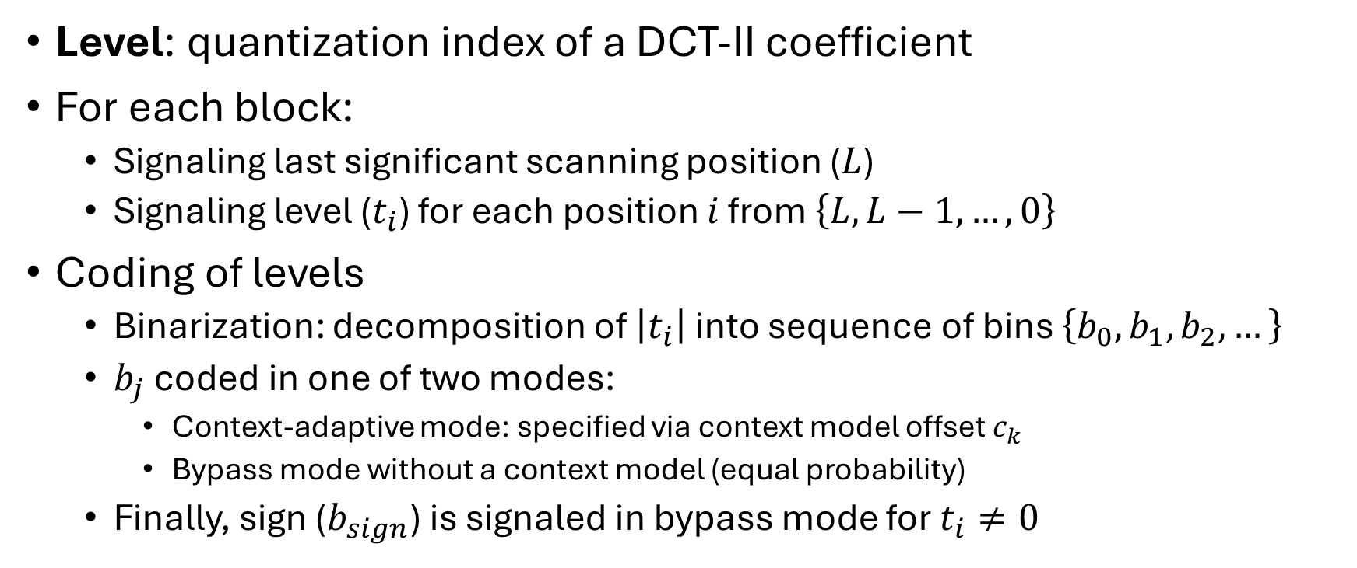
Level coding with CABAC in H.BWC (I)
Level: quantization index of a DCT-II coefficient
For each block:
Signaling last significant scanning position ($L$)
Signaling level ($t_{i}$) for each position $i$ from $\left\{L,L−1,…,0\right\}$
Coding of levels
Binarization: decomposition of $\left|t_{i}\right|$ into sequence of bins $\left\{b_{0},b_{1},b_{2},…\right\}$
$b_{j}$ coded in one of two modes:
Context-adaptive mode: specified via context model offset $c_{k}$
Bypass mode without a context model (equal probability)
Finally, sign ($b_{sign}$) is signaled in bypass mode for $t_{i}≠0$

Slide 3
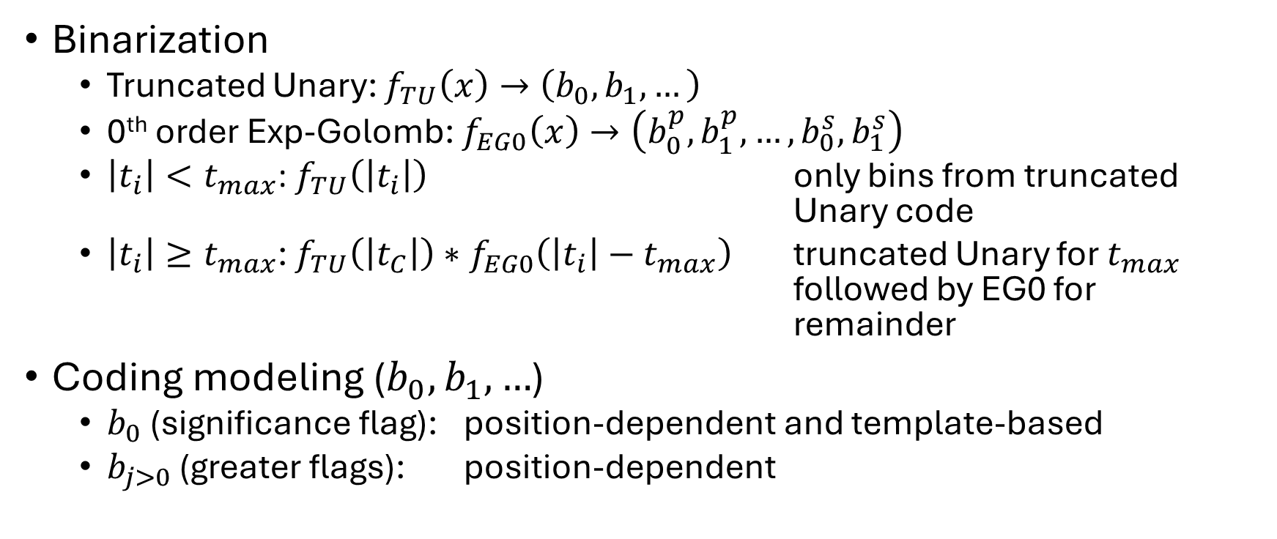
Level coding with CABAC in H.BWC (II)
Binarization
Truncated Unary: $f_{TU}\left(x\right)→\left(b_{0},b_{1},…\right)$
0th order Exp-Golomb: $f_{EG0}\left(x\right)→\left(b_{0}^{p},b_{1}^{p},…,b_{0}^{s},b_{1}^{s}\right)$
$\left|t_{i}\right|<t_{max}$: $f_{TU}\left(\left|t_{i}\right|\right)$ only bins from truncated Unary code
$\left|t_{i}\right|≥t_{max}$: $f_{TU}\left(\left|t_{C}\right|\right)∗f_{EG0}\left(\left|t_{i}\right|−t_{max}\right)$ truncated Unary for $t_{max}$ followed by EG0 for remainder
Coding modeling ($b_{0},b_{1},…$)
$b_{0}$ (significance flag): position-dependent and template-based
$b_{j>0}$ (greater flags): position-dependent

Slide 4
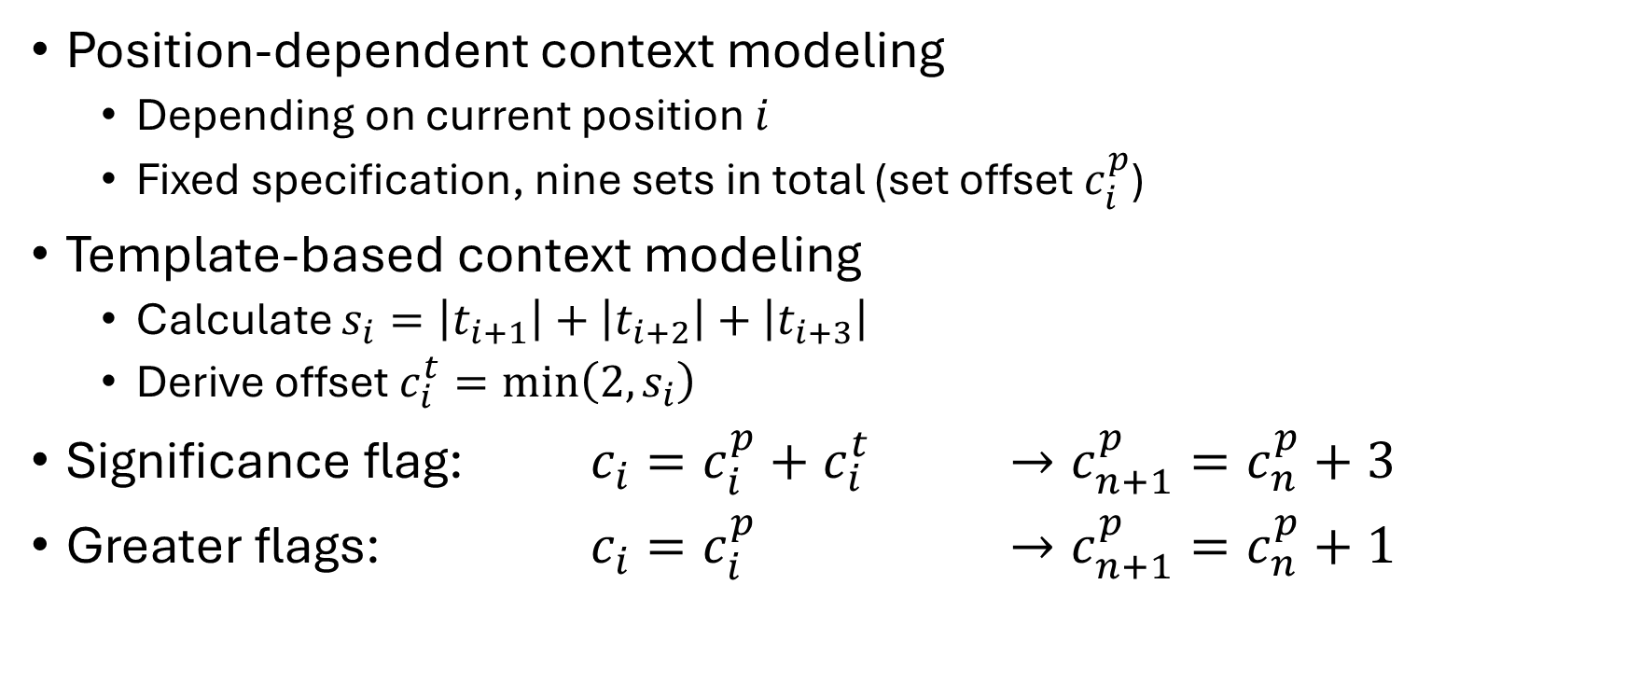
Level coding with CABAC in H.BWC (III)
Position-dependent context modeling
Depending on current position $i$
Fixed specification, nine sets in total (set offset $c_{i}^{p}$)
Template-based context modeling
Calculate $s_{i}=\left|t_{i+1}\right|+\left|t_{i+2}\right|+\left|t_{i+3}\right|$
Derive offset $c_{i}^{t}=min\left(2,s_{i}\right)$
Significance flag: ${c_{i}=c_{i}^{p}+c}_{i}^{t}$ $→c_{n+1}^{p}=c_{n}^{p}+3$
Greater flags: $c_{i}=c_{i}^{p}$ $→c_{n+1}^{p}=c_{n}^{p}+1$

Slide 5
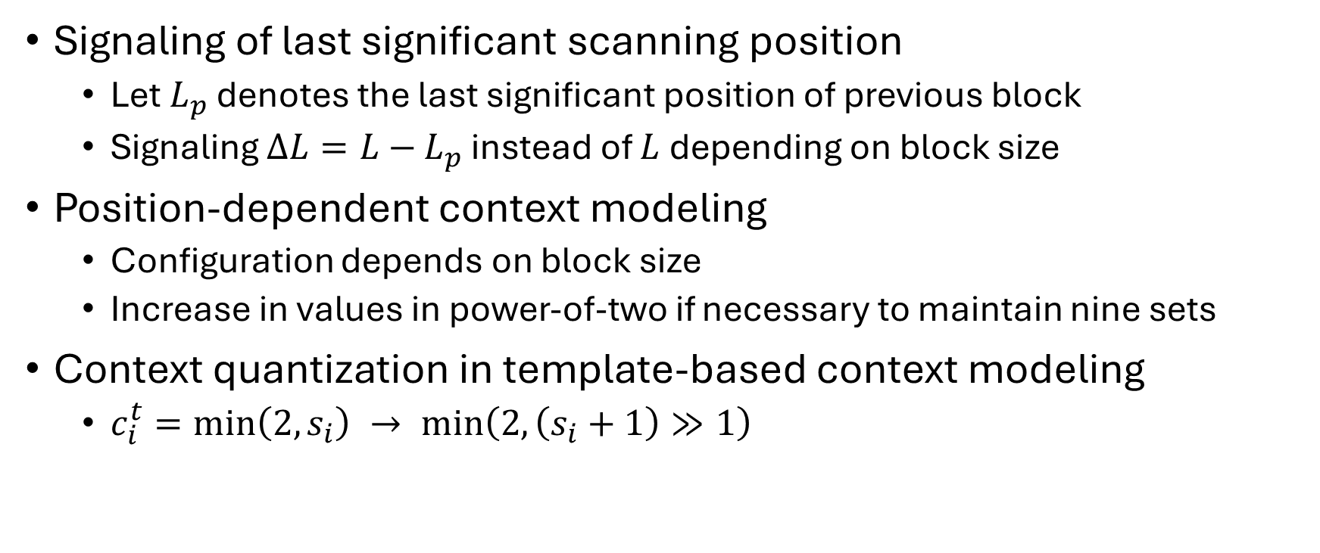
Proposed modifications (I)
Signaling of last significant scanning position
Let $L_{p}$ denotes the last significant position of previous block
Signaling $∆L=L−$ $L_{p}$ instead of $L$ depending on block size
Position-dependent context modeling
Configuration depends on block size
Increase in values in power-of-two if necessary to maintain nine sets
Context quantization in template-based context modeling
$c_{i}^{t}=min\left(2,s_{i}\right) → min\left(2, \left(s_{i}+1\right)≫1\right)$

Slide 6
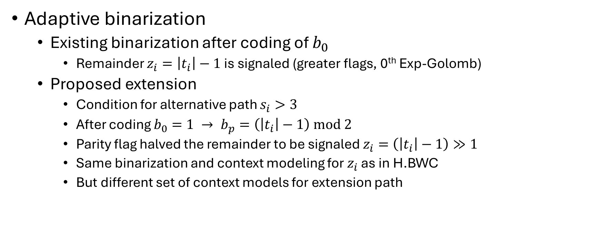
Proposed modifications (II)
Adaptive binarization
Existing binarization after coding of $b_{0}$
Remainder $z_{i}=\left|t_{i}\right|−1$ is signaled (greater flags, 0th Exp-Golomb)
Proposed extension
Condition for alternative path $s_{i}>3$
After coding $b_{0}=1 → b_{p}=\left(\left|t_{i}\right|−1\right) mod 2$
Parity flag halved the remainder to be signaled $z_{i}=\left(\left|t_{i}\right|−1\right)≫1$
Same binarization and context modeling for $z_{i}$ as in H.BWC
But different set of context models for extension path

Slide 7
Experimental results (CTC)
BD-rate EncT DecT
ECG-data -0.31% 100.77% 100.64%
EMG-data -3.49% 103.62% 106.11%
EEG-data -1.36% 103.54% 101.19%
Results show that extension works for conditions of CTC
Non-CTC conditions
Higher compression efficiency observed

