Slide 1
VCEG-BX08 | m72255
Gap analysis and suggested updates to next-generation video coding requirements draft
Jonatan Samuelsson-Allendes
Sachin Deshpande
Tomohiro Ikai (Sharp)

Slide 2
Outline
Introduction
Film grain and digital noise
Mobile video content uploading
Packet loss resilience

Slide 3
Introduction
A gap analysis has been performed relative to existing MPEG/VCEG video coding standards. Updates are proposed to the requirements document based on the gap analysis.
The start of a new standardization project is a chance to challenge conventions and apply an open mindset to adoption of new technology, ways of working, scope of the project, etc.

Slide 4
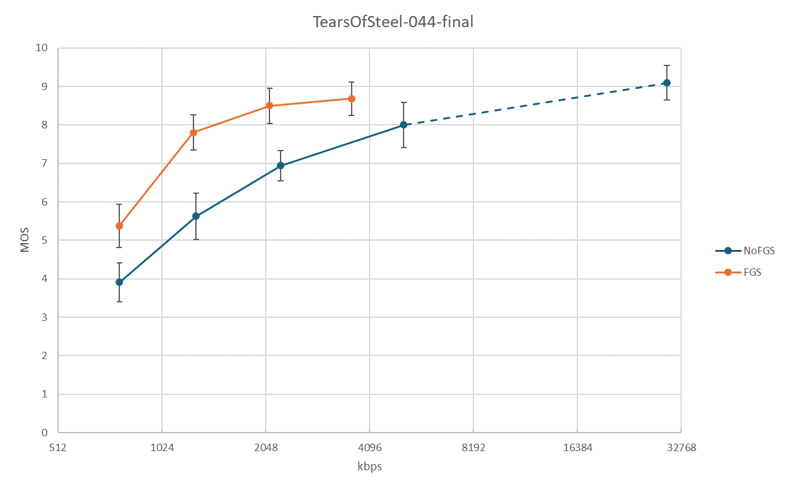
Film grain and digital noise
Film grain and digital noise can have a significant impact on visual quality.
Optional SEI-based solutions for film grain synthesis have ended up in a chicken-and-egg problem.
Example result for Film Grain Synthesis from JVET-AJ0374
Proposal:
- Specific content types to be addressed:
▪ Content with film grain and content with digital noise.

Slide 5
Mobile video content uploading
Usage of cloud storage and social networking services (SNS) is continuously increasing. Bitrate reductions for mobile video content uploading is highly important due to limited uplink speeds. We expect a sweet spot for real time encoding around 2.5x the encoding complexity of VVC.
Connection | Downlink | Uplink
5G | 340 Mbps | 81 Mbps
4G | 20-50 Mbps | 10-15 Mbps
Home broadband | 100 Mbps | 10–20 Mbps
Example downlink and uplink speeds
Proposal:
- Anticipated use cases include:
▪ Mobile video content uploading for cloud storage and social networking services (SNS) applications.

Slide 6
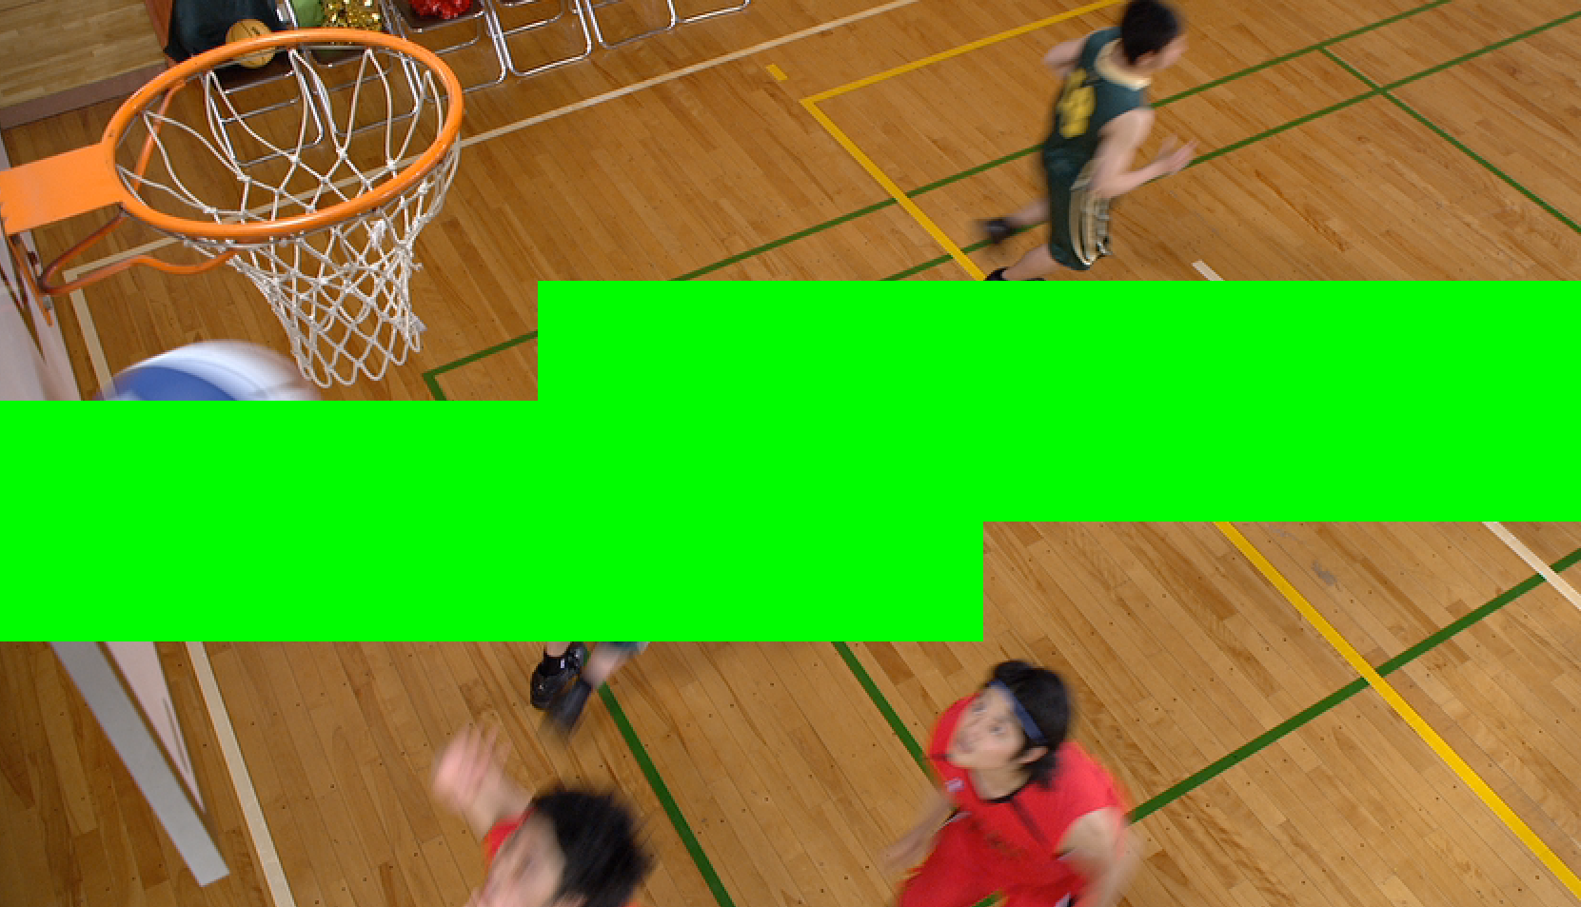
Packet loss resilience
Data loss can correspond to one or multiple pictures but can also correspond to parts of a coded picture.
In-picture error concealment of partially lost coded pictures may be particularly important in applications with very strict latency requirements.
Example of data loss of parts of a coded picture
Proposal:
- The standard should provision for error concealment techniques to handle loss of data
corresponding to parts of a coded picture.

