Slide 1
The role of ICT to combat Climate change ...is there a Danger we fall into a trap ?
An exploration of humans future use of ICT tools to combat climate change and the need for a secure ICT Telecom Network foundation.
LEONARD DONNELLY, LOCATION BRIDGE
COPENHAGEN, DEC 2009
Email: Leonard.donnelly@locationbridge.net

Slide 2
Animals “…solve the trap problem when the confound of tool-use is removed”....however, results went on to ...“show that including a tool in the trap problem profoundly affects the ability of animals to solve it.”
Journal of Experimental Psychology: © 2009 American Psychological Association
Animal Behavior Processes
2009, Vol. 35, No. 1, 23–34

Slide 3
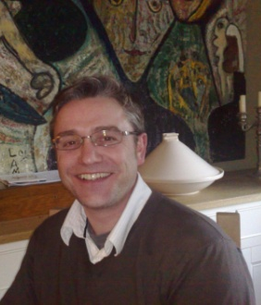
“Ireland has a long history of understanding man made and natural calamities.”
Chairman UNESCO World Heritage Site Working Group,
The global consequences & lessons of Ireland’s Great Famine 1845 – 1850
LEONARD DONNELLY - Professional History
- 20 years in the International ICT Industry
- Executive Chairman: LocationBridge, Smart Digital Economy Networks
- Chairman: National Digital Hub Development Agency, Ireland
- Former Roles:
- Executive Chairman: Intune Networks, Cinehub, Dublin Bay Capital
- VP Network Management: Ericsson Marconi
- Executive Director: Euristix Telecoms Ireland

Slide 4
A Personal experience of Climate Change
“November’s flooding in the Irish Republic was the worst the country had experienced in 800 years, Environment Minister John Gormley said.”
BBC November 2009
Cork City
Planning
Office
James Lovelock, of GAIA fame, recently described Ireland as a “lifeboat for humanity”.
Irish Times 2009

Slide 5
Dichotomy of a ICT Digital Revolution in Combating Climate Change !
The Global Republic of Climate Change : Liberty, Equality, Fraternity ?
Developed countries embark on a new digital economic age while some of the LDC’s have to begin a process of coping with the consequences of a global economic expansion, many of which had NO HAND, act or part in ??
The Questions: 1. Does the use of ICT combat climate change ? 2. Should the approach be driven by digital economics alone ? and, 3. Is the use of ICT going to have a beneficial outcome for those least prepared?
Fair Play is Vital !

Slide 6
ICT Versus Digital Entertainment Networks or both? The role of the Network Debate takes a Major Twist Smart use of Adaptation funds for ICT infrastructure in Developing Countries is of key importance
Video centric Entertainment Versus Smart & Multi Functional Networks…can we come up with a plan for all?
Real Life ICT Network Imperatives:
- Education, R&D and Monitoring
- Political and Cross Cultural Exchange
- E-Commerce
- Knowledge Sharing/ Technology Transfer
- A sense of One
ICT Networks for LDC’s need to be the best, value for money and Smart low carbon oriented.
Moving in unison to a Smart Economic Framework via Low Carbon ICT Networks should be a common goal.
We all need to tell the truth about what it takes to actually combat Climate Change with ICT
Notes:
ICT Networks for LDC’s need to be best, value for money and Smart low carbon oriented.
Moving in unison to a Smart Economic Framework via Low Carbon ICT Networks should be a common goal
6

Slide 7
ICT & Climate Change - A Hot Topic ?
The use of ICT is predicted to reduce total global GHG’s by 15% by 2020 ...and grow to 40% by 2050.
The full potential of ICT cannot be harvested given a fundamental problem with the design of the current ICT Network Infrastructure, don’t bet just yet on the role of ICT.
Source: GeSi & EC. Europa

Slide 8
The Looming ICT Network Power Surge Problem A major uptick in ICT Network CHG Emissions
What’s driving it ?
Broadband penetration, shift to video centric traffic and mobility
Why is Modern Network Technology an Issue ? Stanford 40 Years on !
ICT’s 2020 role to reduce C02 emissions is in jeopardy
ICT’s 2020 Net Gain of 15% may become a Net Loss of 15% ? = 0 Benefit

Slide 9
New ICT Solutions over a Legacy Network? Just to follow blindly is dangerous......
4G Mobile Networks will lead the Power Consumption spike 2010 – 2020
Ambitious Universal NGN broadband Plans e.g. Singapore’s In2015 Plan
Humans will be addicted to video, e.g. BBC iPlayer = 20 – 25% of UK telecom traffic after 2 years from only 1.5m subscribers in 2008. UK population 60m.
What happens next ?
The Key: Metro Fibre Rings are congested, 2nd last mile is the new choke point of the Internet.
“A video Tsunami is going to hit the Telecom’s Network, brownouts will be common and power consumption will soar”.

Slide 10
The Battle for a better ICT Network is central The Melting Pot: Digital Economics, Smart Economics and Climate Change Imperatives
Digital content will multiply by a factor of 10 over the next five years to take the volumes into Zetabytes.
Linares has concerns “over how networks could cope with such traffic in this new ‘Zetabyte era”, Telefonica’s Chief Operating Officer: Julio Linares. B. Forum 2008
Everyone gets the cause & power consequences, but what is the ICT Network solution ?
Ireland understands the mission statements of the Worlds Leading ICT giants - targeting Low Carbon, Renewable/Clean Power sources to drive their ICT Networks.
Why? because our future livelihood depends on it !

Slide 11
“The Smart Economy will be developed via a transition to a low carbon economy.” Irish Government 2009
Ireland has made a deep ICT choice
Irish Government intends to act at the level of fundamentals
Smart Economic Framework – Vertically Integrated Foundation
Smart People (Education & R&D focus)
Smart Energy & Sensing
Smart Bay Renewable Energy
Smart Electricity Network
Smart Exemplar Network
Smart Data Centre (low carbon)
Smart Transportation
Smart Government
Smart Entertainment
The World’s Fastest, Low Carbon Network integrates all facets of the Smart Economy.
The Missing Link
“You can’t make a product greener – whether it’s a car, a refrigerator or a traffic system – without making it smarter.”Thomas Friedman, NYT 2007
Notes:
Ireland has made a deep ICT Network choice “the smart economy will be developed via a transition to a low carbon economy” Irish Government 2009
Thomas Friedman: “You can’t make a product greener – whether it’s a car, a refrigerator or a traffic system – without making it smarter.” NYT 2007.

Slide 12
Ireland is Building a Smart Exemplar Network “A Multi Terabit Capacity Low Carbon Network” developed by Intune Networks”
An Open Government is an essential to creating a Smart ICT Digital Economy
Irish Engineers have solved the Stanford 40 Year Network Technology Problem
Ubiquitous Wireline/ Wireless Network is planned for 2010
75% reduction in ICT Network power consumption
CAPEX/OPEX Cost reduction: 50-80%
350% Internet Capacity/ Performance uplift
World’s first intelligent programmable optical network
Notes:
Ireland is Building a Smart Exemplar Network “A Multi Terabit Capacity Low Carbon Network” developed by Intune Ireland
An Open Government is an essential to creating a Smart ICT Digital Economy.
Irish Engineers have solved the Stanford 40 Year Network Technology Problem.
Ubiquitous Wireline/Wireless Network is planned for 2010.
75% reduction in ICT Network power consumption
CAPEX/OPEX Cost reduction: 50 – 80%
350% Internet Capacity/Performance uplift,
Worlds first intelligent programmable optical network
Cead Mile Failte ! The land of 1000 Welcomes
will be open to assist all to embrace a New Network Foundation for Global ICT solutions
12

Slide 13
CEÁD MÍLE FÁILTE!
The land of 100,000 Welcomes will be open to assist all to embrace a New Network Foundation for Global ICT solutions.
Notes:
Cead Mile Failte ! The land of 1000 Welcomes
will be open to assist all to embrace a New Network Foundation for Global ICT solutions

Slide 14
A Vertically Integrated Plan & Smart ICT Network Foundation
Major Wind Energy
Farms
Major
Wave Energy
Farms
Mega Global Data
Centres
Notes:
A Vertically Integrated Plan & Smart ICT Network Foundation

Slide 15
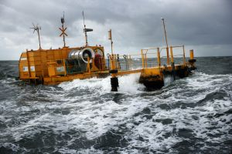
Renewable Energy pioneering ICT Networks in Ireland
One Smart Farm will deliver 20% of total electrical power by 2020
A cluster of Smart Farms could generate all Ireland’s power requirements by 2020
Wave power has “650 times more energy in a cubic meter of moving water than a cubic of moving air.”OceanEnergy Ireland
Notes:
Renewable Energy powering ICT Networks in Ireland One Smart Bay Farm will deliver 20% of total Electrical Power by 2020
A cluster of Smart Bay Farms could generate all Irelands power requirements by 2020
Wave power has “650 times more energy in a cubic meter of moving water than a cubic meter of moving air.” OceanEnergy Ireland.

Slide 16
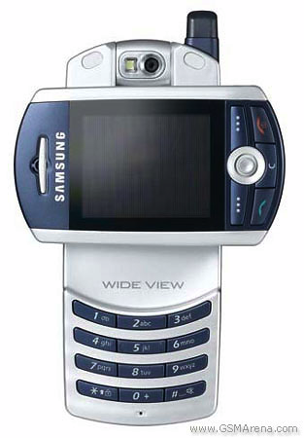
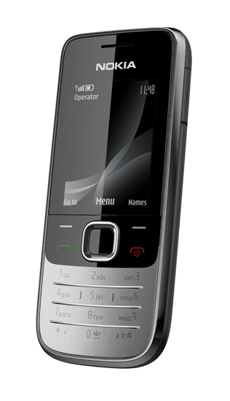
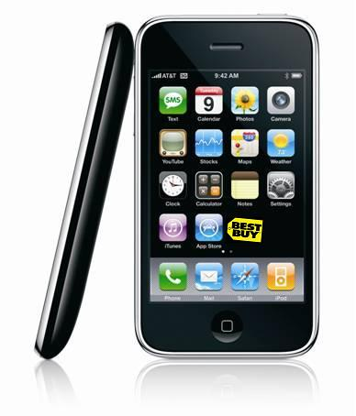
Smart ICT Networks as a catalyst for Monster Economies of the future
How can India benefit from a Smart Irish Plan? A Case Study.
India has 488M mobile subscribers (2G) & circa 500m to go…
ICT Network Power consumption will spike when India moves millions of Subscribers to 3G and 4G Mobile broadband enabled services.
Mobile Broadband over the conventional ICT Telecoms network is a clear danger to CGH emissions reduction goals from one major country alone.
Guiding all Countries to avoid an old ICT Network paradigm and its High Power Consumption impact is where the ITU has a major role to play.
Notes:
Smart ICT Networks as a catalyst for Monster Economies of the future How can India benefit from a Smart Irish Plan ? A Case Study.
India has 488m mobile subscribers (2G) & circa 500m to go...
ICT Network Power consumption will spike when India moves millions of Subscribers to 3G and 4G Mobile broadband enabled services.
Mobile Broadband over the conventional ICT Telecoms network is a clear danger to GHG emissions reduction goals from one major country alone.
Guiding all Countries to avoid an old ICT Network paradigm and its High Power Consumption impact is where the ITU has major role to play.
16

Slide 17
The Smart ICT Networked Economic Model
Rapid ITU ICT Reation Force for good…Carbon Zero ICT Strategies for all.
Developed Countries & New Stars need to retrofit a Smart Networked Economy plan over plaid Entertainment oriented Digital Economy Plans.
Developing Countries need to embrace Smart Economies, new ICT Network Technologies & Education strategies.
Developed Countries have to help, leading by example has served humanity well in the past.
Using Adaptation and Mitigation funds, LDC’s can aim for Carbon Zero ICT Networks from Day One.
Why waste money on the past?
Ireland is putting the Horse before the Cart: ICT Fuel, Network Engine & Vehicles have to be right before the Digital Highways of the next Era can work to attain ICT goals to combat Climate Change …an Enhanced Role for the ITU is key.
Notes:
The Smart ICT Networked Economic Model Rapid ITU ICT Reaction Force for good...Carbon Zero ICT Strategies for all.
Developed Countries & New Stars need to retrofit a Smart Networked Economy plan over plaid Entertainment oriented Digital Economy Plans.
Developing Countries need to embrace Smart Economics, New ICT Network Technologies and Education strategies.
Developed Countries have to help, leading by example has served humanity well in the past.
Using Adaptation and Mitigation funds, LDC’s can aim for Carbon Zero ICT Networks from Day One.
Why waste the money on the past ?
Ireland is putting the Horse before the Cart :
ICT Fuel, Engine & Vehicles have to be right before the Digital Highways of the next Era can work to attain ICT goals to combat Climate Change...
an Enhanced Role for the ITU is key.
17

Slide 18
The role of ICT to combat Climate change ...is there a Danger we fall into a trap ?
THANK YOU
LEONARD DONNELLY, LOCATION BRIDGE
COPENHAGEN, DEC 2009
Email: leonard.donnelly@locationbridge.net

