Slide 1
Carbon Emissions and Telecommunications
Hugh Bradlow, Chief Technology Officer

Slide 2
Telstra's Carbon Emissions Intensity Target
Telstra is aspiring to reduce its own carbon intensity by 15% by 2015 and is committed to developing ICT solutions that will reduce our customers’ carbon footprint.

Slide 3
Telstra's Initiatives
Telstra’s target is to decrease carbon intensity from 64 to 59 tonnes per $M by:
adopting low carbon ICT solutions such as video conferencing and teleworking across Telstra
specific energy saving projects in our facilities and decommissioning redundant network assets
reducing the energy intensity of purchased products and services and our consumption of energy and resources across the company
staff training to reduce office and vehicle fleet emissions.
Notes:
The target is a carbon intensity target rather than an absolute emissions target, since as society as a whole transitions to lower carbon activities, Telstra, as a provider of enabling services, will experience greater power demand. Offering these low carbon services most efficiently is our goal.

Slide 4
Telstra's Customers
Telstra –commissioned Whitepaper: Using ICT to Drive Your Sustainability Strategy
Video Conferencing
Teleworking
Web Contact Centers
Fleet & Field Force Management
Measurement Tools for Emissions savings
Notes:
Telstra Commissioned a report by Climate Risk (an environmental consultancy) on the potential of ICT to drive lower carbon emissions in 2007. It showed that the use of broadband could reduce carbon emissions in Australia by up to 5% through the use of a variety of tools.

Slide 5
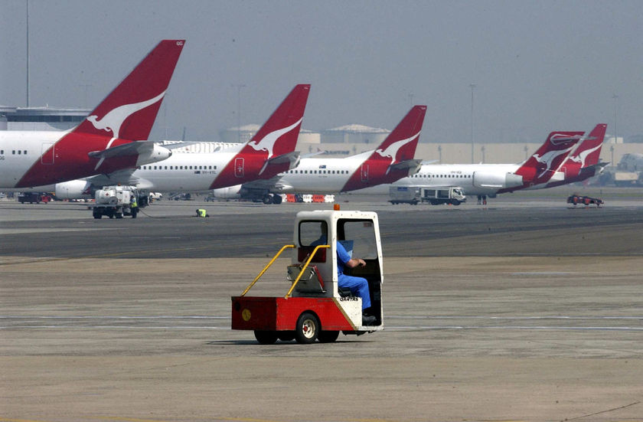
Domestic aviation has increased from 0.3% to 0.8% of Australia’s carbon emissions in the last 5 years.
Notes:
Domestic aviation has increased from 0.3% to 0.8% of Australia’s carbon emissions in the last 5 years.

Slide 6
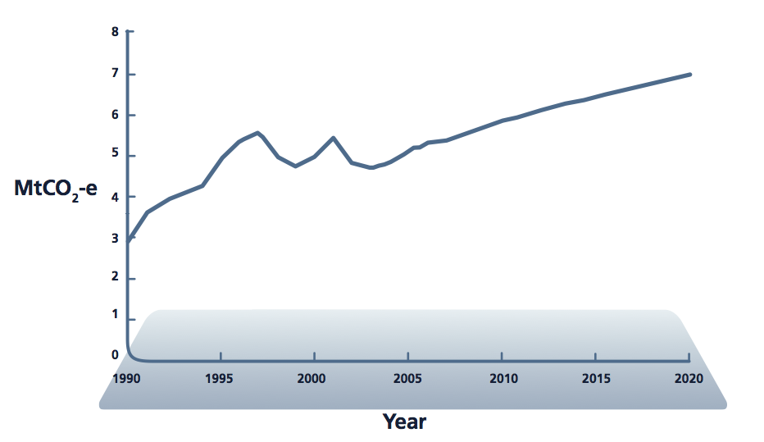
Domestic aviation emissions
Source: A Climate Risk Report: Towards a High-Bandwidth, Low-Carbon Future
Notes:
Trend and Projected Domestic aviation emissions since 1990.
Mega-tonnes of CO2 emission vs year.
Source: A Climate Risk Report: Towards a High-Bandwidth, Low-Carbon Future, commissioned by Telstra.
Aviation is responsible for 0.5% increase in Australia’s Carbon Emissions in the past 5 years.
With the advent of low-cost airlines, this projection could be an underestimate.

Slide 7
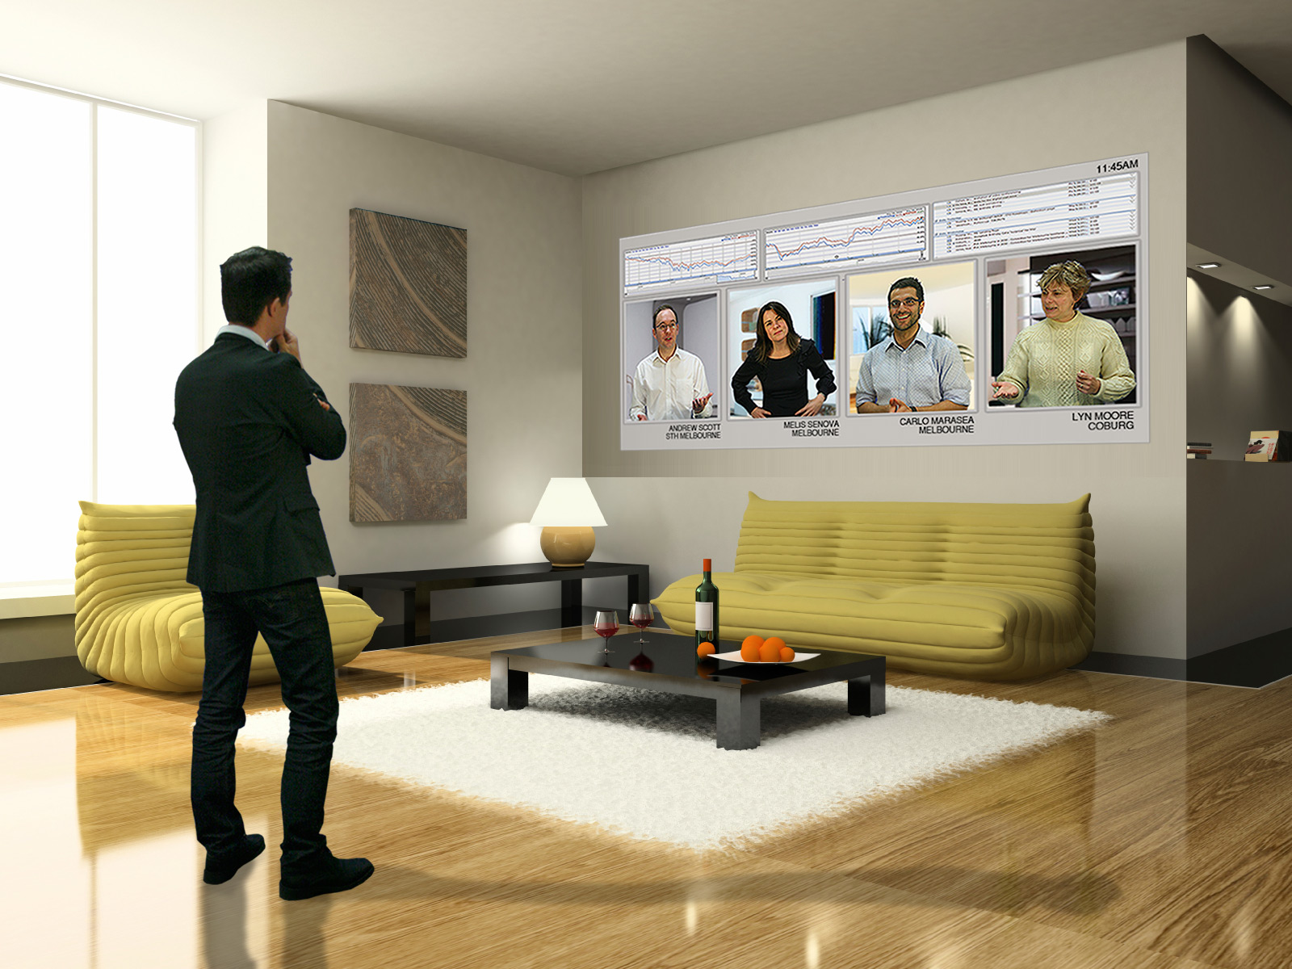
Teleworking, now and beyond
Notes:
Between 35% & 65% of short-haul air travel is for short-term business.
High Definition Telepresence can reduce the need for business travel
There are a variety of such solutions, ranging from consumer video chat and desktop sharing productivity tools, to enterprise level high def. Video conferencing.
All require a robust and high-speed broadband network.

Slide 8
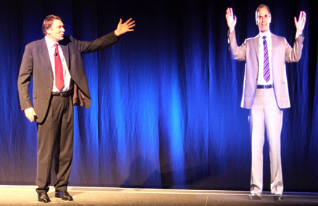
Videoconferencing going further
Notes:
High tech communication tools facilitate new ways of communication
- Can drastically reduce need for travel, which contributes 0.8% of national carbon emissions

Slide 9
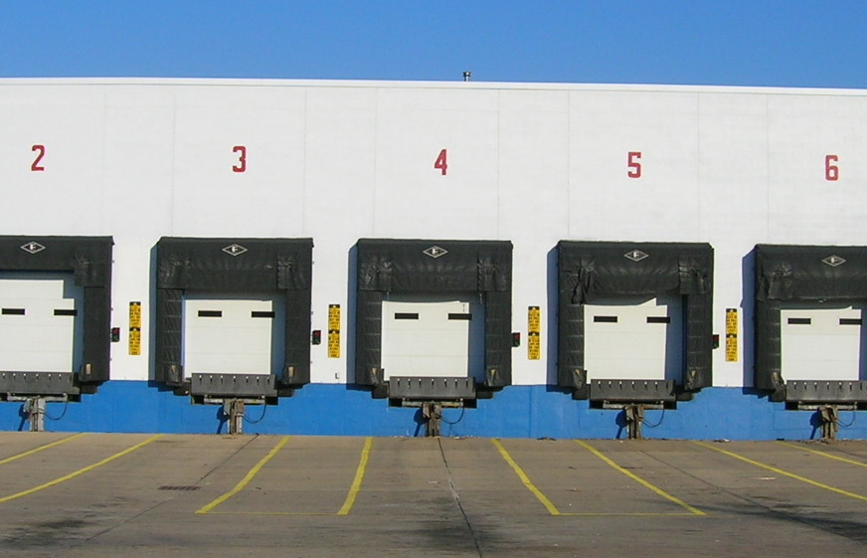
Opportunities in Fleet & Freight Management
Notes:
Road Freight:
36% of transport sector’s emissions
5% of Australia’s total emissions
Target unladen vehicle use; currently ~30% empty
Freight RFID and networked fleet management reduces empty-vehicle journeys
e.g. Mercedes-Benz Fleetboard

Slide 10
Notes:
Road Freight:
- Laden and Unladen vehicle statistics from: A Climate Risk Report: Towards a High-Bandwidth, Low-Carbon Future, commissioned by Telstra.
36% of transport sector’s emissions
5% of Australia’s total emissions
Target unladen vehicle use; currently ~30% empty
Freight RFID and networked fleet management reduces empty-vehicle journeys
e.g. Mercedes-Benz Fleetboard

Slide 11
Virtualisation
Notes:
Server virtualisation can increase efficiency, by increasing the average server utilisation :
utilisation can increase from 10% to 80%
power demand for servers and infrastructure (air conditioning) increases minimally with server utilisation
there are fewer servers, and a potential for considerable power savings
virtualised servers can be more easily powered off during periods of low activity, providing more power savings.

Slide 12
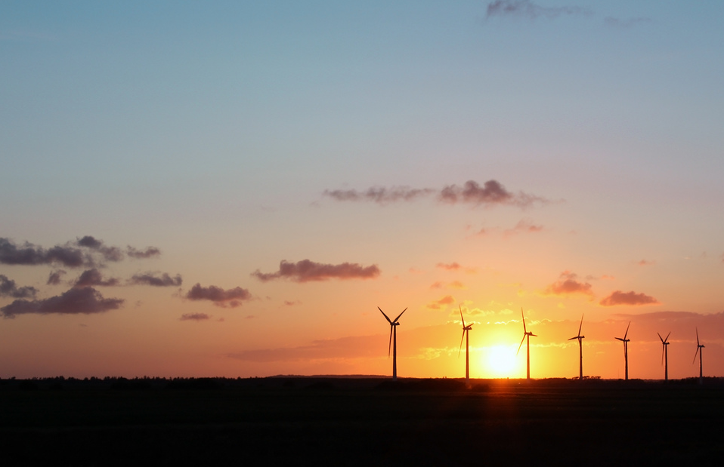
Power Management
Notes:
Presence-based power and contextual power.
Smarter power solutions can save 0.53% of national carbon emissions;
Source: A Climate Risk Report: Towards a High-Bandwidth, Low-Carbon Future, commissioned by Telstra.

Slide 13
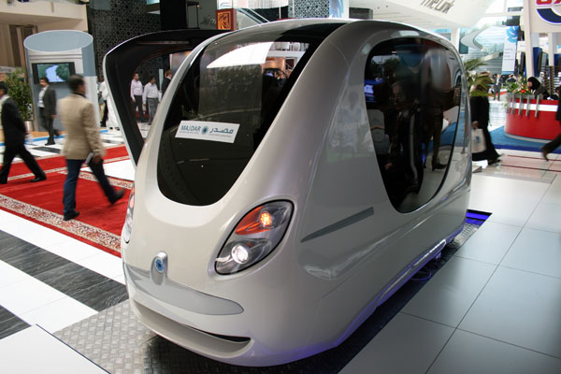
Optimising Commuting
Abu Dhabi’s PRT
Notes:
By 2030 technology will have changed 2 things dramatically:
The efficiency of travel
The need to travel
Planning a future based on a linear extrapolation of today’s travel requirements would be a mistake
Changing the efficiency of travel:
Smart infrastructure and smart cars:
Cars with collision avoidance systems using radar range finding but also stereo vision, laser range finding, ultra-sonic range finding, will allow the traffic to be ‘packed’ more effectively onto the roads.
Smart infrastructure will know exactly how much traffic there is on the road systems, allowing route optimisation across the entire system using sophisticated traffic management algorithms (e.g. the sort of thing that we have been doing in telecommunication networks for years). This will allow optimisation of the overall system utilisation.
Personal public transport:
Encourage people to use public transport by making it more convenient and more comfortable. Convenience comes from ensuring that an individual’s travel needs can be catered for by minimizing waiting and journey times through (a) the system optimisation discussed above and (b) utilising mobile phones to schedule transport availability and facilitate billing (e.g. NFC)
This will reduce the number of cars on the road (and parking requirements) due to higher vehicle occupancy (car share schemes are already shown to do this) and lower car ownership . Vehicle occupancy in Melbourne in 2006/2007 was only 1.2 people per car.
Picture:
A trial in Abu Dhabi of a personal public transport system in a city where there are no cars. The vehicle is a driver-less unit that you program to your next destination.

