Slide 1
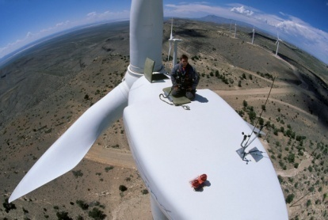
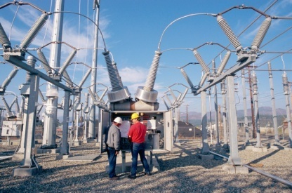
Environmental Sustainability: Interconnected Systems
Rob Bernard
Chief Environmental Strategist
Microsoft Corporation

Slide 2
Our Commitment
At Microsoft, we are committed to software and technology innovations that help people and organizations around the world improve the environment. Our goal is to reduce the impact of our operations and products, and to be a leader in environmental responsibility.
Notes:
Core focus of this commitment is SW & Technology to drive change at scale, reducing the impact of our own operations and products to be a leader in env resp.

Slide 3
Strategy
Enable Radical Energy Efficiency
Drive Research Breakthroughs
Responsible Environmental Leadership
Notes:
Changed Science breakthroughs to Research
Detail in Appendix

Slide 4
Interconnected Systems
Computing Footprint
Water
Land
Air
Transport
Buildings
Computing Footprint
Efficiency
Forests
eWaste
Grids
Energy
Natural Resources
Biodiversity

Slide 5
Interconnected Systems
Computing Footprint
Water
Land
Air
Transport
Buildings
Computing Footprint
Efficiency
Forests
eWaste
Grids
Energy
Natural Resources
Biodiversity

Slide 6
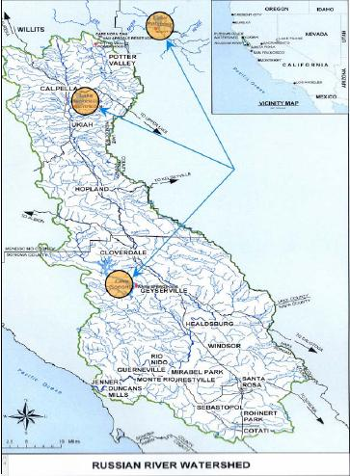
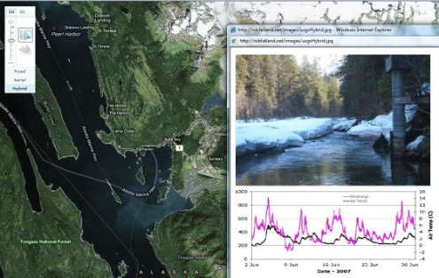
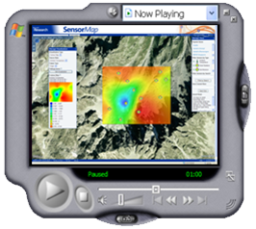
Microsoft Research
Understand Physical World in Real-Time
SensorMap: an open and diverse community of sensor data
ClearFlow: find routes based on least traffic,
Hydroseek: Visualizing data in new ways
We don’t really know what lies ahead……
Climate Models – implications and impact
Species Migrations
Fishing stocks
Disease paths
We must aspire to understand, to change, to move forward
Notes:
Oxford, Cambridge, York, Imperial, Kings College, UCL, Southampton, Edinburgh, Glasgow, Birmingham, INRIA, CNRS, Madrid, Portugal, EPFL, ETH, Trento (CoSBi), Amsterdam, Denmark, Weizmann Institute of Science, Moscow State University, Kansas, Princeton, Scripps, SantaFe, UCSB, Costa-Rica.

Slide 7
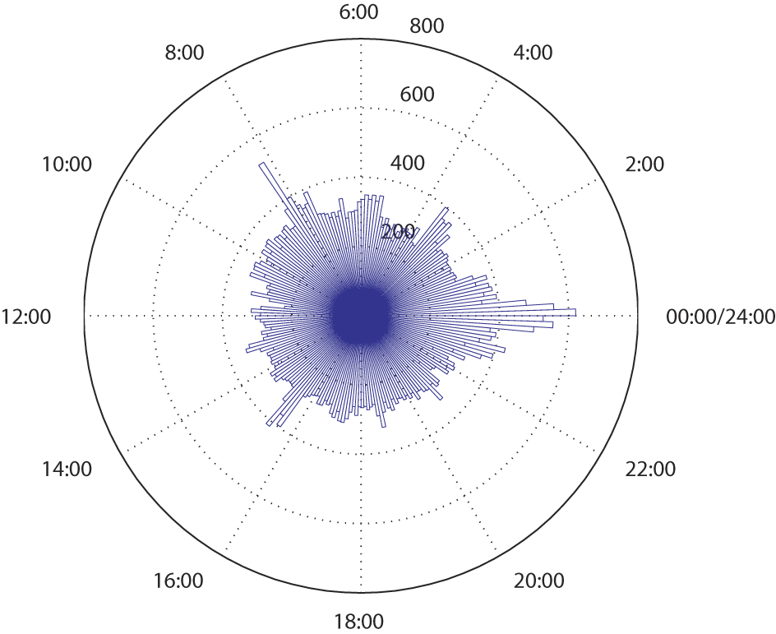
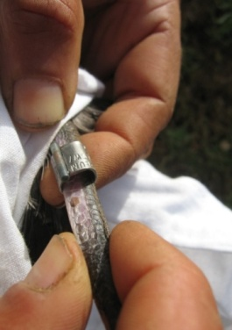
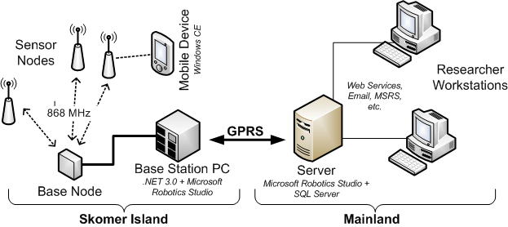
Autonomous Monitoring of Vulnerable Habitats
The global climate is changing. Determining how these changes affect the structure and functioning of sensitive ecosystems is essential for their protection.
Here we combine wireless sensor networks with innovative Microsoft software to automatically monitor sensitive and vulnerable environments. The system has been successfully piloted on Skomer Island, UK to monitor the behaviour and habitat of the Manx Shearwater, an important UK seabird.
By delivering high-resolution, accurate data over long time periods, the system has already demonstrated its utility and value. It has the potential to underpin advances in under-standing a range of ecosystem types.
Daily activity of colony over 2 month period.
Harnessing a combination of different Microsoft technologies including .NET Framework, Microsoft Robotics Studio, Windows CE, SQL Server, IIS, etc.
Providing a system that enables:
Real-time remote monitoring and analysis;
Intelligent sensing;
Remote setup, maintenance and control.
Booth 322

Slide 8
Biodiversity Science
The Convention on Biological Diversity set as a goal for its 188 signatory nations the reduction in the rate of biodiversity loss by the year 2010. This project brings together a consortium of leading organizations in the biodiversity policy and science communities.
In this project Microsoft partners with the United Nations Environment Programme UNEP-WCMC and leading institutions worldwide.
Understanding the geographic distribution of species and how species distributions will change in response to various drivers of environmental change is one of the fundamental problems of biodiversity science: Evaluating and applying emerging ecological niche modelling techniques to study the changing distribution of Mexican cloud forests.

Slide 9
Simulation of Plant Growth and CO2 in the ecosystem
Plant communities may act to amplify or dampen changes in the Earth’s climate system caused by anthropogenic CO2 pollution. We are modeling how much CO2 is extracted from the atmosphere and where this carbon is allocated, accelerating & leveraging research in plant growth, biodiversity and ecosystem functioning.

Slide 10
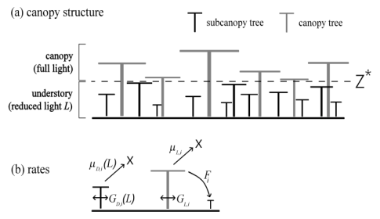
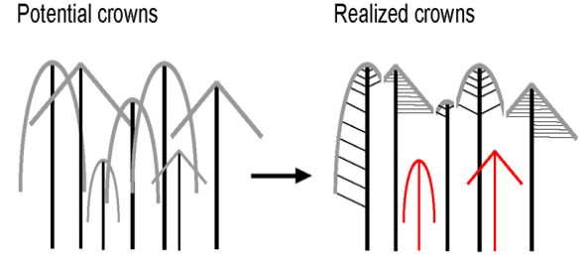
Accelerating Understanding Climate Change Predictive modelling of Global Forest Dynamics
Plant communities are vital to Earth System regulation, but their role and sensitivity to changes is currently barely understood. Scaling from physiology to ecosystems is currently skipped over in Earth System Models, ignores non-linearities in whole plants, interactions between plants within species, or interactions between species, how whole plants respond (growth, mortality) to resources and competition, and dynamics of forest community. This is the single most important outstanding issue in earth system modelling Drew Purves, a scientist in the Computational Ecology Group at MSRC has, together with collaborators Stephen Pacala (Princeton) have developed a predictive model of global forest dynamics and their role in climate regulation and climate change. This work has recently been published in Science, and – importantly – the model itself will be incorporated into the IPCC climate prediction models

Slide 11
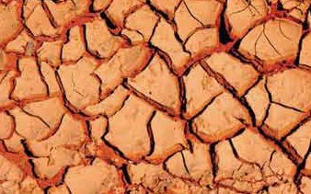
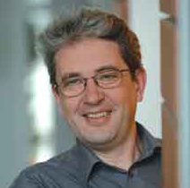
Searching environmental scenarios
The projects “Environmental Scenario Search Engine” and “ClimatePrediction.Net”:
The increasing data volumes from today’s science and the need for an inclusive view on the natural environment requires a new approach to data mining, management and access; the ESSE project includes data from space, terrestrial weather, oceans and terrain, to better understand and thus address “climate change”.
Complex climate models are run on computers of volunteers, so the ClimatePrediction.Net project with the University of Oxford is the largest experiment to try and produce a forecast of the climate in the 21st century with the University of Oxford.

Slide 12
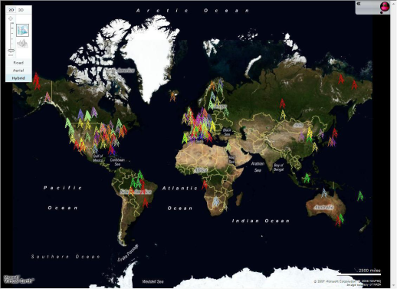
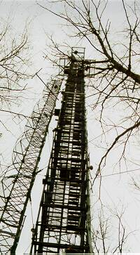
Carbon-Climate Data
What is the role of photosynthesis in global warming?
Measurements of CO2 in the atmosphere show 16-20% less than emissions estimates predict
The difference is either due to plants or ocean absorption.
Communal field science – each investigator acts independently.
Cross site studies and integration with modeling increasingly important
Notes:
The plot is comparing previous values reported in the literature with values in the new dataset. These sorts of comparisons are helping the scientists trust the data as well as get their heads around what “accuracy” we’re talking about given the uniformity of processing (different from what the scientist would do independently).
The Excel sheet is one of our summary data products – find your site-year at a glance with color coding for gap-fill quality, % of data actually present….

Slide 13
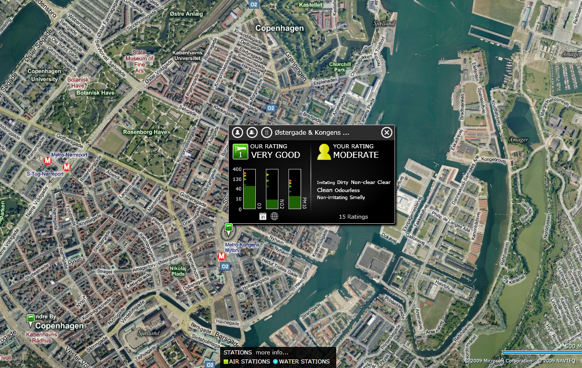
www.eyeonearth.eu

Slide 14
Visit us at: www.microsoft.com/environment
© 2008 Microsoft Corporation. All rights reserved. Microsoft, Windows, Windows Vista and other product names are or may be registered trademarks and/or trademarks in the U.S. and/or other countries. The information herein is for informational purposes only and represents the current view of Microsoft Corporation as of the date of this presentation. Because Microsoft must respond to changing market conditions, it should not be interpreted to be a commitment on the part of Microsoft, and Microsoft cannot guarantee the accuracy of any information provided after the date of this presentation. MICROSOFT MAKES NO WARRANTIES, EXPRESS, IMPLIED OR STATUTORY, AS TO THE INFORMATION IN THIS PRESENTATION.
Notes:
Thank You!

