Slide 1
How satellite communications support climate change projects
Eric Jan Bakker, Vizada
18 December 2009

Slide 2

Content
About Vizada
Satellite communications
Satellite communications in emergencies
Satellite communications for research projects

Slide 3
About Vizada

Slide 4
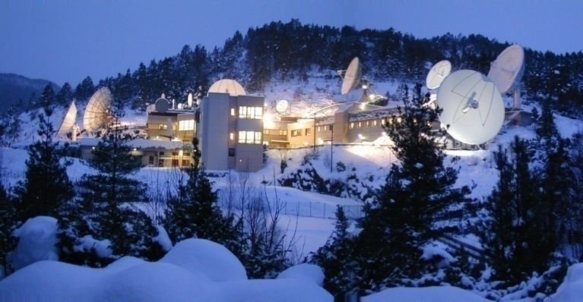
Who is Vizada?
The Worldwide Leading Provider of
Global Satellite Communications
Offering services over multiple satellite networks
Services offered to many United Nations organizations & agencies as well as NGO’s, researchers and commercial users
Leading innovator with over 40 years of experience & with global presence though over 400 local resellers
Notes:
Vizada is the leading innovator with over 40 years of innovation experience
developing and enhancing the full spectrum of satellite communications from satellites to teleports to base connectivity services to Vizada Solutions, our value added services.
Vizada is the proven leader in customer satisfaction
linking people and technology with the best fit communications solutions around the world, every day.

Slide 5
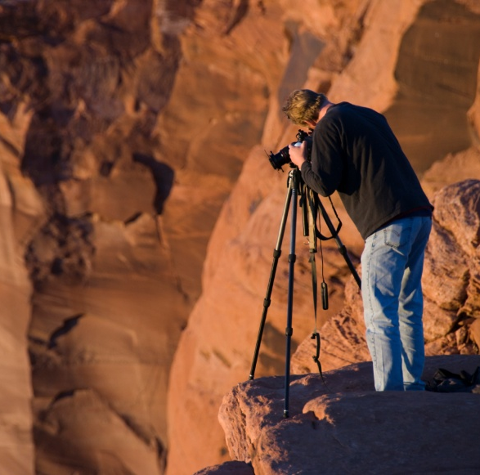
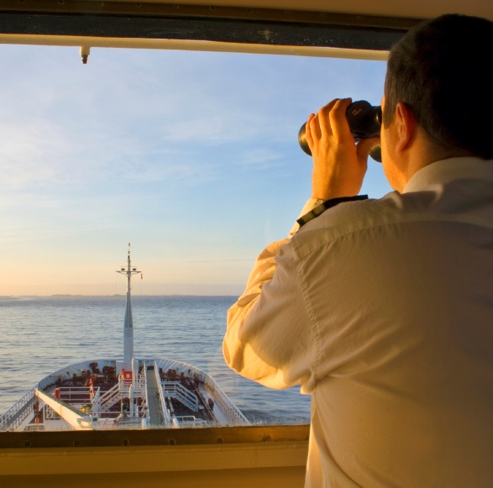
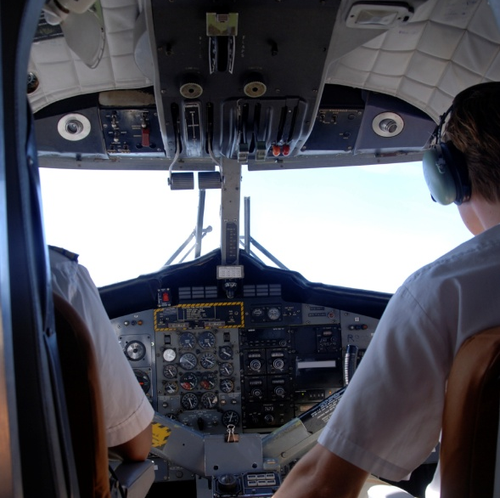
Our proposition
We give people the confidence that they can communicate no matter where they are in the world, under any circumstances
From simple phone calls or email access up to broadband connectivity and secure VPN connections
And this for more than 200,000 end users
On land
At sea
In flight
NGO
Gov & Military
Media
Oil / Gas
Mining
Construction
Commercial
Cruise & Ferry
Fishing
Yachting
Commercial
Military
Business

Slide 6
Satellite communications

Slide 7


Satellite communications
Satellite
PSTN
Internet
Interrconnetion solutions for secure & guaranteed bandwidth
Vizada network
GSM
Mobile user
Terrestrial user
Notes:
Describe how call is made from remote user to final end user.
Best show an Iridium and BGAN to demonstrate the light weight equipment.
Inform that there is different equipment for different requirements (maritime, vehicular etc)

Slide 8


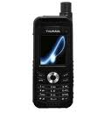



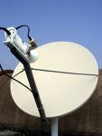
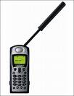




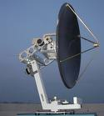

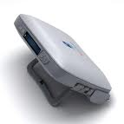



Equipment
VSAT

Slide 9
Sattelite communications in emergencies

Slide 10
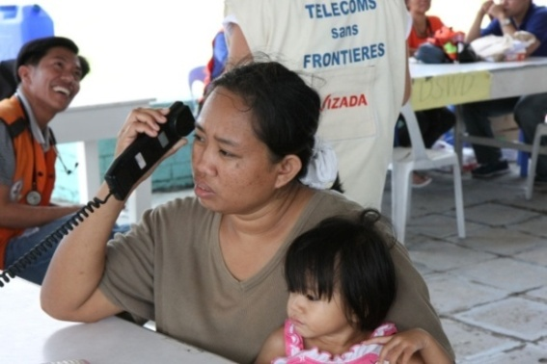
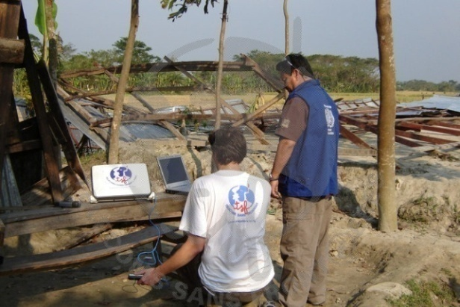
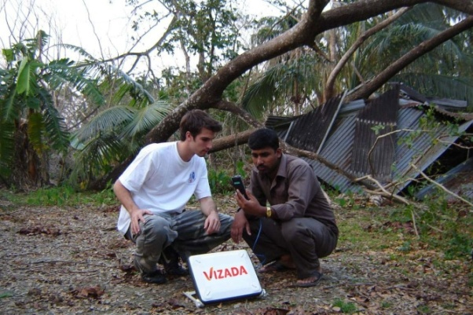
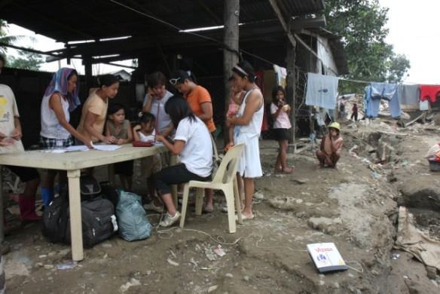
How satellite communications help during emergencies
Often the only way to communicate in affected areas with no or damaged infrastructure.
Easy to carry, deploy & setup
Set up emergency telecoms centers and remote offices in minutes.
Optimize emergency aid processes of humanitarian missions.
Provide communications for local populations in disaster situations.
Raise & increase awareness in to the outside world.

Slide 11
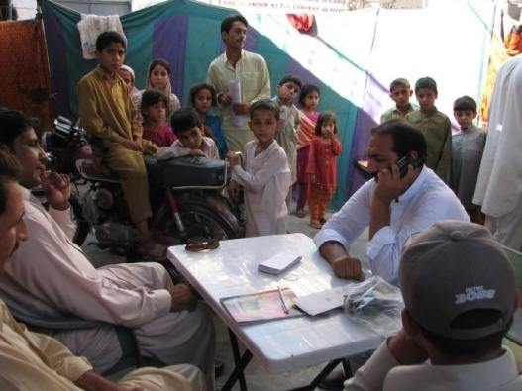
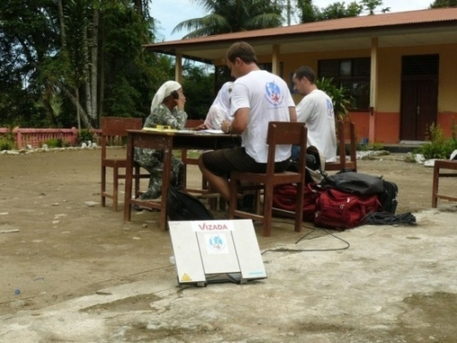
Satellite communications in emergencies
Telecom Sans Frontieres
  Act as first responders to UN agencies like Unicef & WFP.
  Provides telecoms centers & facilities in emergencies, enabling immediate coordination between first responders & speed central organisations for emergency relief operations
  Enable displaced families to contact their relatives
  Latest missions :Pakistan, Indonesia and El Salvador.
United Nations
  Agencies like UNHCR, WFP, UNICEF, WHO and others use satellite communications for their emergency relieve activities
  Coordinated approach ensures higher efficiency & aid where it is mostly needed.

Slide 12
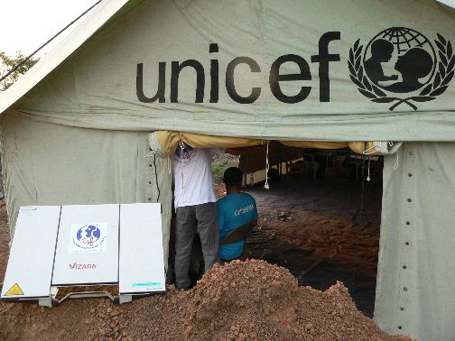
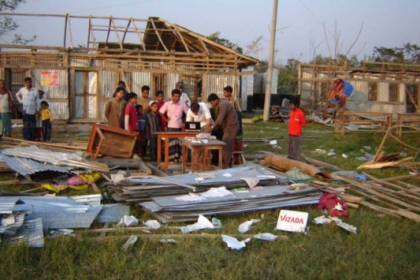
Satellite communications in emerg encies
ITU
  provides communications systems to governments in countries hit by natural disaster.
  Deploy the latest satellite technology to support relieve activities: Inmarsat BGAN, Thuraya, Iridium
  Providing training & raising preparedness levels

Slide 13
Satellite communications for research projects

Slide 14
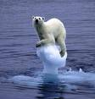
Satellite communications to support research activities
For stationary and mobile, manned as
well as for un-manned projects
Arctic/Ant-Arctic expeditions
Exploration projects in remote locations to study climate change around the globe
Marine research projects, manned and unmanned (garbage in the Pacific Ocean, sea level measuring)
Unmanned projects such as
  Fixed-buoy measurements to retrieve weather information from remote marine areas
  Measurements of density and thickness of snow in mountains
  Drifting-buoys to retrieve weather, current, plankton, temperature information
Notes:
We help professionals work with all the convenience of a mobile office in isolated areas with limited access to terrestrial networks. Remote workers can stay in touch wherever they are on the planet, ensuring complete safety while on the move.
For stationary, we can also offer VSAT solutions (fix solutions), but for all „moving“ operations we provide mobile satellite solutions.

Slide 15
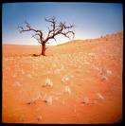
How satellite communications contributes to climate change research projects
Instant connection & transmission of research data: speeds up operations & analysis of retrieved data.
Remote office: enables researchers to use and access applications normally only available in the office or lab.
Security: enhances security arrangements in unexplored & remote zones.
Mobility: easy to set up and handy to carry, mobile satcoms stay with you on the move.
Proximity: keeps teams on long-term missions in touch with the world.

Slide 16
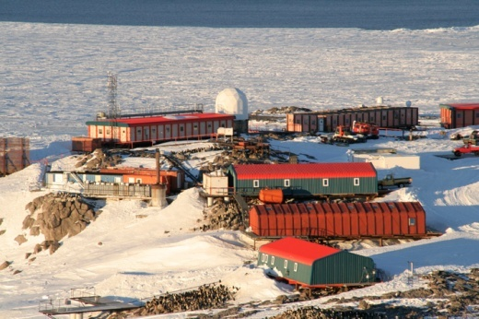
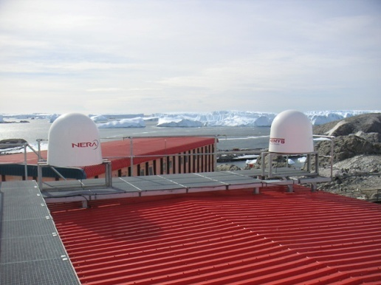
Example of satcom used for research projects -IPEV
Institut Polaire Français : Paul Emile Victor (IPEV) supports
research projects in the Artic – Antarctica : Project Damocles
Study impact of climate changes in the arctic, researching on physic chemistry of the lower and upper layers of the atmosphere (greenhouse gases, stratospheric ozone), glacier dynamics, ice-ocean-
atmosphere exchanges etc
Iridium used to communicate between men on the field, the scientific bases, the IPEV staff and the scientific laboratories in France.
Iridium is also used to transfer scientific data from the field to the laboratories
In DAMOCLES project Iridium is used to transmit
temperature and salinity data measured in the arctic
ocean by remote sensor buoys..

Slide 17
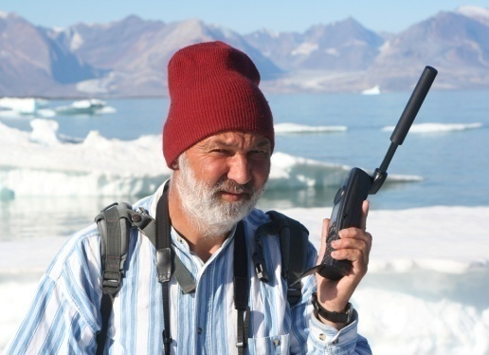
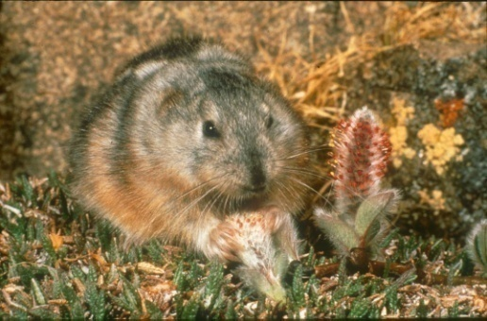
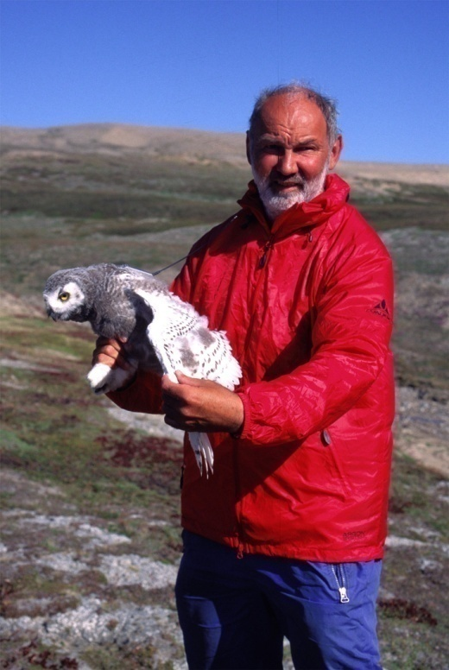
Example of satcom used for research projects - Sittler
Long-term study on lemmings proves that
climate change affects interaction of
species in Greenland
Benoit Sittler uses satellite communications (BGAN and Iridium) to communicate with colleagues and home during his expeditions and to send project updates
Satellite communications also serves for security purposes in these remote locations
Sittler demonstrated how climate change has indirect effects on interactions in the arctic animal communities
Other observation pointing to present changes include the fact that polar bears are now appearing on land regularly due to the earlier disappearance of the pack-ice

Slide 18
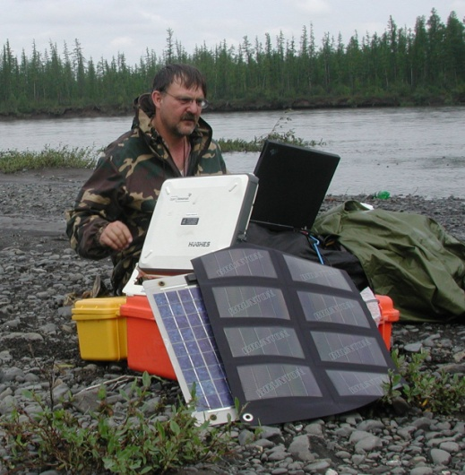
Example of satcom used for research projects - Ranson
NASA Earth Observatory study on
climate change and global warming
NASA scientist Dr. Jon Ranson monitors climate change and global warming in Siberia. The mobile satcoms services have enabled him to send data recorded to NASA teams in the US, as well as keep & update his blog.
Vizada and service provider Explorer Satellite Communications in Fort Lauderdale have provided Inmarsat BGAN and Iridium communications solutions to support NASA Earth Observatory study of Dr. Jon Ranson in Siberia.

Slide 19
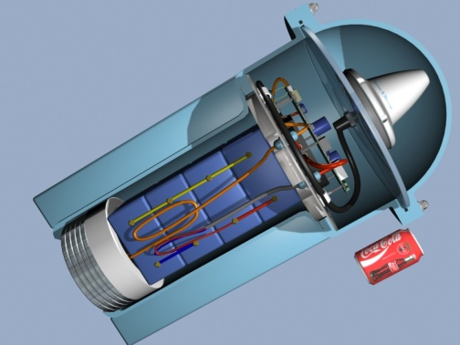
Example of satcom used for exploration projects – Unmanned research projects
Tsunami alert project: French supplier developed tsunami alert system for the French and Polynesian government.
  Buoys with sensors placed in deep sea measure permanently size of the swell/wave
  If certain level is reached, they transmit alert message via Inmarsat Mini C to a control and supervision center on shore.
  Immediately a sound alert is sent to the villages close to the beach to warn population
Drifting-buoy project developed by Satellite AirTime:
  Buoy follows current and measures constantly
  various values like weather, current, plankton,
  temperature information
  Data is sent regularly by the Inmarsat Mini C to
  researchers

Slide 20



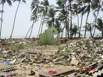
And more …..
Create awareness
Research
Warn
Releave

