Slide 1
Mobile’s Green Manifesto
www.gsmworld.com/greenmanifesto

Slide 2
Mobile’s Direct Emissions
Mobile’s emissions are 0.5% of global total
84% emissions in the network
71% BTS power consumption
13% embedded carbon
16% emissions in devices
4% charging
12% embedded carbon
BTS energy costs to reach $27.5bn by 2012, a rise of 37.5% from 2007
Off-grid rising 80% between 2007 – 2012, from $8.1bn to $14.6bn
On-grid rising 9% between 2007 – 2012, form $11.8bn to $12.9bn
Notes:
Mobile’s direct emissions are only 0.5% of the global total
The majority of our emissions are in powering the network – and ironically the level of these emissions are largely out of our control. In France, for example, most of the energy supplied by the grid to mobile operators is derived from nuclear power which is carbon emission neutral. But in rural Africa and Asia, off grid networks rely predominately on diesel.
The costs of powering networks is set to rise to $27.5bn in 2012, from over $20bn today. The cost of off grid power is set to rise by 90% and will eclipse on-grid power costs for the first time.
Energy costs are often the largest line item in operating costs. There are large incentives for our industry to look at how alterative energy and dynamic power management techniques may lower the bill. There is a also a strong case to be made to governments that they provide incentives for the industry to adopt energy efficient solutions.

Slide 3
Industry Goal #1: Carbon neutral growth
We expect emissions per connection to fall by 40% by 2020
Total emissions will stay flat from 2009 to 2020 despite:
70% increase in connections to 8 billion
Multi billion dollar investment in new networks and ubiquitous coverage
The main driver is the BTS energy efficiency trend
From first generation mobile in 1985, annual CO2 network emissions have fallen from 180kg per sub to 20kg, a 90% reduction
GSM emissions have fallen from 48kg per sub to 20kg, a 60% reduction during GSM’s life cycle
3G emissions have fallen from 55kg per sub to 25kg, around a 55% reduction in 5 years
Notes:
Despite rising energy costs, the Green Manifesto articulates an industry goal of achieving carbon neutral growth.
We expect emission per connection to fall by 40% by 2020 and will deliver this by keeping our total emissions flat, despite a 70% increase in connections and multi billion $ investment in new broadband networks.
The main driver is the network energy efficiency trend:
In just over 20 years since mobile’s 1st generation, average annual CO2 network emissions per subscriber have fallen by 90%
During GSM’s lifecycle we have seen a 60% reduction; and
In five years, 3G HSPA’s annual network emissions per subscriber have fallen by 55%
We can be proud of these data points and confident that the energy efficiency trend is set to continue.

Slide 4
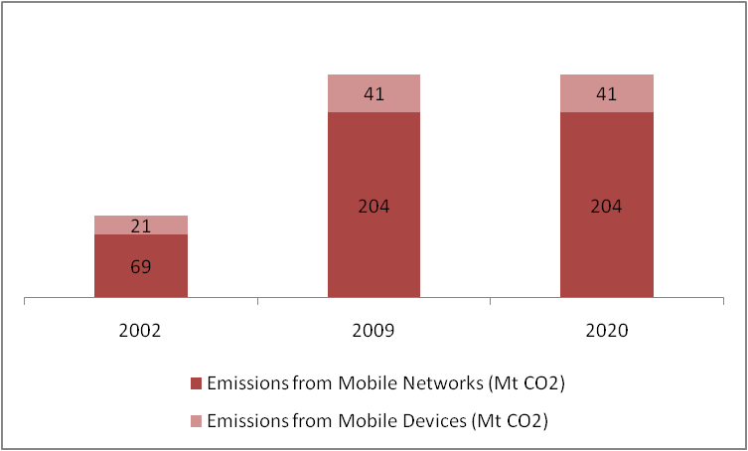
Mobile’s story
10
100
Subscribers
(billions)
Population coverage (%)
5
50
245
245
90
0
0
2002
2009
2020
Notes:
Our story is also something we can be proud of.
We expect to reach the 5bn connection mile stone next year, with 8bn connections by 2020.
We have build out a mobile blanket, with GSM covering around 95% of the world populations today, and we can expect similar trajectories for 3G and LTE.
True, our emission grew rapidly between 2002 and 2009 but this period saw a leap in subscribers from 1 to 4.5 bn and the growth in network population coverage from 50% to 95%. Over the next decade, due to energy efficiencies, alternative power and continued innovation in power management, we do not see our emissions rising.

Slide 5
Industry Goal #2: Catalyse reductions in other sectors
By 2020 mobile could lower emissions in other sectors by an amount almost 5 times greater than its own emissions
The equivalent of taking 1 in 3 cars off the road
The main enabler is embedded M2M smart solutions
We expect the share of mobile enabled emissions savings to be distributed as follows:
Smart grids 30%
Smart buildings 30%
Smart transportation and logistics 26%
Dematerialisation (e.g. Universal Charger) 14%
Notes:
The Green Manifesto’s second goal sets out how mobile can catalyse emissions reductions in other sectors, by almost 5 times our own.
That’s the equivalent of taking a third of cars off the road.
The main enabler is embedded machine 2 machine smart solutions. eCall, for example, is a European public private partnership that the GSMA recently sign up with. It calls for every new car that is sold in Europe to come with an embedded SIM. Initially the embedded solution will be configured for emergency response, saving 4k lives and preventing 100k injuries, but the solution is also expected to reduce traffic congestion by 15% as it is made interoperable with other M2M Smart Transport solutions.
We expect the share of mobile enabled savings to be distributed as follows:
30% in Smart grids – where mobile can be used to save energy, reduce cost and increase reliability and transparency
30% smart buildings – giving consumer control of their home and office space
26% Smart transportation and logistics – synchronised traffic and notification systems, onboard telematics to encourage eco-driving, congestion management, routing and journey management optimisation, and road pricing
16% dematerialisation – eg the Universal Charger or choosing to use your phone rather than travel

Slide 6
Industry recommendations to governments
Support broadband infrastructure deployment:
Make available harmonised spectrum
Speed up the roll out of energy efficient networks
Streamline planning approval
Provide investment incentives e.g. tax brakes for energy efficiencies
Facilitate a common framework to measure energy and environmental performance
Included mobile solutions in policies and programmes with respect to smart grids, buildings and transport
Support the development of open standards to ensure interoperability and drive scale efficiencies
Notes:
Now no public policy document would be complete without our policy recommendations to governments.
We are asking government to support broadband infrastructure deployment by:
Making available harmonised spectrum
Speeding up the roll out of energy efficient networks
Streamlining the planning approval for new sites and
Providing investment incentive eg tax breaks for energy efficiency. This may be one way of offsetting the expected rise in network energy costs.
We are also asking governments to help facilitate a common framework to measure energy and environmental performance: to include mobile solutions in policies and programmes relating to major infrastructure investment and to support the development of open standards to ensure interoperability and drive scale economies

Slide 7
Thank you
www.gsmworld.com/greenmanifesto

