Slide 1

Using ICTs to Tackle Climate Change and Environmental Challenges
3rd Meeting of the Dynamic Coalition on Internet and Climate Change
16 September 2010
Cristina Bueti
Programme Coordinator

Slide 2
ICTs can support the key areas of the Bali Action Plan
Shared
vision
Mitigation
of climate
change
Adaptation
Technology
development
and transfer
Science and
data
monitoring

Slide 3
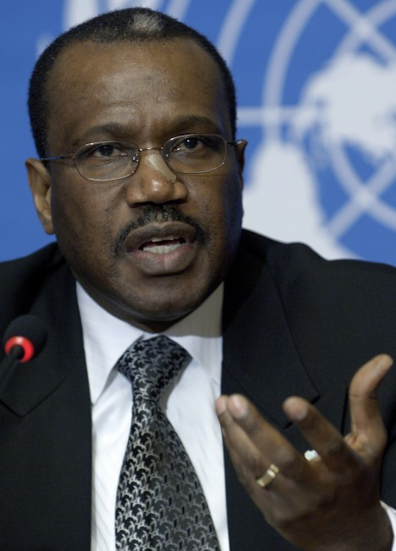
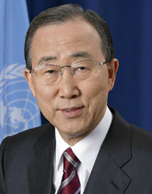
UN identified “it’s critical”
“Climate Change is a global challenge that the
world cannot lose.”
Dr Hamadoun I. Touré
ITU Secretary-General, 13 November 2008
“Climate change is the defining challenge of our era.
ITU’s work to cut greenhouse gas emissions, develop standards and use ‘e-environment’ systems can speed up the global shift to a low-carbon economy.
Ban Ki-moon
United Nations Secretary-General, 12 November 2008
Notes:
Let me now conclude my presentation with two quotes:
Quoting UN Secretary-General Ban Ki-moon, "We have to protect against cyberthreats, especially when they target children. I welcome the ITU’s ‘Child Online Protection’ initiative and urge all States to support it."
Finally, ITU would like to thank the organizers of the WCIII for inviting ITU to speak at this event and I look forward to further exchanges on how we can best collaborate to achieve our common objectives.
Thank you.

Slide 4
Importance further identified at top level
World Telecommunication Standardization Assembly (WTSA)-08, Resolution 73, resolves that CC is a high priority in ITU
World Telecommunication Policy Forum (WTPF) (April 2009), Opinion 3, instructs promotion of Res. 73.
Global Standards Collaboration (GSC)-14 (July 2009), Resolution, encourages related collaboration, etc.
ITU Council (Oct. 2009), Resolution 1307, unanimously decided its importance and active participation in United Nations Framework Convention on Climate Change (UNFCCC) including Conference of Parties (COP)
World Telecommunication Development Conference (WTDC)-10 (June 2010), Resolution on ICTs and CC, resolves to include, as a priority, assistance to developing countries in strengthening their human and institutional capacity in tackling ICTs and climate change

Slide 5
Mitigation
Reducing energy consumption
The promotion of Next Generation Networks (reducing power consumption by up to 40%)
Recycling, e-waste, lifecycle analysis
All new standards are now checked for energy efficiency
New Study Group on Environment and Climate Change

Slide 6
ITU-T created Study Group “Environment & Climate Change”
ITU-T Study Group 5 (April 2009)
  New Working Party (WP3): “ICT and Climate Change”
  Continuing and expanding the work of ITU-T Focus Group on ICT and CC
  Next meetings: 27 Sept-1 Oct (WP3 interim meeting)
  23 November-01 December 2010 (SG5 meeting)
All ITU-T study groups to examine impact of recommendations on climate change

Slide 7
New work items for standard GHG (Green House Gas) measurement and evaluation methods
Methodology for environmental impact assessment of
    ICT goods and services
    ICT projects
    ICT within organisations
    ICT within countries
(Question 18/15)

Slide 8

Methodology
Common methodology for measuring ICT carbon footprint
Without, it will be impossible to provide meaningful comparisons
Helps to establish the business case to go green
Over 40 organisations participate in the ITU group

Slide 9
ITU-T established Joint
Coordination Activity (JCA)
Objectives:
  to co-ordinate across ITU study groups
  to seek co-operation from external bodies including non-ITU member organizations
  Next Meeting will be held during the ITU-T SG5 Rapporteur meeting in Rome (27 Sept. - 1 Oct. 2010)

Slide 10
Standard for a universal charger for mobile phones
“Universal power adapter and charger solution for mobile terminals and other ICT devices” (ITU-T Recommendation L.1000)
  specifies general requirements
  covers charger for mobile phones
Future version will cover other ICT devices
Notes:
Delivers 50% reduction in standby energy consumption, will eliminate up to 82,000 tonnes of redundant chargers, and cuts GHG emissions by at least 13.6 million tonnes annually

Slide 11
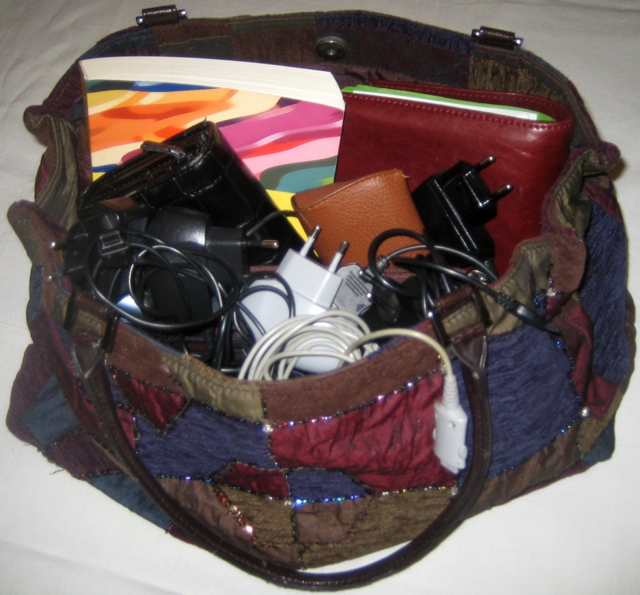
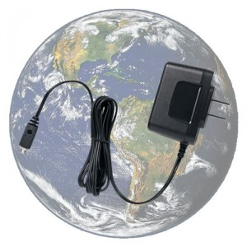
ITU’s universal charger standard
Instead of this …
… have this:
Recommendation L.1000
Approved March 2010
Notes:
11

Slide 12

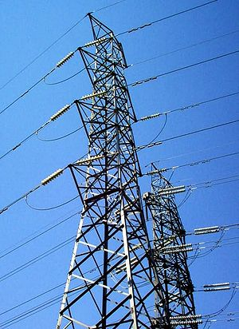
New Technology
Identifying priority sectors where ICTs can reduce emissions
  Smart grid (new Focus Group)
  Smart buildings
  Intelligent transport systems
  Remote working technologies
  Sensor-based networks

Slide 13
Built knowledge and promoted visibility
TECHWATCH Reports on CC and positive impact of new technologies
  Next Generation Networks, Intelligent Transport Systems, etc.
Major Symposia on ICTs and CC
  2008: Kyoto and London
  2009: Quito and Seoul (virtual event)
  2010: Egypt
ITU-T pioneering energy efficient work methods
  Paperless meetings, on-line work tools, virtual symposia
ITU-T providing secretariat to the Dynamic Coalition on Internet and Climate Change as part of the Internet Governance Forum

Slide 14
Raising Awareness
  ITU-GeSI Event on Green ICTs for a Sustainable Future (24 September 2010, New York, United States - during the Climate Week NYC) New
  This workshop will present a series of case studies and will also discuss:
    how “green ICT” initiatives and applications, such as smart grids, cloud computing, videoconferencing, e-government and dematerialization of content, can play a major role in reducing CO2 emissions, and ensuring sustainable development and green growth;
    how to measure the impact of "green ICT" on climate change and how to standardize a methodology to calculate the impact of ICTs on GHG emissions;
    how a standardized methodology, and other initiatives, might assist countries to obtain and make best use of ICTs to address climate change.
5th Symposium on ICTs and the Environment & Climate Change (2-3 November 2010, Cairo, Egypt) New
  Topics to be discussed will include: adaptation to climate change, e-waste, cost-effective ICT technologies, methodology of environmental impact assessment of ICT and financing of climate change solutions.
  Outcome: The symposium will issue the “Cairo Road Map”, a set of recommendations for action in relation to ICTs, the Environment and Climate Change.

Slide 15
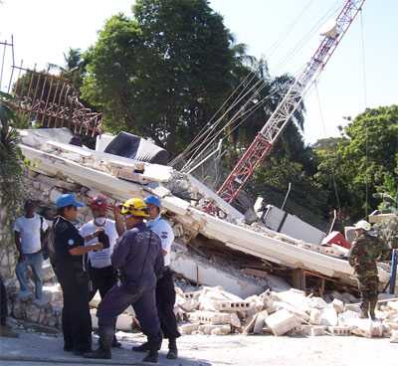
Adaptation
Support to get telecoms up and running after disasters
    Recent examples Pakistan, Haiti and Chile
E-Environment Toolkit will help countries to assess the contribution that ICTs can make to reduce GHG emissions
New Question
  ITU-D SG2, Q24/2: ICT and Climate Change

Slide 16
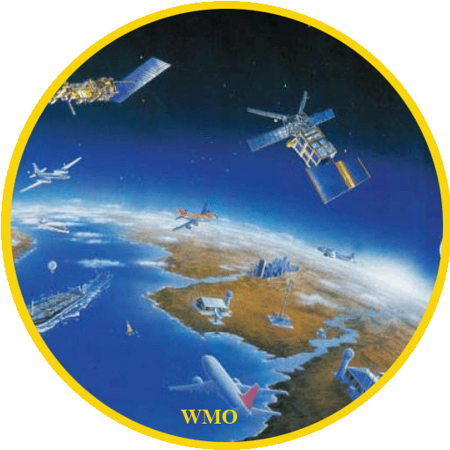


Data Monitoring
As the steward of the global framework for spectrum, ITU-R:
Provides radio-frequency spectrum and satellite orbits for
applications (space and terrestrial) employed in climate
monitoring and climate change prediction
Develops international treaty level standards for
non-interference operation of radiocommunication
systems involved in climate monitoring and mitigation of
negative impact of climate change
Carries out studies (through ITU-R Study Groups) for
development of new wireless technologies
Develops World-wide standards (ITU-R
Recommendations)
Facilitates the introduction and operation of modern radio
technologies and systems with low-energy consumption
Assists administrations in implementing radio systems by
analyzing compatibility between new and existing
systems
Notes:
The ITU Radiocommunication Sector (ITU-R) manages the detailed coordination and recording procedures for space systems and earth stations, which are used for climate data collection and environmental monitoring.

Slide 17

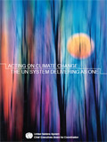
ITU and UN Delivering
As One on Climate Change
ITU is contributing to the effort of the UN system to
“deliver as one” to address climate change and is taking the
necessary steps to deepen the global understanding of
the relation between ICTs and climate change.
  Read the Report: "Acting on Climate Change: The UN
  System Delivering as One"
  ITU is co-facilitator in issues related to WSIS Action Line
  C7: e-environment
Side events and press conference with Mr. Ban Ki-moon, UN Secretary-General in Copenhagen in December 2009
Ongoing Collaboration with UNFCCC, UNEP, WIPO, WMO and UNIDO
On 5 June 2010, ITU together with UNEP and other partners celebrated the World Environment Day

Slide 18

ITU and UNFCCC
Ongoing role in UNFCCC process
  Promotion of role of ICTs in reducing GHGs
ISeeT Kiosk – Daily briefings from high level ICT business people
High level meetings
ITU, partner of the Nairobi Programme
Next Side Event:
  ITU-WIPO Side-Event: The Effective Use of ICTs and the Intellectual Property System for Mitigating Climate Change (7 October 2010, Tianjin, China)

Slide 19
ITU Approaches Climate Neutrality
UN and its specialized agencies are committed to reducing their environmental impact
  to measure and reduce their emissions, and offset the remainder where there is ruling body agreement
  … according to a common, transparent methodology
  … with UN publishing annual results
  (e.g. data for 49 organizations published in Copenhagen in 2009)
  ref: http://www.unemg.org/sustainableun
ITU has taken an inventory of its environmental footprint annually since 2007, to UN standards
Although ITU’s emissions, at 3.33tonne CO₂equivalent per staff member per year are already 60% below the UN average, further reduction work continues
Notes:
UN inventory boundary concerns those areas where management has control: for worldwide operations. Reference procedures are made by ICAO (Air Travel) and UNEP (everything else).
Included are: (as examples) all mission travel, facilities heating/cooling, electricity use, refrigerant use, vehicle use, power generation.
Excluded are: (as examples) commuting, military operations, postage, life cycle of assets.

Slide 20
ITU Environmental Footprint Reduction
(examples)
Air Travel footprint is kept down:
  Use of trains rather than planes where feasible
  Remote participation in events, videoconferencing and tele-presence facilities
100% Hydro-electricity sourcing to ITU HQ,
  certified 12.4gm CO₂equ. /kWhr
ITU HQ premises are warmed by Community heating
  natural gas powered
  Paper use is kept down (60% reduction in last ten years) by:
  by paperless operation: possible at all ITU meetings
  paperless publishing: ITU has published, sold and delivered electronically since 1996
  ubiquitous HQ WLAN availability: for staff, delegates, visitors

Slide 21
Conclusions
We need to promote and publicize the importance of ICTs to combat climate change to all relevant actors: governments, citizens and business; and to establish collaborative partnerships.
We are sure that ICTs can play a key role as an enabling technology to reduce GHG emissions in other sectors.
Global standards, including agreed methodologies to measure the impact of ICTs on climate change can promote more energy efficient ICT products and services.
We need to reduce the vulnerability to disasters and to increase resilience of communities trough ICTs

Slide 22

Related Links
ITU and climate change
http://www.itu.int/themes/climate/
ITU-T and climate change
http://www.itu.int/ITU-T/climatechange/
ITU-T Study Group 5
http://www.itu.int/ITU-T/studygroups/com05/index.asp
ITU events on climate change:
http://www.itu.int/themes/climate/meetings.html
ITU Symposia on ICTs and Climate Change http://www.itu.int/ITU-T/worksem/climatechange/

Slide 23
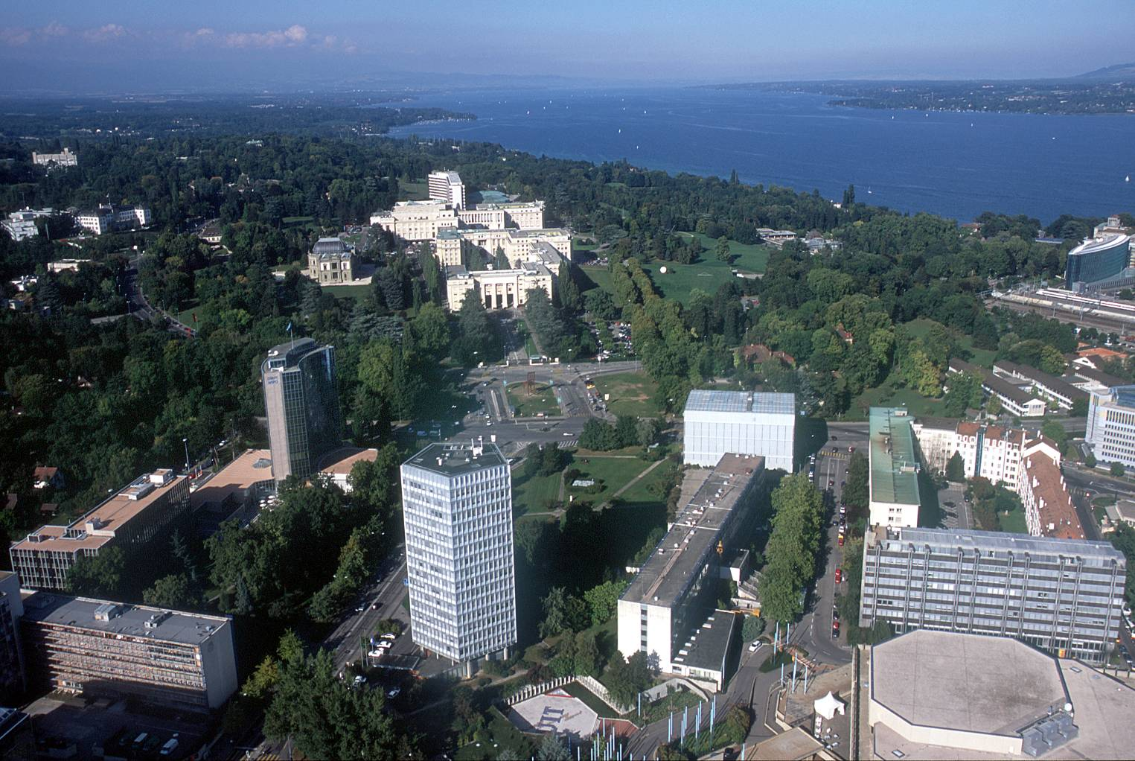
cristina.bueti@itu.int

