Slide 1
BDT Activities on Promoting e-Accessibility for Persons with Disabilities
Plenipotentiary Side Event: Accessible ICTs for Persons with Disabilities
Session SE3
Thursday, 14 October 2010
SAMI AL-BASHEER-AL MORSHID
DIRECTOR,
TELECOMMUNICATION DEVELOPMENT BUREAU

Slide 2
PRESENTATION OUTLINE
What do we mean by accessible ICTs?
Why promote accessible ICTs?
What is BDT doing to promote accessible ICTs?
What can ITU Members do to promote accessible ICTs?
How can we work together to ensure the digital inclusion of persons with disabilities?
Notes:
In this presentation, I would like to explain:
what we mean by accessible ICTs.
why it is important to promote accessible ICTs
what BDT is doing to promote accessible ICTS
what you, ITU members -- both government and the private sector -- can do to promote accessible ICTs
how the tools BDT has developed can facilitate your work in this regard.

Slide 3
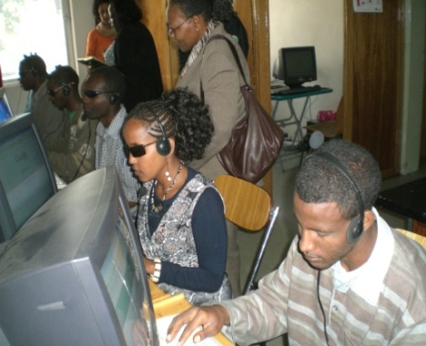
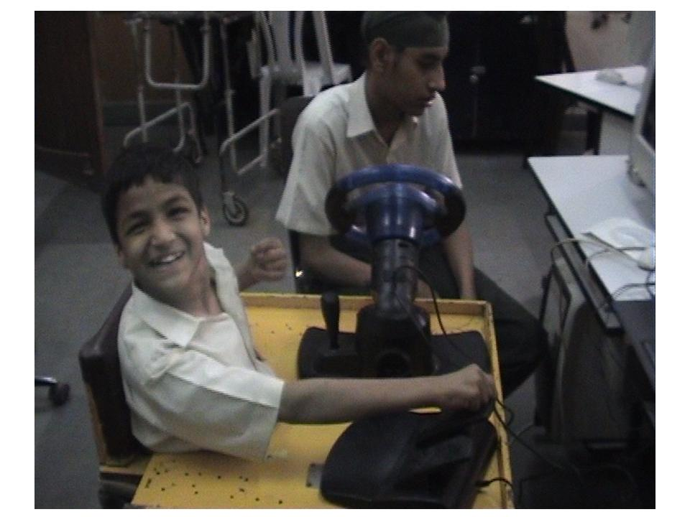
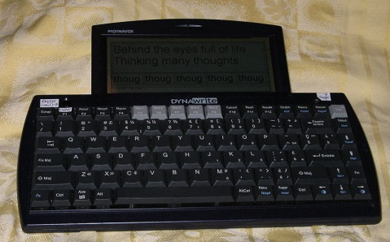
What do we mean by accessible ICTs?
Screen readers for the blind to enable them to access websites and documents
Closed captioning for broadcasting for the deaf
Video description for broadcasting for the blind
Text to speech devices for those with speech impairments to allow for two way communication for inclusive education and work
Text to speech device
Notes:
There has been a lot of talk about accessible ICTs. But what does this mean? [The TSB presentation provided a couple of examples]
There are a range of accessible ICTs that are useful for people with different kinds of disabilities.
For example, blind people can use the Internet the same as sighted people through the use of screen readers, accessible websites and documents posted on the web in an accessible format.
Deaf people can enjoy broadcasting through closed captioning just as blind people can use video description.
The photo on the top right is from a BDT-funded project in Ethiopia providing ICT literacy training for the blind.
The photo on the bottom left comes from our forthcoming module of the Connect a School, Connect a Community toolkit demonstrating how text to speech can be used to assist those with speech impairments to engage in two-way communication necessary for inclusive education and jobs.
The photo on the bottom right shows a child using assistive software to ensure his education
Text to speech technologies exist in major languages, but not in all languages. One of our projects in Mongolia is helping to develop TTS in Mongolian.

Slide 4
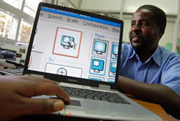
Why promote accessible ICTs for persons with disabilities?
Accessibility is a human right recognized in the UN Convention on the Rights of Persons with Disabilities (CRPD)
Enshrined in Article 9 of the CRPD
  Article 9 of the CRPD defines ICT accessibility as an integral part of accessibility rights on par with transportation and the physical environment.
  Article 9 concerns all ICT products and ICT based applications and services, with a far-reaching implication for industry, governments and civil society
Accessible ICTs can provide a path out of poverty and ensure an inclusive education for persons with disabilities
Notes:
Why is there so much attention given to promoting accessible ICTs for persons with disabilities?
Accessibility is a human right recognized in the United Nations Convention on the Rights of Persons with Disabilities which has now been signed by 147 countries and ratified by 95! Chances are good that your country is a signatory.
The Convention puts rights to ICT accessibility on a par with well-recognized rights to accessibility to transportation and the physical environment, such as ramps to buildings for those in wheelchairs.
Provisions on ICT accessibility are enshrined in Article 9 of the CRPD.
BDT’s work has shown that all too often, few persons with disabilities in developing countries have access to education. As a result, they remain illiterate and have no viable job skills.
Accessible ICTs can provide a path out of poverty and ensure an inclusive education for persons with disabilities.

Slide 5
What is BDT doing?
e-Accessibility toolkit with G3ict
Awareness Raising seminars and workshops: next workshop for CIS Region in Odessa 1-2 November
Connect a School, Connect a Community toolkit module on persons with disabilities
ICT projects for Community ICT Centres for Persons with Disabilities in Burkina Faso, Ethiopia, Mali, Malawi and Zambia
ICT projects on Text to Speech in Mongolia and Sri Lanka
ITU-D Study Group Question 20-1/1-Guidelines & New Study Question
5
Notes:
5
The BDT plays a leading role in sharing best practices that its members, Regulators, Policy Makers and ICT Industry players, can take to promote accessible ICTs for persons with disabilities in line with the UN Convention on the Rights of Persons with Disabilities.
One of the major activities ITU has undertaken is to team up with G3ict to develop an online toolkit for policy makers on e-Accessibility.
In addition, we run awareness raising forums, seminars and workshops for our members to share best practices and raise awareness on key issues to be addressed by Member States to meet the ICT needs of persons with disabilities. Information about all of these meetings is available on the Special initiatives website.
Our next workshop takes place in the CIS region on 1-2 November in Odessa.
We, we also explore best practices through ITU-D Study Group Question 20/1.
In addition, ITU is implementing projects in developing countries to establish community ICT centres equipped with assistive technologies so that persons with disabilities can partake in ICT literacy training as well as ICT-enabled job training. We currently have such projects underway or planned for Burkina Faso, Ethiopia, Mali, Malawi and Zambia.
Due to the need to develop text-to-speech in local languages, we also have a related project in Mongolia.
Let me now tell you more about these activities.

Slide 6
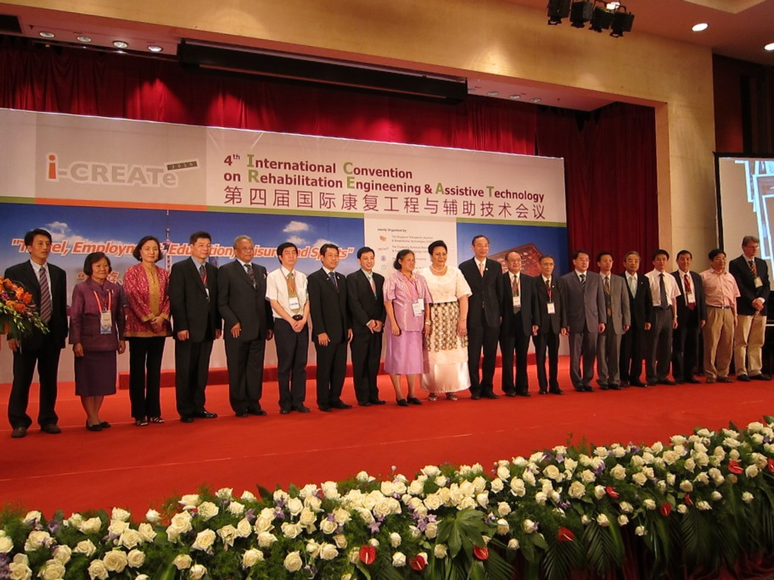
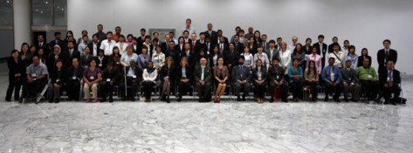
Upcoming and Recent ITU Accessibility Events
Workshop on ICT Accessibility for Persons with Disabilities, Odessa, Ukraine, 1-2 November 2010
Enabling Access to Education Through ICT, organized by the Centre for Internet and Society, G3ict, ITU, WIPO and UNESCO, New Delhi, 27-29 October 2010
Workshop on ICT Accessibility for Persons with Disabilities, Kampala, Uganda, 6 May 2010
Workshop on Accessibility to ICTs” at the 4th International Convention on Rehabilitation Engineering & Assistive Technology (iCREATe-2010), Shanghai, China, 23 July 2010, jointly organized by ITU-D and ITU-T
Asia-Pacific Regional Forum on Mainstreaming ICT Accessibility for Persons with Disabilities,” Bangkok, Thailand, 25-27 Aug 2009
ITU invites partnerships for the “Regional Seminar on Digital Inclusion for Persons with Disabilities and Ageing Societies” planned to be held in 2011
Notes:
This slide shows some of the upcoming and most recent events organized by or together with BDT on accessibility.
I extend a warm invitation to all of our members, and especially those in the CIS region, to attend the meeting in Odessa on 1-2 November.
Also, as you can see, ITU, together with its partners G3ICT, UNESCO, WIPO and India’s Centre for Internet and Society, is organizing an event on accessible education, featuring the role of assistive technologies, to be held in New Delhi at the end of this month.
We have also organized meetings in the Africa region, Arab States and Asia Pacific to raise awareness on the importance of accessible ICTs.

Slide 7
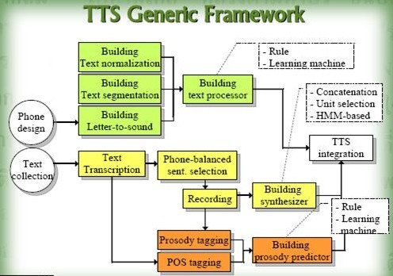
Project: Text to Speech Development in Mongolia -2010-2011
Build Mongolian Text-To-Speech (TTS) engine which supports Speech Application Programming Interface (SAPI) run on MS Windows
Make the Mongolian TTS compatible with both licensed screen reader and opensource-based screen reader
Conduct “training the trainers” on TTS development and “user training” on opensource-based screen reader.
The Project is implemented within the human capacity development framework of ITU/AMD partnership project and is supported by the Department of Broadband, Communications, and the Digital Economy (DBDCE), Australian Government.
Development partners include the National Electronic and Computer Center (NECTEC) of Thailand, the National IT Park (NITP) of Mongolia and the National University of Mongolia (NUM)
Notes:
As I mentioned, we also have a project on developing a text to speech application in Mongolian. While there are a range of screen readers for the blind in major languages, creating screen readers in other languages remains a challenge.
The Asia Pacific office, together with its partners in Thailand and Australia are working with the National University of Mongolia to develop a text to speech application for Mongolia.

Slide 8
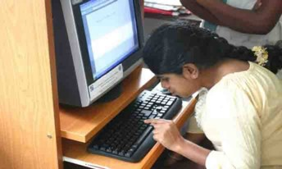
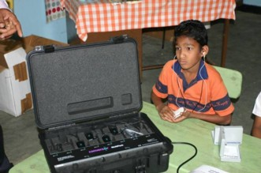
Project: Building Capacity for Harnessing ICTs for Disempowered / Marginalized Communities in Sri Lanka (eNABLE)
ITU Assistance Phase 1 – technical assistance in IT equipment and assistive technologies to 28 centres.
About 2,292 people including students, marginalized people and PwDs have been benefited
ITU Assistance Phase 2 – technical assistance in IT equipment and assistive technologies to 33 schools, 2 universities, 17 vocational training centres, and 17 Ranaviru villages.
About 4,678 people including students, marginalised people and PwDs have been benefited
Notes:
This slide demonstrates one of the projects in Sri Lanka using assistive technologies to create community ICT centres for persons with disabilities.
We have also funded such a centre in Burkina Faso and Ethiopia, and many of our multi purpose community telecentres in Africa benefit from assistive technologies.

Slide 9
What can you do to promote accessible ICTs
9
Ensure accessible ICTs and assistive technologies are available in the market (mobile phones, websites, etc)
  regulate availability
  industry codes
Ensure captioning, video description and for digital tv
Raise awareness about accessible ICTs – a lot is already built in
Use universal service funds for projects to provide job training for persons with disabilities or education to children
Procure only accessible ICTs
Raise awareness about the CRPD and the capabilities of persons with disabilities
Ensure access in times of emergencies
Notes:
9
Now that we’ve looked at what BDT is doing, let’s talk about what you – our ITU members – can do to promote accessible ICTS in your home markets, and then demonstrate how the e-Accessibility toolkit could serve as a resource for you in promoting accessible ICTs.
This slide captures 6 steps that could make your countries more accessible for persons with disabilities:
Ensure accessible ICTs are available in the market. This can be done by regulating availability or through voluntary industry codes
Ensure captioning and video description become the norm, especially in the transition from analogue to digital tv
Raise awareness about accessible ICTs. Increasingly manufacturers are building in accessible features. But many people don’t know about them. Operators, manufacturers and regulators could publicize these features!
Fund projects to provide job training or education to persons with disabilities through universal service funds
Government members can make it a policy to procure only accessible ICTs and thereby create a market for accessible ICTs
Government members can raise awareness with their counterparts in education and labour ministries about how persons with disabilities can use accessible ICTs to get jobs and enjoy an inclusive education

Slide 10
How can the e-Accessibility toolkit help?
Example: Promoting accessible mobile phones
Notes:
The e-Accessibility toolkit provides useful resources that you can use for all of these steps.
I will now demonstrate an example on promoting accessible mobile phones in your markets.

Slide 11
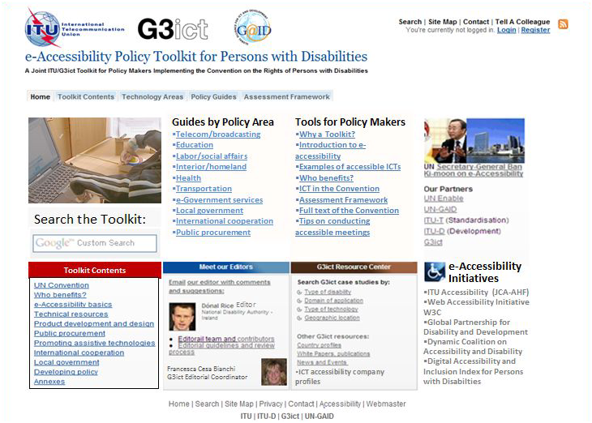
www.e-accessibilitytoolkit.org
Notes:
Say you wanted to learn more about the accessible features on mobile phones that are desired by persons with disabilities and how you could act to ensure these become more widely available in your country.
From the main page of the e-Accessibility Toolkit click on Technical resources which is highlighted in yellow.

Slide 12
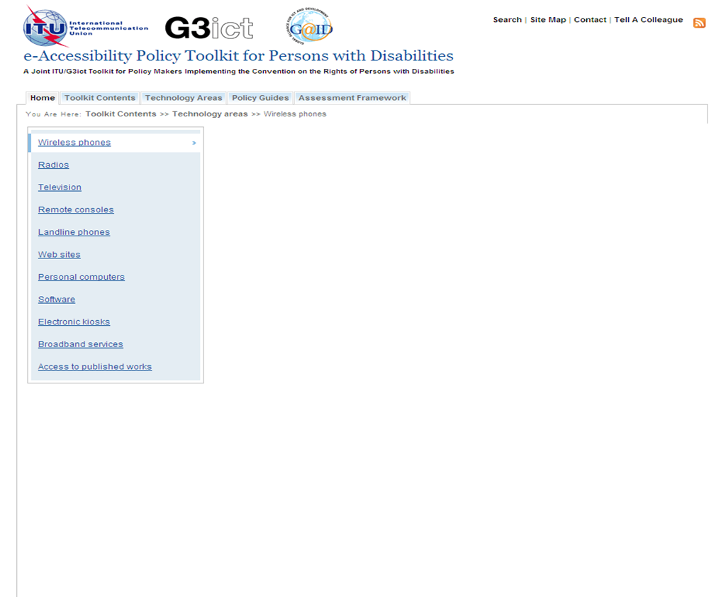
Accessibility features required by Persons with Disabilities
Blind and visually impaired people can adjust display settings such as font size or color contrast;
Blind or visually impaired people can use text to speech to access menus, receive audio feedback and have text, such as SMS, read loud;
Pictorial address books (containing an image of the person beside their name and phone number) has considerably empowered some people with cognitive disabilities to use cell phones;
Deaf persons can use a range of services including:
  SMS text messages
  Sign language via video calls (on 3G networks)
Persons unable to use a keypad can use voice recognition software.

Slide 13
Examples of Mobile Phone Regulations and Industry Codes
FCC Order on Section 255 (United States)
FCC rules on hearing aid compatibility (United States)
Mobile Industry Good Practice Guide for Service Delivery for Disabled and Elderly Customers in the UK
Voluntary charter signed by French operators, disabled persons organizations, government and national regulatory authority (France)
Accessibility criteria defined by voluntary French charter
French Regulatory Authority report on voluntary charger implementation
Notes:
From this same link, you will find a few examples of regulations and voluntary industry codes to promote accessible mobile handsets.
In the online version, each reference includes a hyperlink to take you to the original material. We invite those countries that have similar regulations and industry codes to share them with us so they can be added to the e-Accessibility toolkit.
The toolkit contains the same kind of background information and references on all the steps you could take to promote accessible ICTs:
For example, the toolkit includes resources on accessible broadcasting, public procurement, and the built-in accessible features that could be advertised to the public.

Slide 14
Thank You!
For more information:
See the Special Initiatives website at
www.itu.int/ITU-D/sis/
Or contact
sis@itu.int
Notes:
We hope that you will use these BDT tools and resources. Together we can make the world a more accessible place for persons with disabilities.
If you would like more information about this presentation, please contact the BDT Special Initiatives Division or visit their website.

