Slide 1

Common Alerting Protocol (CAP) and the UN Action Plan on Early Warnings for All
presented 13 March 2023
at the 2023 WSIS Forum
by Eliot Christian
Eliot.J.Christian@alert-hub.org
Notes:
My presentation is: “The international standard Common Alerting Protocol (CAP) and the UN Action Plan on Early Warnings for All".
My name is Eliot Christian. Since 2001 I have been involved in
defining and promoting CAP, especially internationally.

Slide 2
Presentation Outline
The Common Alerting Protocol (CAP)
CAP Editor Freeware
CAP Alert Hubs
The Call to Action on Emergency Alerting
The ‘UN Early Warnings for All’ Action Plan
Notes:
These are the major topics in this presentation.
First: What is CAP?

Slide 3
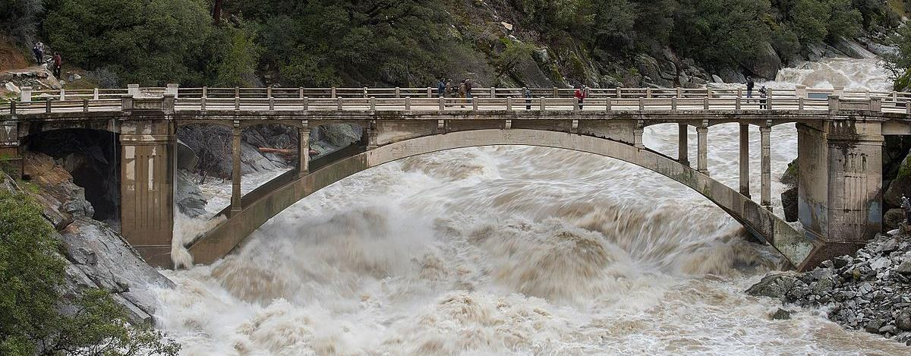
Breaking News: A Flood is Coming
Lives are at stake. People need to be warned.
Notes:
Consider this Breaking News: A Flood is Coming
Lives are at stake. People need to be warned.
They need to know the Key Facts for this emergency.

Slide 4
The Key Facts
What is the emergency?
Where is the affected area?
How soon do we need to act?
How bad will it be?
How certain are the experts?
What should we do?
Notes:
What is the emergency?
Where is the affected area?
How soon do we need to act?
How bad will it be?
How certain are the experts?
What should we do?

Slide 5





CAP Carries Key Facts
All-Hazards
All-Media
CAP
Notes:
CAP is the standard format for carrying those Key Facts.
CAP is designed for All-Hazards, All-Media, communications:
about any and all kinds of hazard (Weather, Fires, Earthquakes, Volcanoes, Landslides, Child Abductions, Disease Outbreaks,
Air Quality, Transportation Problems, Power Outages ...)
over any and all media (television, radio, telephone, fax,
highway signs, e-mail, Web sites, news feeds, ...)
Imagine CAP as a "standard business form" in paper on a clipboard.
According to your role (as a responder, manager, journalist, school principal) you will need other information to supplement the key facts.
But, everyone involved in the emergency should have at least the Key Facts, communicated by a CAP alert.

Slide 6
A CAP Alert is like a News Article
CAP Alert
  Headline
  Sent Onset Expires
  Sender Contact
  Category Description
  Instruction
  Urgency Severity Certainty
  AreaDescription AreaPolygon
  ...
News Article
  Headline
  Dateline
  Byline
  Body of the Article
Notes:
A CAP Alert is like a News Article, but CAP provides more structure.
Each Key Fact has its own separate element. And, many of those elements hold actual data rather than just plain text.
The data in CAP are coded values essential for automated processing, routing, translation and much more.

Slide 7
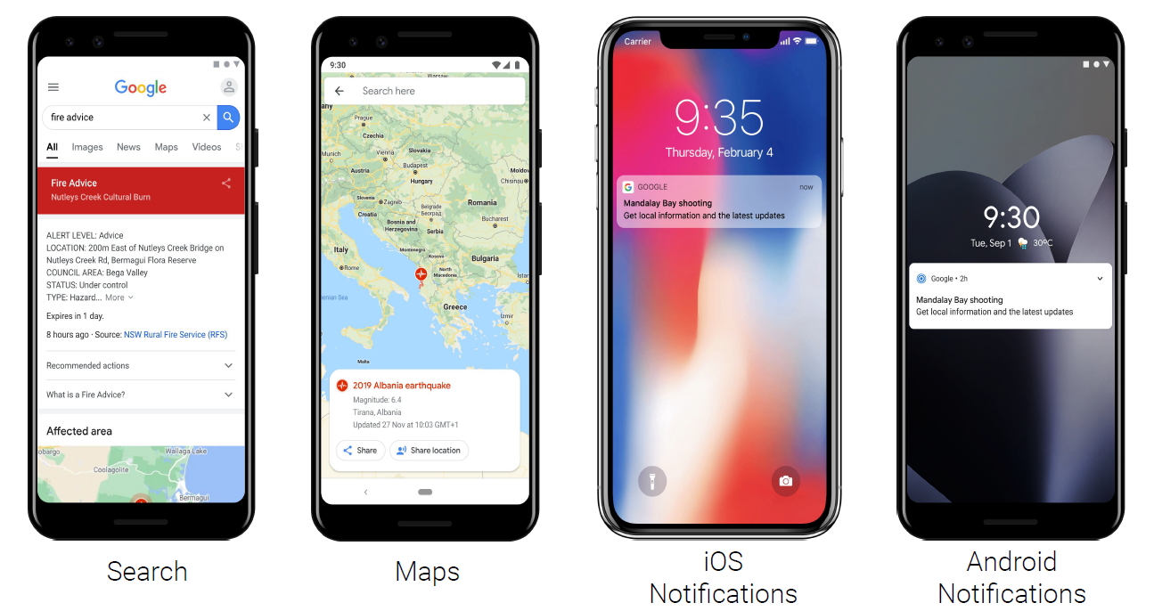
Example: Google Crisis Response
Notes:
The standardized structure of CAP enables Google, for example,
to deliver emergency warnings on a range of services.
Used by billions of people worldwide, these include Google Search, Google Maps, and push notifications.

Slide 8
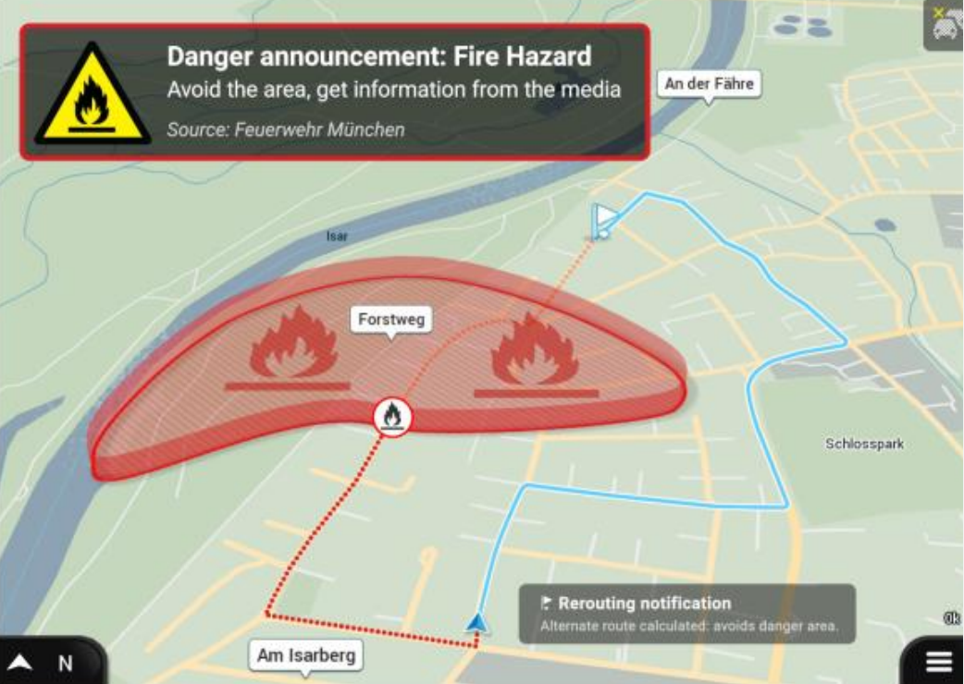
In-vehicle Navigation Systems
TPEG2 Emergency
Alerts and Warnings
(EAW)
Traveller Information
Services Association
(TISA)
picture from
TISA Press Release
(Sep 2021)
Notes:
And CAP is essential for sending CAP alerts to in-vehicle navigation systems. Those CAP alerts enable drivers to avoid danger areas, or take other actions as appropriate.

Slide 9
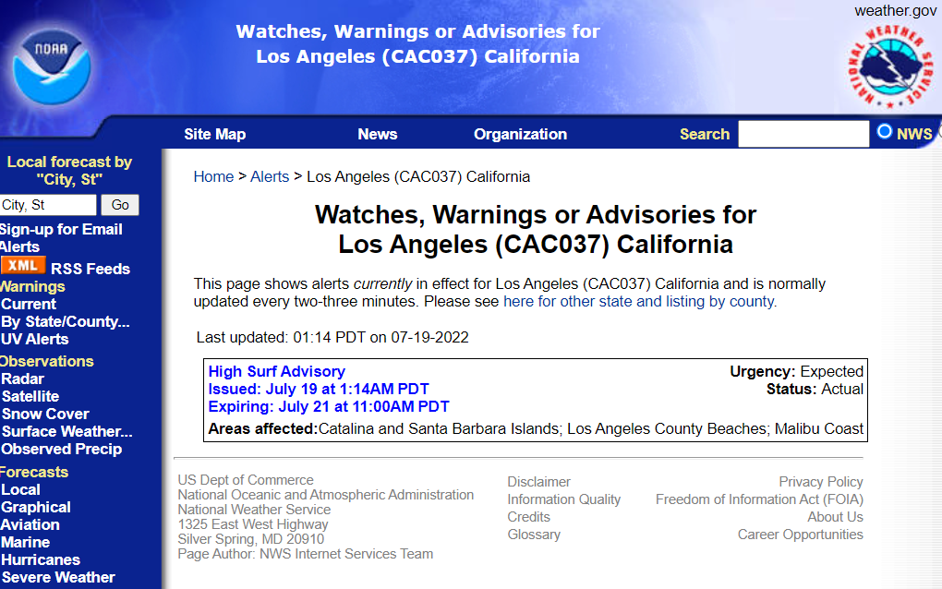
City-level CAP Alert Feed
https://alerts.weather.gov/cap/wwaatmget.php?x=CAC037&y=1
Notes:
These and other disseminators get published CAP alerts through Internet standard “news feeds”. (The same way that “blogs” are published.)
Here is an example CAP news feed. This one is published by
the U.S. National Weather Service for the county of Los Angeles.

Slide 10
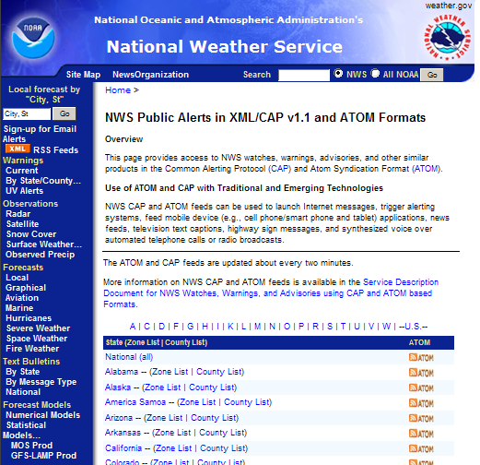
National CAP Alert Feed
https://alerts.weather.gov/cap/us.php?x=0
Notes:
National Weather Service maintains thousands of CAP news feeds,
by county and by “forecast zone”.
Here we see the URRL of an aggregate CAP Feed at national-scale.

Slide 11
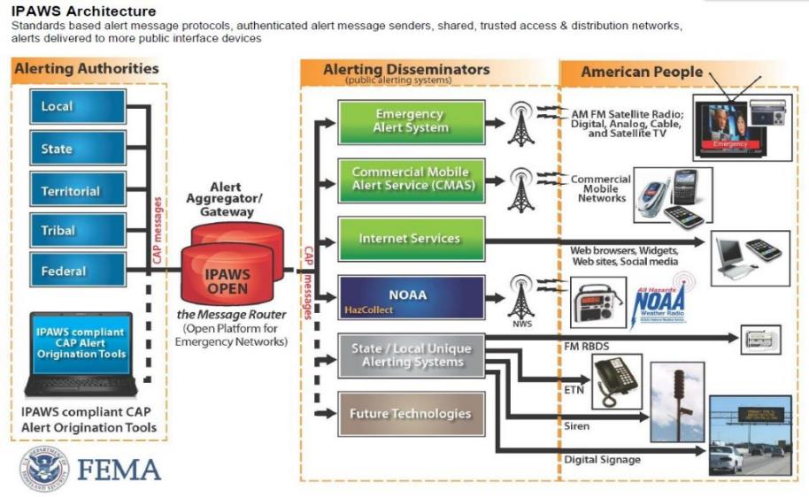
U.S. Integrated Public Alert and Warning System (IPAWS)
Notes:
The National Weather Service aggregated CAP feed is just one
source in the U.S. Federal Integrated Public Alert and Warning
System (IPAWS).
IPAWS aggregates CAP alerts from more than 1,700 federal, state, local, tribal and territorial alerting authorities.

Slide 12
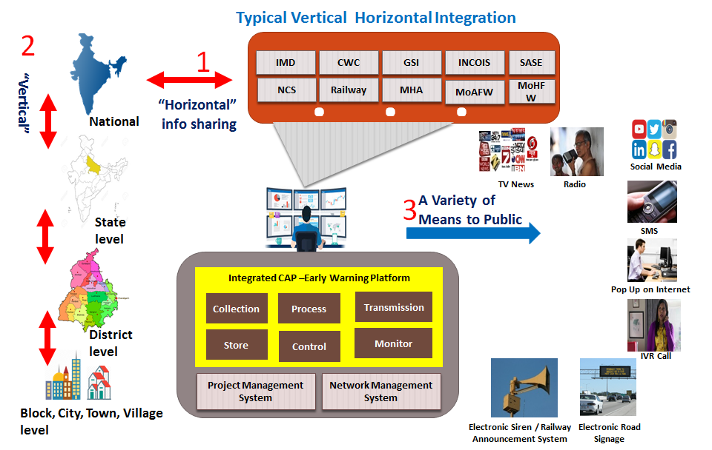
CAP in India
Notes:
Other national-scale CAP-based emergency warnings systems have a similar architecture. This is a diagram of India’s "Integrated Disaster Early Warning Platform".
On the left we see that CAP alerts are aggregated from the village and city level, through District and State levels, and on up to the National level.

Slide 13
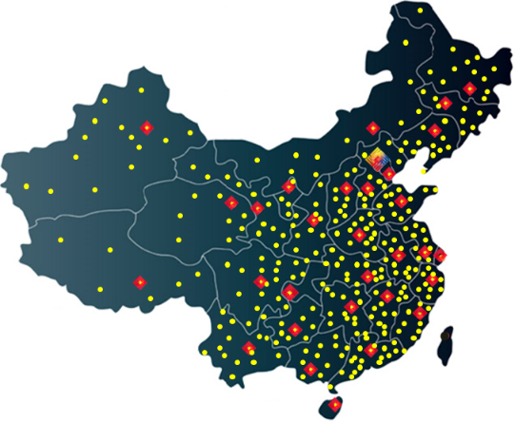
CAP in China
1 national center
31 provincial centers
343 municipal centers
2015 county centers
10126 specialty staff
Notes:
China's CAP-enabled, all hazards alert system is called NEWRES,
the National Early Warning Release System.
NEWRES has one national, 31 provincial, 343 municipal, and
2,015 county centers.

Slide 14
Is the source authoritative?
Aggregators and other intermediaries might lack direct knowledge needed to distinguish an authoritative source of alert messages
This lack becomes critical as alerting
makes use of large-scale public networks
The international Register of Alerting Authorities fills that knowledge gap
Notes:
Given that emergency alerting is often life-critical, receivers want
to be sure that a warning source is authoritative.
Because emergency alerting uses large-scale public networks,
it is impossible to know your sources personally, as you might
have done in a small town.
The international Register of Alerting Authorities is like a referral service--you might trust a registered alerting authority because
you trust the service that registered them.

Slide 15
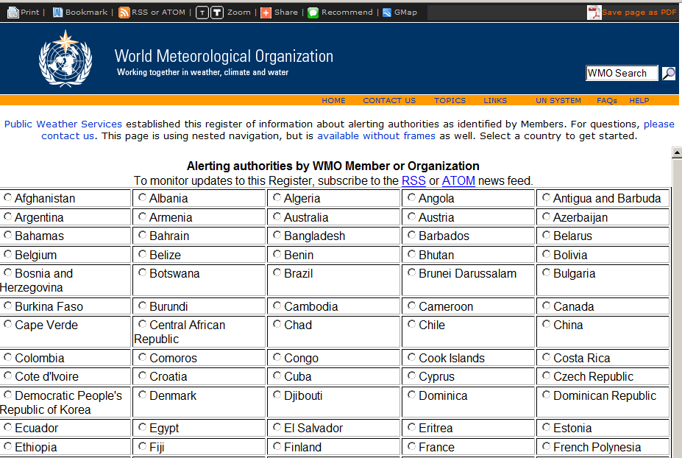
Register of Alerting Authorities http://www.wmo.int/alertingorg
Notes:
This is the international Register of Alerting Authorities,
operated by the World Meteorological Organization (WMO).

Slide 16
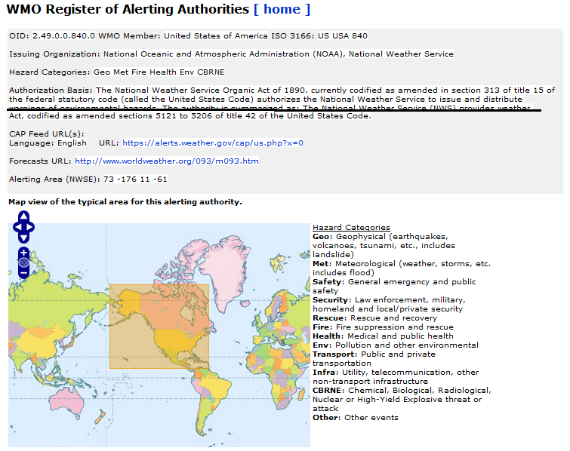
hazards
CAP Feed URL
https://alerts.weather.gov/cap/us.php?x=0
area
Notes:
Here is the register record for the alerting authority I just showed:
the U.S. National Weather Service.
We see hazard categories for which this authority typically issues alerts; and the map shows its typical alerting area. Notice that this register record has that CAP Feed URL we just looked at.

Slide 17
Presentation Outline
The Common Alerting Protocol (CAP)
CAP Editor Freeware
CAP Alert Hubs
The Call to Action on Emergency Alerting
The ‘UN Early Warnings for All’ Action Plan
Notes:
Now that you have a sense what CAP is about, I’d like to mention
the CAP Editor Freeware.

Slide 18
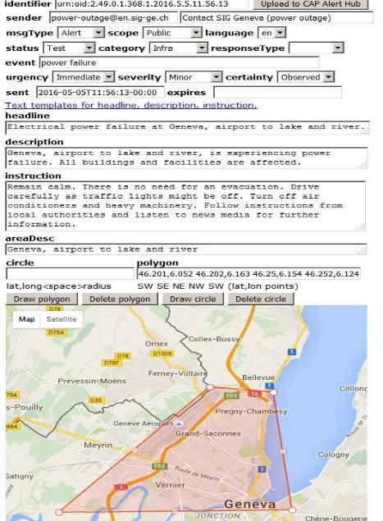
Free Tool for
CAP Alert Creation
and Publishing
https://cap.alert-hub.org
2023 WSIS Forum
Exhibition Booth
Free Tools
for CAP-based
Emergency Alerting
Notes:
CAP Editor is a free tool for CAP alert creation and publishing.
Now in operational use by 53 countries. CAP Editor supports 30 languages so far. It is already initialized for 374 alerting authorities in 205 countries/territories. More can be added easily.
Anyone can try out the CAP Editor tool as a guest. To actually publish alerts, the alerting authority just needs to designate which persons are allowed to create and publish its CAP alerts.
I am demonstrating this tool during the 2023 WSIS Forum at my Exhibition Booth titled: Free Tools for CAP-based Emergency Alerting.

Slide 19
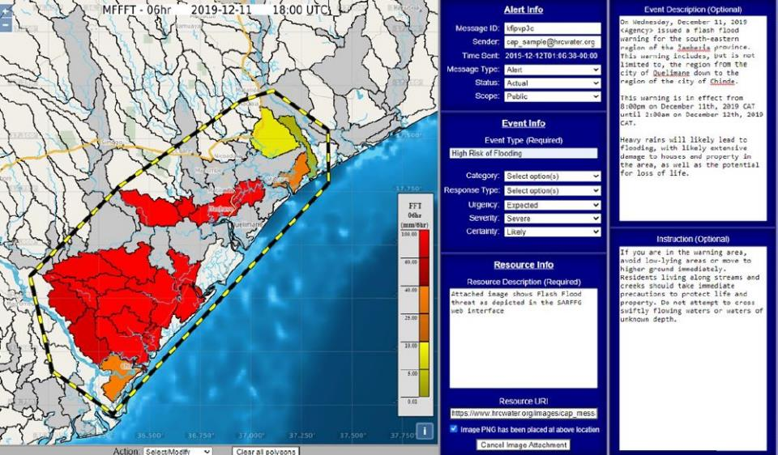
Flash Flood Guidance System
Notes:
Of course, there are many other tools for creating CAP alerts and publishing CAP Feeds. My opening slide showed a flood emergency. Here we see that a CAP tool is part of the international Flash Flood Guidance System.

Slide 20
Presentation Outline
The Common Alerting Protocol (CAP)
CAP Editor Freeware
CAP Alert Hubs
The Call to Action on Emergency Alerting
The ‘UN Early Warnings for All’ Action Plan
Notes:
Now let’s turn to CAP Alert Hubs.
We have seen there are many thousands of CAP alert feeds, even
for a single nation. Aggregating CAP news feeds allows large-scale intermediaries (such as an international news organization) to monitor CAP alerts from just a few sources.
Yet, the more local-scale CAP Feeds remain available for use by
cities, nations and regions.

Slide 21
CAP Alert Hubs
Free service aggregating CAP alert feeds
All subscribers can get near-real-time updates
Benefits of being cloud-based:
    Speed
    Scale (performance, reliability, availability)
    Redundancy
    Security and Authenticity
    Analytics
Notes:
So, a CAP Alert Hub aggregates CAP feeds in one location. CAP alerts published by alerting authorities get aggregated on the Hub almost as soon as a CAP alert is posted online.
There are several benefits to having CAP feeds aggregated on a cloud-based CAP Alert Hub:
Speed - Dissemination time is crucial for sudden-onset events such as earthquakes, tsunami, terrorists strikes, and tornadoes
Scale - The global scale dissemination infrastructure provides high performance, high reliability, and high availability
Redundancy - An additional copy of alert messages is kept elsewhere from the originator
Security and Authenticity
Analytics - A centralized aggregator simplifies analysis and enables optimization of alert dissemination

Slide 22
Three-level Architecture
CAP Alert Hub
CAP Alert Feed
CAP Alert
Notes:
At all scales, CAP Alert Hubs are based on a simple, three-level architecture.

Slide 23
Individual CAP Alert
A CAP alert is an XML document compliant with the schema defined in ITU X.1303
A CAP alert is a public, legal document:
“A public document is one that is or should legally be readily available for inspection
by the public, as a document issued by
[...] a governmental department.“
CAP Alert
Notes:
The basic unit of an emergency alerting system is the individual CAP Alert: an XML document following the schema defined in ITU X.1303.
From a policy perspective, a CAP alert is a public, legal document. According to the online Free Dictionary: “A public document is one that is, or should legally be, readily available for inspection by the public, as a document issued by [...] a governmental department.”

Slide 24
CAP Alert Feed
A CAP Alert Feed provides time-ordered links to CAP alerts as a publish/subscribe service compliant with either the RSS or ATOM Internet news feed standards
CAP Alert Feed
CAP Alert
Notes:
A CAP Alert Feed is a “series of alerts”. It provides time-ordered links to CAP alerts, as a “publish/subscribe” service. That service follows either the RSS or the ATOM Internet standard for news feeds.

Slide 25
CAP Alert Hub
A CAP Alert Hub provides aggregated
alerts as publish/subscribe services
Supports shared situational awareness
at scale: city, nation, region, global
Might focus on a particular theme,
type of hazard, highest impact, etc.
CAP Alert Hub
CAP Alert Feed
CAP Alert
Notes:
A CAP Alert Hub also provides simplified access to aggregated CAP alerts. The access is again via a publish/subscribe service, compliant with either RSS or ATOM specifications.
A CAP Alert Hub is a “collection of records”, with alerts typically arranged according to time of publication. Such an alert series across multiple alerting authorities serves the shared situational awareness requirement for emergency management.
Aggregation of alerts into collections can be applied at any geospatial scale: city, nation, region, or global.
Selection of alerts into collections can also be applied to focus on a particular theme, such as all alerts having to do with transportation,
food security, and so on.
Extending a series of alerts to long time scales on a collection of alerts from one alerting authority yields an archive, encompassing perhaps millions of separate emergencies over decades.

Slide 26
Many CAP Alert Hubs
Each CAP Alert Hub aggregates from published CAP alert feeds
Each CAP Alert Hub republishes CAP
alerts to its subscribers
A CAP Alert Hub provides a copy of the
alert; it is not an alerting authority
CAP Alert Hubs are alert publishers, not
CAP alert originators or alert editors
Notes:
Each CAP Alert Hub subscribes to published CAP alert feeds and offers the aggregate to its own subscribers.
It is important to emphasize that a CAP Alert Hub provides only a copy of the alert; it does not have the role of an alerting authority. Think of a CAP Alert Hub as a publisher rather than an originator or an editor.

Slide 27
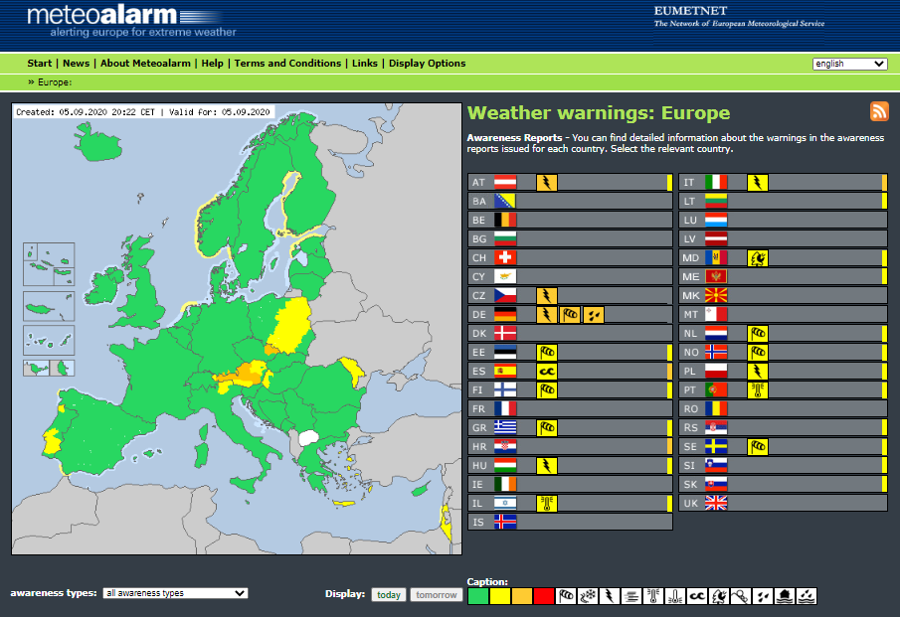
MeteoAlarm
Notes:
Here we see a CAP Alert Hub at regional scale: MeteoAlarm.
Operated on behalf of 37 European national weather services, MeteoAlarm features a graphic Web page highlighting severe
weather situations.
But, MeteoAlarm also publishes a CAP news feed specific to
each partner country. This allows national-scale needs to be
served in addition to European-scale needs. And, these 37
MeteoAlarm feeds are aggregated in turn by global-scale
CAP Alert Hubs.

Slide 28
WMO Alert Hub
Now aggregates CAP feeds published
by 131 countries and other sources
Operated by Alert-Hub.Org on behalf
of USA as a WMO Member
Core component of WMO Global
Multi-Hazard Alert System (GMAS)
Notes:
WMO Alert Hub is one CAP Alert Hub at global scale. It is now aggerating 199 CAP Alert Feeds, published by 131 countries.
WMO Alert Hub was given to WMO by the government of the United States. On behalf of the U.S. Government, my company (Alert-Hub.Org) operates WMO Alert Hub.
WMO Alert Hub is also a core component of WMO’s Global Multi-Hazard Alert System (GMAS).

Slide 29
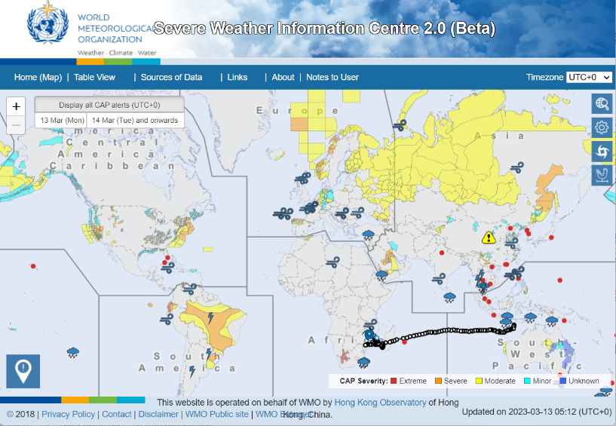
WMO Severe Weather Information Center
Notes:
A CAP Alert Hub can be focused on a particular topic, such as tsunami or flash floods,
The Severe Weather Information Center aggregates a subset of the CAP news feeds aggregated by the WMO Alert Hub, selecting only those specific to severe weather. This Alert Hub is operated on behalf
of WMO by Hong Kong Observatory.

Slide 30
IFRC Alert Hub
Free online source for published emergency alerts from local, national, and regional sources
Multi-hazard alerting focus, leveraging CAP for all manner of emergency preparedness and response activities: city -> country -> global
Consumers of IFRC Alert Hub: Red Cross and Red Crescent National Societies, news organizations, telecommunications providers, international and national emergency managers, disaster relief organizations, among many others
Notes:
The International Federation of Red Cross and Red Crescent Societies (IFRC) Alert Hub is a free online source for published emergency alerts. It leverages CAP for all manner of emergency preparedness and response activities, at all scales, from city through country and on
up to global.
Expected consumers of IFRC Alert Hub include Red Cross and Red Crescent National Societies, news organizations, telecommunications providers, international and national emergency managers, and disaster relief organizations, among many others.

Slide 31
Presentation Outline
The Common Alerting Protocol (CAP)
CAP Editor Freeware
CAP Alert Hubs
The Call to Action on Emergency Alerting
The ‘UN Early Warnings for All’ Action Plan
Notes:
Our next topic is the worldwide Call to Action on Emergency Alerting.

Slide 32
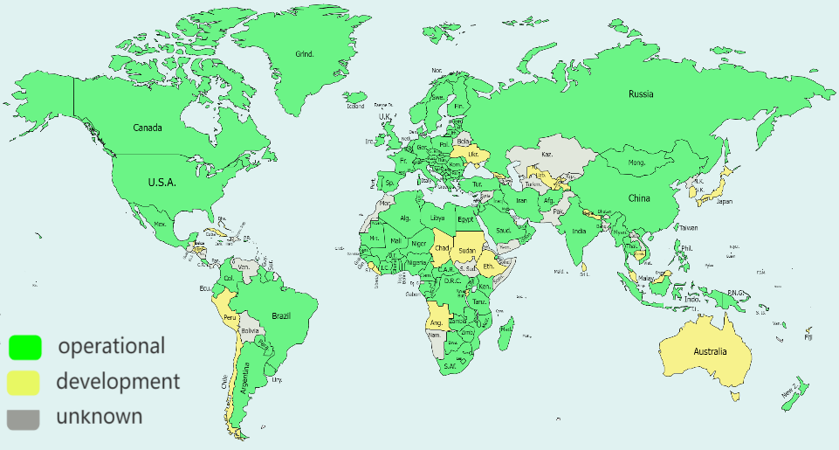
CAP Implementation, Worldwide
clickable map with zoom and pan:
https://cap-uptake.alert-hub.org/map.html
Notes:
Here is a global view of CAP uptake at the country level.
Today, 92% of the world's population lives in a country with at least
one national CAP news feed operating (82%, green on this map.) or
in testing now (10%, yellow on this map).
Countries shown in gray have not yet begin testing CAP, as far
as I know. A large percentage of these are "Least Developed" or "Developing" countries. Sadly, those are often countries especially vulnerable to disasters.

Slide 33
Call to Action on Emergency Alerting
International organizations, international NGOs, and international companies involved in emergency alerting
are endorsing the Call to Action on Emergency Alerting:
To scale up efforts to ensure that by 2025
all countries have the capability for effective, authoritative emergency alerting that leverages
the Common Alerting Protocol (CAP), suitable
for all media and all hazards.
Notes:
Recognizing this CAP implementation gap, international organizations, international NGOs, and international companies involved in emergency alerting are urged to endorse the Call to Action on Emergency Alerting:
To scale up efforts to ensure that by 2025 all countries have the capability for effective, authoritative emergency alerting that leverages the Common Alerting Protocol (CAP), suitable for all media and all hazards.
I mentioned that 82% of the world’s population lives in a country with at least one national-level CAP alert news feed operational. That is up from 42% in 2017: an average increase of 8% per year. At this rate, we are on track to reach 100% in 2025.
With simple freeware tools such as CAP Editor, it is easy for countries to implement CAP--at no cost and with nothing to install.

Slide 34
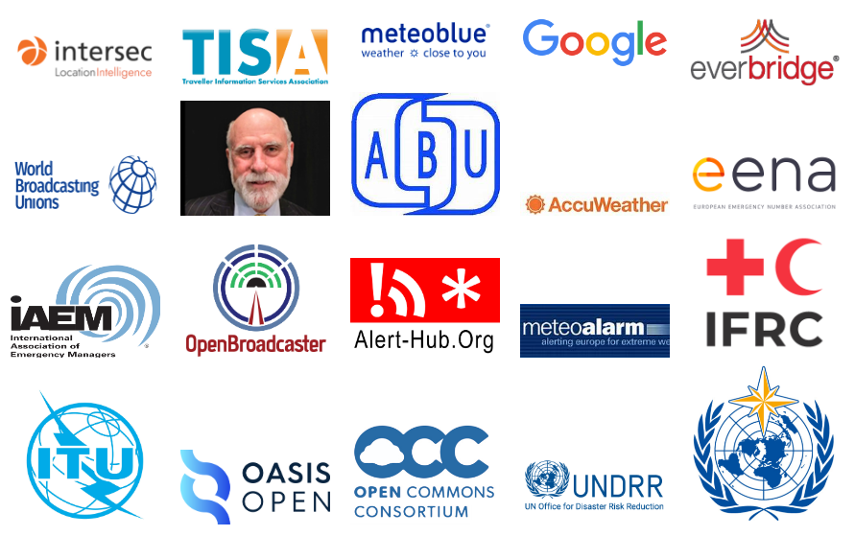
Endorsements of the Call to Action
Notes:
Here are the logos from the 20 endorsements so far.
These include seven companies: Intersec, MeteoBlue, Google, Everbridge, AccuWeather, OpenBroadcaster, and Alert-Hub.Org.
There are also endorsements by ten major international organizations: TISA (Traveller Information Services Association), World Broadcasting Unions, ABU (Asia-Pacific Broadcasting Union), EENA (European Emergency Number Association), IAEM (the International Association of Emergency Managers), MeteoAlarm, ITU, Open Commons Consortium, UNDRR, and WMO.
NGO’s and standards groups have also endorsed the Call to Action, specifically IFRC and OASIS.

Slide 35

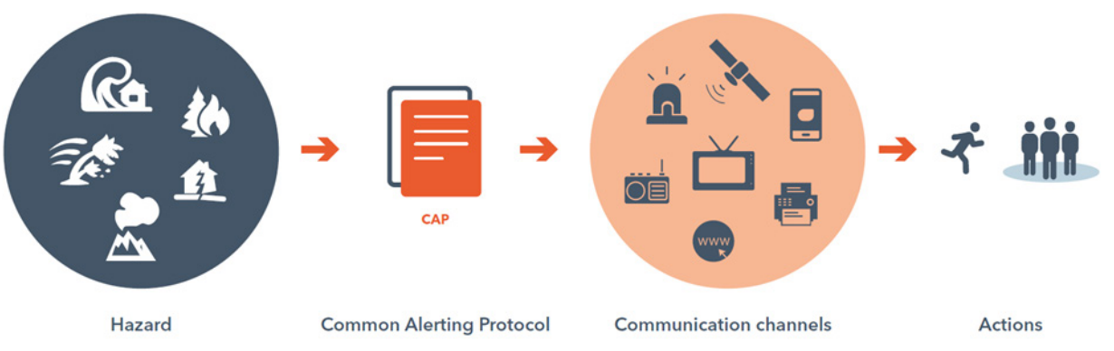
    ITU Guidelines for National Emergency Telecommunications Plans (NETPs)
“CAP enables authorities to warn people of a disaster immediately, and up to global scale”
Notes:
The endorsement by ITU notes that CAP is part of the ITU Guidelines for developing National Emergency Telecommunications Plans.

Slide 36

Endorsement by Vint Cerf
In decades past, emergency warnings reached
most people in harm's way through mass media
such as over-the-air broadcast radio and television.
Now, people spend more and more time online (chatting, streaming movies and sports, learning, shopping, gaming, etc). Many will not get emergency messages designed for mass media. Yet, it is easy for Internet technologies to deliver CAP alerts to online users, and to life-saving online devices such
as sirens, digital signage, bridge controls, bed shakers, etc.
Let's build out a future where CAP-enabled alerting becomes
a humanitarian feature of all major cloud services and
computer operating systems worldwide.
Notes:
Vint Cerf, “Father of the Internet” endorsed as himself.
His endorsement has a visionary outlook for CAP:
In decades past, emergency warnings reached most people in harm's way through mass media such as over-the-air broadcast radio and television. Now, people spend more and more time online (chatting, streaming movies and sports, learning, shopping, gaming, etc.).
Many will not get emergency messages designed for mass media.
Yet, it is easy for Internet technologies to deliver CAP alerts to online users, and to life-saving online devices such as sirens, digital signage, bridge controls, bed shakers, etc. Let's build out a future where CAP-enabled alerting becomes a humanitarian feature of all major cloud services and computer operating systems worldwide.

Slide 37
Presentation Outline
The Common Alerting Protocol (CAP)
CAP Editor Freeware
CAP Alert Hubs
The Call to Action on Emergency Alerting
The ‘UN Early Warnings for All’ Action Plan
Notes:
With all this as background, let’s end with the ‘UN Early Warnings for All’ Action Plan.

Slide 38
    UN Early Warnings for All Action Plan
    3.1 billion USD plan with one goal:
    To ensure every person on Earth is protected by early warning systems within five years
    The Action Plan is organized in Four “Pillars”:
    1. Risk Knowledge and Management
    2. Observations and Forecasting
    3. Dissemination and Communication
    4. Preparedness to Respond
Notes:
The Action Plan was launched in 2022 at the Conference of the Parties to the Convention on Climate Change. It calls for new investments of 3.1 billion US dollars to achieve its goal:
To ensure every person on Earth is protected by early
warning systems within five years.
The Action Plan is organized in four Pillars. "Pillar 3" addresses
the "Dissemination and Communication” of warnings.

Slide 39
    Dissemination and Communication
    One of the Actions: Establish CAP Editor
    and Alert Hub to further enhance multi-hazard
    CAP-based emergency alerting
    One of the Outcomes:
    All countries have the capability for effective, authoritative emergency alerting that leverages the Common Alerting Protocol (CAP), suitable
    for all media and all hazards.
    (Same as Call to Action on Emergency Alerting)
Notes:
One of the Actions in the “Dissemination and Communication” Pillar
is to "Establish CAP editor and Alert Hub to further enhance multi-hazard CAP based emergency alerting". CAP Editor and the Alert
Hub are both provided by my non-profit company Alert-Hub.Org.
The CAP Editor freeware is now in operational use by 53 countries
and 27 are testing it. The Alert Hub freeware aggregates emergency alerts from 199 CAP Alert Feeds.
One of the Outcomes in the “Dissemination and Communication”
Pillar is: "All countries have the capability for effective, authoritative emergency alerting that leverages the Common Alerting Protocol (CAP), suitable for all media and all hazards." This exactly restates
the Call to Action on Emergency Alerting.

Slide 40
Explore Further
Exhibition Booth: Free Tools for CAP-enabled Emergency Alerting (CAP Editor and Alert Hub)
Videos:
CAP Animation YouTube (2 m 40 s)
Volcano alert YouTube (1 m 23 s)
Broadcasters drrhub.org/learn-cap.php (40 m)
CAP Training and other matters – contact
Eliot Christian eliot.j.christian@alert-hub.org
Notes:
This concludes my presentation.
All this week I am at the Exhibition Booth titled: Free Tools for CAP-enabled Emergency Alerting. Those free tools are the CAP Editor
and the CAP Alert Hub.
Here are links to some CAP videos you might like to watch.
Feel free to contact me about anything related to CAP.

Slide 41
Comments, Questions?
The Common Alerting Protocol (CAP)
CAP Editor Freeware
CAP Alert Hubs
The Call to Action on Emergency Alerting
The ‘UN Early Warnings for All’ Action Plan
Notes:
We have some time now for any Comments or Questions on these
or related topics.
.

