Slide 1
GEC COVID-19
Initial Project Responses
A selection of Girls’ Education Challenge (GEC) initial project interventions during the COVID-19 crisis
June 2020

Slide 2
Contents
Section |  | Page
1 | About the GEC | 3 – 5
2 | The GEC and COVID-19 Response | 6 – 8
3 | Case Studies | 9 - 19

Slide 3
1. About the GEC

Slide 4
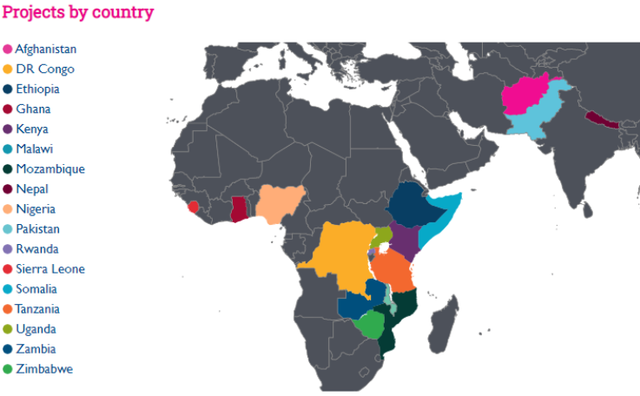
Overview of the GEC
Operating since 2012, the Girls’ Education Challenge (GEC) is the largest donor-funded girls’ education programme in the world. The programme has 41 projects across 17 countries.
The projects were selected through an open, robust and transparent process, and they were assessed for their ability to implement innovative, effective and sustainable ways to increase girls’ enrolment in, and completion of, education programmes and to provide them with enhanced capabilities for healthy productive lives.
  Phase 2 of the GEC (2017-2025) works through two windows:
    The GEC Transition (GEC-T) projects support up to 1.32 million marginalised girls to continue to learn and transition into secondary school, further education or livelihoods.
    The Leave No Girl Behind (LNGB) projects support up to 190,000 highly marginalised adolescent girls who have dropped out of, or never attended, school to participate in learning opportunities and develop a range of academic, life and vocational skills.

Slide 5
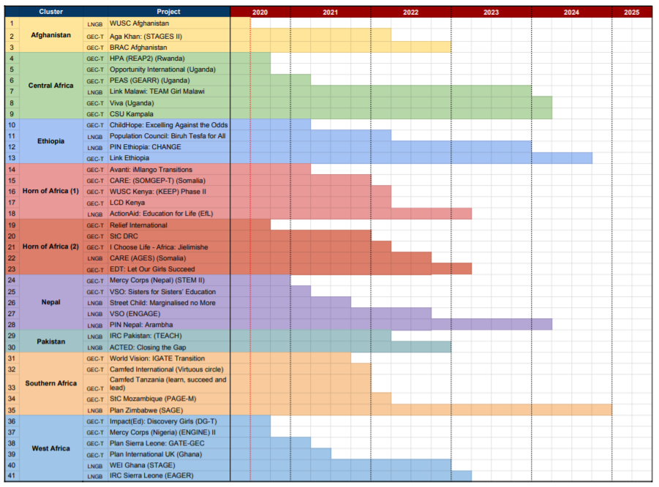
Forward look on GEC Projects 2020 - 2025
This table shows the timeline for the 41 projects within the GEC portfolio over the next five years.
The projects are grouped into ‘clusters’ according to their region and are provided with technical and fund management support through the cluster team structure.
Project closure dates are subject to change.

Slide 6
2. The GEC and COVID-19

Slide 7





COVID-19 and the GEC
As the COVID-19 pandemic has worsened, all the GEC countries have implemented some form of lockdown and closed schools in order to try to stem the spread of the virus
GEC projects have had to significantly alter and adapt their operations in order to respond rapidly to the evolving situations in their local contexts and continue to support the lives and education of the girls the programme supports
The 38 currently active projects have submitted initial project response plans. Their response activities can be categorised across five key output domains (see right). In addition all projects aim to keep in touch with their beneficiaries and coordinate with National Government efforts, Education clusters and so on.
Some of the planned activities are adaptations to existing activities, while others are completely new to the projects. All activities are designed to ensuring the safety and wellbeing of the GEC girls, their families, communities and the project staff, while also supporting continued learning through the crisis where possible.
The following slides outline case study examples of some of the GEC projects’ initial responses across various output domains and which employ different tools and technologies to achieve them. These activities start in May/June 2020.
The response plans are being shaped and adapted with the guidance of the Fund Manager as the situation unfolds in each context, and are subject to change. The activities reflected in the case studies are not exhaustive, but have been chosen to demonstrate how different responses aim to help achieve outputs in different domains.
Most response plans cover output domains 1 to 4. We expect that overtime as national governments look towards re-opening schools, so too will the GEC projects transition activities to support schools and learning centres to re-open.
COVID-19 Project Response Output Domains
  1. Continuation of teaching and learning
  Driving continuity of learning using quality materials and accessible approaches, including professional development of educators
  2. Wellbeing and resilience
  Supporting social-emotional learning, positive coping skills and social networks
  3. Social protection and safety
  Ensuring equitable and safe access to basic services including health, SRHR, WASH, including bursaries, cash transfers and nutrition programmes
  4. Influencing society and institutions
  Combatting exclusionary norms and advocating for continued investment in education (formal and informal), positive support networks and enabling environments for girls to flourish.
  5. Return to school / learning centres
  Mitigating drop-out, preparing girls and families/caregivers, and supporting schools/centres for the return to formalised learning

Slide 8
The tools and technologies used to reach girls during COVID-19
The GEC projects are deploying numerous tools and technologies to keep in touch with the GEC girls, to help keep them safe, to support a connection to learning for them and to coordinate activities with local communities, national governments and DFID.
The tools and technologies being used are a mixture of online and offline technologies, allowing projects to reach girls and local communities even if they may not have access to the internet, TV or radio. Some tools and technologies focus on trying to reach individuals, while others will aim to reach larger groups and several reach beyond the project beneficiaries to wider groups.
The diagram below outlines some of the tools and technologies being used, whether online and offline, and reaching individuals directly or reaching groups.
Reaching Groups
  Learning materials broadcast by TV and/or radio
  Awareness and guidance messages broadcast by TV and/or radio, promoted visually through posters or orally through public announcements
  Surveys conducted via SMS
  Social media groups
  Online surveys, including Microsoft Forms
Offline
Online
  SMS (phone) learning
  Print lesson materials distributed through community networks
  Healthcare provisions physically distributed through community networks
  Remote tuition through internet-enabled EdTech sessions, including solar-powered and satellite-enabled technologies
  Learning activities shared with teachers, mentors, parents via Whatsapp or other Apps
  Online banking and mobile money
Reaching Individuals Directly

Slide 9
3. Project Response Case Studies from the GEC

Slide 10
List of Case Studies
Output Domains Key
 | Social Protection & safety | Continuation of teaching & learning | Wellbeing & resilience | Influencing society & institutions | Return to school / learning centres
Project Activity | Organisation | Output Domains | Page
(1) Monitoring wellbeing and the continued education of girls in Nepal | VSO |  | 11
(2) Providing urgent healthcare support to marginalised groups in Ethiopia | Child Hope |  | 12
(3) Continuing education through TV and Radio broadcasts in Ghana | Plan UK |  | 13
(4) Providing psycho-social and wellbeing support to girls in Afghanistan | Community-Based Education for Marginalised Girls in Afghanistan |  | 14
(5) Broadcasting safeguarding, health and education messages in Ghana, Kenya and Nigeria | ImpactEd |  | 15
(6) Using multiple methods of communication to reach girls in Zimbabwe | Plan International |  | 16
(7) Maintaining learning by leveraging local networks in Ethiopia | People in Need (PIN) |  | 17
(8) Providing food supplies and psycho-social support to girls in Nepal | Street Child |  | 18
(9) Learning from the Ebola crisis and supporting girls through community groups and radio communications in Sierra Leone | International Rescue Committee (IRC) |  | 19
Notes:
Relief International in Somalia are supporting the government by broadcasting and sharing short videos on handwashing and staying safe during the pandemic.
VSO and Mercy Corps in Nepal are using leafleting, WhatsApp and text messaging to spread information in line with government guidance.
IRC in Pakistan are involved in a mass awareness-raising campaign in three provinces which involves radio campaigns, distribution of educational material and Robo Calls.
Plan UK in Sierra Leone are adapting their life skills content, based on learnings from the secondary impacts of the Ebola crisis, the new contextual realities and asking girls what information they need at this time.
In Northern Nigeria, older girls involved in Mercy Corps vocational training activities are making masks and soap and setting up basic handwashing facilities in public spaces within their communities.
Projects in Afghanistan are continuing to support teachers at all project community schools
Link Community Development in Malawi and Cheshire Services in Uganda are providing regular meals to children in high risk situations.
CAMFED is expanding its self-study modules for use by girls in Tanzania, Zimbabwe and Zambia while schools are closed.
The IGATE project is reworking the way in which it supports girls to study. Facilitators are
networked geographically to support learners and being given fresh guidance on how to help family members support continued home-based learning using locally available resources.
In Ghana, Plan’s MGCubed team is currently training and supporting government teachers to adapt lesson plans to be suitable for broadcast distance learning. This includes lesson rehearsal and feedback, before the materials are finalised.

Slide 11
1. Monitoring wellbeing and the continued education of girls in Nepal
GEC-T | VSO | Sisters for Sisters’ Education
Long term project overview
This project works with 64 schools to provide remedial after school classes for over 7,000 marginalised girls, helping them to transition from primary to secondary school, and leave primary school ready to continue their education or secure sustainable employment. Better performing students support students in lower grades.
Context
Nepal initially reported a low number COVID-19 cases, but these are now increasing. Schools in Nepal have been suspended since 18 March and a country-wide lockdown came into effect on 24 March with all but essential services closed down.
Output Domains
Wellbeing & Resilience
Continuation of teaching & learning
Project Response to COVID-19
VSO have developed an online tool to collect information on and remain in contact with project beneficiaries.
The tool involves a questionnaire for school stakeholders (learners, parents and caregivers, and teachers) which asks about issues relating to girls’ continuing education and their wellbeing. The questions are different depending on the type of stakeholder responding.
The project has mobilised adult and teacher ‘champions’ to help disseminate the tool and trace the status of primary actors using mobile phones.
VSO have also created social media groups to help share information and connect to beneficiaries. This has allowed them to connect and circulate information on safeguarding and counselling services to beneficiaries.
What we are learning
The online questionnaire has already provided results which help the project to understand how girls are coping during the crisis and how they can be supported.
They found, for example, that 80% of girls are continuing their studies, and that there is a minimum of one mobile phone in each family, with around 43% having access to a smart device with internet.
This information allows the project to plan activities using online and offline (e.g. radio) mediums to continue to stay in contact with the girls and encourage their continued education during the crisis.

Slide 12
GEC-T | Child Hope | Excelling Against the Odds
2. Providing urgent healthcare support to marginalised groups in Ethiopia
Long term project overview
This project supports over 16,000 marginalised girls in remote areas of Ethiopia who face child marriage, street-life and domestic work which hinder their attendance at school. They create stimulating and appropriate classrooms, providing teachers with training necessary to tailor their teaching to the needs of individual girls, and offer life skills to raise girls’ aspirations. The project also aims to instigate a ‘Girls’ Movement’ led by young female leaders on the value of education.
Context
The first reported case in Ethiopia was on 13 March.
Schools were ordered to close on 16 March, which has also meant that school feeding programmes have ceased.
All land borders closed on 23 March and the government declared a 5-month long state of emergency on 8 April.
Output Domains
Influencing society & institutions
Social protection & safety
Project Response to COVID-19
Following a series of local group meetings with leaders and community care coalitions to determine what interventions were most needed, Child Hope have transitioned activities towards health support, specifically to the provision of soap and sanitary materials to remote communities.
They used an eligibility criteria to identify the most marginalised families, prioritising families already involved in the project and extending support to families in the same communities who meet eligibility criteria, such as families with disabilities.
Child Hope are working with local health authorities (who they have previously worked with on local sexual and reproductive health projects) to support the distribution effort and are training them on safeguarding and how to report incidents.
The project has also helped to disseminate national Government and WHO health guidance to prevent the spread of the virus, such as effective handwashing, and social distancing.
What we are learning
The project has managed to distribute over 16,450 bars of soap and sanitary provisions to marginalised families who would not otherwise have such provisions; this has only been made possible by partnering with and utilising the network of the government health extension workers in the local communities.

Slide 13
GEC-T | Plan UK | Making Ghanaian Girls Great!
3. Continuing education through TV and Radio broadcasts in Ghana
Long term project overview
The Making Ghanaian Girls Great! project supports 18,000 girls across 139 schools in Ghana to complete school, by delivering interactive learning sessions via solar powered EdTech distance learning methods. As part of this project, 72 government school classrooms will be transformed into learning and information hubs.
Context
Schools have been closed in Ghana since 16 March 2020 and the Ministry of Education was tasked with rolling out a distance learning education programme.
The country has placed restrictions on movement since 27 March 2020 and public gatherings have been banned.
Output Domains
Continuation of teaching & learning
Social protection & safety
Influencing society & institutions
Project Response to COVID-19
This project has transitioned activities to support the Ghanaian Government’s distance learning education programme in response to the COVID-19 crisis.
The Ghana Broadcasting Corporation plays a key role to reaching basic education learners through national TV, and has been airing free content for learners in different grades. The project has been generating the academic content for TV broadcasts and is also supporting the broadcast of public health messaging.
Those without access to TV can engage in the content through audio-recordings of televised lessons broadcast over radio. The project is also undertaking a mapping exercise of TV and radio penetration among the project target beneficiaries which they will use to plan for the provision of radios and/or TVs for households currently without access. The team are also working on including the use of sub-titles and sign language into the content for learners with disabilities.
The project team is training public school teachers to adapt lesson plans to be suitable for broadcast distance learning, including lesson rehearsal and feedback. They are also providing guidance to parents and caregivers for home learning.
What we are learning
While the broadcasts are reaching large numbers, the content is limited because there is only one TV channel to broadcast both SHS and Basic school lessons for specific grades, leaving little time for life skills and extra curriculum content.
The project plans to gather all the information on access to resources and technologies and will be sharing findings with the Ghanaian Government to encourage greater government support for the distance learning initiatives.

Slide 14
GEC-T | Continuation of education for marginalised girls
4. Providing psycho-social and wellbeing support to girls in Afghanistan
Long term project overview
This project provides community-based primary education to 49,150 girls for two years through 1,670 community-based girls’ schools (CBGS). Subsequently, it supports girls to access state secondary schools, to continue their secondary education in community-run schools or to undertake technical and vocational education and training (TVET).
Context
Afghanistan has reported over 12,000 cases of COVID-19, which was exacerbated by the return of 140,000 refugees from Iran, an early hotbed of the virus. The healthcare system is ill-equipped, particularly for girls and women as there are few female doctors. The economy has been heavily impacted by the crisis, as many rely on informal work, and food insecurity is leading to a rise in violence, crim and migration.
Output Domains
Social protection & safety
Wellbeing & Resilience
Continuation of teaching & learning
Project Response to COVID-19
As well as trying to enable continued learning, the project has focused their efforts on the psycho-social support and mental wellbeing of girls and women, by prioritising human-to-human engagement as much as possible. To do this, they have employed a combination of helplines, TV and radio programmes and community peer groups with social distancing.
The ‘Home Learning Helpline’ can be reached by anyone with a phone. For those without phones, the project plan to make free community phones available. The helpline will operate like a call centre whereby the caller will choose from one of three options: (i) grade-level education support ( teachers they know rather than just any teacher at that grade), (ii) mental or emotional support (psychosocial first aid), and (iii) parenting support.
The socially distant peer groups will be run by community-based female volunteers and offer in-person psycho-social support for girls and a physical place of safety during the crisis if needed.
The TV and radio ‘ed’ programme will support continued learning and the project will equip teachers with the means to call or SMS students to prompt them to watch or listen to content and they can then follow up with students with assessment style questions.
What we are learning
The project have found that partnering and coordination of activities more broadly is key to both avoiding duplication and also getting the best response measures and technology in place to reach the most marginalised girls. For example, engagement with the EdTech hub enabled them to partner with a telecom company to create the helpline.

Slide 15
GEC-T | Impact (Ed) | Discovery Project
5. Broadcasting safeguarding, health and education messages in Ghana, Kenya and Nigeria
Long term project overview
ImpactEd works across 2,000 schools in Ghana, Nigeria and Kenya to improve girls’ literacy and numeracy skills, life skills, and raise girls’ aspirations. They combine professional development of teachers with video technology and teaching resources.
Context
Across Ghana, Kenya and Nigeria, national governments have implemented lockdowns and school closures in response to COVID-19. During this time, the risks of domestic violence, child abuse and exploitation are increasing in a context of school closure, restricted movement and livelihood insecurity.
Output Domains
Social protection & safety
Wellbeing & Resilience
Continuation of teaching & learning
Project Response to COVID-19
ImpactEd are mobilising their Cell-Ed platform to communicate child protection and the importance of girls’ education to school and community leaders, teachers and households in project areas. Communications will provide accurate COVID-19 information, messaging related to social distance and good hygiene, consistent with approved content published by government health authorities in each country and WHO.
Covid-19 messaging will also be done through radio broadcast which will have national reach.
ImpactEd’s Video Library will be made available, license free for Government TV broadcasting of educational programming with a national reach across all three countries. This includes producing short public health announcements featuring celebrities focusing on prevention measures to be distributed via broadcast TV, radio, WhatsApp, Facebook, Twitter and YouTube
The project will also broadcast My Better World episodes on Citizen TV in Kenya (soon to follow in both Ghana) every weekday, a powerful tool for providing relevant resources and support in addition to strong messaging around child rights and girls’ education. My Better World is an award winning animated series based on the life skills programme developed by CAMFED.
What we are learning
In each of the countries, ImpactEd has found that collaboration with Government efforts has enabled them to reach the widest audience as well as influence and improve the national messaging efforts.
The project has also found that they have been able to leverage their existing systems such as the Cell-Ed platform and My Better World TV episodes to support COVID-19 messaging.

Slide 16
LNGB | Plan International |Supporting Adolescent Girls’ Education (SAGE)
6. Using multiple methods of communication to reach girls in Zimbabwe
Long term project overview
SAGE targets over 14,500 out-of-school adolescent girls in Zimbabwe to improve learning outcomes and assist with transition into formal education, training or employment. They aim to deliver sustainable, transformative change through skills training, improved access to financial resources, engagement with civil society and government stakeholders, and foster more positive gender attitudes to support and protect girls.
Context
COVID-19 was first found in Zimbabwe in March 2020 at which point the Government introduced lockdowns with restrictions of movement and school closures. The country faced a malaria outbreak at the same time placing strain on the healthcare system.
Economic distress is a critical issue as inflation has risen above 500%, prices continue to rise, and food and electricity shortages are rife exacerbated by COVID-19.
Output Domains
Social protection & safety
Wellbeing & Resilience
Continuation of teaching & learning
Return to schools & learning centres
Project Response to COVID-19
During COVID-19, Sage aim to: (i) keep SAGE girls safe, (ii) continue to support girls on their learning journeys, and (iii) monitor girls’ safety and learning journeys.
They have begun by conducting a contact analysis to understand the best methods of communication for different stakeholders. They found that over half the learners have access to mobiles with SMS messaging only.
As such the project has arranged for bulk SMS communications to girls to focus on continuing learning, safeguarding and wellbeing, which have been followed up by direct phone call support from hub volunteers.
They found that over 70% of the project volunteers had access to a smartphone, so they created volunteer capacity development training through Whatsapp on key topics including: how to monitor safeguarding and wellbeing, report issues and signpost girls to local services during the crisis; how to lead learning conversations over the phone including numeracy, literacy and life skills, and preparing for the return to hubs and future modules.
To reach a wider audience they are leveraging Plan International Zimbabwe’s mass radio and television communication programme to raise awareness about the project.
The project is also planning to support the development of guidelines for safely returning to schools when the time comes.
What we are learning
The interventions are providing a sense of hope to parents that their children are being contacted and cared for. Despite many girls having no access to phones, community support through volunteers has still enabled groups to come together and with the Whatsapp training more volunteers are reporting successful community engagement.

Slide 17
LNGB | People in Need | CHANGE
7. Maintaining girls learning by leveraging local networks in Ethiopia
Long term project overview
CHANGE project seeks to support up to 21,500 girls to improve learning outcomes, and to progress through formal, non-formal and vocational education. The project aims to increase enrolment, attendance and learning by providing safe and inclusive alternative learning programmes, and training teachers in child and gender sensitive education. It also provides families with revolving funds for investment in income generating activities and small business start-ups.
Context
Ethiopia declared a state of emergency in March 2020 and introduced measures banning public transport, gatherings and closure of all schools until September.
Though reported cases have been relatively low for its 110m strong population, Ethiopia faces economic difficulties and the lockdown exacerbates issues of gender-based violence, child marriage and out of school children - reportedly 1.6m girls (UNICEF 2018).
Output Domains
Social protection & safety
Wellbeing & Resilience
Continuation of teaching & learning
Project Response to COVID-19
The Change project has focused their COVID-19 response activities on equity and keeping in contact with girls and maintaining distance learning where possible.
The project has managed to maintain contact with over 80% of the girls, largely through phone contact either directly or with families or neighbours, but with poor radio access and limited or no internet, the project has had to focus on in-person activities through the field staff who live in project intervention areas and so can maintain contact with the girls directly through community action groups. The project has provided mobile air time for all field staff and facilitators to support this effort.
On the ground, the field staff facilitators have been allocated small groups of around 25-30 girls who meet on a weekly basis, while following strict social distancing measures. The groups meet for around 1 – 2 hours and use distributed education materials to learn. The project is also engaging in capacity building of facilitators to enable them to monitor and support the girls’ safety, wellbeing and support public health messages. The project is distributing protective supplies of face masks, sanitizers and soaps for the group meetings.
What we are learning
With connectivity severely limited, the project has managed to maintain contact with the project beneficiaries largely because of its extensive community network of field staff.
However, enabling girls to continue learning in small groups has only been possible with the blessing and support of parents or caregivers and local administrations.
Notes:
Lessons learnt
Parental consent key. Closer collaboration with local administration and CAG is also v important.
COVID economic challenges have been very difficult. Particularly in southern regions, food insecurity has been very difficult. No radio program designed by the gov, so we couldn’t organise any learning activities through that medium. Also internet has been difficult in project intervention areas.
keep in touch and as an information flow, carrying out different analyses, including access to resources, GESI etc., pivoting to do WASH activities – and a strong equity lens around recognising the regional and sub-group differences in terms of activity opportunity and design.

Slide 18
LNGB | Street Child | Marginalised No More
8. Providing food supplies and psycho-social support to girls in Nepal
Long term project overview
This project targets up to 7,500 of Nepal’s highly marginalised Musahar girls who, due to their low-caste, face complex, often interrelated barriers and experience limited or no access to education. The project aims to improve learning outcomes, focusing on functional literacy and numeracy to gain employment, and tackle obstacles the girls face such as fears for safety and security and in-school gender-related exclusion from curriculum and instruction.
Context
Nepal has reported a low number COVID-19 cases, but has had very limited testing. Schools in Nepal have been suspended since 18 March and a country-wide lockdown came into effect on 24 March with all but essential services closed down. As well as severe economic impacts, the Musahar community has faced extreme food insecurity during the pandemic, and have in some cases been left off Government distribution lists owing to their caste status.
Output Domains
Social protection & safety
Wellbeing & Resilience
Influencing society & institutions
Project Response to COVID-19
The project initially conducted a rapid needs assessment to understand how it could support beneficiaries during the pandemic and found that 100% of beneficiaries had experienced a loss of income and 79% had received no support. The overwhelming response was that the food insecurity situation was critical.
As food distribution is a Government matter, Street Child focused on enabling local government to reach the families most in need. They reached out to the local government officials with whom they had strong relationships already and shared the data and information that they had gathered from the rapid needs assessment, and advocated for the local authorities to provide desperately needed support.
The rapid needs assessment also found that many of the girls were experiencing stress and sadness as the food insecurity, economic distress and threat of violence increased. The project therefore began working with specialist organisations to provide psycho-social support to girls through phone communication. The project’s membership of Protection Clusters enabled access to critical information on psycho-social and gender-based violence related support services, which the project then cascaded promptly to girls through community-based mechanisms.
What we are learning
The project faced immense challenges that they were only able to tackle through collaboration with local authorities and agencies working with the communities affected. The project plan to conduct another needs assessment to understand if the situation has improved for the Musahar communities and seeks to collaborate as much as possible with other agencies and groups operating in the area to expand their reach and increase relief distribution and safeguarding efforts.
Notes:
Collaboration and coordination with local government
Community management committee as focal points for weekly monitoring check-ins during the covid lockdown.
Food insecurity emerged as biggest threat, was confirmed by rapid needs assessment. 100% had experienced a loss of income/livelihood, but 79% of project beneficiaries had not received any support. Extremely challenging to keep communities engaged when reporting risk of hunger/starvation.
So SC got in touch with local gov, who they have good relationships with, shared the information they had on the communities, asked them to prioritise local communities. Enabling local gov to reach families most in need sharing available data to lobby, advocate and coordinate.
Increase communities coping capabilities. Will be conducting another assessment at end of May to understand how things have improved.
Collaboration through stakeholders and clusters
2.7% in the survey said they are ‘not okay’ – attributed to food insecurity, stress, sadness etc.
SC working with specialist organisations to provide psycho-social support to girls through phone communication.
Membership of protection clusters enabled access to critical info on psycho-social and GBV related support services, cascaded promptly to our girls through community based mechanisms.
want to look at leveraging cluster memberships to share GEC best practices widely and maximise impact. Particularly in the regions where people have faced conflict during relief distribution and intensifying safeguarding concerns.

Slide 19
LNGB | IRC | Every Adolescent Girl Empowered and Resilient
9. Learning from the Ebola Crisis and supporting girls through community groups and radio communications in Sierra Leone
Long term project overview
This project targets 32,500 of Sierra Leone’s most marginalised, adolescent girls, including pregnant girls and young mothers, those affected by Ebola, disabilities or violence, and those who cannot afford and may never have been to school. EAGER aims to improve learning and support girls to transition primarily to vocational and professional training, self-employment or other employment, and where feasible, formal/non-formal education.
Context
Sierra Leone had its first case of coronavirus on 31 March 2020 which was followed by national lockdown measures including school closures and travel restrictions.
During the Ebola crisis schools were closed for nine months disrupting learning, causing many to drop out and lead to a surge of gender-based violence and pregnancies - more than 18,000 adolescent girls became pregnant during the peak of the Ebola crisis, all of which leaves a worrying precedent for the effects of school closures today.
Output Domains
Social protection & safety
Wellbeing & Resilience
Influencing society & institutions
Project Response to COVID-19
Having found that only 20% of the girls involved in the project have access to a phone, IRC have focused on maintaining direct contact by facilitating meetings among small community groups, created by dividing the existing group structures into smaller groups so that they can meet while adhering to social distancing measures.
They are focusing on life skills content, recognising the risks and explaining sources of help in relation to gender-based violence and sexual and reproductive health, and combatting misinformation about COVID-19.
The content has been adapted to avoid any activities that require physical contact but rather encourage discussion among the small groups. The groups are reminded that they can talk to mentors privately and reach government free hotlines.
The national government has focused on radio messaging during the crisis; the project is working with BBC Media Action to develop radio public service announcements around gender-based violence messages to bring them to life through positive role modelling and storytelling. This is helping them to reaching a wider audience, reinforce messages among communities, and ultimately work towards a more informed and supportive society
What we are learning
The project has used the learnings from the Ebola crisis to focus on critical issues such as sexual and reproductive health, safeguarding and mental wellbeing.
Maintaining group meetings is allowing the girls to experience physical and emotional safety and helps them stay connected to their peers and mentors who are key to supporting the psychosocial wellbeing of the girls, particularly as many girls do not otherwise have a trusted access they can speak to.

Slide 20
Thank you
For further information, please contact:
Freda Wolfenden, Education Director
Girls’ Education Challenge
m: +44 (0) 7843 371958
e: freda.wolfenden@pwc.com
John Tress, Engagement Director
Girls’ Education Challenge
m: +44 (0) 7983 351 125
e: john.w.tress@pwc.com
The Girls’ Education Challenge is a project funded by the UK’s Department for International Development and is led and administered by PricewaterhouseCoopers LLP, working with organisations including Nathan Associates London Ltd. and Social Development Direct Ltd.
This publication has been prepared for general guidance on matters of interest only, and does not constitute professional advice. You should not act upon the information contained in this publication without obtaining specific professional advice. No representation or warranty (express or implied) is given as to the accuracy or completeness of the information contained in this publication, and, to the extent permitted by law, PricewaterhouseCoopers LLP and the other entities managing the Girls’ Education Challenge (as listed above) do not accept or assume any liability, responsibility or duty of care for any consequences of you or anyone else acting, or refraining to act, in reliance on the information contained in this publication or for any decision based on it.

