Slide 2
Cybersecurity in the era of Quantum Information Technology :
challenges and considerations for ICT networks
A brief summary of some ongoing EU initiatives
Adam M. Lewis
Joint Research Centre: European Commission
World Summit on Information Security, Action Line C5, Virtual Meeting, 31st July 2020

Slide 3

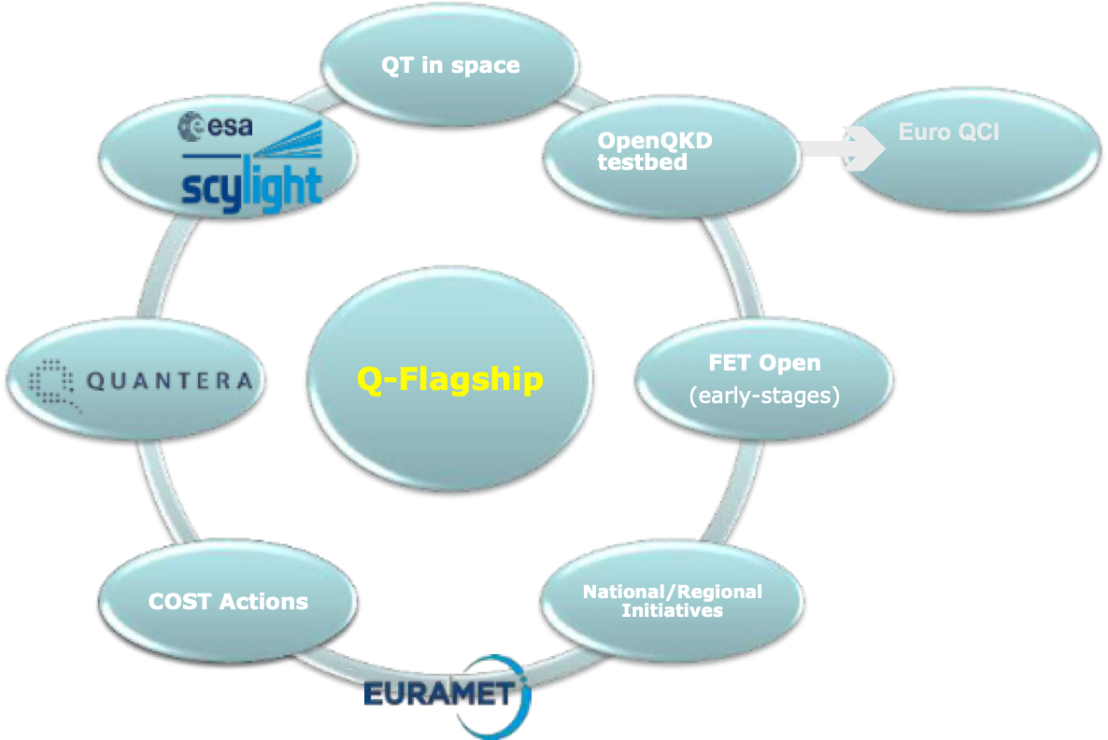
The Fleet of EU Quantum Technology Programmes
www.qt.eu

Slide 4
EU Quantum Technology Flagship
Projects on Quantum Communications
https://civiquantum.eu/
Continuous variable quantum communication
http://quantum-internet.team/
Quantum networking of quantum processors
https://qrange.eu/
Quantum random number generators
https://quantum-uniqorn.eu/
Integrated photonics for quantum communications

Slide 5
EU Quantum Technology Flagship:
projects on Quantum computing
Superconducting quantum processor with up to 100 qubits,
available for external users
Scalable trapped-ion quantum computer and its software stack

Slide 6
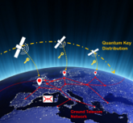
European Quantum Communications Infrastructure
Terrestrial segment
  Links to local & national quantum networks
Use cases:
Government communications
Telecommunication networks
Critical infrastructures
Space segment
  Links to EU space programme
OpenQKD testbeds
  R&D, new protocols, support to services (spin-offs),
  training, standardisation

Slide 7
JRC reports relevant to Quantum Technology and Cybersecurity
The Impact of Quantum Technologies on the EC’s Policies:
Part 2 Quantum Communications from Science to Policies
EUR 29017 EN DOI:10.2760/881896
The Impact of Quantum Technologies on the EC’s Policies:
Part 3 Perspectives for Quantum Computing
EUR 29402 EN DOI:10.2760/737170
Quantum Key Distribution in-field implementations
EUR 29865 EN DOI:10.2760/38407

Slide 8
Just released!
Cybersecurity, our digital anchor
EUR 30276 EN DOI:10.2760/352218

