Slide 1
Women Engineers and Entrepreneurs: Challenges and Opportunities while facing Lockdown
MANAGING TEAM REMOTELY
Asma BRINI
CEO FOUNDER ABSHORE
26 May 2020

Slide 2
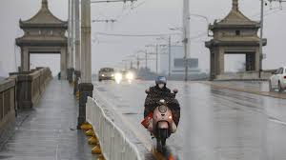
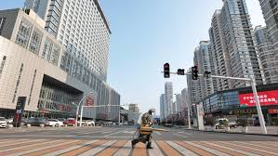
I. Awarness & anticipation
Awarness
Notes:
Data centres are now part of the basic infrastructure of
many corporations, companies and government agencies. Running and
operating them efficiently and effectively is necessary for the economic
viability and delivery of the various functions and services undertaken
by these organisations
Energy is a central component for data centres across the globe to deliver effective services to customers. Yet, on a global scale, data centre power consumption amounts to roughly 416 terawatts, or around three percent of all electricity generated on the planet and growing. It is clear that the industry needs to take action and accelerate their search for new ways to minimise carbon emissions and increase energy efficiency –this is a challenge that many organisations face.
When it comes to integrating sustainability measures into their facilities, data centre operators have a unique set of challenges on their hands. While data centres do not generate waste or products like other groups, this high energy- and water-use sector must prioritise their sustainability programs now as the demand for sustainability measures, clean energy and efficient facilities increases.
At present, a major concern regarding data centers is their extremely high energy consumption and carbon dioxide emissions. However, because of the over-provisioning of resources, the utilization of existing data centers is, in fact, remarkably low, leading to considerable energy waste. Therefore, over the past few years, many research efforts have been devoted to increasing efficiency for the construction of green data centers. The goal of these efforts is to efficiently utilize available resources and to reduce energy consumption and thermal cooling costs.

Slide 3
Ii. audit
Dec. 2019
Feb. 2020
HR process 50%
Sales process 50%
Operational process 10%
HR process 60%
Sales process 70%
Operational process 50%
Committees : daily, weekly, monthly
Concerns by the evolution of the corona virus
Webinars and Information following OMS recommandations
Health risk of our staff members and teams
Emergency committee meeting ➔ Go on remote work
5 days after President Macron have announced the Lockdown
Notes:
Data centres are now part of the basic infrastructure of
many corporations, companies and government agencies. Running and
operating them efficiently and effectively is necessary for the economic
viability and delivery of the various functions and services undertaken
by these organisations
Energy is a central component for data centres across the globe to deliver effective services to customers. Yet, on a global scale, data centre power consumption amounts to roughly 416 terawatts, or around three percent of all electricity generated on the planet and growing. It is clear that the industry needs to take action and accelerate their search for new ways to minimise carbon emissions and increase energy efficiency –this is a challenge that many organisations face.
When it comes to integrating sustainability measures into their facilities, data centre operators have a unique set of challenges on their hands. While data centres do not generate waste or products like other groups, this high energy- and water-use sector must prioritise their sustainability programs now as the demand for sustainability measures, clean energy and efficient facilities increases.
At present, a major concern regarding data centers is their extremely high energy consumption and carbon dioxide emissions. However, because of the over-provisioning of resources, the utilization of existing data centers is, in fact, remarkably low, leading to considerable energy waste. Therefore, over the past few years, many research efforts have been devoted to increasing efficiency for the construction of green data centers. The goal of these efforts is to efficiently utilize available resources and to reduce energy consumption and thermal cooling costs.

Slide 4
IIi. results
Dec. 2019
Feb. 2020
May 2020
HR process 50%
Sales process 50%
Operational process 10%
HR process 60%
Sales process 70%
Operational process 50%
HR process 90%
Sales process 90%
Operational process 90%
Committees : daily, weekly, monthly
Some shortened daily scrum
Others added emergency, whole enteprise
Others kept unchanged steering comittee
Reorganisation : 15% more resources for the task force➔ More than 20% of efficiency in terms of productivity and objectives achievment
Business continuity plan, new process streamline
Project teams and Clients: secure, focus more on objectives
Notes:
Data centres are now part of the basic infrastructure of
many corporations, companies and government agencies. Running and
operating them efficiently and effectively is necessary for the economic
viability and delivery of the various functions and services undertaken
by these organisations
Energy is a central component for data centres across the globe to deliver effective services to customers. Yet, on a global scale, data centre power consumption amounts to roughly 416 terawatts, or around three percent of all electricity generated on the planet and growing. It is clear that the industry needs to take action and accelerate their search for new ways to minimise carbon emissions and increase energy efficiency –this is a challenge that many organisations face.
When it comes to integrating sustainability measures into their facilities, data centre operators have a unique set of challenges on their hands. While data centres do not generate waste or products like other groups, this high energy- and water-use sector must prioritise their sustainability programs now as the demand for sustainability measures, clean energy and efficient facilities increases.
At present, a major concern regarding data centers is their extremely high energy consumption and carbon dioxide emissions. However, because of the over-provisioning of resources, the utilization of existing data centers is, in fact, remarkably low, leading to considerable energy waste. Therefore, over the past few years, many research efforts have been devoted to increasing efficiency for the construction of green data centers. The goal of these efforts is to efficiently utilize available resources and to reduce energy consumption and thermal cooling costs.

Slide 5
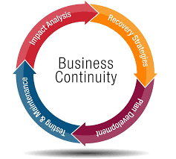
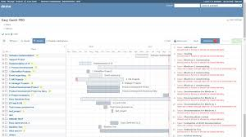
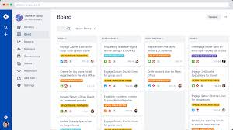
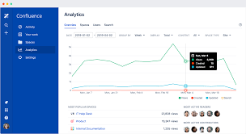
III. results
Organisation, Tools and Communication
Fridays meeting whole entreprise
+
Notes:
Data centres are now part of the basic infrastructure of
many corporations, companies and government agencies. Running and
operating them efficiently and effectively is necessary for the economic
viability and delivery of the various functions and services undertaken
by these organisations
Energy is a central component for data centres across the globe to deliver effective services to customers. Yet, on a global scale, data centre power consumption amounts to roughly 416 terawatts, or around three percent of all electricity generated on the planet and growing. It is clear that the industry needs to take action and accelerate their search for new ways to minimise carbon emissions and increase energy efficiency –this is a challenge that many organisations face.
When it comes to integrating sustainability measures into their facilities, data centre operators have a unique set of challenges on their hands. While data centres do not generate waste or products like other groups, this high energy- and water-use sector must prioritise their sustainability programs now as the demand for sustainability measures, clean energy and efficient facilities increases.
At present, a major concern regarding data centers is their extremely high energy consumption and carbon dioxide emissions. However, because of the over-provisioning of resources, the utilization of existing data centers is, in fact, remarkably low, leading to considerable energy waste. Therefore, over the past few years, many research efforts have been devoted to increasing efficiency for the construction of green data centers. The goal of these efforts is to efficiently utilize available resources and to reduce energy consumption and thermal cooling costs.

Slide 6
Iv. Transforming the challenges INto opportunities
The Challenges
Do we still need offices ?
How to source and retain employees world wide ?
How making this new order of things an opportunity for business ?
Notes:
Data centres are now part of the basic infrastructure of
many corporations, companies and government agencies. Running and
operating them efficiently and effectively is necessary for the economic
viability and delivery of the various functions and services undertaken
by these organisations
Energy is a central component for data centres across the globe to deliver effective services to customers. Yet, on a global scale, data centre power consumption amounts to roughly 416 terawatts, or around three percent of all electricity generated on the planet and growing. It is clear that the industry needs to take action and accelerate their search for new ways to minimise carbon emissions and increase energy efficiency –this is a challenge that many organisations face.
When it comes to integrating sustainability measures into their facilities, data centre operators have a unique set of challenges on their hands. While data centres do not generate waste or products like other groups, this high energy- and water-use sector must prioritise their sustainability programs now as the demand for sustainability measures, clean energy and efficient facilities increases.
At present, a major concern regarding data centers is their extremely high energy consumption and carbon dioxide emissions. However, because of the over-provisioning of resources, the utilization of existing data centers is, in fact, remarkably low, leading to considerable energy waste. Therefore, over the past few years, many research efforts have been devoted to increasing efficiency for the construction of green data centers. The goal of these efforts is to efficiently utilize available resources and to reduce energy consumption and thermal cooling costs.

Slide 7
THANK YOU
Notes:
Data centres are now part of the basic infrastructure of
many corporations, companies and government agencies. Running and
operating them efficiently and effectively is necessary for the economic
viability and delivery of the various functions and services undertaken
by these organisations
Energy is a central component for data centres across the globe to deliver effective services to customers. Yet, on a global scale, data centre power consumption amounts to roughly 416 terawatts, or around three percent of all electricity generated on the planet and growing. It is clear that the industry needs to take action and accelerate their search for new ways to minimise carbon emissions and increase energy efficiency –this is a challenge that many organisations face.
When it comes to integrating sustainability measures into their facilities, data centre operators have a unique set of challenges on their hands. While data centres do not generate waste or products like other groups, this high energy- and water-use sector must prioritise their sustainability programs now as the demand for sustainability measures, clean energy and efficient facilities increases.
At present, a major concern regarding data centers is their extremely high energy consumption and carbon dioxide emissions. However, because of the over-provisioning of resources, the utilization of existing data centers is, in fact, remarkably low, leading to considerable energy waste. Therefore, over the past few years, many research efforts have been devoted to increasing efficiency for the construction of green data centers. The goal of these efforts is to efficiently utilize available resources and to reduce energy consumption and thermal cooling costs.

