Slide 1
Women Engineers and Entrepreneurs:
Challenges and Opportunities while facing Lockdown
Betty Bonnardel
CEO, AB5 Consulting
26 may 2020

Slide 2
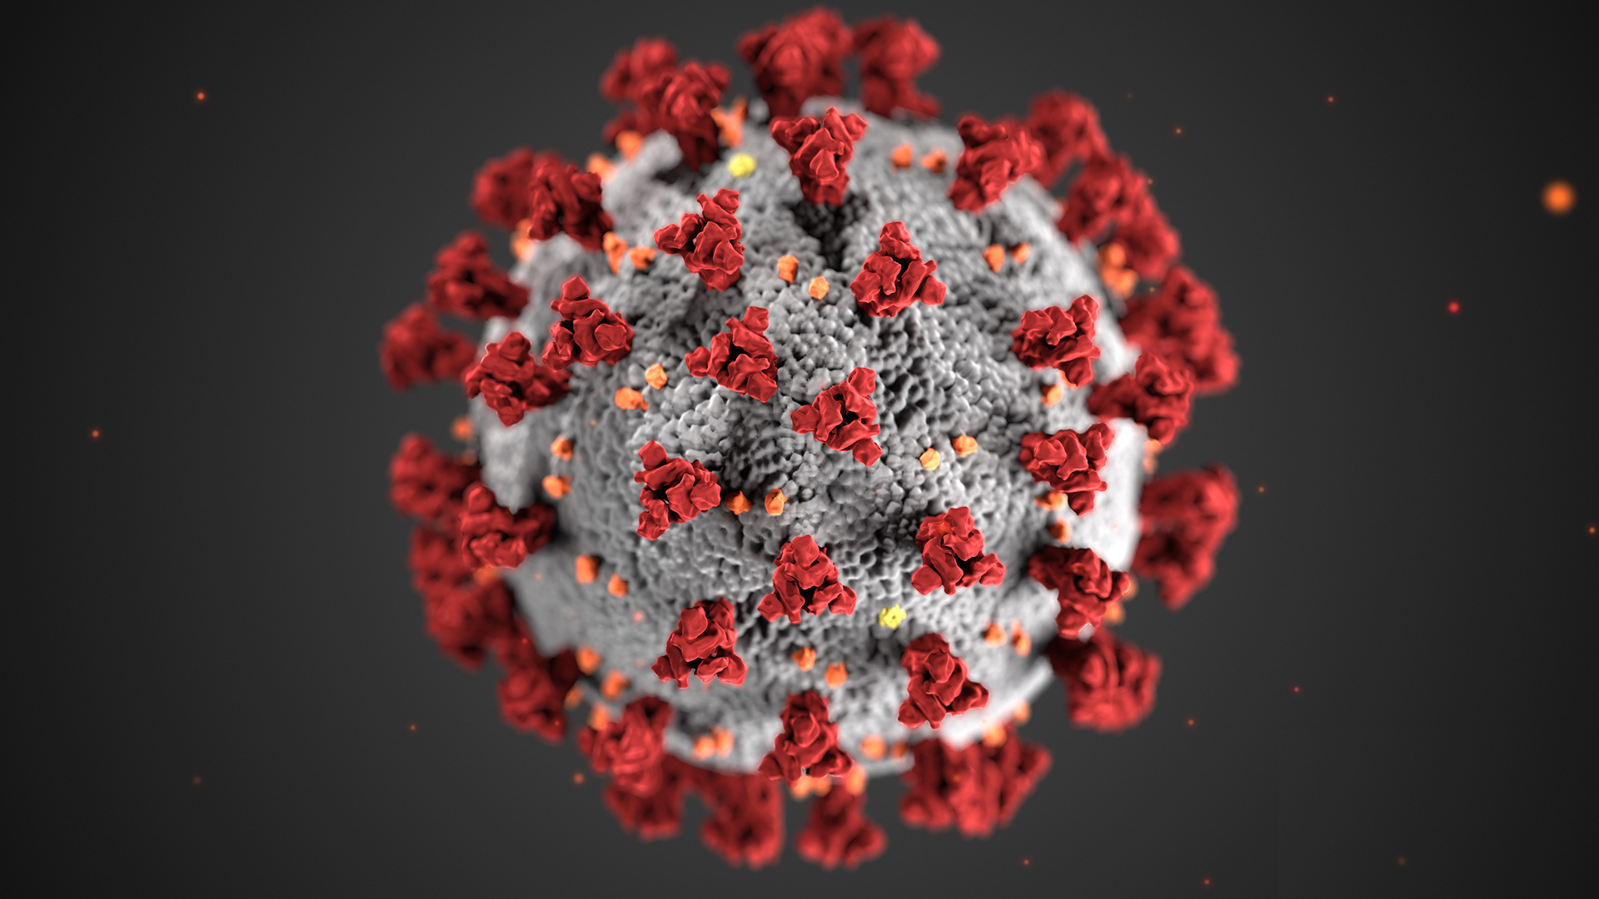
Before
252M female entrepreneurs worldwide for a total of 400M business women
Women entrepreneurs are more likely present in retail/government/health/education and social services
Largest gender gaps in agriculture, mining and ICT
Female-founded businesses accounted for only 21% of deals in 2019 in the UK
Source: https://www.prnewswire.com/news-releases/more-than-250m-women-worldwide-are-entrepreneurs-according-to-the-global-entrepreneurship-
monitor-womens-report-from-babson-college-and-smith-college-300960196.html & https://www.forbes.com/sites/davidprosser/2019/12/10/women-entrepreneurs-still-missing-out-on-funding/#4ce1f6802152

Slide 3
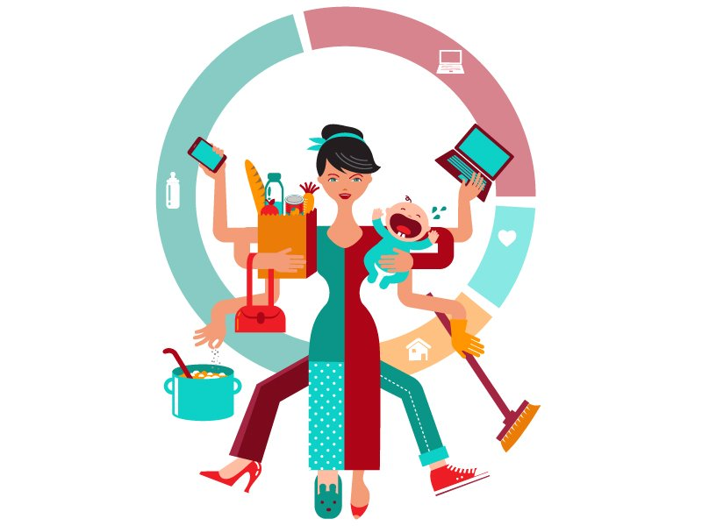
During
Survey from Cherie Blair Foundation for Women around the globe
93% negatively impacted by COVID-19 (access to customers, reduction in services, supply chain impact)
Immediate need for financial support, HR management
Source: https://tribune.com.pk/story/688029/the-super-woman-syndrome-a-new-age-dilemma/?amp=1 & https://cherieblairfoundation.org/app/uploads/2020/05/
impact-of-covid19-on-women-entrepreneurs-in-low-and-middle-income-countries-report-1.pdf

Slide 4

What may help your business?
Pivoting, adapting and re-purposing in the short term
Long-term anticipation if possible
Use of online opportunities
Business resilience and risk planning
Health and wellbeing
Source: https://www.prnewswire.com/news-releases/more-than-250m-women-worldwide-are-entrepreneurs-according-to-the-global-entrepreneurship-
monitor-womens-report-from-babson-college-and-smith-college-300960196.html & https://www.forbes.com/sites/davidprosser/2019/12/10/women-entrepreneurs-still-missing-out-on-funding/#4ce1f6802152

Slide 5
After
A sustainable change of habits?
A need to (re)define work-life balance?
A definite need for more concrete actions to promote female entrepreneurship and support women through connectivity and access to online support

Slide 6


