Slide 1
TW:Cyber security standards norms and approach
12:00 - 13:00 CEST on 7 July

Slide 2
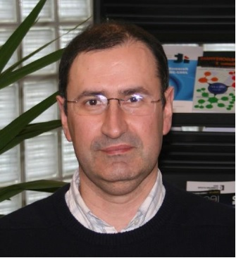
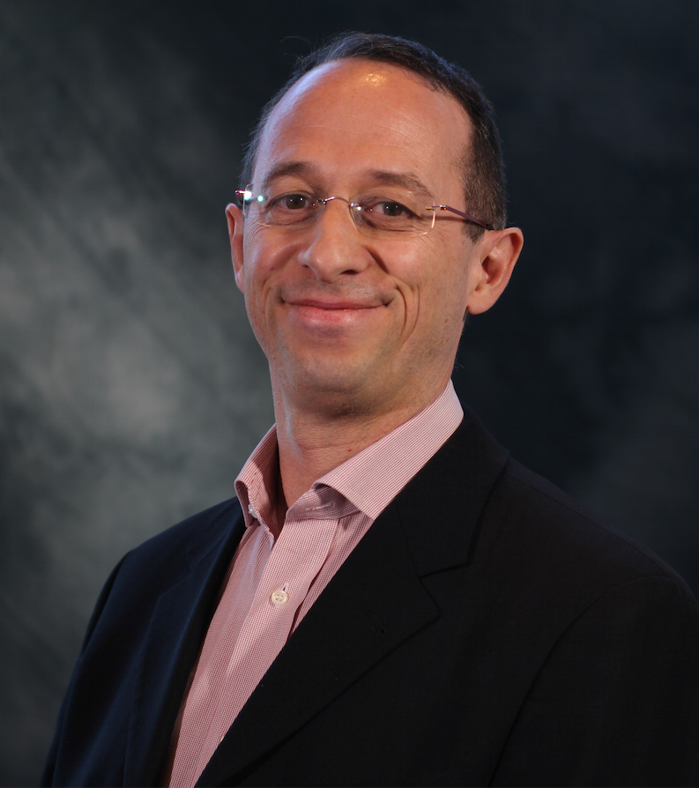
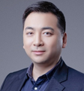
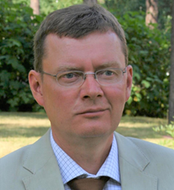
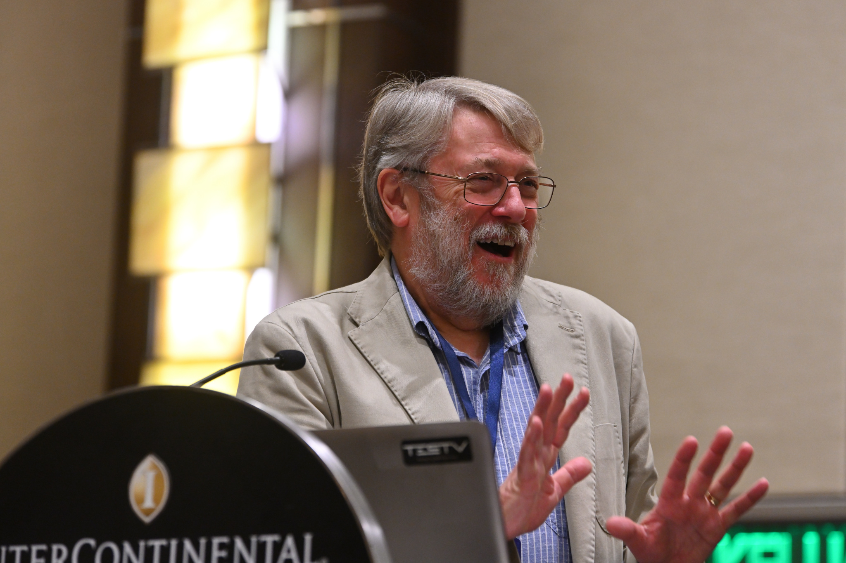
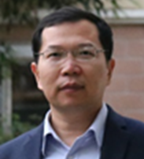
Panellists
Moderator
Rui Luis Aguiar
Chair of the Steering Board
Networld2020 European Technology Platform
Speaker
M. Arnaud Taddei
Technical Director
Standards and Architectures
Office of the CTO， Broadcom
Speaker
MinPeng Qi
Vice Chair of 3GPP SA3
NGMN SCT LEAD
Speaker
Valtteri Niemi
Professor
leads the Secure Systems research group
University of Helsinki,Finland
Speaker
Chris Mitchell
Professor
co-founded Information Security Group
University of London,UK
Speaker
Jianfeng Nan
Director of cyber security and user privacy protection affairs department,
Huawei

Slide 3
Agenda
1、Warm Up 12:00-12:05
2、Presentation 12:05-12:45
2.1 SG17 perspective on cybersecurity standardization (M. Arnaud Taddei)
2.2 A Brief Introduction about Security Framework
based on Trust Relationship for 5G Ecosystem in ITU-T (Minpeng Qi)
2.3 Three points about standards and cybersecurity (Valtteri Niemi)
2.4 How to make 5G trust and security a reality (Chris Mitchell）
2.5 Co-creating cyber security through rational and objective measures (Jianfeng Nan)
3、 Q/A 12:45-13:00

Slide 4

Thank you
It will be appreciated if you would like to share comments on the workshop.
Contact us: James.xie@Huawei.com

