Slide 1
Overview of ITU-T Study Group 15
Networks, Technologies and Infrastructures for Transport, Access and Home
Hiroshi OTA (ITU/TSB)

Slide 2
COVID-19 and telecommunication
Broadband Internet has been an essential infrastructure of the society for recent decades.
Due to the COVID-19 pandemic, which requires drastic reduction of physical contact between people, broadband connectivity became more important.
More and more physical activities, such as conferences, seminars, education or even consulting with a doctor, are replaced by virtual activities using telecommunication.
ITU-T SG15 develops international standards (Recommendations) on telecommunication network infrastructure to support broadband Internet.

Slide 3
Study Group 15 (SG15) mandate
  SG15 is responsible for the development of standards on:
  optical transport network
  access network
  home network and power utility network infrastructures
  equipment
systems
  maintenance
optical fibres and cables and their related installation
  instrumentation
  and measurement techniques
  management
  test
  control plane technologies
  to enable the evolution toward intelligent transport networks, including the support of smart-grid applications.

Slide 4
SG15 Working Parties (WPs)
WP1/15: Transport aspects of access, home and smart grid networks
WP2/15: Optical technologies and physical infrastructures
WP3/15: Transport network characteristics

Slide 5








WP1 – Broadband Access
NG-PON2
Broadband access
up to 2 Gbps
Next generation of
converged fiber access
going to higher speeds
G.mgfast
Next generation
G.fast targeting 5-10 Gbps
Visible Light
Communication
for home networking
G.fast dynamic time assignment
(DTA) – downstream/upstream
bit-rates responsive to
customer traffic
Powerline
communication
(PLC)
Continue collaboration with
G.hn and G.hn2 home
networking over indoor
phone, power, and coax
wires >2 Gbps
G.RoF
Radio over fiber
for mobile fronthaul

Slide 6






WP2 – Optical Technologies
Optical Network
Infrastructure
Disaster relief and
emergency communication
Optical Fibre Technologies
and Cables for easy and
environmentally
friendly outside plants
Multichannel bi-directional DWDM
applications targeted at lower cost
optical solutions for applications
including mobile fronthaul and backhaul
Optical cable installation with
minimal existing infrastructure
200G
400G
Short-reach (OTN client) 200G and
400G interfaces reusing components
developed for Ethernet applications
100G and future higher-rate
coherent multi-vendor
interoperable interfaces
25 Gbit/s optical interface for mobile
optimized transport

Slide 7







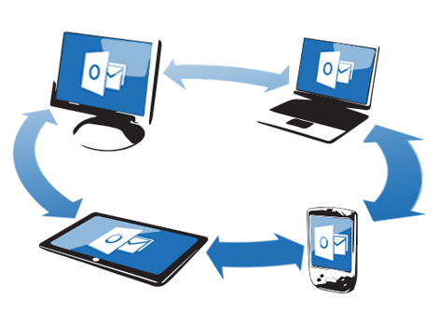

WP3 – Optical Transport Networks
Transport and synchronization
supporting 5G mobile
fronthaul and backhaul
Synchronization of packet
networks and future OTN
networks, e.g., beyond 100G
MTN
G.mtn (metro transport network)
for 5G optimized transport
Network survivability
(protection and restoration)
Architecture and other
Transport SDN Aspects
Management aspects of
control and transport planes
New “B100G” OTN interfaces,
including the use of coherent
G.698.2 interfaces
Core Information model
enhancement for
management of
synchronization
and optical media
Equipment & management
specifications for OTN,
Ethernet and MPLS-TP

Slide 8
Meetings
Past meetings since 2017
  Geneva, 19 – 30 June 2017
  Geneva, 29 January – 9 February 2018
  Geneva, 8-19 October 2018
  Geneva, 1 – 12 July 2019
  Geneva, 27 January – 7 February 2020
Future SG15 meeting
  Virtual, 7-18 September 2020

