Slide 1
Competition in Internet Services
WSIS Forum 19 March 2018
Michael Kende

Slide 2
Internet service companies among the largest in the world
Rank (end 2017) | Company (year)
1 | Apple (1976)
2 | Alphabet (1998)
3 | Microsoft (1975)
4 | Amazon.com (1994)
5 | Facebook (2004)
6 | Tencent (1998)
7 | Berkshire Hathaway (1839)
8 | Alibaba (1999)
9 | Johnson & Johnson (1886)
10 | JP Morgan Chase (1799)

Slide 3
The Internet can facilitate competition
Internet can lower entry barriers
  Cost of website lower than traditional entry costs
  Amazon started with very low costs
Switching costs for users are low
  Google CEO: ‘Competition is one click away’
  As easy to move away from Google as it was to move to Google
But …
Notes:
Market power evaluation with zero prices

Slide 4
High-tech market power
In general, technology markets tend toward high market share
  AT&T in local telephony
  IBM in mainframe computers
  Microsoft in personal computer OS
This stems from a variety of factors
  Strategic decisions
  Quality of services
  First-mover advantage
  Network effects
  Economies of scale
First, entry costs are higher than expected
  Website quality is an important signal, and websites can be expensive
  Download time matters, and this can lead to significant investments in distribution
  Other costs can include research, development, physical distribution, etc.
Switching costs have an impact
  Recommendations based on preferences
  Suite of services
Notes:
This stems from a variety of factors
Strategic decisions
High quality
First-mover advantage
Network externalities
Mkt power
Investment (unexpected)
Network externalities
Winner
Network externalities are unique to high tech industries
Network externalities arise when value increases, the more users there are
Direct network externalities
when benefits arise from number of users
AT&T, Skype, WhatsApp
Indirect network externalities
when number of users leads to more compatible services
Microsoft OS with software and hardware; Apple App store with the number of apps
takes all

Slide 5
Network effects
Network effects or externalities
  More users the better
  Externalities because increased benefits
Different types
  Direct (communications)
  Indirect (software, applications)
Notes:
Direct network effects
Direct communications between users
Telephone network, Skype, etc.
Indirect network effects
Need complementary products
The more users, the more products
Computer with peripherals, app store with apps
Two-sided markets
Increase in one side benefits the other side
Credit cards: More users, more vendors
Gaming: More players, more games

Slide 6
Economies of scale
Manufacturing
  High fixed cost
  Significant marginal cost
Capacity constraints
  Slow down production
  Leave room for competitors

Slide 7
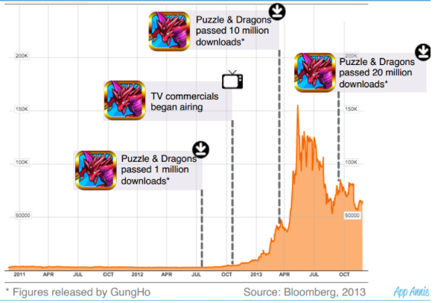
Online ‘winner takes all’
The game Puzzle & Dragons quickly grew to be the top game
  Popularity started with some TV ads
  Became the first game ever to pass $1billion in revenues
There were few constraints on growth
  Apps distributed by Apple and Google
  No increased production costs
  Parent company had just over 300 employees, no seeming increase during growth

Slide 8
Market power assessment
It is not anti-competitive to win a large market share
Judge Learned Hand stated that a company should not be penalized for ‘superior skill, foresight, and industry’
Indeed, with network externalities it is likely that someone will have a large market share
It is difficult to assess market power in these digital markets
  Pricing issues
  Dynamic markets
AT&T, IBM, Microsoft had issues in adjacent markets
Concerns
  Merger review
  Impact of ex ante constraints
  Timing of ex post remedies

