Slide 1
World Summit on the Information Society
Vik Bhoyroo
Ag. Executive Director
National Computer Board, Mauritius
15 June 2017 Geneva

Slide 2
Agenda
Mauritius – An Overview
Key Indicators – 2016
International Benchmarks
Policy/Strategy developed over last five years
Smart Government Services
E-Government
Web Portal
E-Services / E-Payment
WIFI Mauritius Project

Slide 3
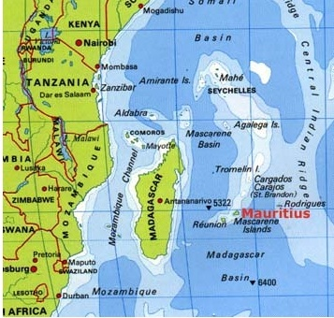
Mauritius – An Overview
Mauritius – an island state in the south west of the Indian Ocean
Language: English and French
Population 1.3 M
Labour Force 0.6 M (597,500)
Working pop. 0.5 M
GDP per Capita: USD 9540 (2014)
GDP Growth: 3.5 % (2014)

Slide 4
Key ICT Indicators - 2016
ICT Contribution to GDP– 5.5 per cent (forecast of 5.7 for 2017)
ICT Growth Rate– 5.6 per cent
Export of ICT Services– Rs bn 5.4
Mobile phone subs./100 inhab. – 144 per cent
Internet subs/100 inhab. – 86.3 per cent
Broadband Internet subs/100 inhab. – 68.3 per cent
% of households with a computer – 57 per cent (2015)
% of households with Internet access - 60 per cent (2015)
750 ICT – BPO companies

Slide 5
International Benchmarks
Networked Readiness Index (WEF) – 49th in 2016
ICT Development Index (ITU) – 73rd in 2016
E-Government Development Index (UN) – 58th in 2016
Global Innovation Index (WIPO) – 53rd in 2016
Global Cybersecurity Index (ITU) – 9th in 2014
Global Services Location Index (AT Kearney) – 30th in 2016
Global Competitiveness Index (WEF) – 45th in 2017
Open Data Barometer (WWWF) – 59th in 2016

Slide 6
Policy/Strategy developed over last five years
National ICT Strategic Plan (NICTSP) 2007-2011 and 2011-2014
National Broadband Policy 2012 – 2020
Open Access Policy for Undersea Cable Landing Station in Mauritius 2010
E-Government Strategy 2013-2017
E-Health Plan 2011-2014
National cyber security strategy and action plan (2014-2019),
National Green IT Policy and Strategy
National E-Waste management Policy and Strategy
National Open Source Policy and Strategy and Action Plan

Slide 7
Vision of Government
To achieve the vision of Government in making of a Smart Mauritius and raising the country in the leagues of a high income economy, ICT will be key in delivering Smart Government services which is a primordial sub-set of a smart country.
An efficient, productive and innovative public sector can be a strong driver of economic growth through its support for the private sector.

Slide 8
Empowering People
To stand up against poverty, Government should empower people by providing equal access to information and knowledge sources.
E-Government can act as a facilitator for equal access to information, thus empowering people in all aspects of social arenas.
E-Government is an effective tool to bridge the knowledge gap between impoverished and upper class citizens.
The E-Gov platform of Mauritius (www.govmu.org) has many websites and umbrella portals, operating as gateways to information and services.
E-Government in Mauritius has introduce in 2005 e-Services so as to dramatically reduce transaction costs and improve internal planning mechanisms.

Slide 9
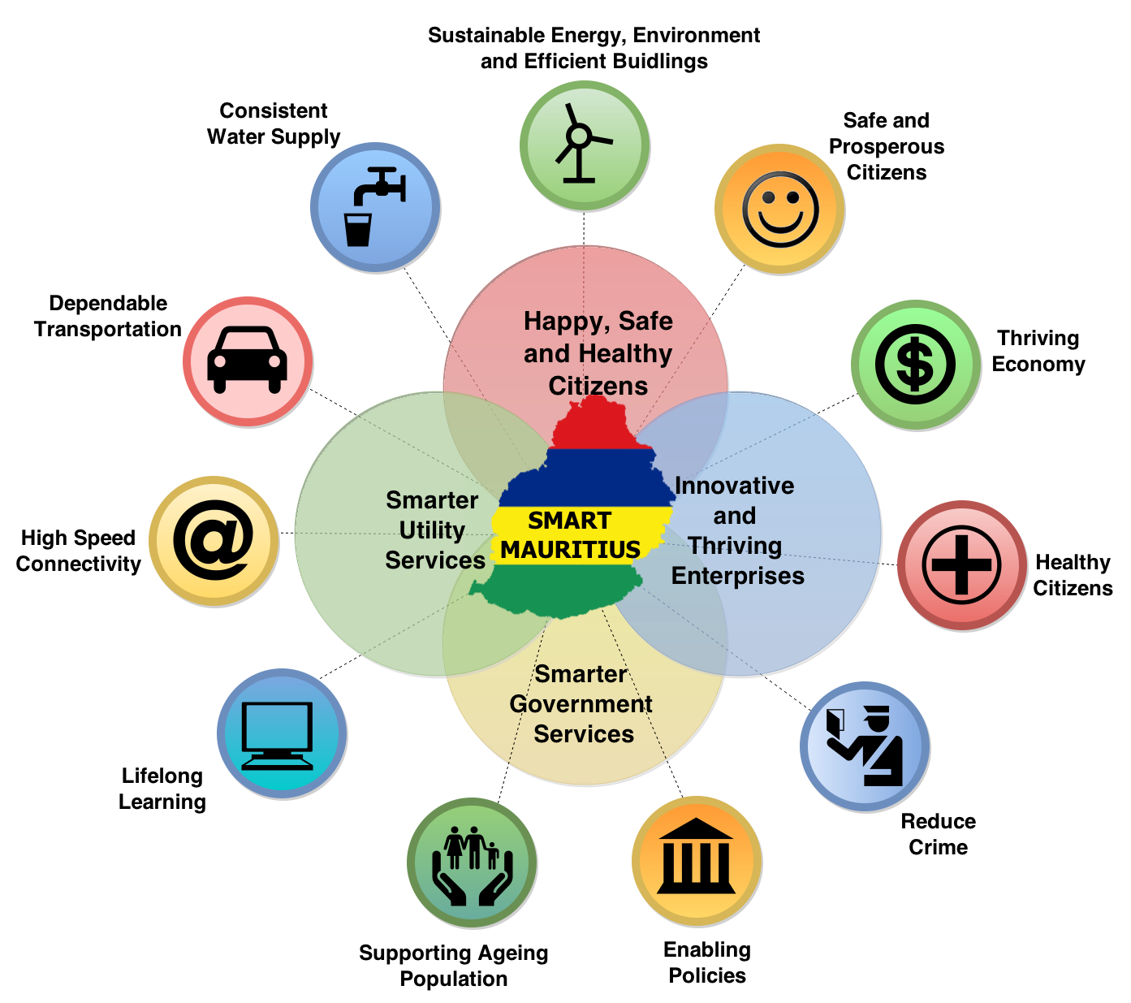
Smart Government Services
E-Government Projects across all social and economic dimensions e.g.
Health
Education
Transport
Tourism
Agriculture
Law and Order
Financial Services
Gender
ICT among others

Slide 10
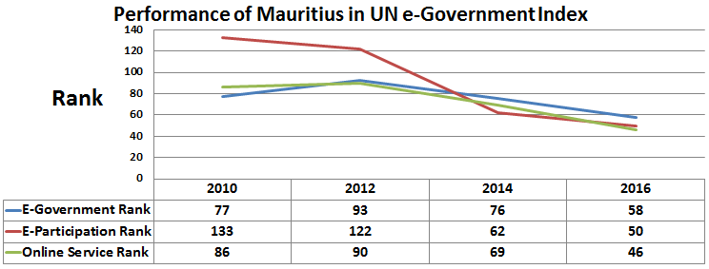
Smart Government Services
Mauritius has improved significantly in e-Government as evidenced by the latest UN e-Government Survey 2016 which ranks Mauritius as 58th in the world in e-Government Development Index, 46th in the Online Service Index and 50th in the e-Participation Index.

Slide 11
Benefits of E-Government
e-Government brings about better delivery of Government services to citizens and contribute to their empowerment (G2C), improved interactions with business (G2B), efficient relations with other Government agencies (G2G), enhanced performance of employees (G2E)
www.govmu.org
G2C
G2B
G2G

Slide 12
Electronic Delivery of Services (e-Services)
50 new e-Services in addition to the existing 65 e-Services on the Government portal are being implemented by the Ministry of Technology, Communication and Innovation for increased convenience of citizens through 24x7 accessibility to prioritised services and reduction in the provision of counter services and yielding savings.
www.govmu.org

Slide 13
e-Payment and m-Payment Services
The system aims to support payment by credit/debit cards and mobile payment using Orange Money platform with a view to reducing time spent to make payments to Government.

Slide 14
WIFI Mauritius Project
Aims & Objectives:
Promoting connected communities and providing universal access to Internet to every citizen of Mauritius
To revolutionize the way Mauritians communicate, interact and transact with each other.
To act as key building blocks in Mauritius’ Digital Empowerment and help to create a digitally empowered nation, transcending social and economic barriers.

Slide 15
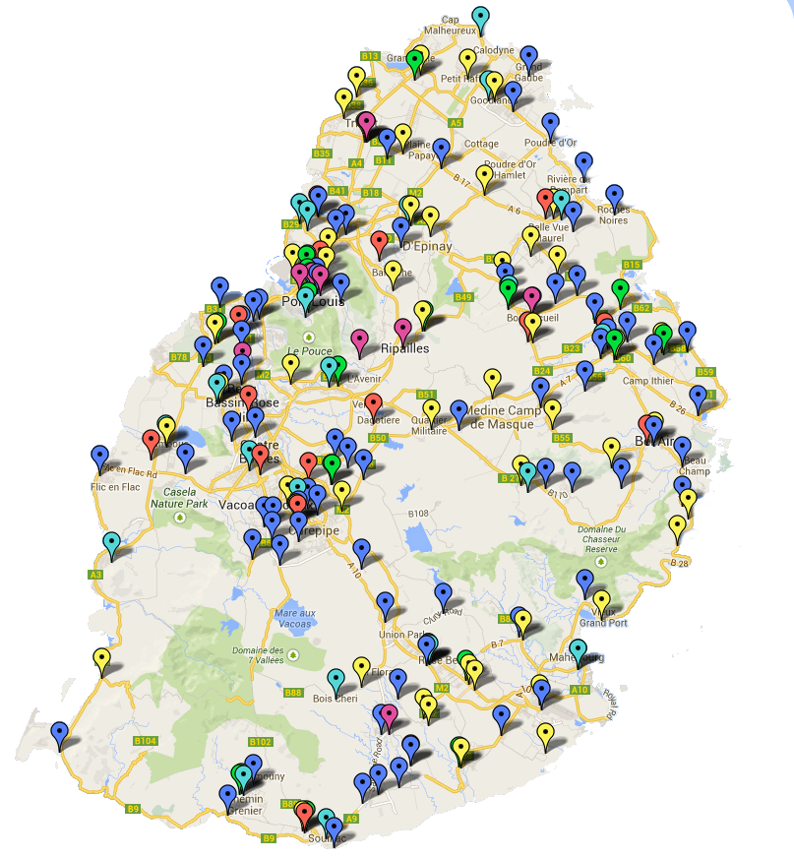
WIFI Mauritius Project
Promoting connected communities through 600 WIFI Hotspots and 270 Computer Clubs

Slide 16
Thank You for
Your Attention
vbhoyroo@ncb.mu

