Slide 1


World Summit on the Information Society (WSIS) Implementation Process
WSIS Forum 2017:
Mapping and Data Collection to Enable Internet Connectivity at Schools

Slide 2



WHO IS
PROJECT CONNECT?
Project Connect is a new non-profit, founded in January 2017, working to provide online mapping of every school in the world, including real time data about the quality of each schools connectivity, in order to create an observable metric of the progress towards enabling educational access and opportunity for all students.

Slide 3
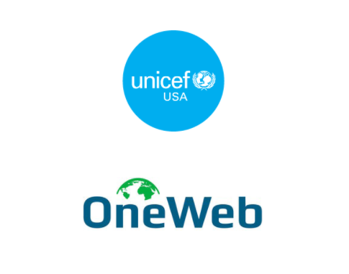
PARTNERS

Slide 4

WHAT WILL
PROJECT CONNECT DO?
We are creating a publicly accessible, real time map of every school in the world and a measure of their connectivity*
*There will be some countries and regions in which we will only provide aggregate information due to security concerns

Slide 5
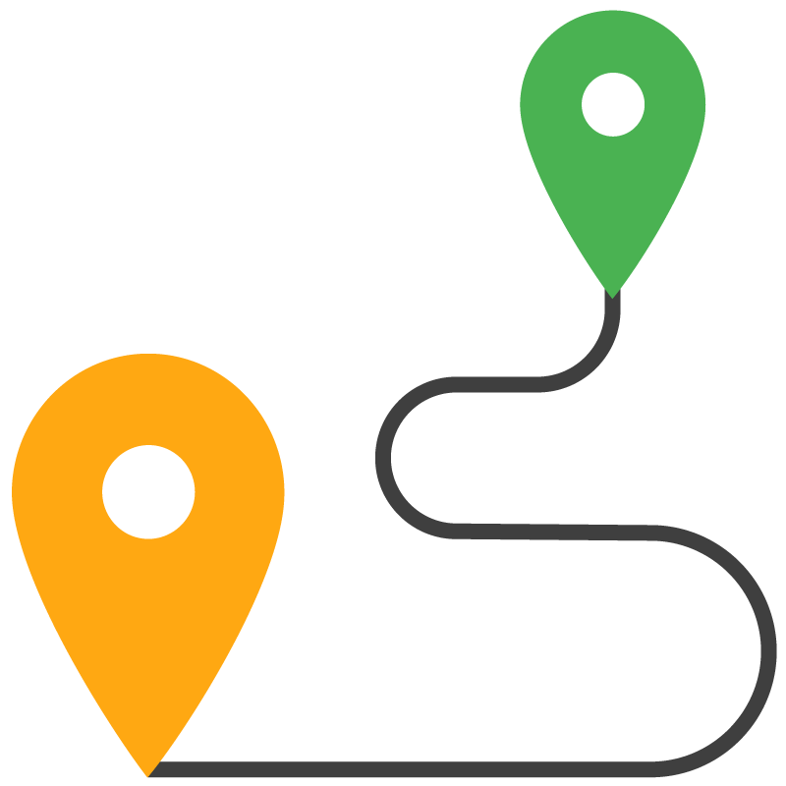


HOW WILL WE DO
THIS?
MAPPING SCHOOLS
  Working with Governments and NGOs to
  collect existing data
  Crowd – sourcing and on the ground data collection
  High resolution satellite imagery and machine learning
MEASURING CONNECTIVITY
  Hardware and software that will actually measure
  Crowd-sourcing and on the ground data collection
COUNTRY-SPECIFIC RESEARCH
  We will conduct country-specific operational
  research projects where we work with providers to
  connect schools and learn from it

Slide 6
TWO KEY PROBLEMS WE ARE TRYING
TO SOLVE
Many national governments don’t know where all of the schools in their country are, meaning they can’t adequately provide services to them
Many national governments and NGOs are committed to connecting schools to the internet, but we don’t yet have the capability to monitor whether that is actually occurring and where on a large scale

Slide 7
WHICH ALIGN WITH SDGS
SDG 4
Ensure inclusive and equitable quality
education and promote lifelong learning opportunities for all
SDG 9
Build resilient infrastructure,
promote inclusive and sustainable industrialization and foster innovation

Slide 8
WHY DO WE
NEED TO SOLVE THESE?
LACK OF ACCESS
  Increasing number of children don’t have access to education
  Estimated that by 2030, 60 million children won’t have access to primary education
  Since 2007, the global rate of school enrollment has stagnated
  Climate change and global conflicts are only exacerbating this issue, by increasing the number of children who are on the move and difficult to reach for education
LACK OF QUALITY
  Not just a question of getting kids into school, but what kind of infrastructure and information they are receiving once they are there
  Digital literacy skills and access to information increasingly important

Slide 9
HOW WILL THIS DATA BE USED?
NATIONAL GOVERNMENTS can use this for planning purposes for their education work
PARTNERS such as UNICEF and other NGOs can use it for resource allocation
NGOS can use it to help with coordination
PARTNERS can use this for research initiatives, such as the new information poverty initiative from UNICEF or to improve data around internet connectivity, schools, and education
COMPANIES AND SCHOOLS can use it to advocate for connectivity

Slide 10



WHY DOES CONNECT-ING SCHOOLS TO THE INTERNET MATTER?
TECHNOLOGY
  can help close the education gap in hard to reach areas and populations
DIGITAL LITERACY SKILL
  increasingly important
INTERNET CONNECTIVITY
  is going to spread, going through schools ensures more equitable access and ability to have the infrastructure needed to be used effectively

Slide 11
HOW WILL THIS HELP US CONNECT ALL OF THE SCHOOLS?
REAL-TIME DATA that’s granular gives everyone a better ability and incentive to act
GOVERNMENTS can use it to know where there are outages
PARTNERS can use it to form funding proposals
PRIVATE SECTOR INTERNET PROVIDERS can use it as preliminary public market research
RESEARCH INSTITUTIONS and other partners can use to help inform the empirical basis for school connectivity

Slide 12

WHAT WE NEED TO ACCOMPLISH THIS?
PARTNERSHIPS
We are looking for partners that have:
  Data they are willing to share
  Technical expertise that could help with our pilots
  Government or other relationships they are willing to leverage
  Existing networks of schools or internet connectivity
Or that are interested in working together on:
  Operational research
  On-the-ground data collection and crowd-sourcing efforts
  Testing out our tools

Slide 13




WHAT DO YOU GET AS
A PARTNER?
BRONZE
Recognized as a partner in our literature and website
SILVER
Same as above plus opportunities for engaging with other partners at select yearly events
GOLD
Same as above plus collaborations and access to relevant discussions at global network events
Shared operational research on key areas of interest
Be invited onto relevant Project Connect advisory committees, as well as on the data-sharing committee for the country or countries where you provided data.
PLATINUM
Same as above plus opportunities to participate in high level government meetings with Project Connect
Access to data visualization expertise for your data
Field visits with Project Connect staff and partners

Slide 14



Thank You
Information Society for SDGs
www.projectconnect.world
@sarajacobs89
sara@projectconnect.world
www.wsis.org
www.wsis.org/sdg
www.wsis.org/forum
www.wsis.org/prizes
www.wsis.org/stocktaking
www.wsis.org/review
wsis-info@itu.int

