Slide 1
Digital Financial Services and Financial Inclusion
WSIS: Thematic Workshop
Geneva, Switzerland, 29 May 2015
Vijay Mauree
TSB, ITU

Slide 2
I. Panelists
Mr Francis Wangusi, Director General, Communications Authority of Kenya
Prof Kalamullah Ramli, Director General, Ministry of Communications and IT, Indonesia
Mr N Parameswaran, Principal Advisor, TRAI, India
H.E Mohamed Ibrahim, Head, National ICT and Digital Economy Office, Somalia
Mr Ahmed Said, NTRA, Egypt
Dr Unho Choi, UNHCR
Olutunmbi Idowu, Head Compliance and Risk Control, Ericsson
Ms Oksana Smirnova-Krell, CEO, Intervale
Mr Jonathan Greenacre, Researcher, Oxford University

Slide 3
II. Set the scene: Digital Financial Services
Short Video on Digital Financial Services

Slide 4
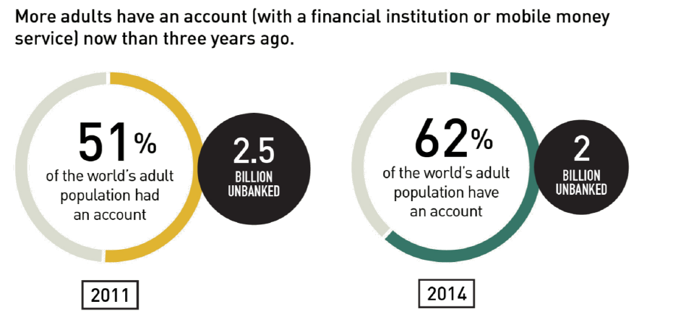
II. Set the scene: Digital Financial Services
1.6 billion have a
mobile phone
Source: FINDEX 2014

Slide 5
III. DFS Market Situation
NUMBER OF LIVE MOBILE MONEY SERVICES FOR THE UNBANKED BY REGION - 2014
Source: GSMA

Slide 6
IV. Digital Financial Services: Account Penetration
800 m
43 m
22.5
2.7
billion
adults living in 89 mobile money markets
103
million active accounts globally
37.8
active accounts
per 1,000 adults globally
792,701,953
1.9 bn
60 m
75.4
■ Enabling regulatory approach (47 countries) ■ Non-enabling regulatory approach (42 countries)
Source: GSMA

Slide 7
ITU Focus Group Digital Financial Services (FG DFS)
IV. ITU FG DFS
Forum for Discussion & Dialogue
Set up for 2 years
Groups all key players of the DFS Ecosystem (Banks, Regulators, Consumer Organizations, International Organizations, MNOs, DFS Providers, Platform Providers etc.)
Open to all stakeholders
1st Meeting: Geneva, 5th December 2014.
97 participants, 25 countries
2nd Meeting: Washington DC, 21st April 2015.
93 participants, 33 countries, 22 regulators
3rd Meeting: 30 Sept – 2 October 2015 in Malaysia
4th Meeting: 15-17 December, ITU, Geneva
www.itu.int/en/ITU-T/focusgroups/dfs/
Notes:
Mobile money services are still in their early stages of development and there is not a technology dominant standard. This is an area where there is a lot of innovation happening and there are a number of stakeholders such as banks, merchants (e.g starbucks), telecom companies, technology firms (e.g Google), credit card companies and financial services organizations offering different services aiming to get a share of the market. Telecom operators will have a big role in enabling financial inclusion in the future and interoperability (although now is not a major issue) of mobile payment platforms could be an issue in the context of international remittances. There is a need for a multistakeholder approach for standards development for mobile payment services.
In their infancy, mobile money platforms are predominantly used for money transfers between known parties. In this case, it is reasonable to accept mobile-money platforms restricted to users of a particular MNO because the parties can agree beforehand to operate on a given network belonging to a particular MNO. As mobile money matures towards m-payments and m-financial services, improved interoperability
becomes increasingly critical.
Additional regulatory attention is also needed for issues of competition and interoperability. Like other network industries, economies of scale and high barriers to entry could create uncompetitive market outcomes in the mobile money industry. In cases where a mobile money service is tied to a dominant mobile network operator (as in the case of Kenya’s Safaricom, which has 68 percent of the mobile subscribers market), that operator is at an advantage in dictating the market. The appropriate form of regulation is still emerging. Premature competition regulation may have a negative impact on the growth of mobile money. One of the main ways to reduce mobile money market domination is through interoperability. Interoperability can occur at various levels: in Nigeria, where the
Central Bank has been keen to avoid a dominant market player, interoperability is required at the level of the bank, the switch, and the payment channel. In other countries, mobile money occurs in a “walled garden” because interoperability is not technically allowed. Consumers wishing to swap between mobile money services must have multiple SIM cards and use cash to exchange between different digital wallets (incurring time, effort, and extra fees). Sensing a market opportunity, third-party firms are beginning to offer interoperability between different mobile money services. Because these interoperability systems are often unofficial, however, they remain tenuous. While some observers (e.g GSMA) are of the opinion that consumer demand will ultimately pressure providers to allow interoperability in time, others detect a potential market failure. The interoperability issue has to be treated with caution. Mobile money operators are often reluctant to allow formal interoperability because, after investing heavily in their product, they do not want to make it easy for customers to move their money to competitors. In fact, in markets where customers frequently change mobile phone operators to save money, mobile money services are seen as a key way of keeping customers locked into an operator’s own network.

Slide 8
Key Objectives
IV. ITU FG DFS
Promote dialogue and coordination between FS and Telco regulators
Raise Telco regulators awareness of the role D/MFS play to promote FI
Given the increasing participation of MNOs in the provision of DFS, there is a need to clarify roles and responsibilities between the FS and Telco regulators. Though Central Banks remain the leading regulator for payment systems, Telco regulators need to be involved in the discussion;
Identify a series of key issues where the FG can consensually adopt principles, identify best practices, develop guidelines that can help emerging markets fast track policy reform.
Notes:
Mobile money services are still in their early stages of development and there is not a technology dominant standard. This is an area where there is a lot of innovation happening and there are a number of stakeholders such as banks, merchants (e.g starbucks), telecom companies, technology firms (e.g Google), credit card companies and financial services organizations offering different services aiming to get a share of the market. Telecom operators will have a big role in enabling financial inclusion in the future and interoperability (although now is not a major issue) of mobile payment platforms could be an issue in the context of international remittances. There is a need for a multistakeholder approach for standards development for mobile payment services.
In their infancy, mobile money platforms are predominantly used for money transfers between known parties. In this case, it is reasonable to accept mobile-money platforms restricted to users of a particular MNO because the parties can agree beforehand to operate on a given network belonging to a particular MNO. As mobile money matures towards m-payments and m-financial services, improved interoperability
becomes increasingly critical.
Additional regulatory attention is also needed for issues of competition and interoperability. Like other network industries, economies of scale and high barriers to entry could create uncompetitive market outcomes in the mobile money industry. In cases where a mobile money service is tied to a dominant mobile network operator (as in the case of Kenya’s Safaricom, which has 68 percent of the mobile subscribers market), that operator is at an advantage in dictating the market. The appropriate form of regulation is still emerging. Premature competition regulation may have a negative impact on the growth of mobile money. One of the main ways to reduce mobile money market domination is through interoperability. Interoperability can occur at various levels: in Nigeria, where the
Central Bank has been keen to avoid a dominant market player, interoperability is required at the level of the bank, the switch, and the payment channel. In other countries, mobile money occurs in a “walled garden” because interoperability is not technically allowed. Consumers wishing to swap between mobile money services must have multiple SIM cards and use cash to exchange between different digital wallets (incurring time, effort, and extra fees). Sensing a market opportunity, third-party firms are beginning to offer interoperability between different mobile money services. Because these interoperability systems are often unofficial, however, they remain tenuous. While some observers (e.g GSMA) are of the opinion that consumer demand will ultimately pressure providers to allow interoperability in time, others detect a potential market failure. The interoperability issue has to be treated with caution. Mobile money operators are often reluctant to allow formal interoperability because, after investing heavily in their product, they do not want to make it easy for customers to move their money to competitors. In fact, in markets where customers frequently change mobile phone operators to save money, mobile money services are seen as a key way of keeping customers locked into an operator’s own network.

Slide 9
Four Working Groups Have Been Established to Lead the Focus Group’s Efforts
IV. ITU FG DFS
Main areas of work
Interoperability
Consumer Experience & Protection
Technology, Innovation & Competition
DFS Ecosystem

