Slide 1
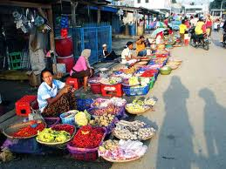
Providing Digital Services Platform for Economy
Prof. Kalamullah Ramli
Director General of Posts and Information Technology
MCIT Indonesia

Slide 2
Agenda
Indonesia Telco Outlook
National Policy and regulation on digital service platform
Existing digital service platform for DFS
Challenging and opportunity in implementation of DFS
ITU roles in accelerating implementation of DFS
Conclusion

Slide 3
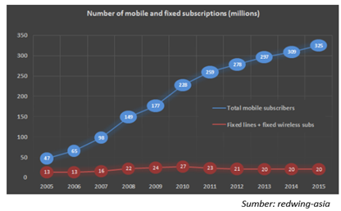
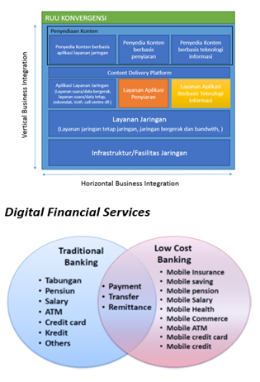
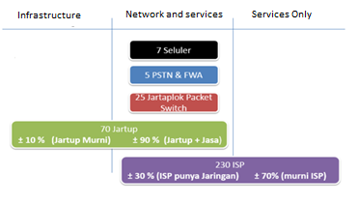
Indonesian Telco Outlook
Data and facts
Future Trends
The communications sector, which consists of postal services, information technology services and telecommunication services, accounted for 6.8% of GDP (total ~ 216 Trillion Rupiah) in FY13. The total output of the communications sector grew at a CAGR of 21% in 2004-2014.
Mobile network grew 7.7% YoY in FY13 which increases penetration to 121.5%
The fixed line network grew 2.5% YoY in FY13, compared to 1.6% to FY12
The mobile service ARPU trend continued in 2013, with a market weighted average blended ARPU fell by 5% for this year
Industry Composition
Including financial inclusion

Slide 4
General Digital Service Platform Ecosystem
Business Model
Extention : Branchless banking etc
Intermediary : between User and CA/Start Ups/Merchant
It is “digital mall” and
International recognized
Trusted and comfortable
Financial Institution
User
OBO
Security Operation Centre
Trust : Business Model
Knowing Your Customer
Merchant
Digital Service Platform
Content Apps
Broadband Service
Network Infrastructure
Start Up
Agents
SME and Co-operation
Public Service/transaction Provider
Smart Hub Content : as intermediary system for new media developed by content application developer
OBO: Other Broadband Operator

Slide 5
Digital Service Platform Regulations and policies
1. It is a “hybrid services” which will need a new regulation of telecommunication
2. Investment protection policy from regulator by consolidating player.
3. Technical regulation of platform : SoC Framework, QoS Framework, KYC Framework (E-digital numbering)
4. Business regulation: Intermediary Framework and Extention framework
5. Consumer Protection Regulation.
Security Operation Centres
Trust : Business Model
Knowing Your Customer
Digital Service Platform
Broadband Service
Network Infrastructure
Agents
6. National coverage including for Digital Financial Inclusion purposes (Vertical horizontal platform)
7. As a smart hub content which will develop a competitive based for local content in facing OTT.
Integrated national policy on DFS for in providing financial access for unbankable. National policy on Single national platform for payment. National Policy on single digital national platform for public services.

Slide 6
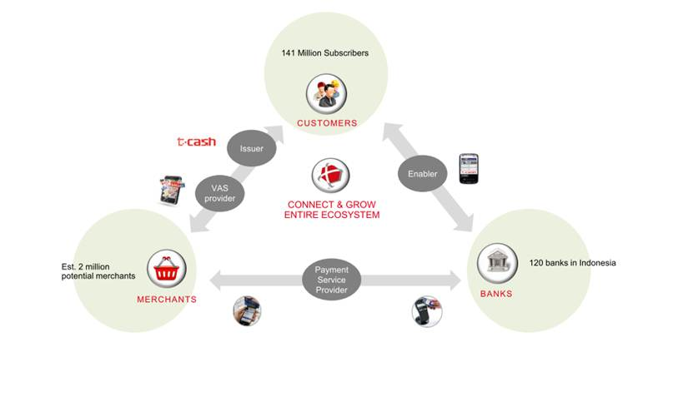
Existing Digital Financial Service Ecosystem
Telkomsel is largest operator providing digital financial services platform in Indonesia. This platform will integrated with more than 100.000 agent and sme as telkomsel’s partner.

Slide 7
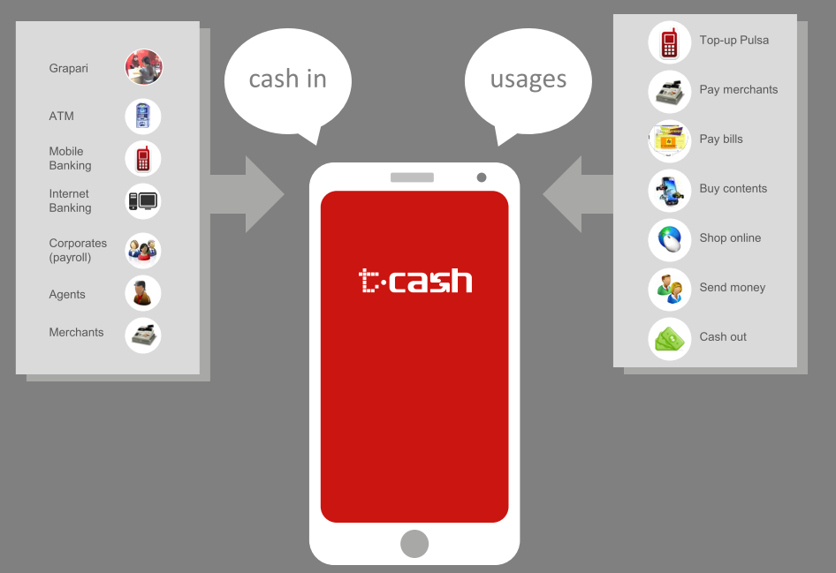
Existing Digital Financial Service
T-cash platform as a digital service platform for facilitating financial services has grown rapidly and need to be interoperable with banking platform

Slide 8
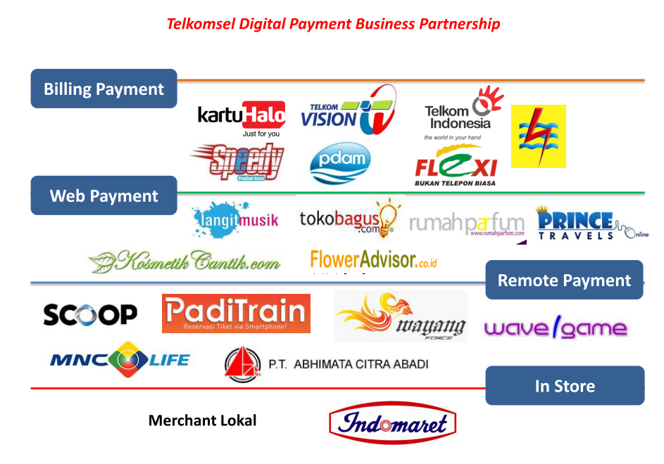
Digital Financial Service Ecosystem

Slide 9
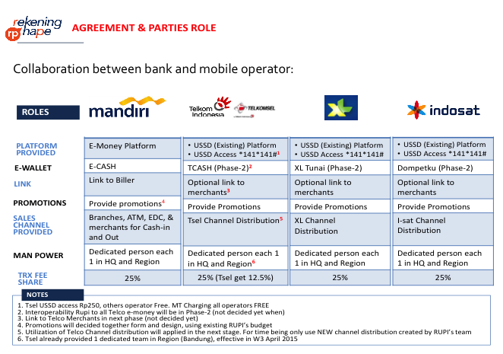
Interoperability of Mobile Money and Mobile payment

Slide 10
Progress of Mobile Money and Mobile Payment

Slide 11
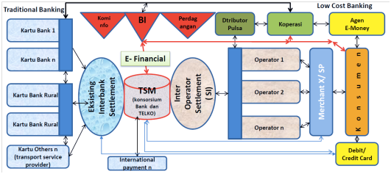
Final goal of DFS ecosystem
A multi bank, multi mobile operator, multi merchant, multi agent platform are integrated by one trusted secure manager system and will provide all type of digital financial services.

Slide 12
Challenging in implementing DFS
Integrate and harmonize all related policies to be in direction : taking opportunity of DFS in increasing national efficiencies including developing a good ecosystem of DFS
Develop an understanding that DFS is a hybrid services which will provide by a single national digital platform and need to regulate and facilitate it more flexible but trusted and secured;
More than just MoU, presidential instruction should be in place to instruct all government policy maker to do those two above urgent activities;

Slide 13
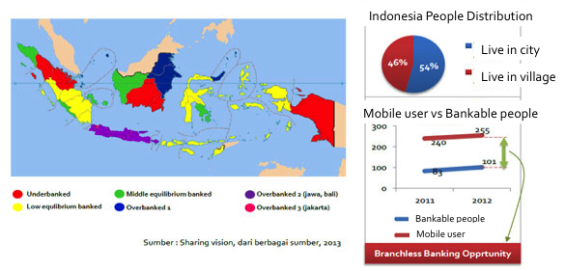
Opportunity in implementing DFS
DFS will provide financial access for more than 80 millions unbankable people to increase their quality of life (41,6 millions are in villages);
For daily life they can afford from their daily activities but need financial access for health, education and social activities. Micro saving and loan provide by DFS will enable them to manage those needs.

Slide 14
ITU’s roles
ITU should strengthening her roles in accelerating development of Digital Financial Platform by providing proper assistance for developing countries.
Developing countries need a technical guidance in:
Creating a national framework for the development of digital Financial Services Ecosystems.
Managing national resources along the relevant parties to the development of digital Financial Services ecosystems.
Designing comprehensive Financial Services Digital ecosystems national
Creating a roadmap of action plans of each party involved in the development of digital Financial Services ecosystems.
ITU also could setting an indicative time line in implementation of digital financial services through a resolution in standardization assembly or development conference (Resolution on Implementing digital financial services especially digital financial inclusion on 2020).

Slide 15
Conclusion
Providing Digital Service for Economy is a key in advancing National Competitiveness and Regional Competitiveness (Asia Competitiveness)
National policy and Regulation including Roadmap of Implementation should be in place to Harmonize between related Parties in Providing Digital Services for Economy
Type of digital services that should be implemented as important to increase efficiency and effectiveness in national/regional development:
Digital Financial Inclusion
Digital Service Platform for Business (e-logistic, e-commerce, e-payment, M2M, e-procurement, e-government)
Digital Service Platform for Public (e-book, e-banking, new media, e-health, e-money)
ITU should strengthening her roles in accelerating development of Digital Financial Platform by providing proper assistance for developing countries.

Slide 16
Thank You!

