Slide 1

Making money work
Olutunmbi Idowu
Head of Compliance & Risk Control
Ericsson M-Commerce

Slide 2


Progress
Commercial in confidence | © Ericsson AB 2015 | 2015-05-27 | Page 2
Notes:
The Networked Society is not just a vision of the future – it is happening right now as we speak, everywhere we look.
From a historical perspective, it is easy to see that we are on the verge of a turning point, from which change will happen big and fast. We are experiencing the technological revolution of our time, the ICT revolution.
To put it in perspective: It took 100 years to connect 1 billion places. It took 25 years to connect 5 billion people. And by 2020, there will be 50 billon connected things. That is more than 6 things per every person on earth, and we’re there in less than 7 years.
As connectivity gets more and more integrated in our way of life, our challenges are and will be to serve the very fundamental functions of society. Functions and services on which we all depend on, and therefore they cannot fail.

Slide 3




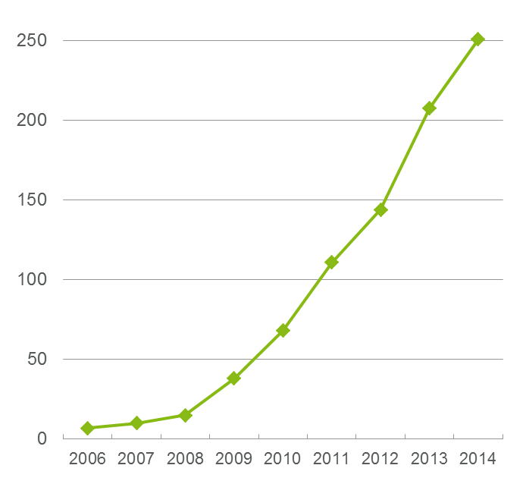
Mobile money market Development
Live deployments^{A}
2.5B^{B}
lack a bank account
(3 years ago)
251^{A}
live deployments in emerging markets in Nov 2014
$395B^{D}
mobile money transactions 2017
2.1B^{C}
subscriptions charged and billed by Ericsson
1.0B^{E}
has a mobile but not a bank account
2nd
generation is coming
Sources:
A GSMA MMU Mobile Money Tracker, 5th November 2014
B Source: World Bank, Policy Research Working Paper 7255
C Source: Ericsson 2014
D Berg Insights, Mobile Money in Emerging Markets
E GSMA and McKinsey

Slide 4

SLOW Service uptake
255
21
Live MFS deployments in emerging markets (March 2015)
MFS deployments with more than
1 million users
(March 2015)
2Bunbanked!!!!!!!!!!
(2014)
Source: GSMA State of the industry Report 2014
Source: GSMA Mobile Money Tracker,
Source: World Bank Policy Research Working Paper 7255
Commercial in confidence | © Ericsson AB 2015 | 2015-05-27 | Page 4

Slide 5

WASHINGTON, April 17, 2015
“…….Numeric commitments that will help promote financial inclusion and achieve universal financial access by the year 2020”.
“World Bank Group and a broad coalition of partners
  multilateral agencies
  banks
  credit unions
  card networks
  microfinance institutions and
  telecommunications companies
Source: World Bank Group
Commercial in confidence | Ericsson AB | 2015-02-16 | Page 7
Notes:
LINK TO OPEN MONEY FILM

Slide 6
World Health Organisation
“Ministers of health from around the world attending this week’s World Health Assembly (WHA) in Geneva, Switzerland, adopted a landmark resolution to secure a lasting world free of all polio-disease once and for all”
1988 – World Health Assembly adopted a resolution for the worldwide eradication of polio
Global Polio Eradication Initiative (GPEI),
  spearheaded by national governments,
  WHO, Rotary International,
  the US Centers for Disease Control and Prevention (CDC),
  UNICEF,
  and supported by key partners – NGOs………..
Same process the led to
  eradication of smallpox in 1980.
Source: WHO
http://www.who.int/features/factfiles/polio/en/
Commercial in confidence | Ericsson AB | 2015-02-16 | Page 7
Notes:
LINK TO OPEN MONEY FILM

Slide 7

Goal
A world where financial services are accessible to all and interconnected to each other.
Where using money is
easy and affordable.
Where any device is a
commerce device
And where the power to choose is provided
Commercial in confidence | © Ericsson AB 2015 | 2015-05-27 | Page 7

Slide 8

summary
The social promise of Financial Inclusion is attainable through effective partnerships
Fit-for-purpose regulations needed to create the enabling environment required for imaginative participation
New players bring innovation, direction and drive

Slide 9


FROM ACTIVATED WALLETS TO ACTIVE WALLETS
Commercial in confidence | © Ericsson AB 2015 | 2015-05-27 | Page 9

Slide 10


It’s time for Money to Change
When money is open, the way
we send, spend, and receive
money will change forever.
Commercial in confidence | © Ericsson AB 2015 | 2015-05-27 | Page 10

Slide 11



http://www.ericsson.com/openmoney
@EricssonMcomm
http://www.youtube.com/ericsson
http://www.facebook.com/ericsson
Commercial in confidence | © Ericsson AB 2015 | 2015-05-27 | Page 11

