Slide 1
Mobile Banking Services Overview
Evolution and Impact of Mobile Money in Developing Countries
Ahmed Said
Director of Economic Affairs
National Telecom Regulatory Authority
Egypt

Slide 2
Reaching the “Unbanked”
A significant number of adults (2.7 billion) in the developing world have no access to basic banking services
This lack of access constrains growth and prosperity for both consumers and the economy
Using mobile phones for banking (m-banking) offers tremendous opportunities to enhance growth and development.

Slide 3
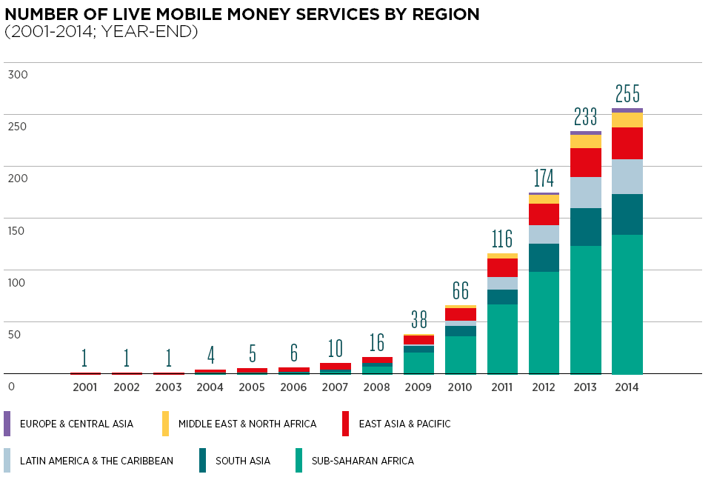
As of December 2014, there were 255 live mobile money services in 89 markets compared with one live service across one market between 2001 and 2003
Source: GSMA

Slide 4
Mobile Payment is increasing at a rapid pace with non banks slowly increasing their share of transactions
Source: World Payment report 2014

Slide 5
The mobile money service has started in Egypt in April 2013 by the three mobile operators
3 mobile operators provide the mobile money service.
Currently there are 1.4 million users (Jan 15’)
No interoperability
There should be a bank involved
Cooperation between Telecom Regulator and Central bank

Slide 6
In general most of the mobile money success stories are in the developing countries.
Success of Mobile Money in Developing Countries. Why?
High Number of Unbanked people
Transportation Issues
High Number of Microfinance Loans
Lower GDP
&
Low income

Slide 7
In well-established mobile money systems, revenue generation has reached as high as 21% of total MNO revenue

Slide 8
Still there are lots of actions and steps towards increasing and expanding the usage of mobile banking services across the world
Awareness
Customer Intelligence: Understanding customers’ needs
Interoperability between service providers
Involving more non banking institutions
The microfinance loans

Slide 9
Thank you

