Slide 1
Technology challenges for
Trust Information Infrastructures
WSIS: High-Level Dialogue
Geneva, Switzerland, 28 May 2015
Chaesub Lee
Director, ITU TSB

Slide 2
Contents
Today IS and Infrastructures
What and why Trust?
Challenges for Trust
Future Trusted Infrastructures

Slide 3
I. Today IS and Infrastructures
Information Super Highway
GII: Global Information Infrastructure
Forming concept &
Social consensus
Connecting the people: Mobile
Connect the world: Broadband
Provide Connectivity
Smart Devices: Smart ICTs
Connecting the Things: IoT
Provide Mobility
Make Safe and Smart Information Society

Slide 4
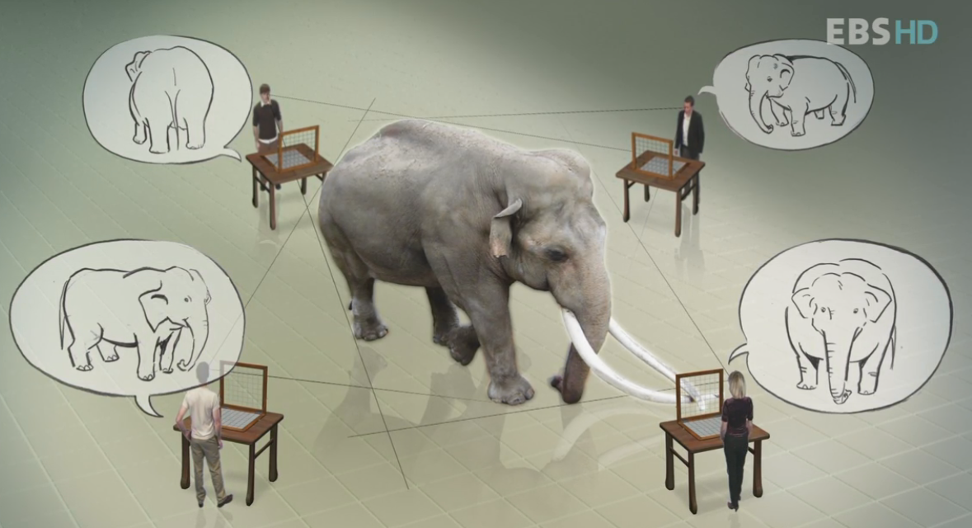
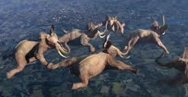

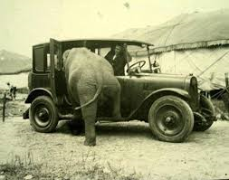
I. Today IS and Infrastructures
Problem Space 1: Convergences
  Intra convergence (FMC) → Inter convergence (IPTV) → External convergence (ITS, Smart Grid, e-health)
  Leaded by Technology Innovation concluded by business success
  Differences: culture, environment, eco-systems
connection
Contents
Information
Application
Connection
System
application
Present
system
information

Slide 5
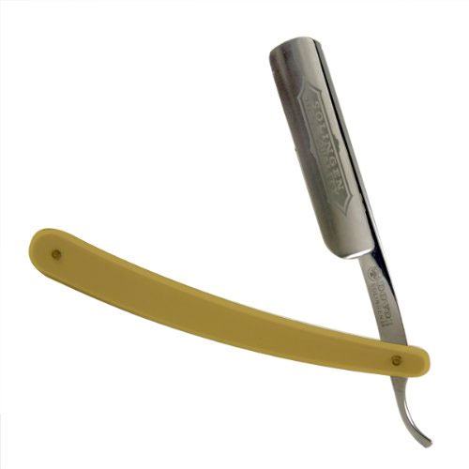
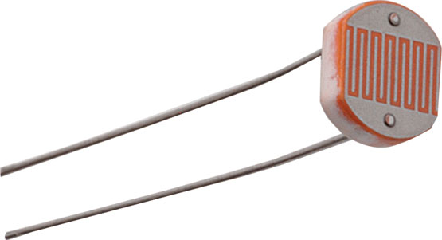
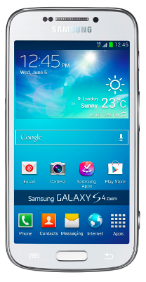
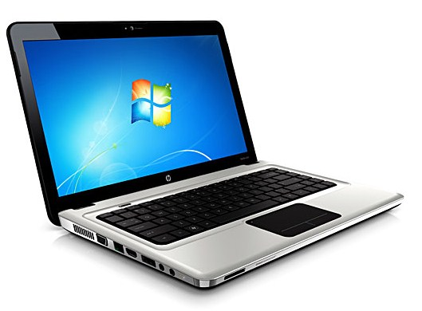
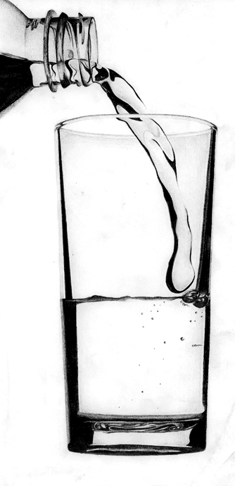
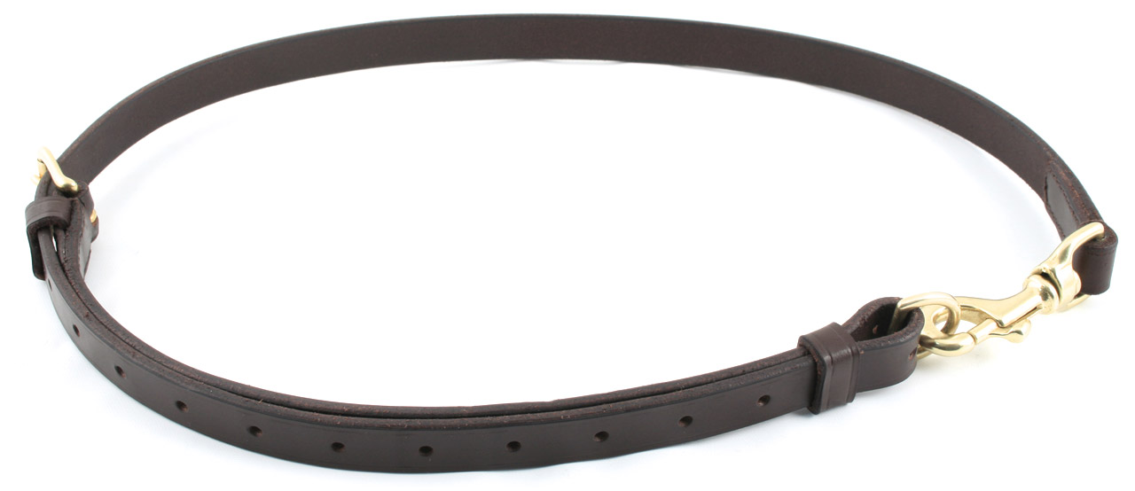
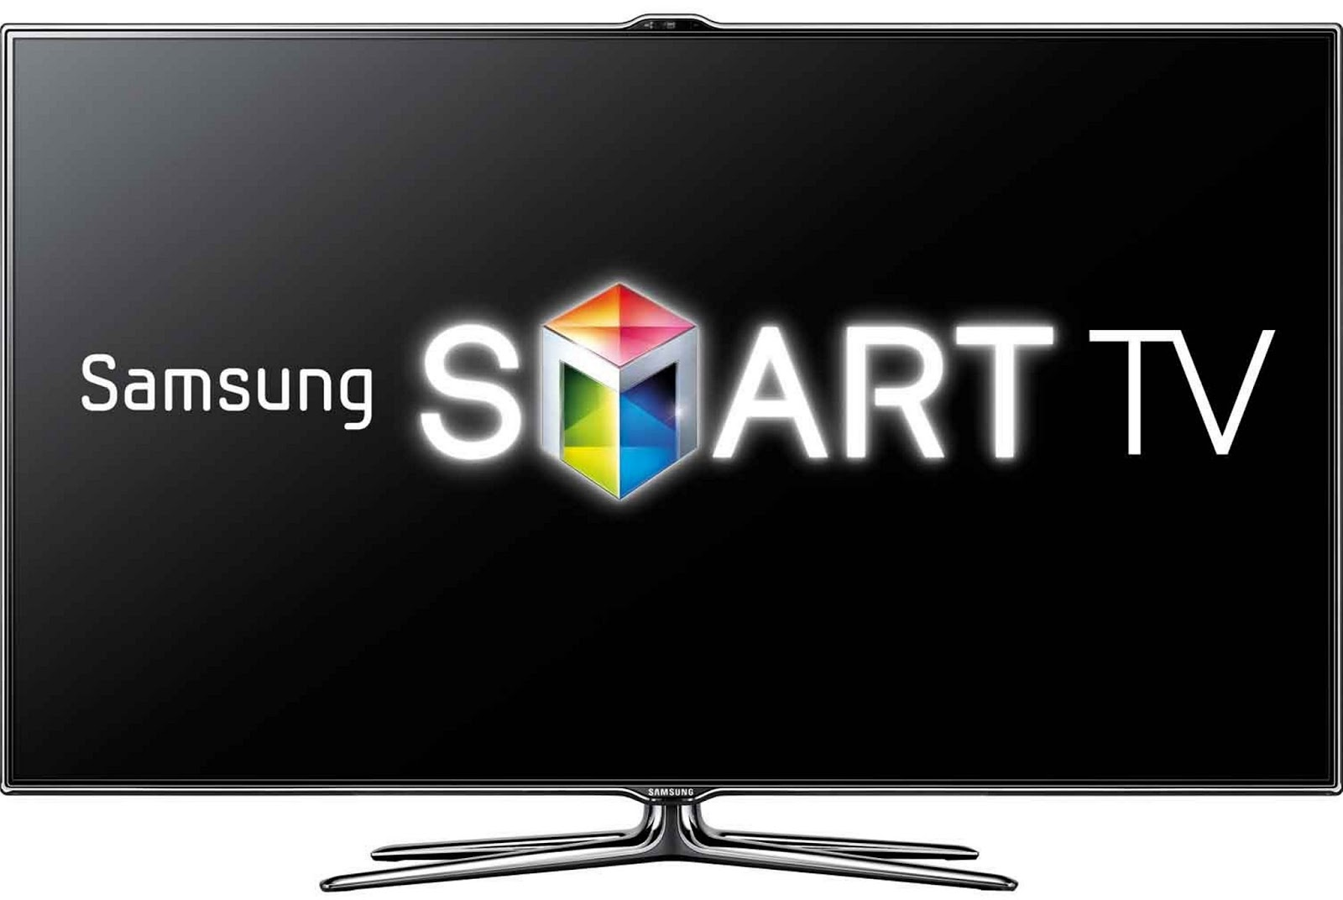
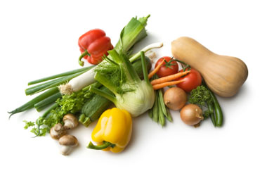
I. Today IS and Infrastructures
Problem Space 2: Complexity and Heterogeneity
  Functions and capabilities getting complex: System/Functions → Intelligent → Smart → Next (???)
  Integrate various functions/capabilities into a system/function
    Codecs: voice, video, multimedia, including Related PF
    Connecting capabilities: WiFi (802.11 a/g/ab)+3G+4G+5G
    Security platforms and protocol stacks
Could be
OK
Too difficult and cost
But

Slide 6

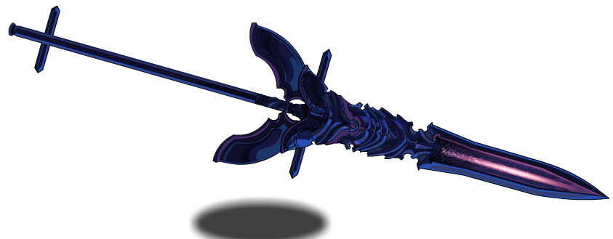
I. Today IS and Infrastructures
Problem Space 3: Cybercrimes
  exposing our societies to the threat of cybercrimes
  cyber-attacks on ICTs are borderless (anywhere)
  Status of today cybercrimes:
    12 cybercrime victims/second, 1 M victims/day
    50% on-line adults have been victims of cybercrime
  Additional costs but very few impacts to raise income
  Divide the world in two groups, so never ending (Spear & Shield)
Offender
Defender

Slide 7
I. Today IS and Infrastructures
Problem Space 4: Lost trust
  How to ensure trust of sources from on-line (data, information, knowledge, providers, contents, brokers etc.)
  Less trust data → Incorrect information → Poor knowledge
  waists huge time: productivity, efficiency and effectiveness
  no guidelines and reference to indicate the level of trust
K
I
M
1
7
0
7
3
B
L
U
K
I
M
1
7
0
7
3
B
L
U
DATA
E
2
7
M
M
A
R
K
1
8
2
E
7
2
F
M
A
R
K
1
8
2
9
2
B
L
A
C
K
4
5
M
9
2
B
L
A
C
K
4
5
M
Name; Height; Weight; Color; Age; Sex
KIM 170 73 BLUE 27 M
Name; Height; Weight; Color; Age; Sex
KIM 170 73 BLUE 72 F
Information
Name; Height; Weight; Color; Age; Sex
MARK 182 92 BLACK 45 M
Name; Height; Weight; Color; Age; Sex
MARK 182 92 BLACK 45 M
Mr. Kim as 27 years old young man like blue color with size 170cm and 73 kg (need normal size for man)
Ms. Kim as 72 years old lady like blue color with size 170cm and 73 kg (need normal size for old women)
Knowledge
Mr. Mark as 45 years old middle aged man like black color with size 182cm and 92 kg (need big size)
Mr. Mark as 45 years old middle aged man like black color with size 182cm and 92 kg (need big size)

Slide 8
I. Today IS and Infrastructures
Problem Space 5: Autonomy
  Increase of autonomy functions and systems even under distributed and software based environments
  Distributed processing and computing even communication
  Increase sharing resources and emerge binding as one among different resources (slicing and virtualization)
F
F
Peer-Peer
Virtualize with
Slicing
Client-Server
F
F
F
F
Client-
Server
F
F
Client-Server
Peer-
Peer
F
Client-Server
Client-
Server
F
F
Client-
Server
F
F
Peer-
Peer
Peer-
Peer
F
Peer-
Peer
Client-
Server

Slide 9
The Meaning of Trust
II. What and why Trust?
Is the meaning of trust for a machine the same as that of trust for a person?
  The machine is not as smart as a person
  The trust for a person cannot be transferred to another person

Slide 10
Trust and Pre-defined Knowledge
II. What and why Trust?
One person can earn his/her trust by working together with others for some time
A machine can be trusted at once when it access to networks based on some pre-defined knowledge it has
Pre-defined Knowledge is used to support for trusting a machine

Slide 11
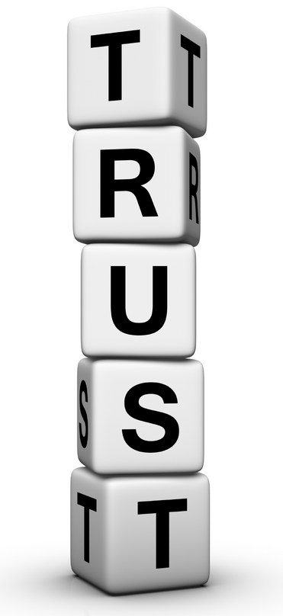
Elements for being Trust
II. What and why Trust?
Confidence
Dependence
Goodness
Belief
Ability
Honesty
Expectation
Faith
Future
Integrity
Surety
Strength
Applying engineering analysis (?)

Slide 12
II. What and why Trust?
Connected World → Connecting People → Connecting Things (near future) → Knowledge Networking
Living normal life under “Echo-Life environments” by Trust
Trust: Solution for resolving Problem Spaces (Convergences, Complexity, Cybercrimes, Lost of Trust and Autonomy)
Complexity of Safety
Trust
Cost
Trust complements to enhance Safety and reduce Complexity
Trust
Cost
Complexity of Safety

Slide 13
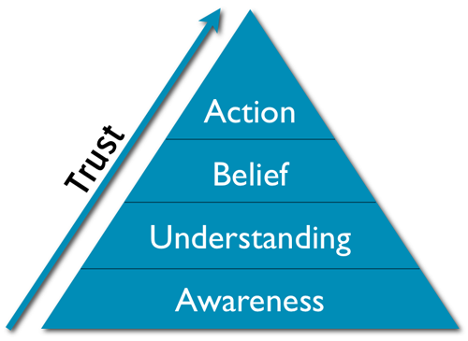



Relationship between Knowledge & Trust
II. What and why Trust?
Decision Making
Trust
Expectation
Knowledge
Data interpretation
Data collection, processing, management
(Source) Trust pyramid
http://www.johnhaydon.com/how-make-people-trust-your-nonprofit/

Slide 14
Requirements form Social-Cyber-Physical Infrastructure
II. What and why Trust?
Humans
Social World
Individuals, Communities, SW agents
DIKW
Cyber World
Computation, Communication, Control
Things
Physical World
Physical Systems, Sensors, Actuators
DIKW: Data, Information, Knowledge, Wisdom
Social-Cyber-Physical Infrastructure

Slide 15
Trust Relationships by considering CPS
II. What and why Trust?
Social trust among humans and things
From individual trust to community trust
Human-to-Human Trust
Thing-to-Thing Trust
Humans
Humans
Things
Things
Trustworthy Social-Cyber-Physical Infrastructure
Human-to-Thing Trust

Slide 16
Challenge 1 – Trust Relationships
III. Challenges for Trust
Social-Cyber-Physical Relationships
  Co-existence
  Connectivity
  Interactivity
  Spatio-temporal situations
Human-Thing Relationships
Social
T
R
U
S
T
Cyber
Physical
Trust as a cross domain relationship

Slide 17
Challenge 2 – Trust Management
III. Challenges for Trust
Identity management
Trust management
  Reputation
  Recommendation
Dynamics
  Adaptive knowledge based control
Users
T
R
U
S
T
Applications
Computing
Networks
Things

Slide 18
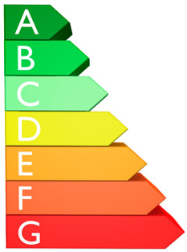
Challenge 3 – Measure & Calculate
III. Challenges for Trust
Measurable trust
  Metrics
Trust calculation
  Subject vs. Object
Trust level

Slide 19
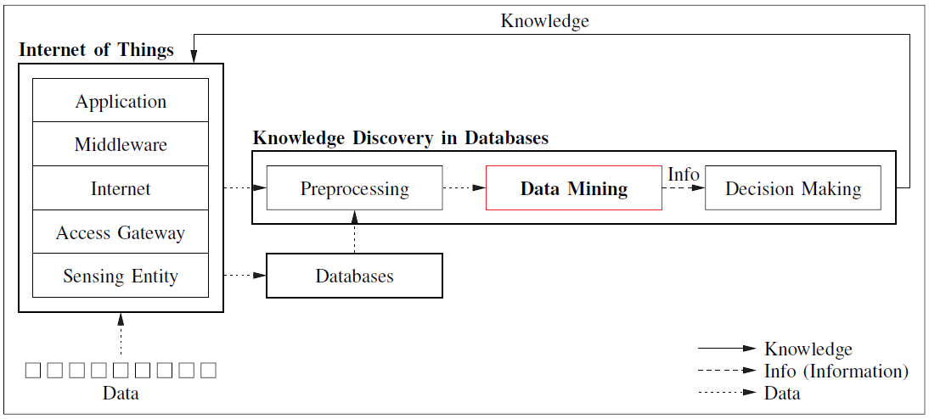
Challenge 4 – Decision Making
III. Challenges for Trust
From sensing to actionable knowledge and trust-based decision making
    Reasoning (Policies, Rules)
Trustworthy data fusion/mining
Data perception trust

Slide 20
Challenge 5 – Autonomy
III. Challenges for Trust
Intelligence for handling trust requirements under dynamic conditions
Trust in Autonomics
  Feedback loop: Monitoring → Analyzing → Planning → Execution
Distributed intelligence
  Fog computing, Edge computing
Autonomy
Optimizing
Control
Monitoring

Slide 21
IV. Future Trusted Infrastructures
Trust should be one of critical word to identify features of “Future IS and their infrastructures”
Smart Capabilities for Trustworthy:
  For trustworthiness relationships between entities, each parties should knew about each other
  The level of trust should be dependent on the level of knowing each other (more knowing, more trust)
  Smart capability used to collect information to help knowing the details not only for that entity but also environments such as network status, communication sessions and others
Echo-Capabilities by Knowledge Networking:
  Knowledge should be shared cross over different areas , services and devices
  Context/Content-aware Networking Capabilities

Slide 22
IV. Future Trusted Infrastructures
New Features for the Future Information Infrastructure
  Better solution for Safer and Smarter operation of Infrastructure, while well enhance quality (with enhanced Broadband)
  Ubiquity and Mobility: need enhancement (e.g. seamless) of mobility and realize better Ubiquity
  Trust: new feature for safer society with
  efficiency and effectiveness (an entity having
  trust to other entity)
FTII
Trust
Ubiquity
Mobility
Mobility
Security
Security
Quality
Quality
Quality
Connectivity
Connectivity
Connectivity
Connectivity
1990s
~ 2008
~ 2015
2020 ~

Slide 23

International Telephone and Telegraph Union
International Telecommunication Union
International Trust Union
I
Trust
yoU

